Slide 1
Digital Schools Awards Digital Wellbeing Award for Cyber Resilience and Internet Safety
@Schools_Digital
Jen McKay
Independent
Validator
Digital Schools Awards
www.digitalschoolsawards.com

Slide 2
Overview of Digital Schools Awards Programme
The Digital Schools Awards is a digital schools programme and awards scheme that recognises, rewards and promotes a whole school approach to the effective use of digital learning technologies in education
Successful collaboration between Governments, Education Agencies and Industry, led by HP
Encourages young people to become digitally skilled
Focus on nursery, special education, primary and post-primary schools

Slide 3
Available Awards
More than 1.2M learners already benefiting from Digital Schools Awards programme
Digital Wellbeing Award for Cyber Resilience and Internet Safety introduced to help schools tackle cyber risks and keep pupils safe online
Special Recognition for Computational Thinking (secondary schools only) recognising computational thinking principles for problem solving across the curriculum
I
nnovation transfer expanding initiative within Europe & beyond with Awards4SELFIE

Slide 4
The Digital Wellbeing Award framework can support your setting to develop a strategic approach to cyber resilience and internet safety

Slide 5
Digital Wellbeing Award for Cyber Resilience and Internet Safety
Provides a whole-school road map for promoting students’ digital wellbeing through strong Cyber Resilience and Internet Safety practices
Along with the award criteria encompassing Leadership, Learning and Teaching, Student Digital Competence and CLPL, the framework provides a wide variety of links, resources and examples on which schools can draw in both applying for the award and in planning areas for development

Slide 6
Digital Wellbeing Award for Cyber Resilience and Internet Safety
Developed with Education Scotland, and supported by Scottish Government, Child Protection Unit & Police Scotland, the award recognises the link between the safe and appropriate use of digital technologies and the wellbeing of all users It integrates the DigiLearnScot “Consume, Create, Communicate” and the Scottish Government’s “Recognise, React, Recover” policies and resources so that schools can implement key policy drivers when applying for the award

Slide 7
Digital Wellbeing Award for Cyber Resilience and Internet Safety
Schools can apply for the Digital Wellbeing Award in conjunction with their Digital Schools Award application or independently, before or after their school has received the Digital Schools Award

Slide 8
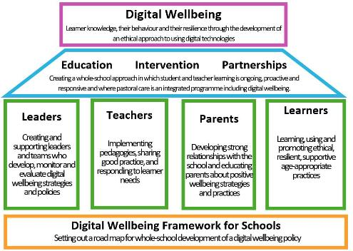
Digital Wellbeing Award for Cyber Resilience and Internet Safety
Being positive, constructive and resilient in the skills, attitudes and knowledge needed to use digital technologies for personal, social and learning purposes
Wellbeing of 21st century children is increasingly subject of concern & making its way into education policy in many countries, particularly in light of increase in online & remote education as result of Covid-19 pandemic

Slide 9
How to apply for the Digital Wellbeing Award for Cyber Resilience and Internet Safety
The video covers 1. Where you can find the Digital Wellbeing Award self-evaluation tool on the Digital Schools Awards website 2. Outline of the sections and supporting resources 3. How to submit for validation
The video above can be found at: https://youtu.be/sSoL0T29OC4

Slide 10
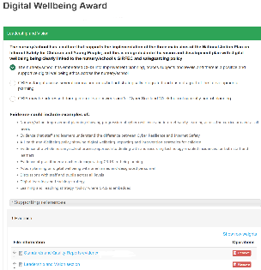
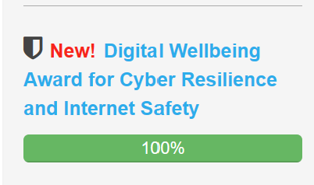
How it works
Stage 1 - registration
Schools register online for an account at www.digitalschoolsawards.com
(if schools are already registered for the Digital Schools Award then this step will already be completed)
Complete the self-review
framework and upload documentary evidence
When the colour indicator shows you have achieved the requirements in readiness for a virtual validation visit, then click submit, and an external validator will then be in touch to arrange the virtual validation visit

Slide 11
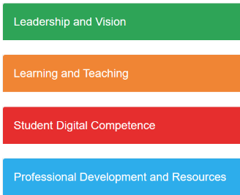
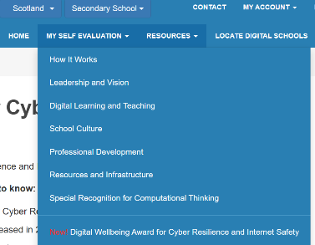
Completing the Self-Review Framework
Click on “My Self Evaluation” > “Digital Wellbeing Award for Cyber Resilience and Internet Safety”
For each heading, select your response, from the choices provided, which best describe the current position of your school
Upload documents/files which support each section – there are suggested examples of the kinds of supporting documents which you may wish to consider uploading

Slide 12
Preparation for the validation visit
The validator will be in touch to find a suitable day and time, usually within a few weeks of a school applying for validation
It’s helpful if the school prepares a presentation to help tell the story you wish to share, and send that to the validator in advance
Some schools use PowerPoint, some use Sway, OneNote, Wakelet or other means – use what works best for you to create a narrative linking to the uploaded files for each of the headings in the self-review framework
A virtual validation visit for the Digital Wellbeing Award will likely last between 60-90 minutes, and a timetable created by the school would be agreed in advance with the validator, in the understanding that school needs may require changes on the day

Slide 13
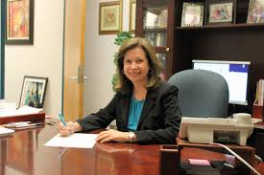
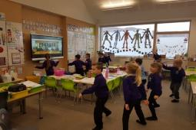
How it works
Stage 2 – typical validation visit – currently virtual
Discussions with the school digital learning leader and member of senior management team
Hearing from practitioners
Discussions with pupils
Round-up/Plenary session with explanation of what happens next

Slide 14
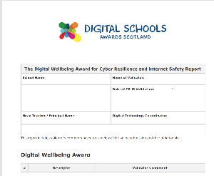
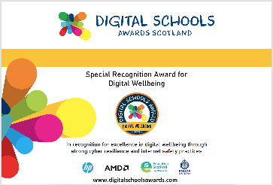
How it works
Stage 3 – feedback and recognition
School receives a written report based on the validation visit
Certificate of Recognition
Digital Wellbeing Award Badge to use on school website and email signature

Slide 15
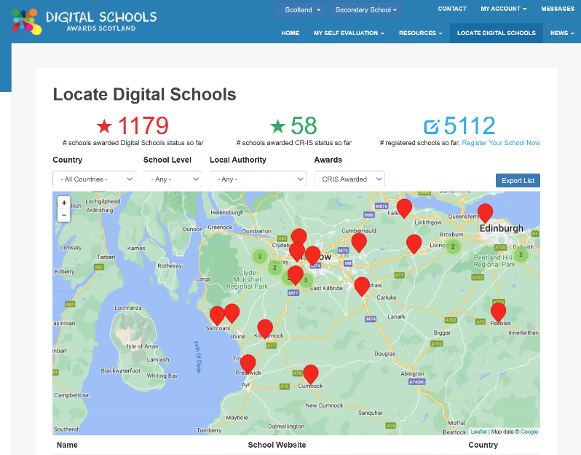
Who can help?
All schools awarded the Digital Wellbeing Award can be found on Digital Schools Awards website map (click on “Locate Digital Schools” > then choose “CRIS Awarded” from dropdown) at https://www.digitalschoolsawards.com/school-locations
Contact a school to ask their advice and about their experience
Advice can also be requested from a Digital Schools Awards validator

Slide 16
Digital Schools Awards Digital Wellbeing Award for Cyber Resilience and Internet Safety THANK YOU
@awards4selfie.eu
@Schools_Digital
Jen McKay
jen@digitalschoolsawards.com
Independent
Validator
Digital Schools Awards
www.awards4selfie.eu
www.digitalschoolsawards.com

