Slide 1
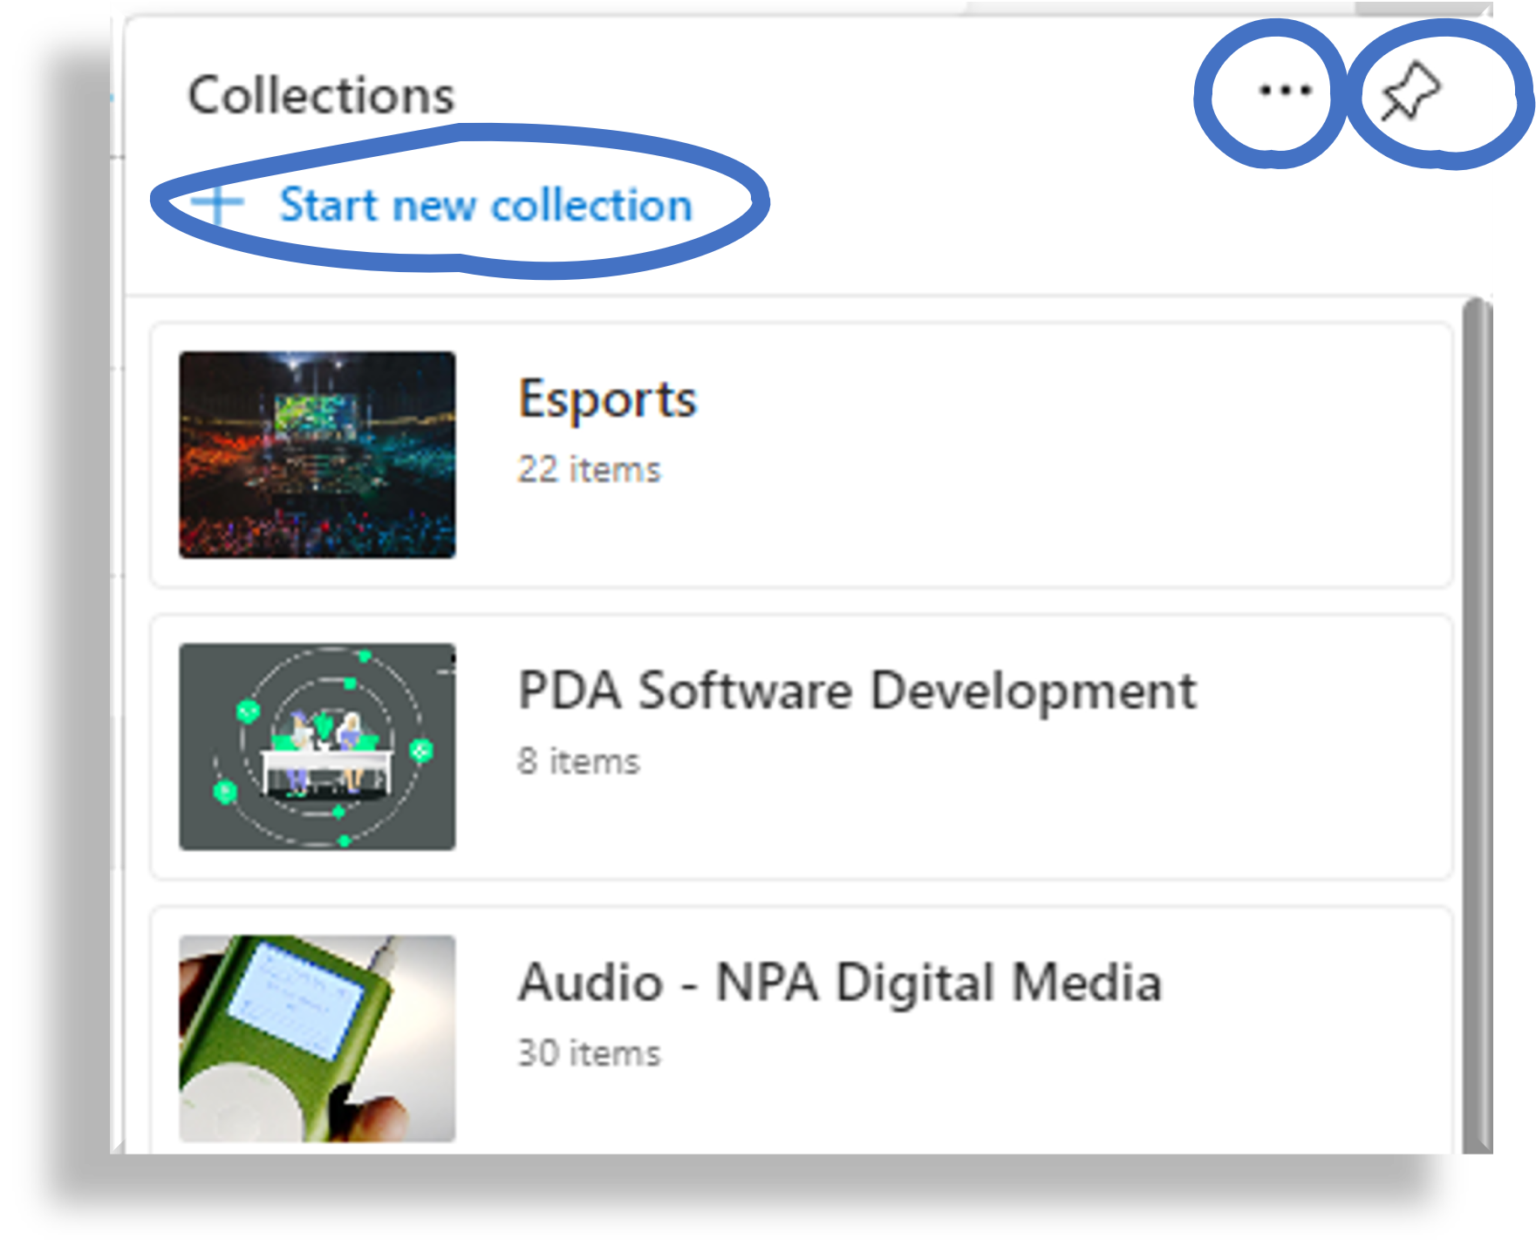

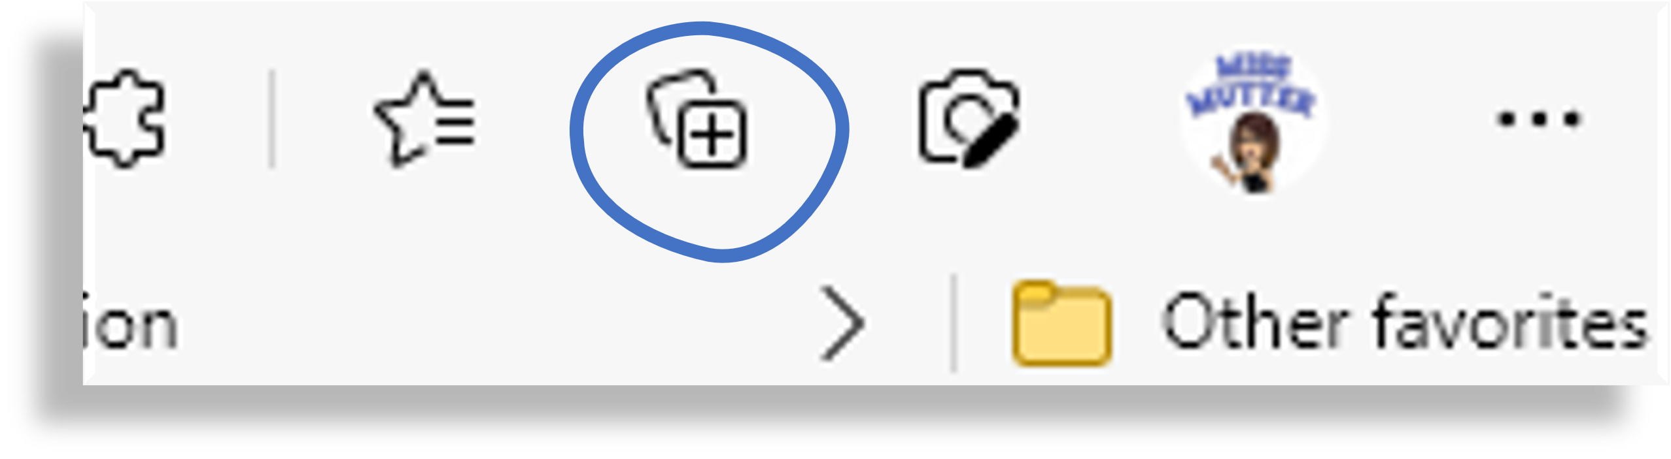
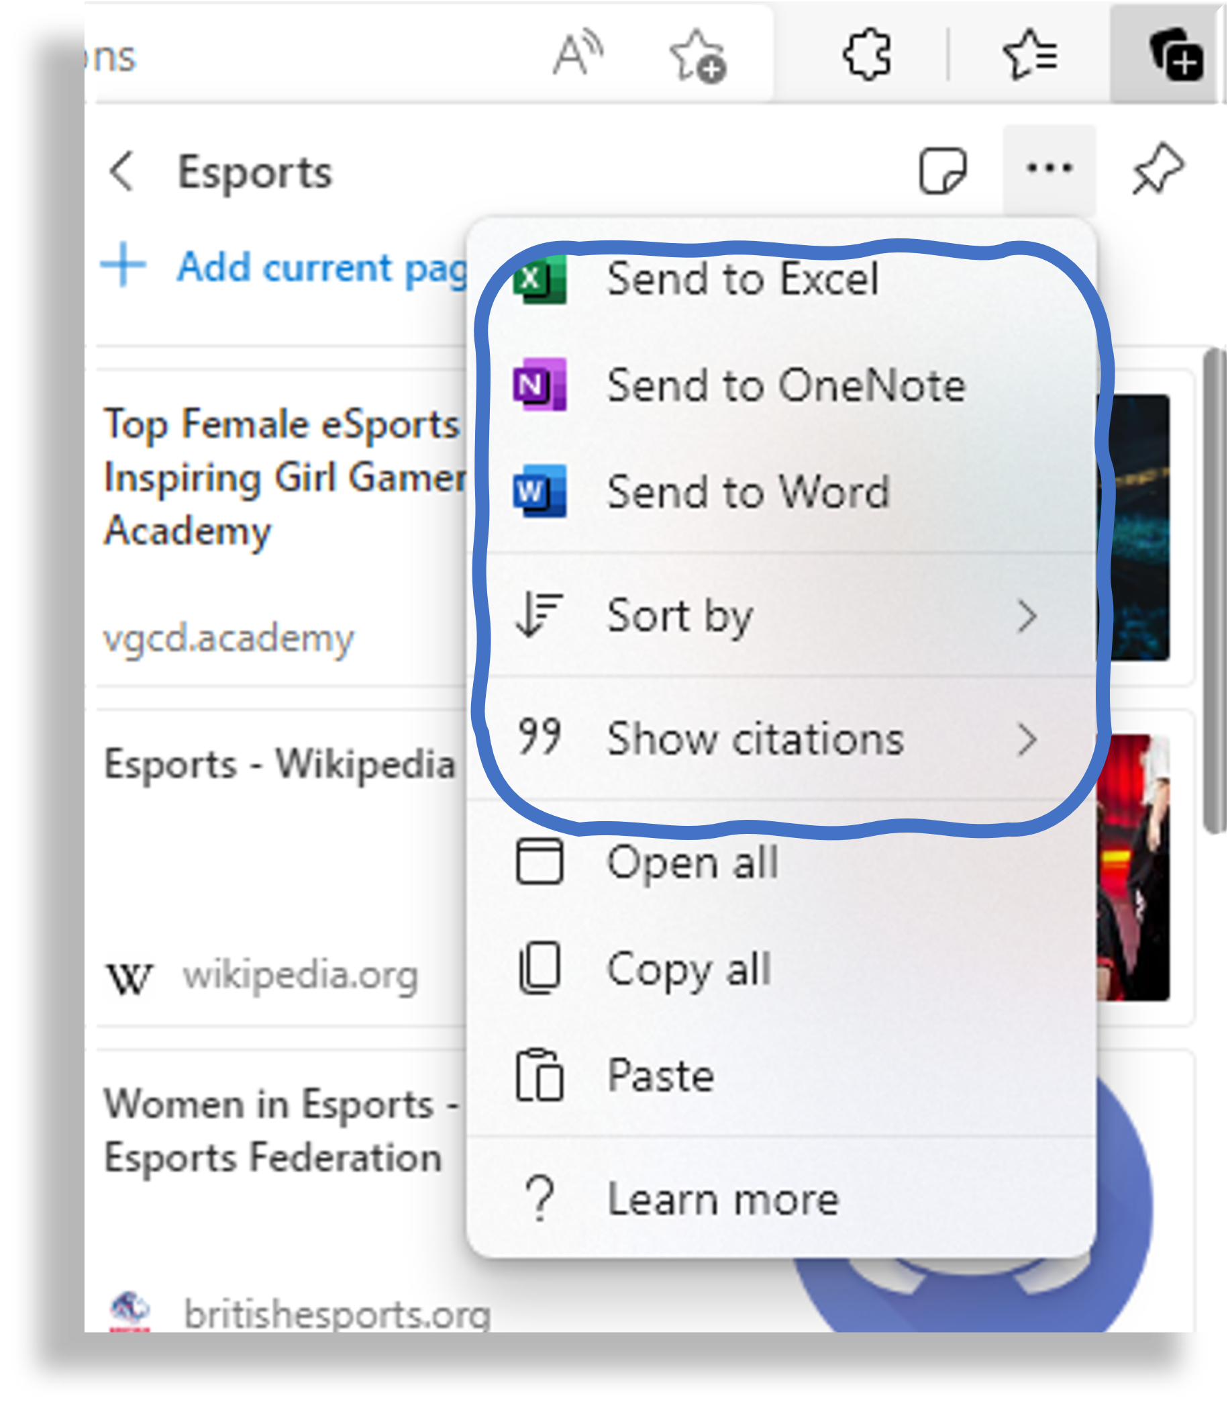

Collections in Edge Browser
Tracy Mutter
Computing Science Teacher
Falkirk High school
I use collections in Edge while doing research to capture and organise related information into meaningful groups. I can sort a collection into order which can help me find things within a collection. Once a collection is complete I share it directly into a variety of applications – Word or OneNote are my favourites. I also use it to automatically generate citations so that these can be included for pupils.
I add webpages, selected text or images to collections by right clicking and selecting add to a collection.
I sign into the Edge browser so that my collections are synced, making it easier to work across devices.
Open Collections by clicking the Plus symbol on the top right of the browser.
You can Start new collections, Open existing ones to view contents, sort all your collections via the 3 dot menu or pin collections open.
You can send the collection to a variety of apps and automatically generate references
Video demonstration
Microsoft Learn course on Edge
@TricksyBell @FHSComputing

