Slide 1
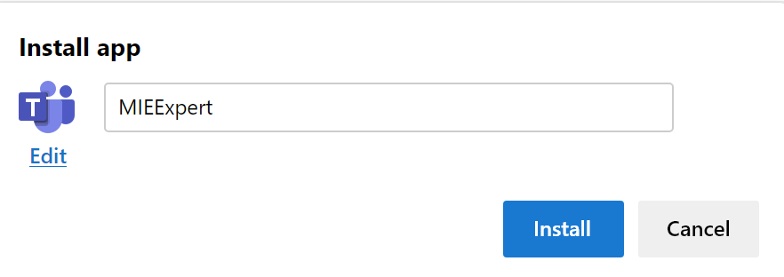
Cross-curricular
Microsoft Edge web browser
Malcolm Wilson
Digital Transformation Specialist
Tablet Academy Scotland
Make use of Microsoft Edge web app feature for quicker access to different logins for Microsoft Teams on the same device
When you need to log in to Microsoft Teams with different accounts then you can have quick access on the taskbar on your PC/laptop without the need to log in or log out when switching between accounts
The Microsoft Teams web app icon will show for each login you need (just hover over each icon to reveal the identifier for each account)
On Microsoft Edge browser on your PC/laptop sign into Microsoft Teams with one of your accounts
Click on the ellipsis (three dots …) at top right of Edge browser to bring up menu
From menu click on side arrow at “Apps” and select “Install this site as an app” from sub-menu
Type an identifying name for this account (you can also choose a different icon by clicking on “Edit”) & then click “Install” > choose “Pin to Taskbar” > click “Allow”
@claganach

