Slide 1
Using QR codes within Early Years.
West Early Learning and Childcare

Slide 2
Introduction
Today I will share our Journey with you from introducing the QR codes to the children to them now being independent and able to use them with minimal support.

Slide 3
What is a QR code?
A QR code stands for quick response.
The QR code is made up of lots of dots
The QR code contains links

Slide 4
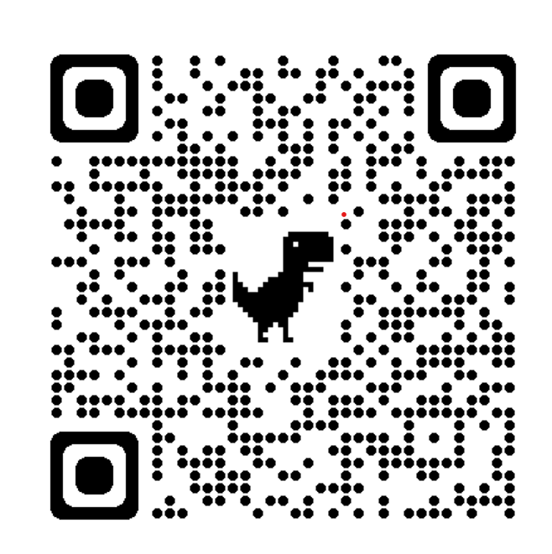
Example QR code
This code holds a link to the chatter kids' app and will show you how Sarah brought her playdough robots to life.

Slide 5
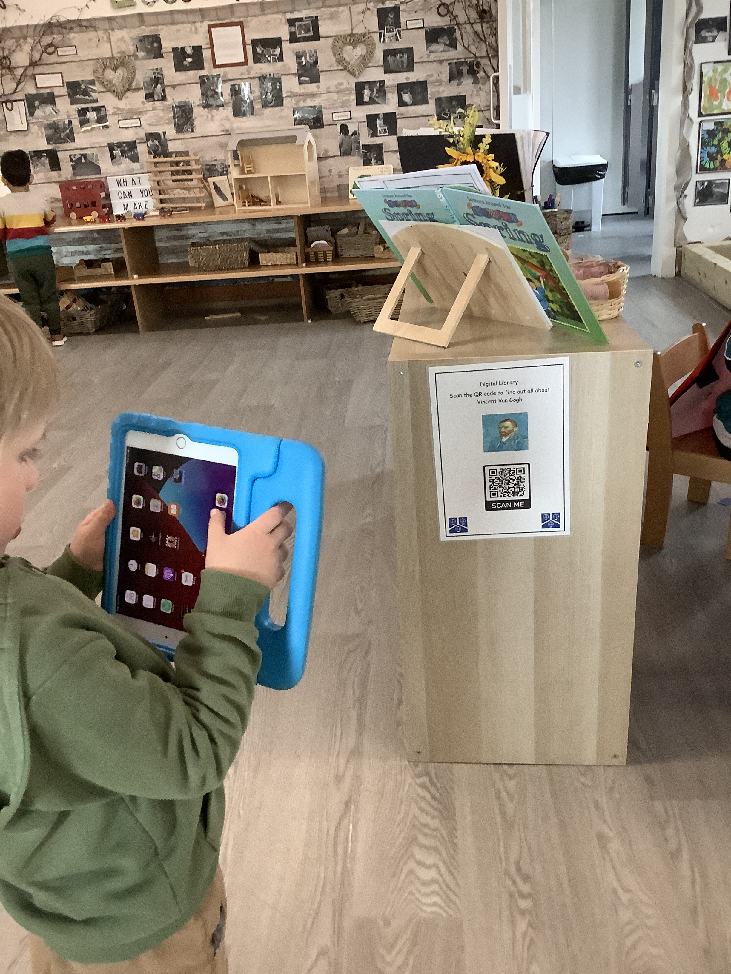
Impact on Children’s learning.
Children can use the iPads independently to take their learning forward.
Opens discussion surrounding internet safety.

Slide 6
Curricular areas.
Literacy Listening and Reading
Home Corner - Looking after a baby and Hairdressers
Expressive Arts- Van Gogh, Butterfly's
Investigation area- How it’s made, Playdough
Outdoor area- Planting

Slide 7
Thank you

