Slide 1
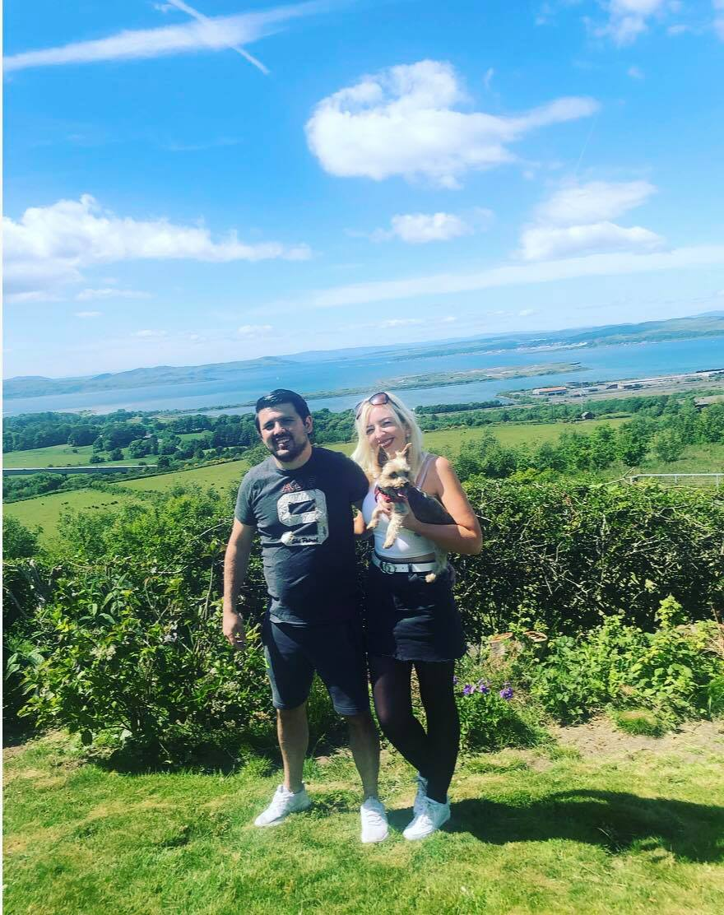
Wednesday 25th June
Schools CLOSED!
No visiting friends
Shops, cinemas, parks closed…
Social Distancing – 2 metres
Work from home
No toilet rolls!
Movie Nights
Arts and crafts
Long walks
Reading
Monopoly and jigsaws
All Our Key Workers
Seeing our family
(especially James)
Lion King
Sleeping Beauty
The Little Mermaid

