Slide 1
Computing
Online Safety
Year One
Computing | Year 6 | Online Safety | People Online | Lesson 3

Slide 3
Aim
I understand the benefits and pitfalls of online relationships.
I can identify information that I should never share.
Success Criteria
I can identify personal information.
I can explain why someone might have an online friendship.
I can explain what to do if I am asked or told something online which makes me uncomfortable.
I can explain some of the dangers of revealing personal information to an online friend.

Slide 4
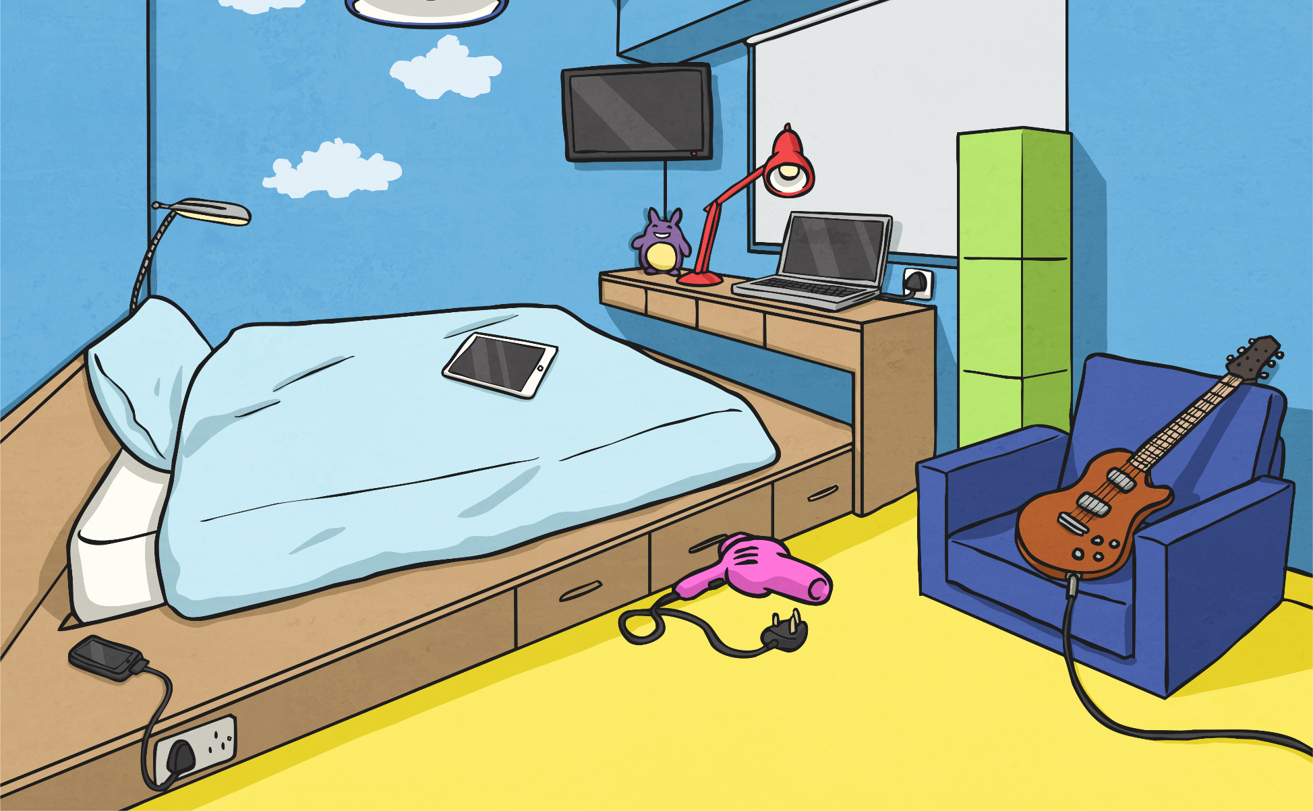
Chatting Online
Messaging Apps
Online Gaming- typing
How do you chat online?
Forums and Message Boards
How is chatting to someone you’ve never met, different to an in-person friendship?
Social Media
Comments on Content
That’s what we’ll look at today.
Chat Sites
Online Gaming- microphone

Slide 5
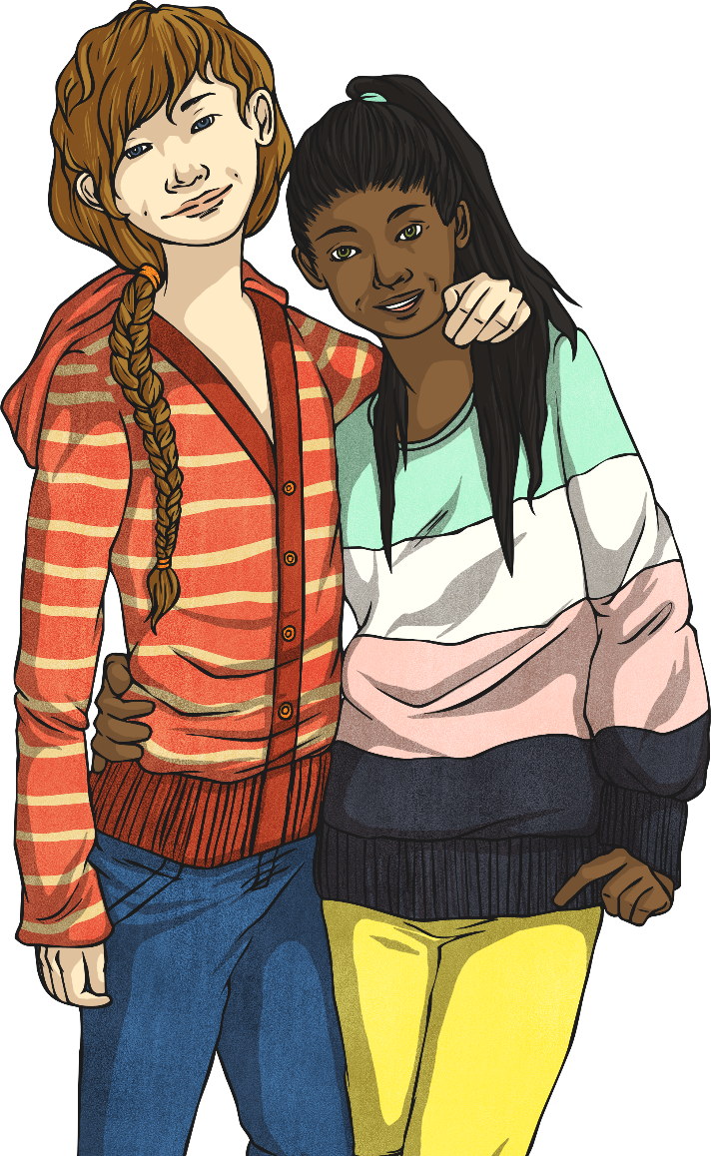
Why Do We Chat Online?
Why do people like to chat online?
To make new friends with similar interests.
To talk to someone who can’t tell any of your real-life friends.
To get advice.
To meet people to game with regularly.
To gossip.
Just for fun!
So… can online friendships and chatting be good? Of course!
If you know how to stay safe.

Slide 6
Who Am I?
MaisieMoo12: Hi nice to meet you.
Maisie is chatting to a friend she’s met online. She a 12 year old girl who lives in West London and goes to a school called Rosebank Secondary. Here’s their conversation:
Jas719: Hey.
MaisieMoo12: What’s your name? Age?
How old is Jas719?
Is Jas719 a boy?
What is Jas719’s real name?
Where does Jas719 live?
Can you describe what Jas719 looks like?
How do you know?
Jas719: Jack, I’m 13. Where do you live?
I live in Brighton.
MaisieMoo12: I’m in London. Do you have a photo so I know what you look like?
Jas719:
I’ll send you one later. I have brown hair and eyes and I’m quite tall I suppose.

Slide 7
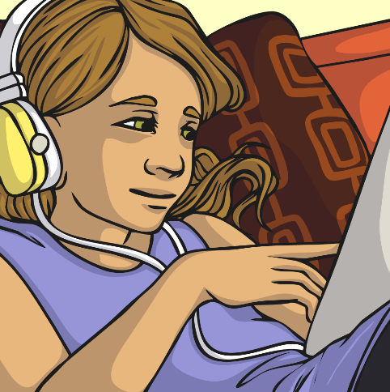
Who Am I?
Can you see why Maisie shouldn’t have told Jas719 certain things?
Who could Jas719 be?

Slide 8
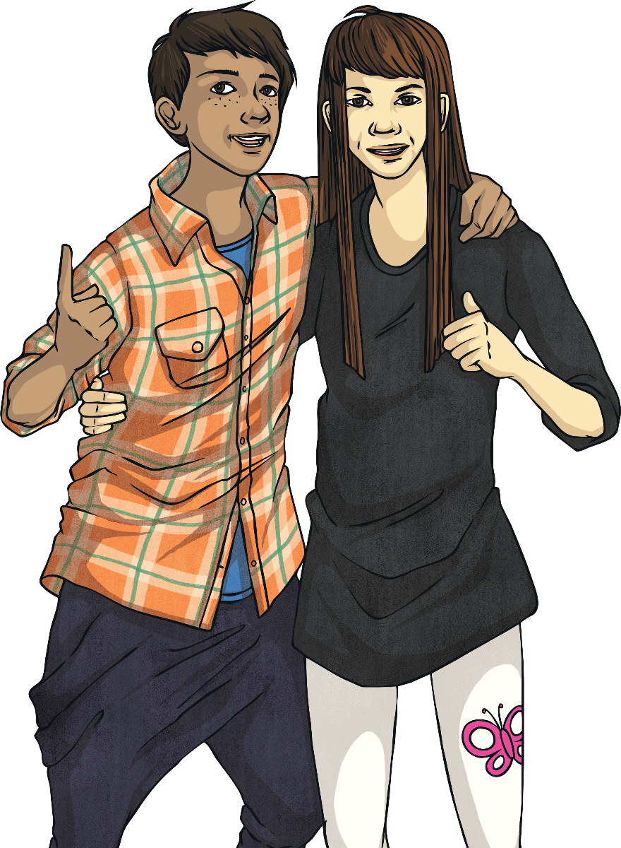
What Can We Talk About?
Thinking about the kind of information Maisie shared with Jas719, and what we know already, what kind of things can you talk about online?
Sort the conversation topics on your activity sheet into the categories, safe and unsafe to reveal to a stranger online.
Remember, any personal information should be kept private.

Slide 9
What Can We Talk About?
Safe to talk about online
Unsafe to talk about online
Favourite subject at school
What your hobby is
How many brothers and sisters you have
What you did at the weekend
Your friends (without names)
Your teachers (without names)
Your favourite TV show
Your date of birth
Which school you go to
Where you do your hobbies
Home address
Your full name
Your parents’ full names
The town/city you live in
Where you went at the weekend.
Did you get them right? If not, can you explain why?

Slide 10
What Would You Do?
Look at the examples of some online conversations in groups.
Use the highlighter pens to indicate where you find examples of somebody revealing something they shouldn’t online. Make notes at the side to explain why you think they shouldn’t give that information away.

Slide 11
What Would You Do?
Scott2009:
It’s my birthday next week!
NoST57:
Yeah? When?
Scott2009:
On the 13th.
Scott2009 has given away:
His real name in his username
His birthday
Where he’ll be on Saturday morning
NoST57:
What you getting?
Scott2009:
Asking for new football boots. I play on a Saturday near Warburton.

Slide 12
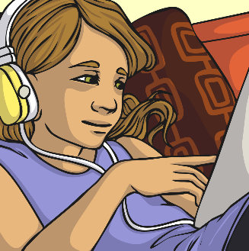
What Would You Do?
Leedsgirl41:
Been on a school trip today.
DrGamerKy:
Where to?
Leedsgirl41:
Just to Carlton Hall. It’s a place down the road from my school
DrGamerKy:
What school you go to?
Leedsgirl41 has given away:
Her city
Where her school is
A teacher’s name…
Leedsgirl41:
Hmm… don’t think I should say online.
DrGamerKy:
Fair enough. Any favourite teachers?
What could DrGamerKy work out from this?
Leedsgirl41:
Miss Riley is pretty fun.

Slide 13
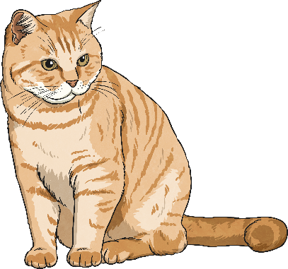
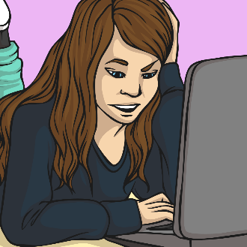
What Would You Do?
Jonesy1010:
Hi!
cAr12Ta:
Hi, who are you?
Jonesy1010:
I’m Lauren.
cAr12Ta:
Hi Lauren, do you live anywhere near Manchester?
Leedsgirl41 has given away:
Her city
Where her school is
A teacher’s name…
Jonesy1010:
Not too far, I sometimes go into Manchester shopping
cAr12Ta:
Me too, my school is St Peters in Manchester so I get the bus in on Friday after school sometimes.
What could DrGamerKy work out from this?

Slide 14
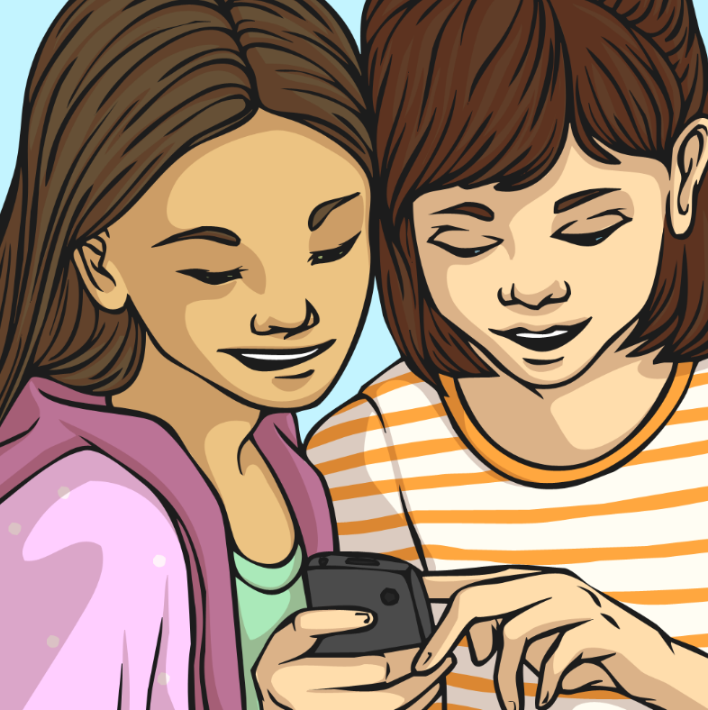
If You’re Worried…
If you are worried about online chats and friendships there are lots of good sources of advice online:
www.safekids.com/chat-room-safety
www.kidsmart.org.uk
www.bbc.co.uk/cbbc/shows/stay-safe
If you want to talk to somebody about something online, then you can call Childline, anytime, on: 0800 1111
Remember, if you think that something is serious enough to report to the police, you can ask an adult for advice on, or help to do this.

Slide 15
Aim
I understand the benefits and pitfalls of online relationships.
I can identify information that I should never share.
Success Criteria
I can identify personal information.
I can explain why someone might have an online friendship.
I can explain what to do if I am asked or told something online which makes me uncomfortable.
I can explain some of the dangers of revealing personal information to an online friend.

