Slide 1
Bridge of Weir
Primary School
Primary 1
Curriculum Evening
Wednesday 6 September 2017

Slide 2
Welcome to Bridge of Weir Primary School

Slide 3
Welcome to Bridge of Weir Primary School
o = o

Slide 4
Welcome to Bridge of Weir Primary School
o = o
e = e

Slide 5
Welcome
to Bridge
of Weir
Primary
School!

Slide 6
Curriculum for Excellence
English and Literacy
Numeracy and Mathematics
Health and Wellbeing
Expressive Arts
Sciences
Religious and Moral Education
Social Studies
Technologies

Slide 7
Fast Phonics First
Three or four letters a week
Alphabet book home with each new sound
Sound and name of the letter – for lower case and capitals

Slide 8
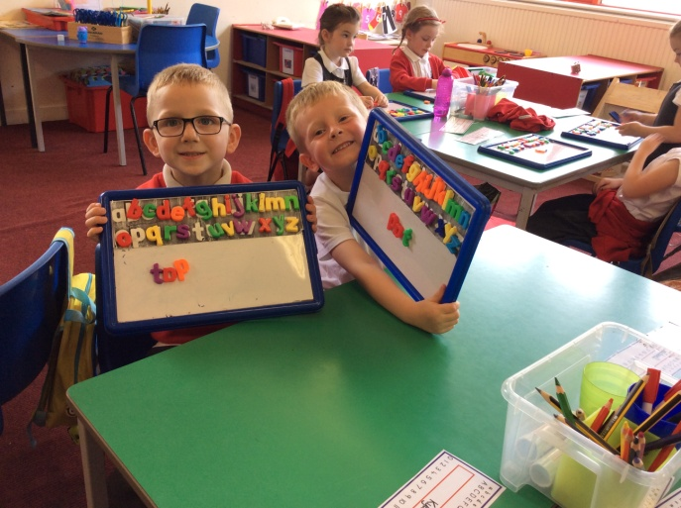
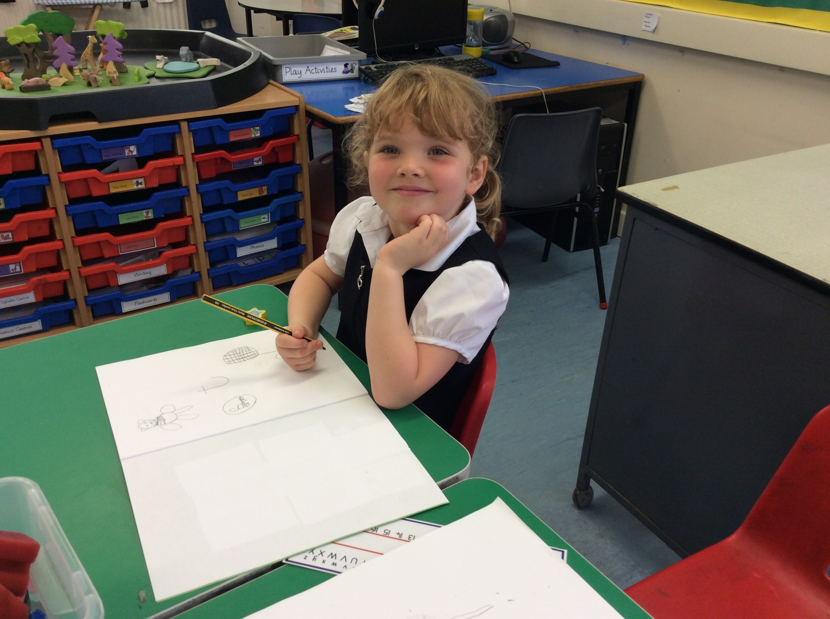
Wordbuilding
Magnet boards
Writing letters
Word attack skills

Slide 9
Storyworlds
Four Worlds
Our World Fantasy World
Animal World Once Upon A Time World

Slide 10
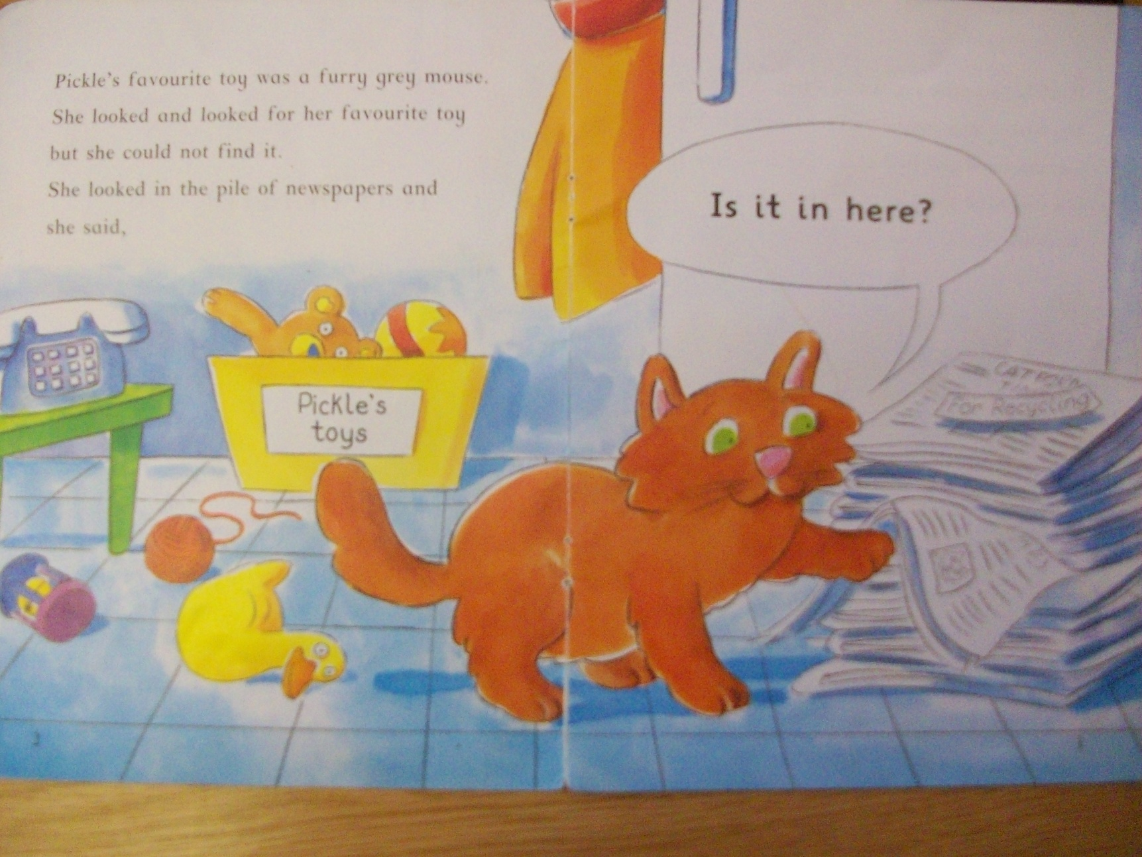
Stage 1 See Saw Approach

Slide 11
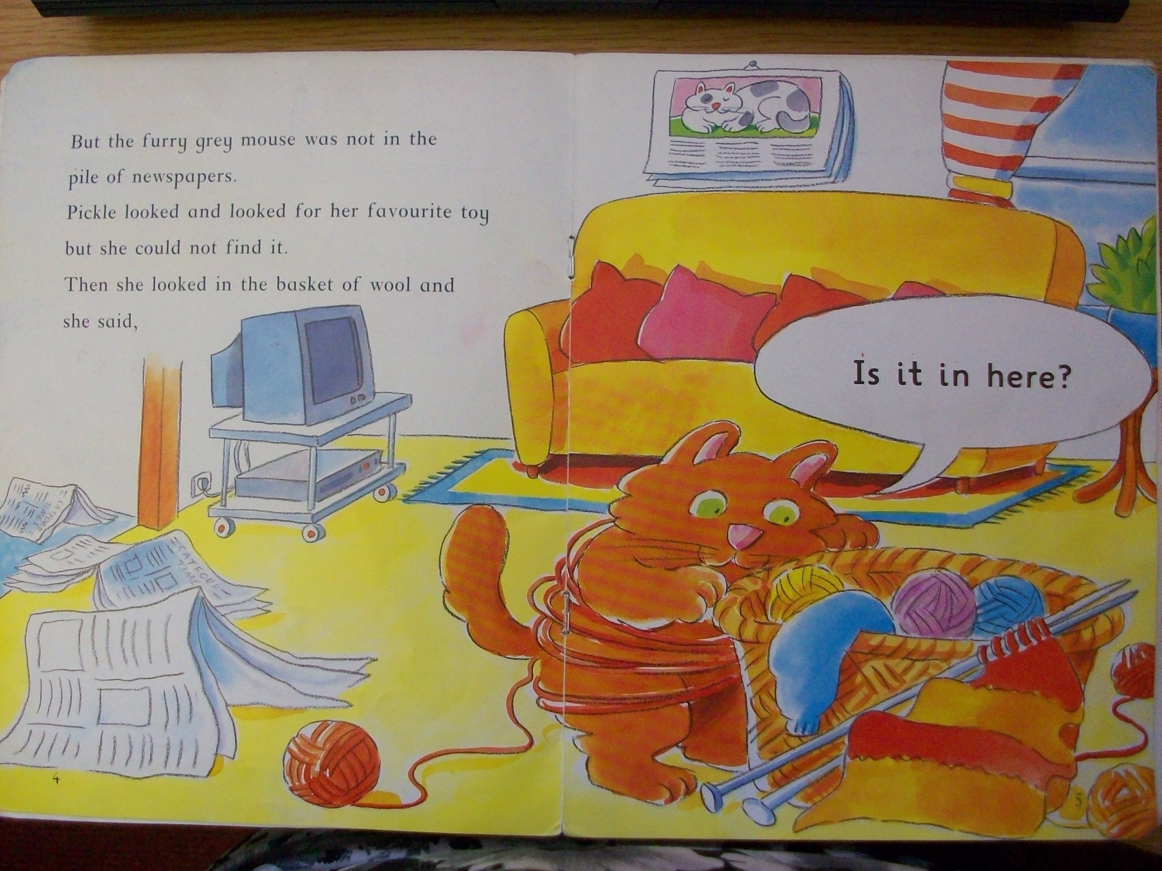

Slide 12
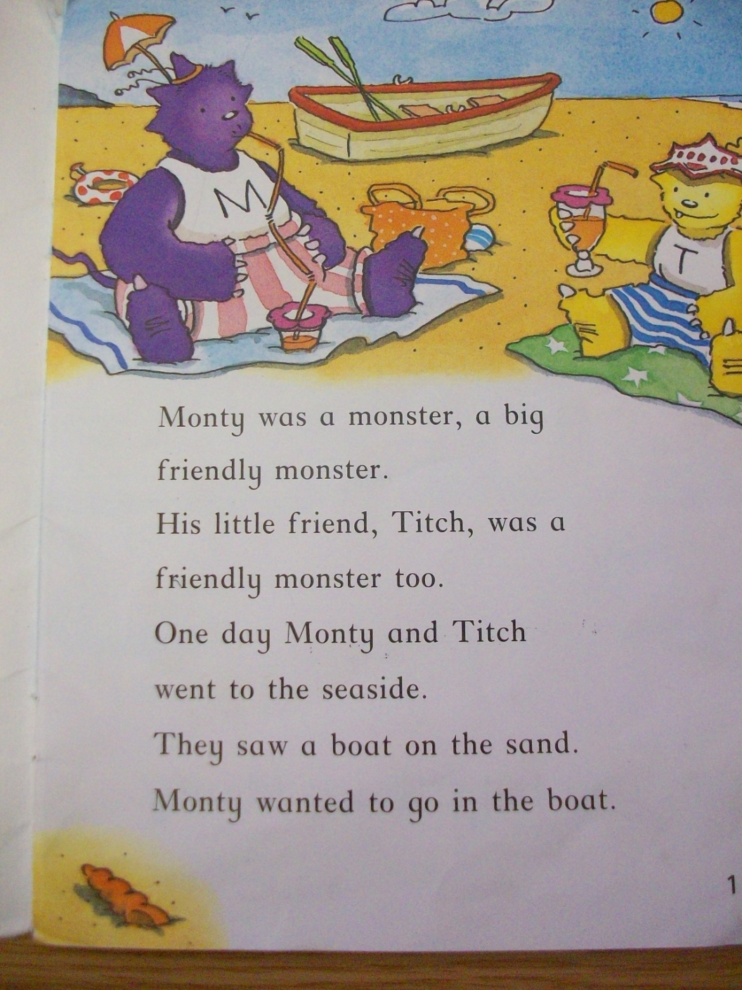
Stages 2 and 3
Springboard Approach

Slide 13
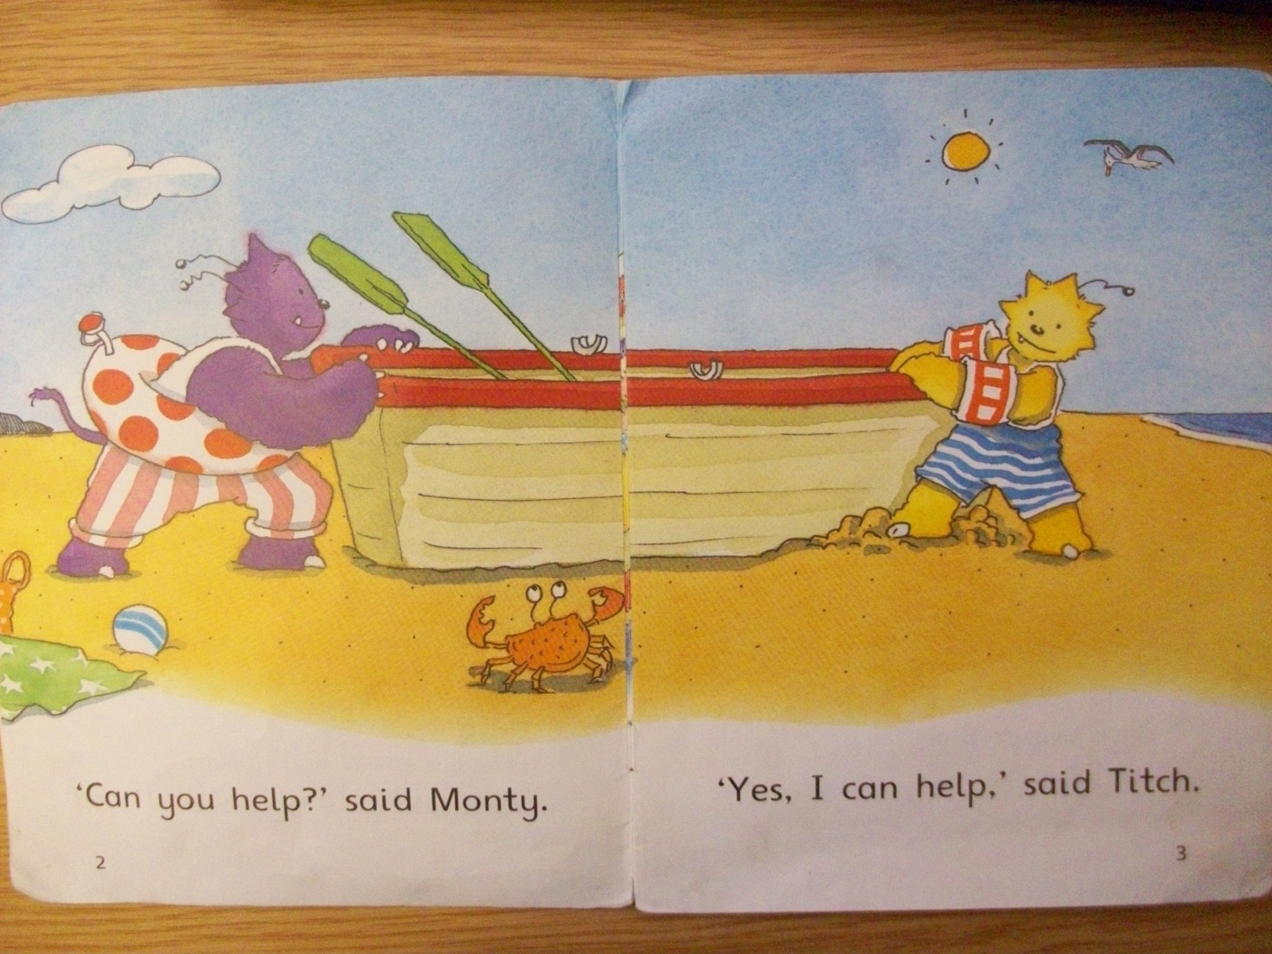

Slide 14
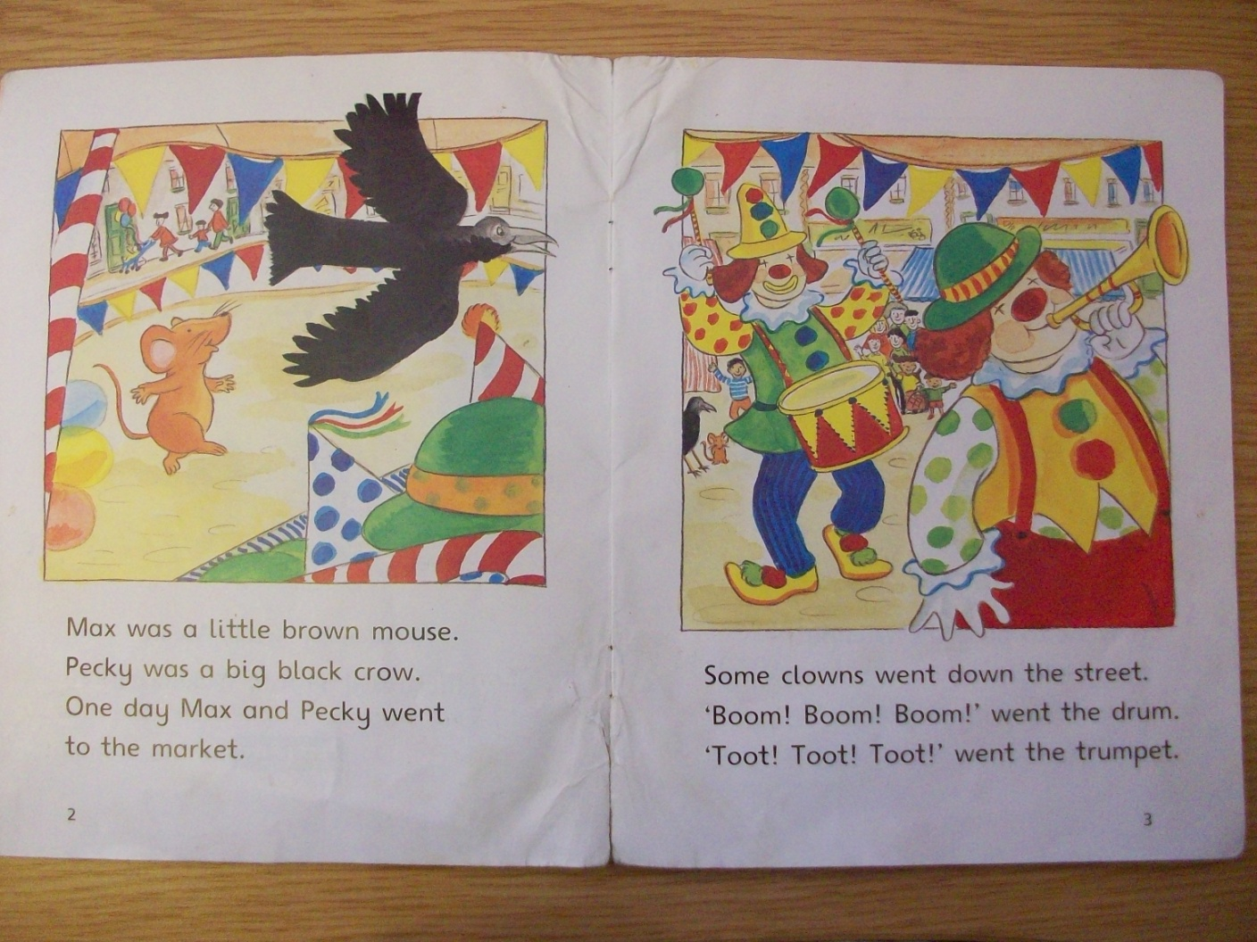
Stage 4 onwards – child reads independently

Slide 15
Hearing reading
Not heard by teacher every day but the child may -
read with a classroom assistant or parent helper
play Storyworlds computer game
read a workbook or worksheet
play reading games

Slide 16
Reading skills
Letter/sound correspondence
Blending
Whole word recognition
Following the text
Understanding punctuation
Visualising
Predicting
Summarising
Comprehension

Slide 17
What if my child gets stuck on a word?
Try sounding it out
What letter does it start with?
Look at the picture
Read on to the end of the sentence

Slide 18
Choose a time that suits you and your child best
Sit comfortably
Look at the title
Discuss pictures
Predict
You may wish to read the story to your child first
Praise and encourage

Slide 19
Reading marker
You:
Sign to show you have heard the reading
Write a comment or a word your child is unsure of
Teacher:
Writes a comment or draws a star/happy face etc
Writes word(s) your child is unsure of

Slide 20
Foundations of Writing
Start with themselves
Children draw and tell the story and teacher scribes
Later children draw and write
“Have a go” at writing

Slide 21
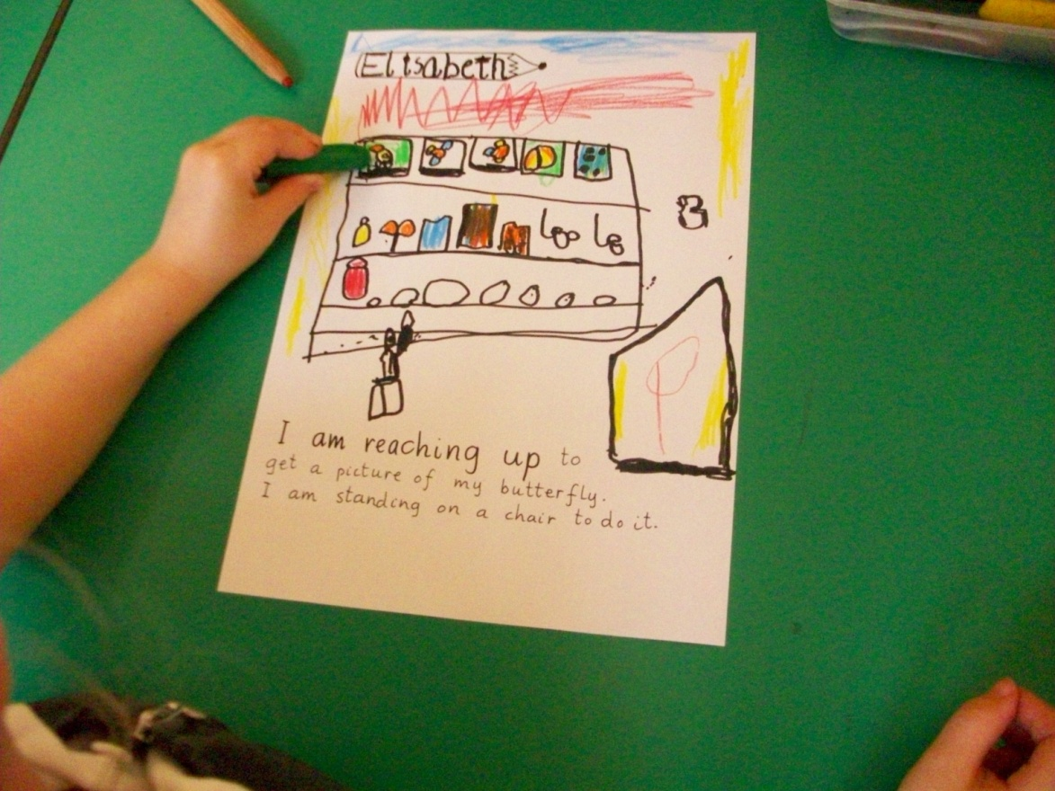
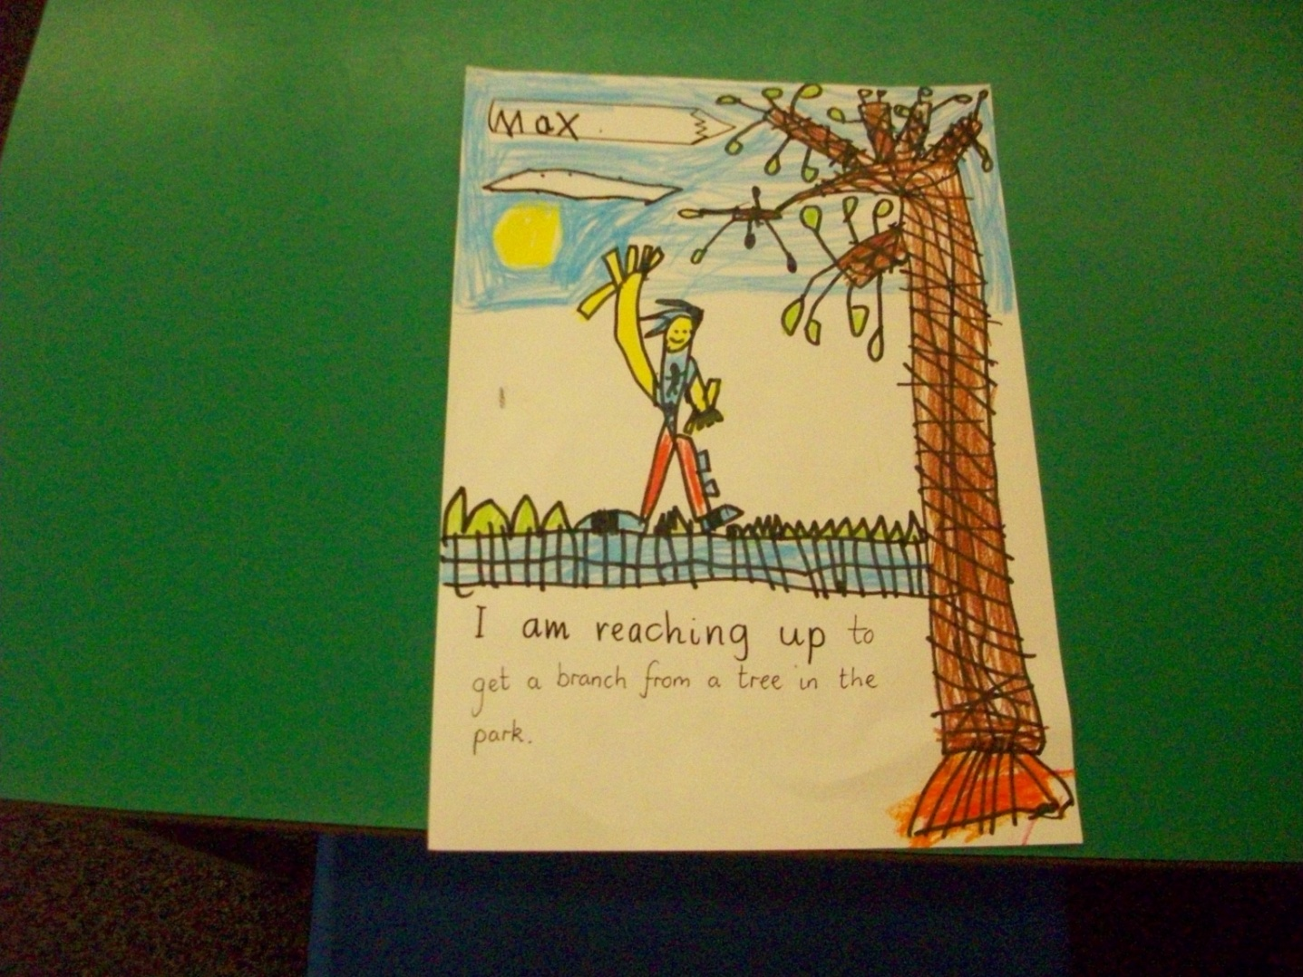

Slide 22
Reading
identify an information book and a story book.
identify parts of a book (cover /page/blurb); describe the role of author and illustrator.
identify rhyming words in a story.
identify and read most single letter sounds
identify and read some two letter digraphs eg ss, ch, sh, ee
read simple, unfamiliar words by sounding out
read a selection of common words which can’t be sounded out eg said, the, come
read prepared text by myself.
ask questions about what I have read
recall key points about what I have read.
know that I can find information from a variety of sources (books, internet, Smartboard, displays).

Slide 23
Writing
recognise writing and know that it means something.
hold a pencil properly when writing.
form most letters correctly.
leave finger spaces between words.
write a three letter (CVC) word correctly on my own.
write using different materials and for different purposes.
use letter sounds and common words I know to “have a go” at writing words or a story.
write a sentence on my own using a capital letter and full stop.

Slide 24
Talking & Listening
talk to different people.
talk about my ideas, thoughts and feelings.
talk about my experiences and things I have done.
talk about why I like some texts better than others.
listen well when others are speaking.
listen to learn new things.
ask questions to help me understand what I have listened to or watched.
answer questions to show I understand what I have listened to or watched.

Slide 25
Numeracy and Mathematics
Estimation and rounding
Number and number processes
Fractions
Money
Time
Measurement
Patterns and relationships
Properties of 2D shapes and 3D objects
Symmetry
Data and analysis

Slide 26
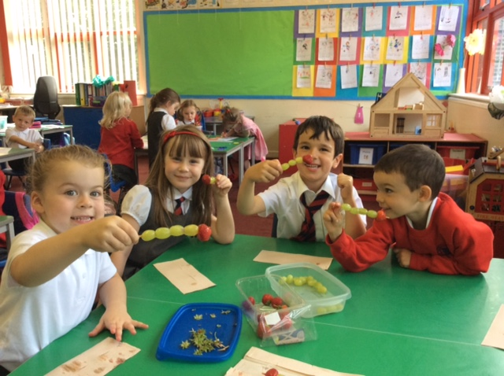

Slide 27
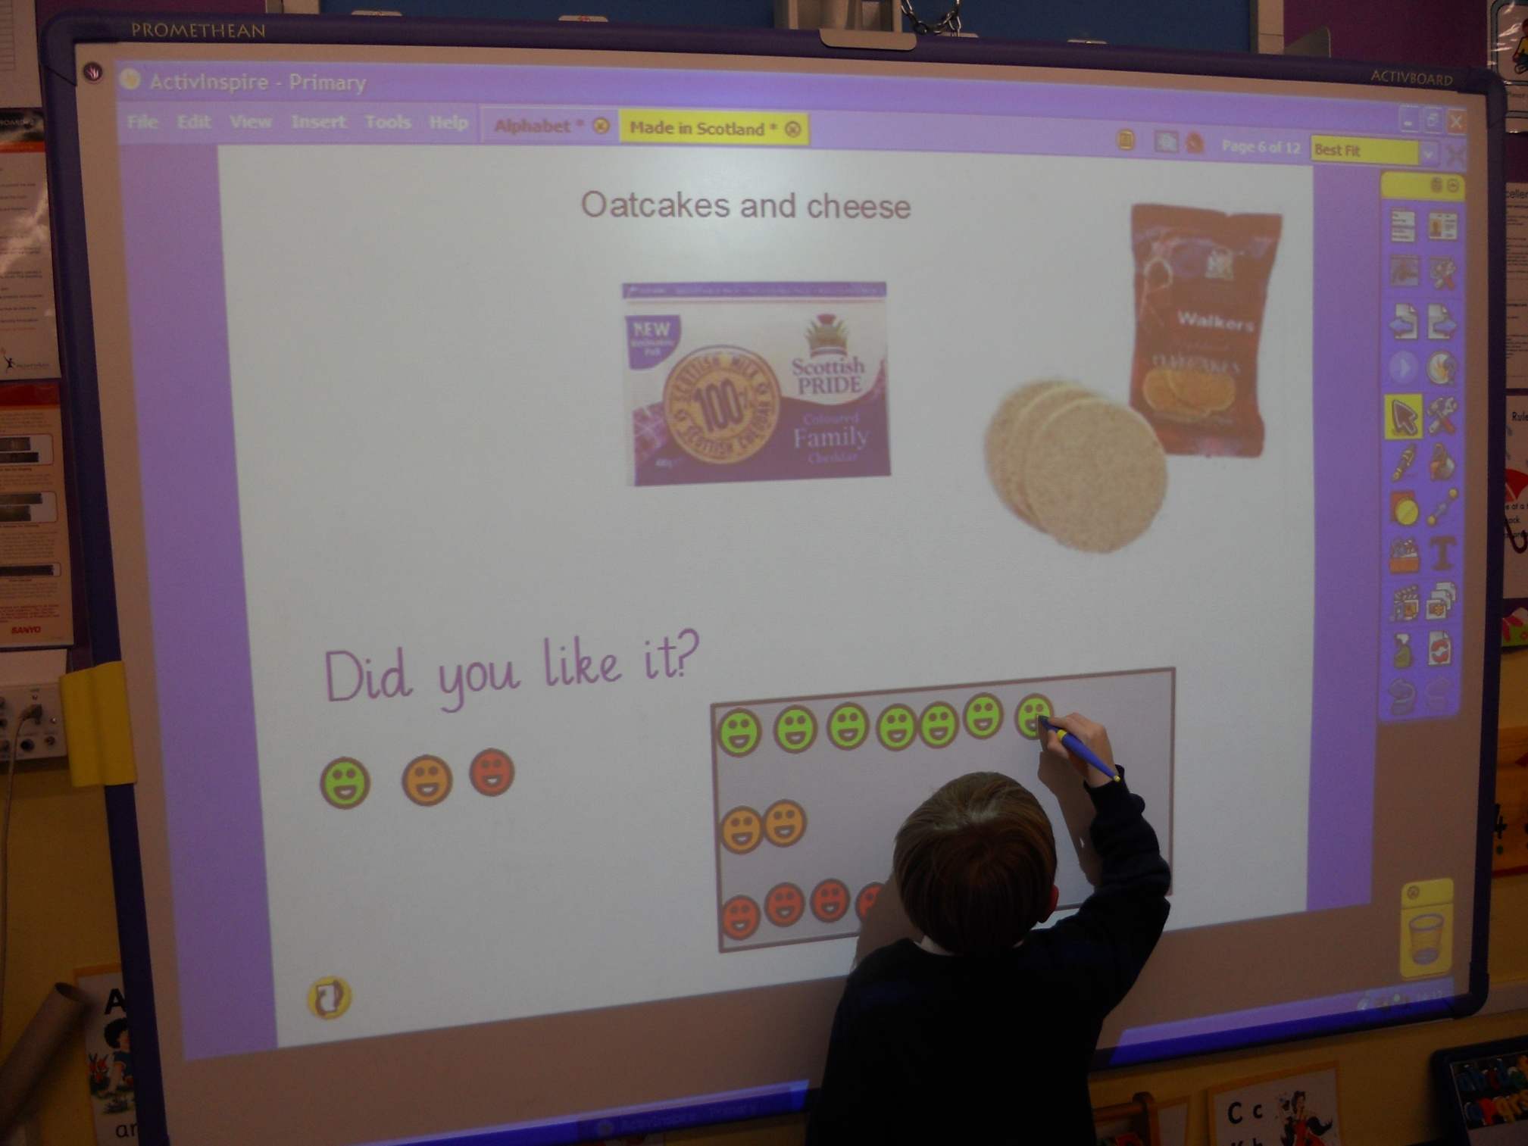

Slide 28
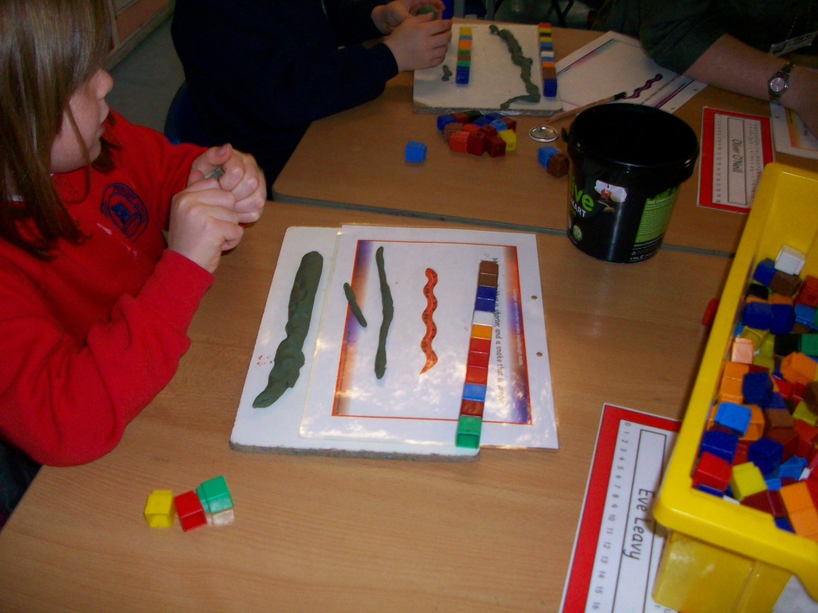

Slide 29
www.educationscotland.gov.uk

