Slide 2
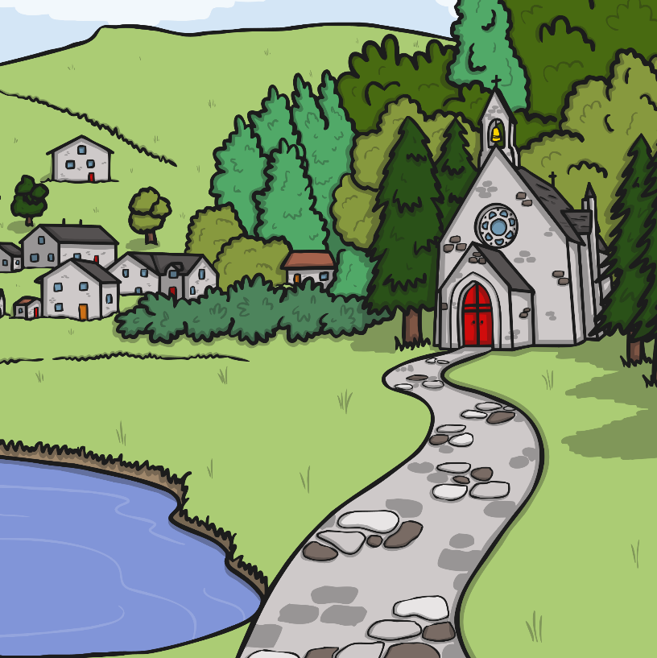
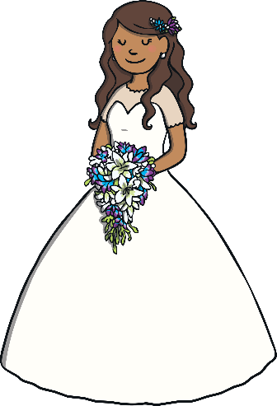
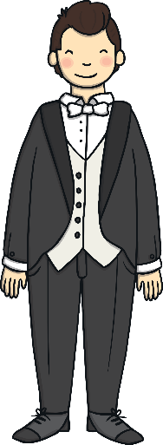
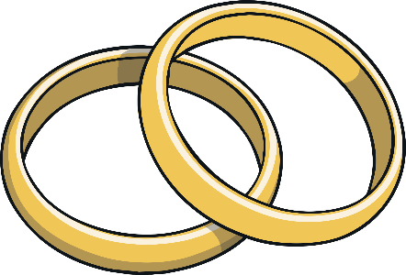
What Is a Wedding?
A wedding is when two people who love each other make special promises to one another. It is a happy time when friends and family come together to celebrate the love that the two people have for
each other.
Have you ever been to a wedding?
Who got married?
What was it like?
Talk About It

Slide 3
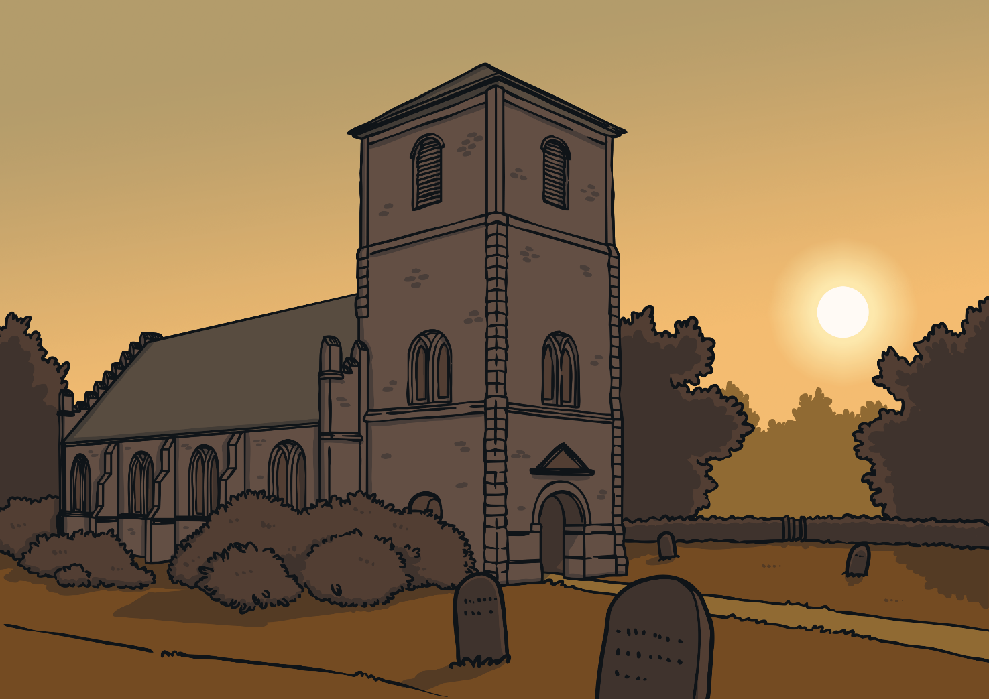
Who Are Christians?
Christians are a group of people who follow Jesus. Their special building is called a church and
their special book is the Bible.
Tell your partner anything you
know about the Christian faith.
Talk About It

Slide 4
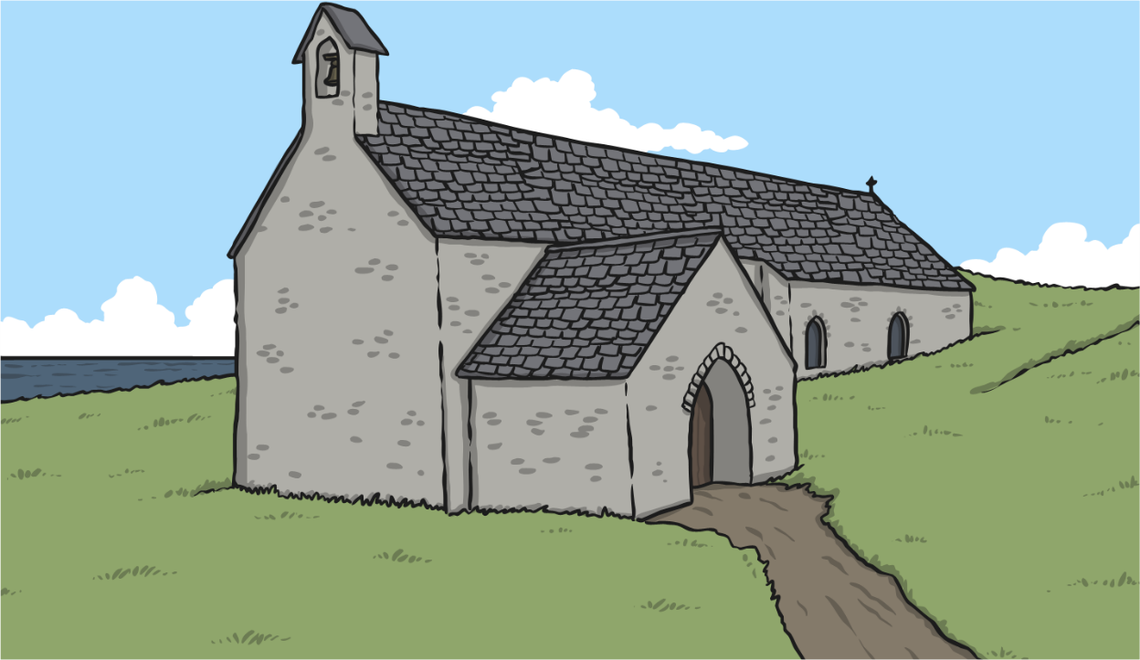

Before the Wedding
The people getting married decide when they are going to get married.
They send invitations to their friends and family.
Sometimes they send out a gift list. The guests
can buy presents from this list.
What would you put on a wedding gift
list?
Wedding
Invitation
Talk About It

Slide 5
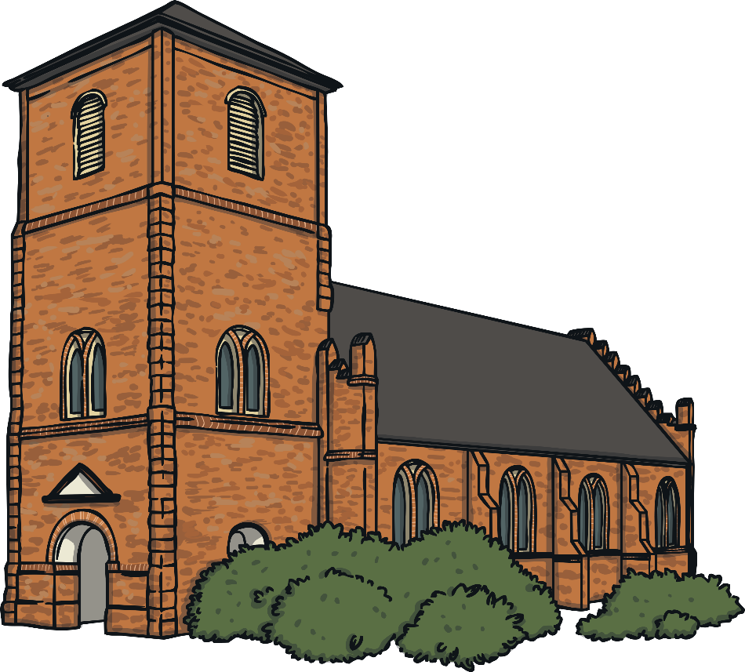
Where Does a Christian Wedding Take Place?
A Christian wedding happens in a church.

Slide 6
Who Takes Part in a Christian Wedding?
Click on the circle to find out more about the people in a wedding.
The people getting married.
The Couple
Performs the marriage ceremony.
The priest, minister
or vicar
A good friend or relative of the groom.
The best man
Walks the bride to the front of the church.
The father of the bride
Friends or relatives of the bride.
Bridesmaids
Shows the guests where they need to sit before the wedding.
Ushers

Slide 7



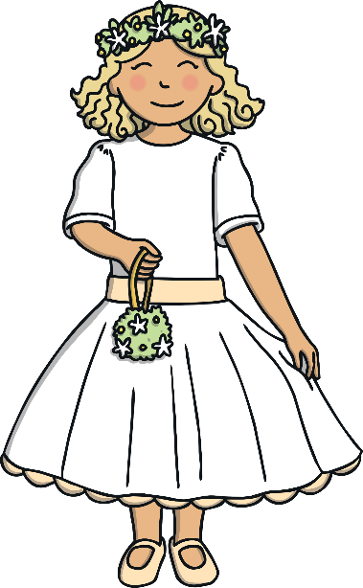
What Do People Wear at a Wedding?
Guests at a wedding will wear smart clothes.
Sometimes women wear big hats.
A groom will wear a smart suit and have a flower in his button hole. Sometimes grooms have a special hat called a top hat.
A bride often wears a long white dress. Sometimes a bride wears a veil, which is a see-through material which goes over her head. The bride often carries a bunch of flowers.
Bridesmaids wear nice dresses. They sometimes wear flowers in their hair and carry a bunch of flowers. They help the bride on her special day.

Slide 8
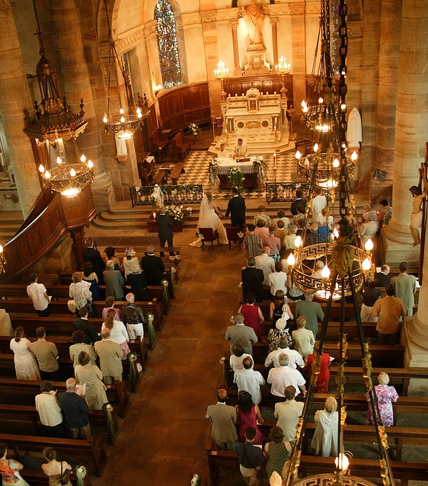
What Happens at a Wedding?
When the couple arrive at the church, special music will start playing. The guests all stand up and the couple walk to the front of the church where the vicar is waiting.

Slide 9
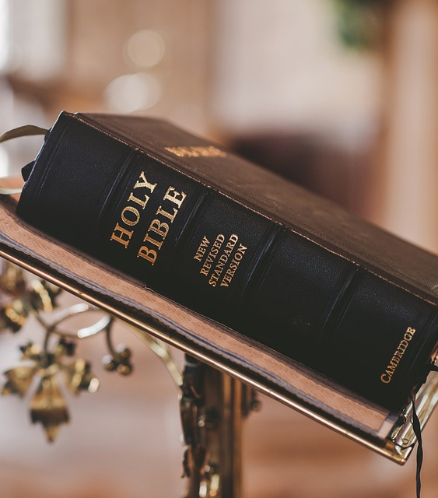
What Happens at a Wedding?
Sometimes special songs called hymns are sung. Parts from the Bible or special poems are read.

Slide 10
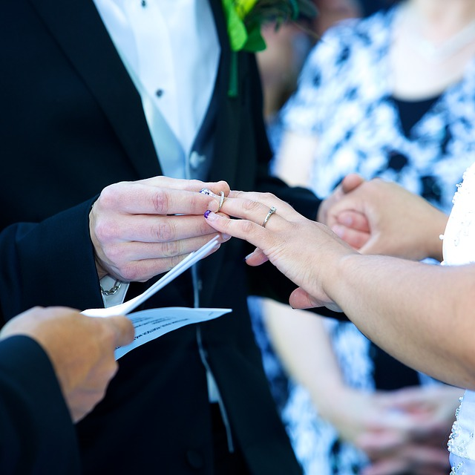
What Happens at a Wedding?
The couple make promises to each other called vows.
These often include these words:
‘…for better, for worse,
for richer, for poorer,
in sickness and in health,
to love and to cherish…’
The couple give each other rings as
a sign of their love and to show that
they are married.

Slide 11
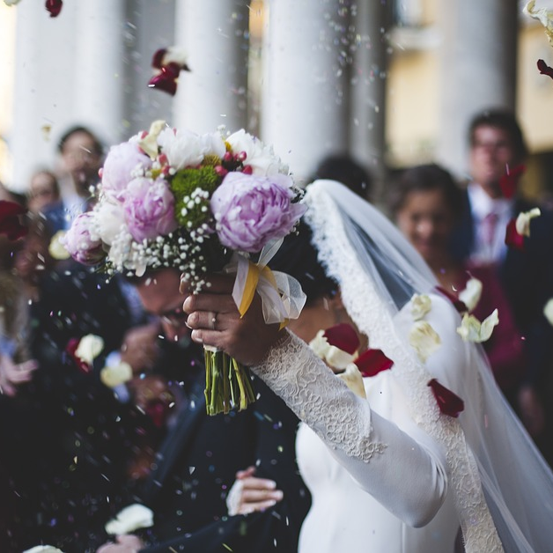
What Happens at a Wedding?
After the vows and giving of the rings, the vicar, minister or priest says that the couple are now married. Often they
then kiss.
The couple sign a register, which is a
legal record to show that they are
now married.
After that, special music will play
and they walk back up the church
aisle and outside.
Guests sometimes throw confetti or
flower petals in celebration.

Slide 12
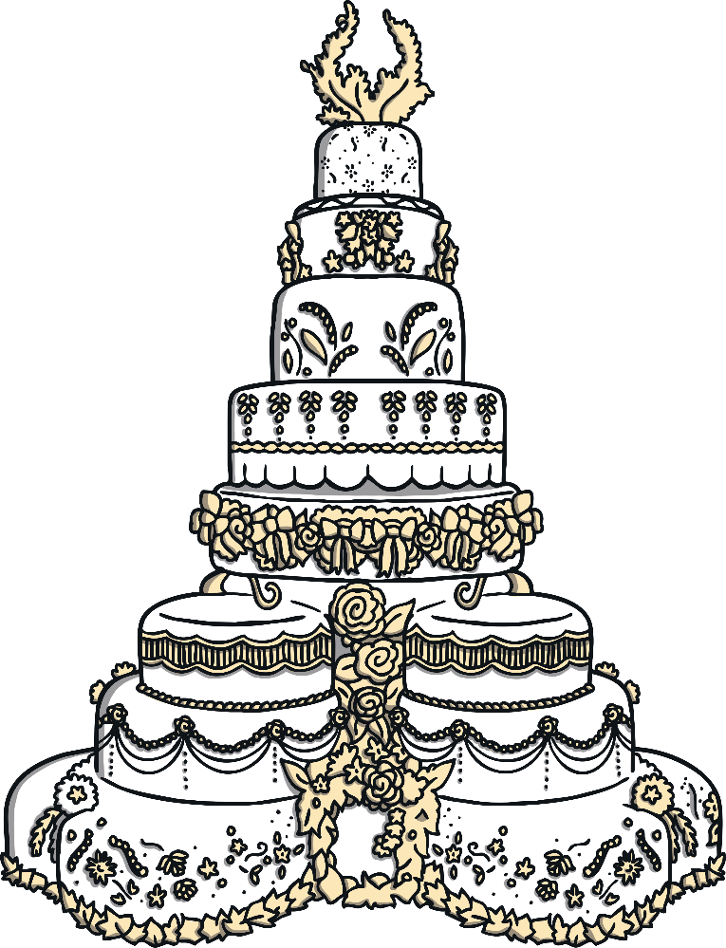
What Happens After the Wedding?
After the wedding ceremony, there is a big party called a wedding reception.
The guests have lots of yummy food.
Some of the people make speeches about the special day. There is a cake which the couple cut.
After the food, people sometimes dance to a
band or a DJ. It is a happy time.

Slide 13
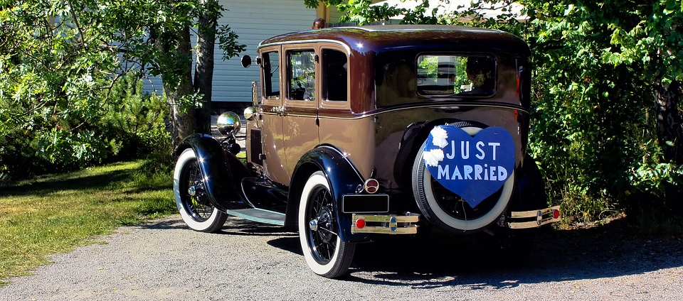
What Happens After the Wedding?
At the end of the wedding reception, the guests go home.
The newly-weds go on a special holiday called a honeymoon.

