Slide 1
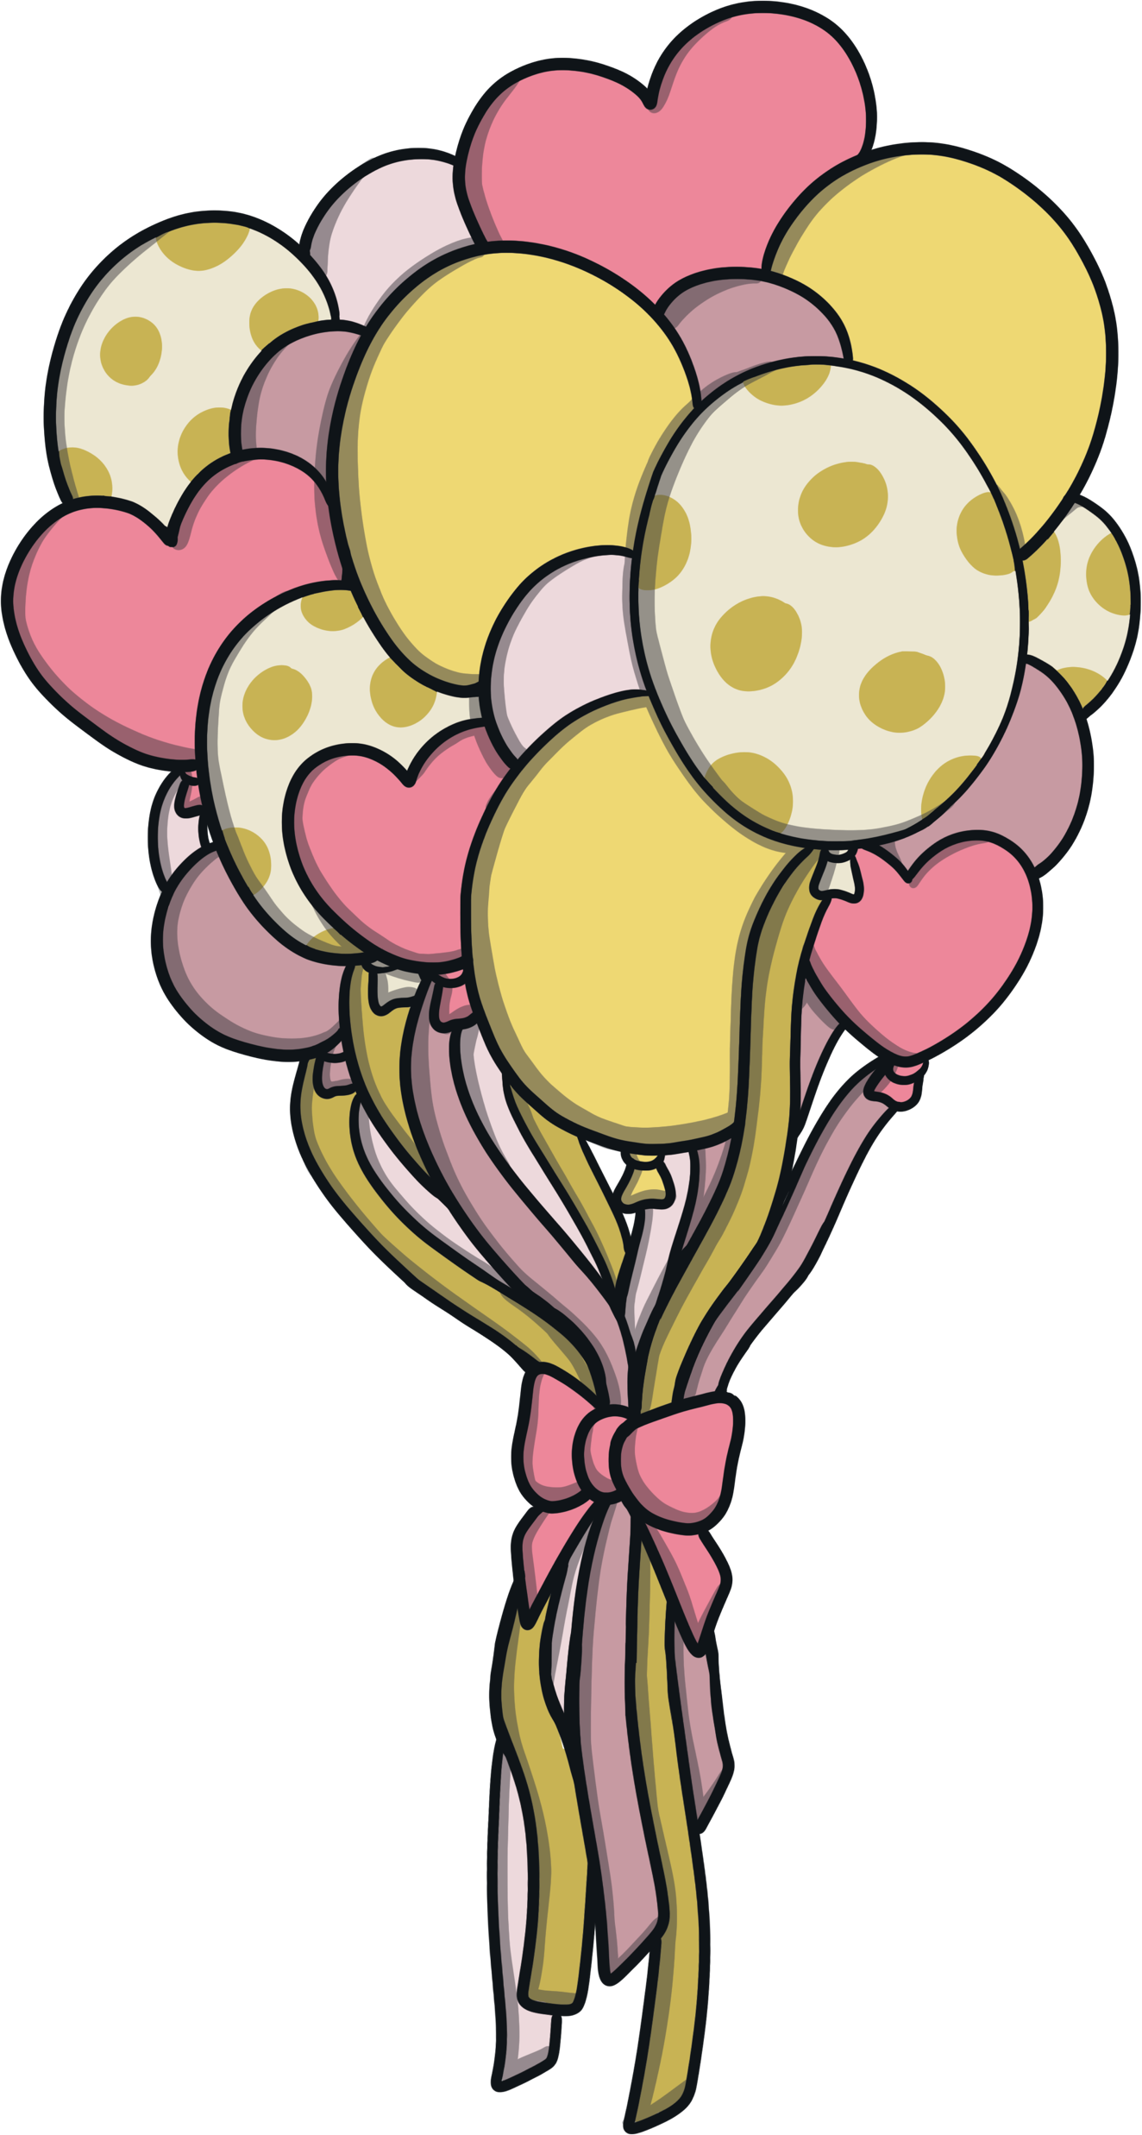

Slide 2
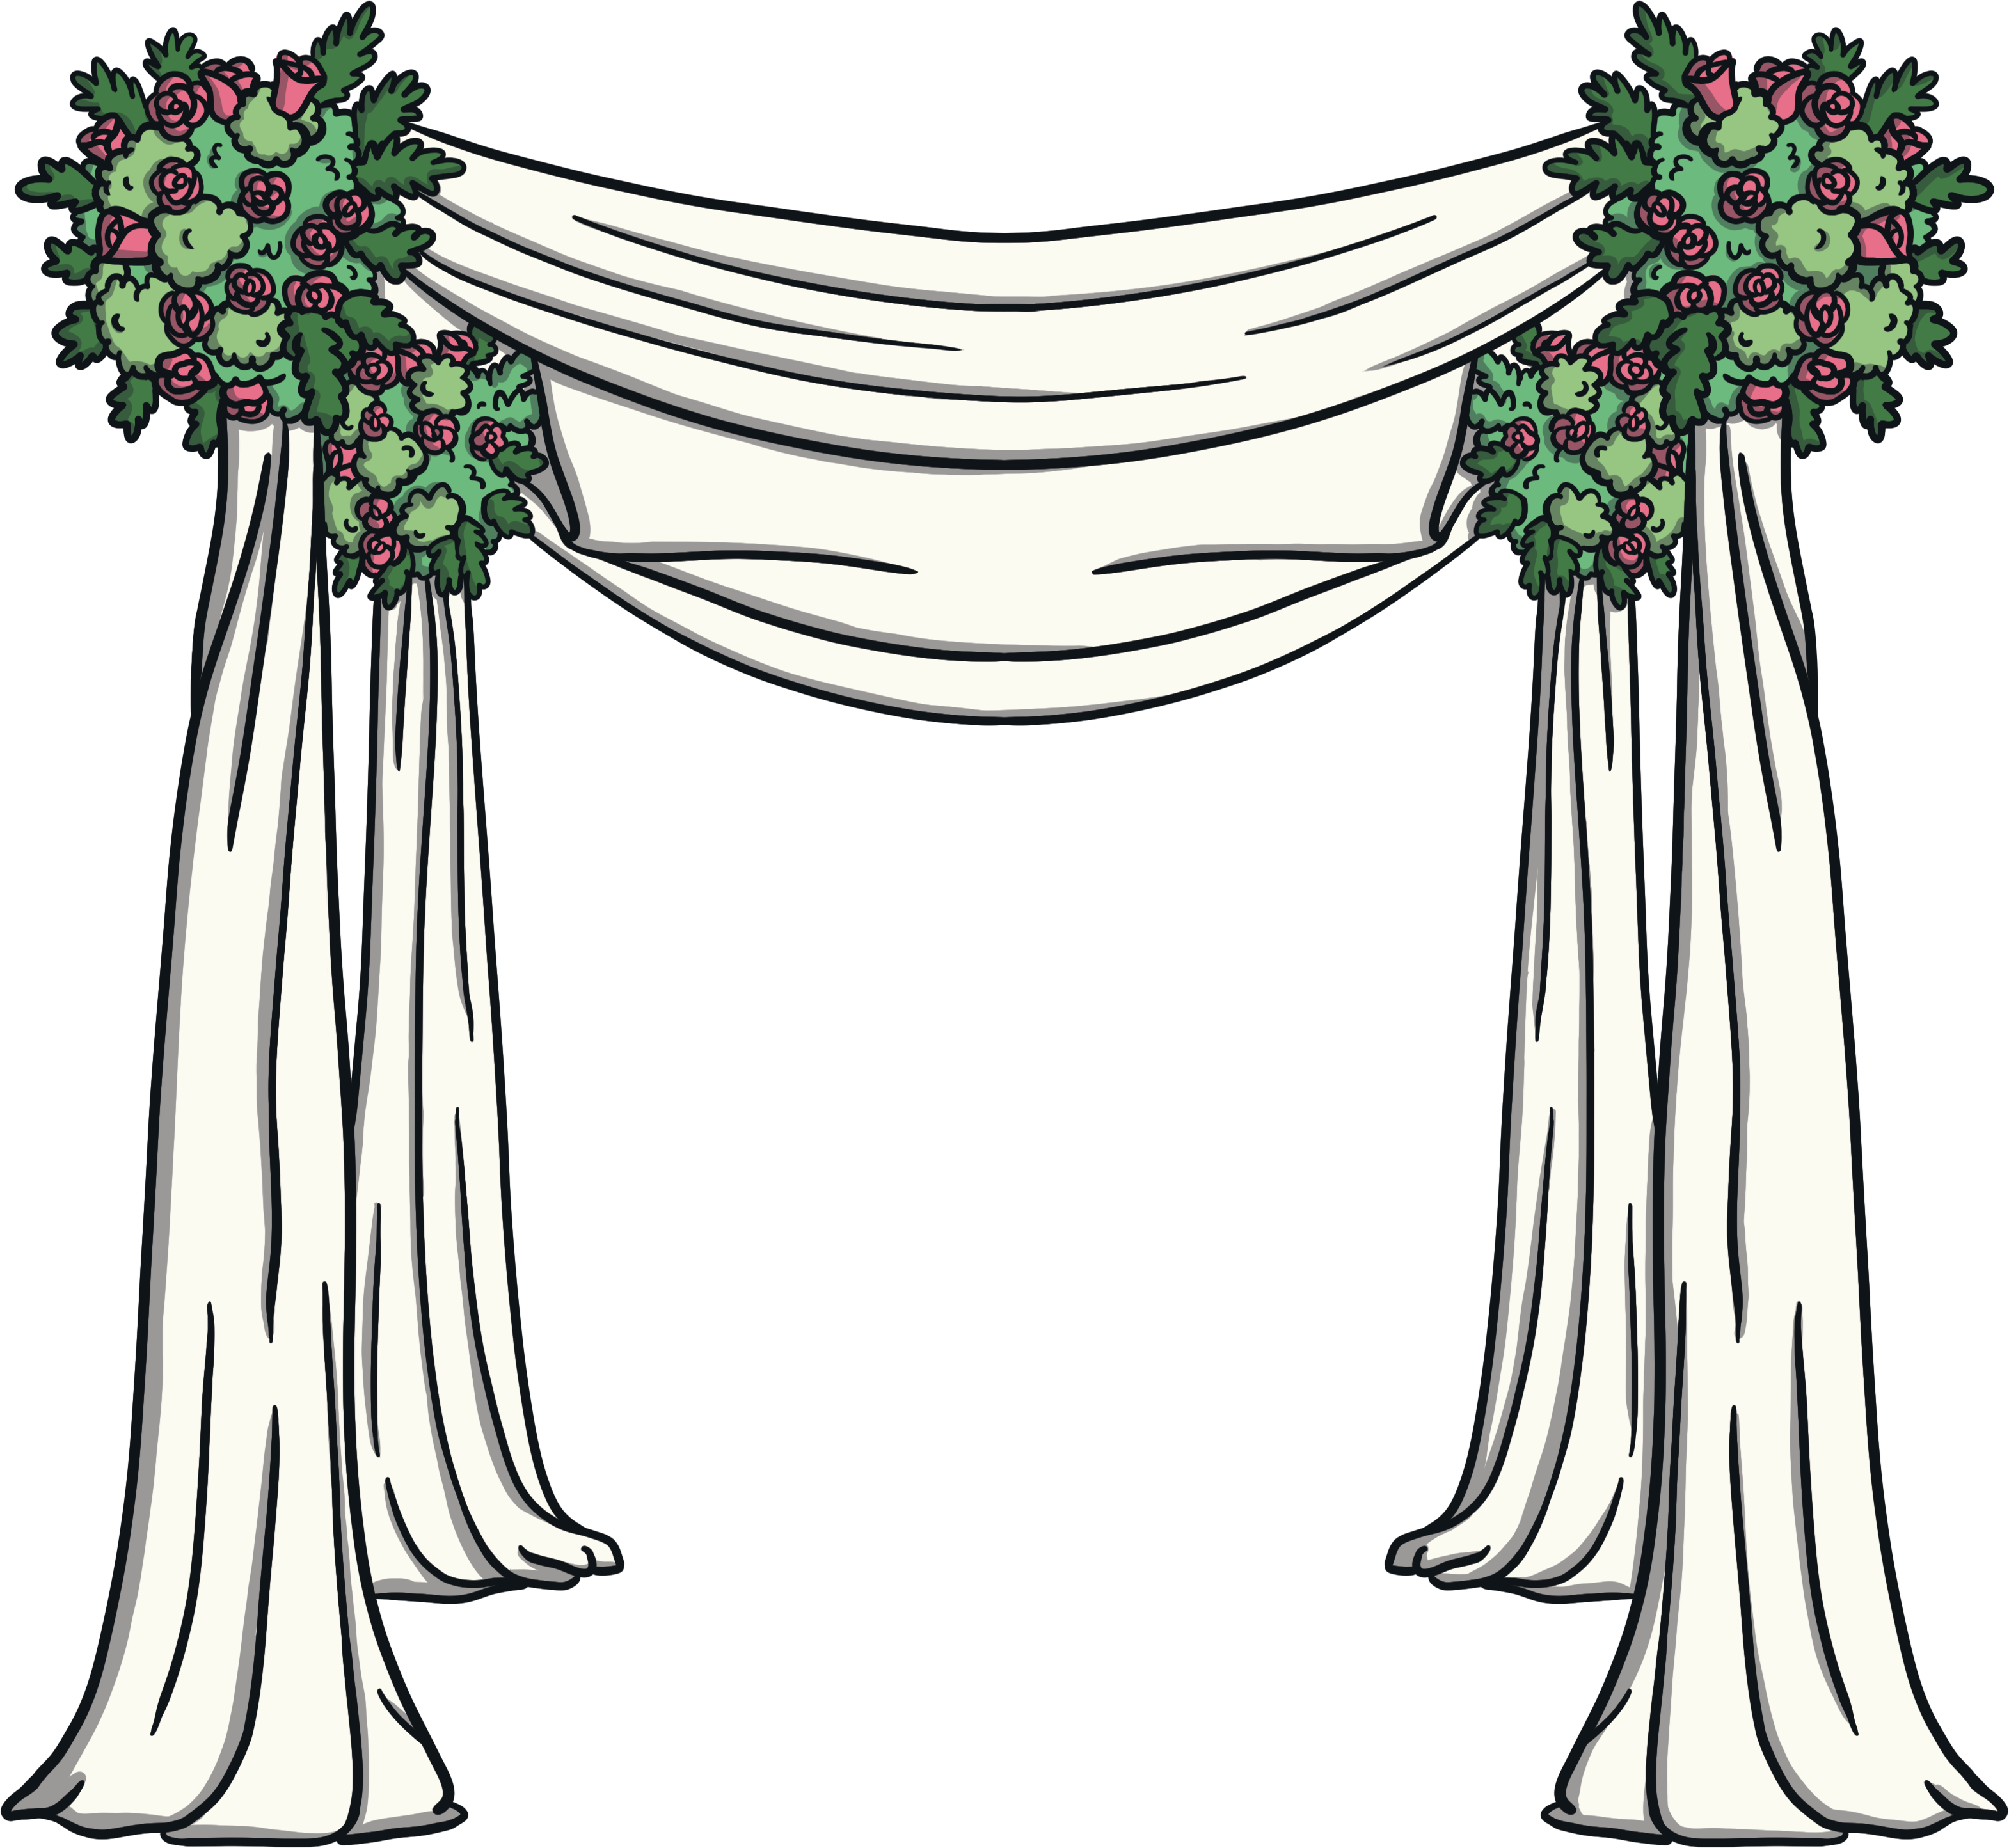
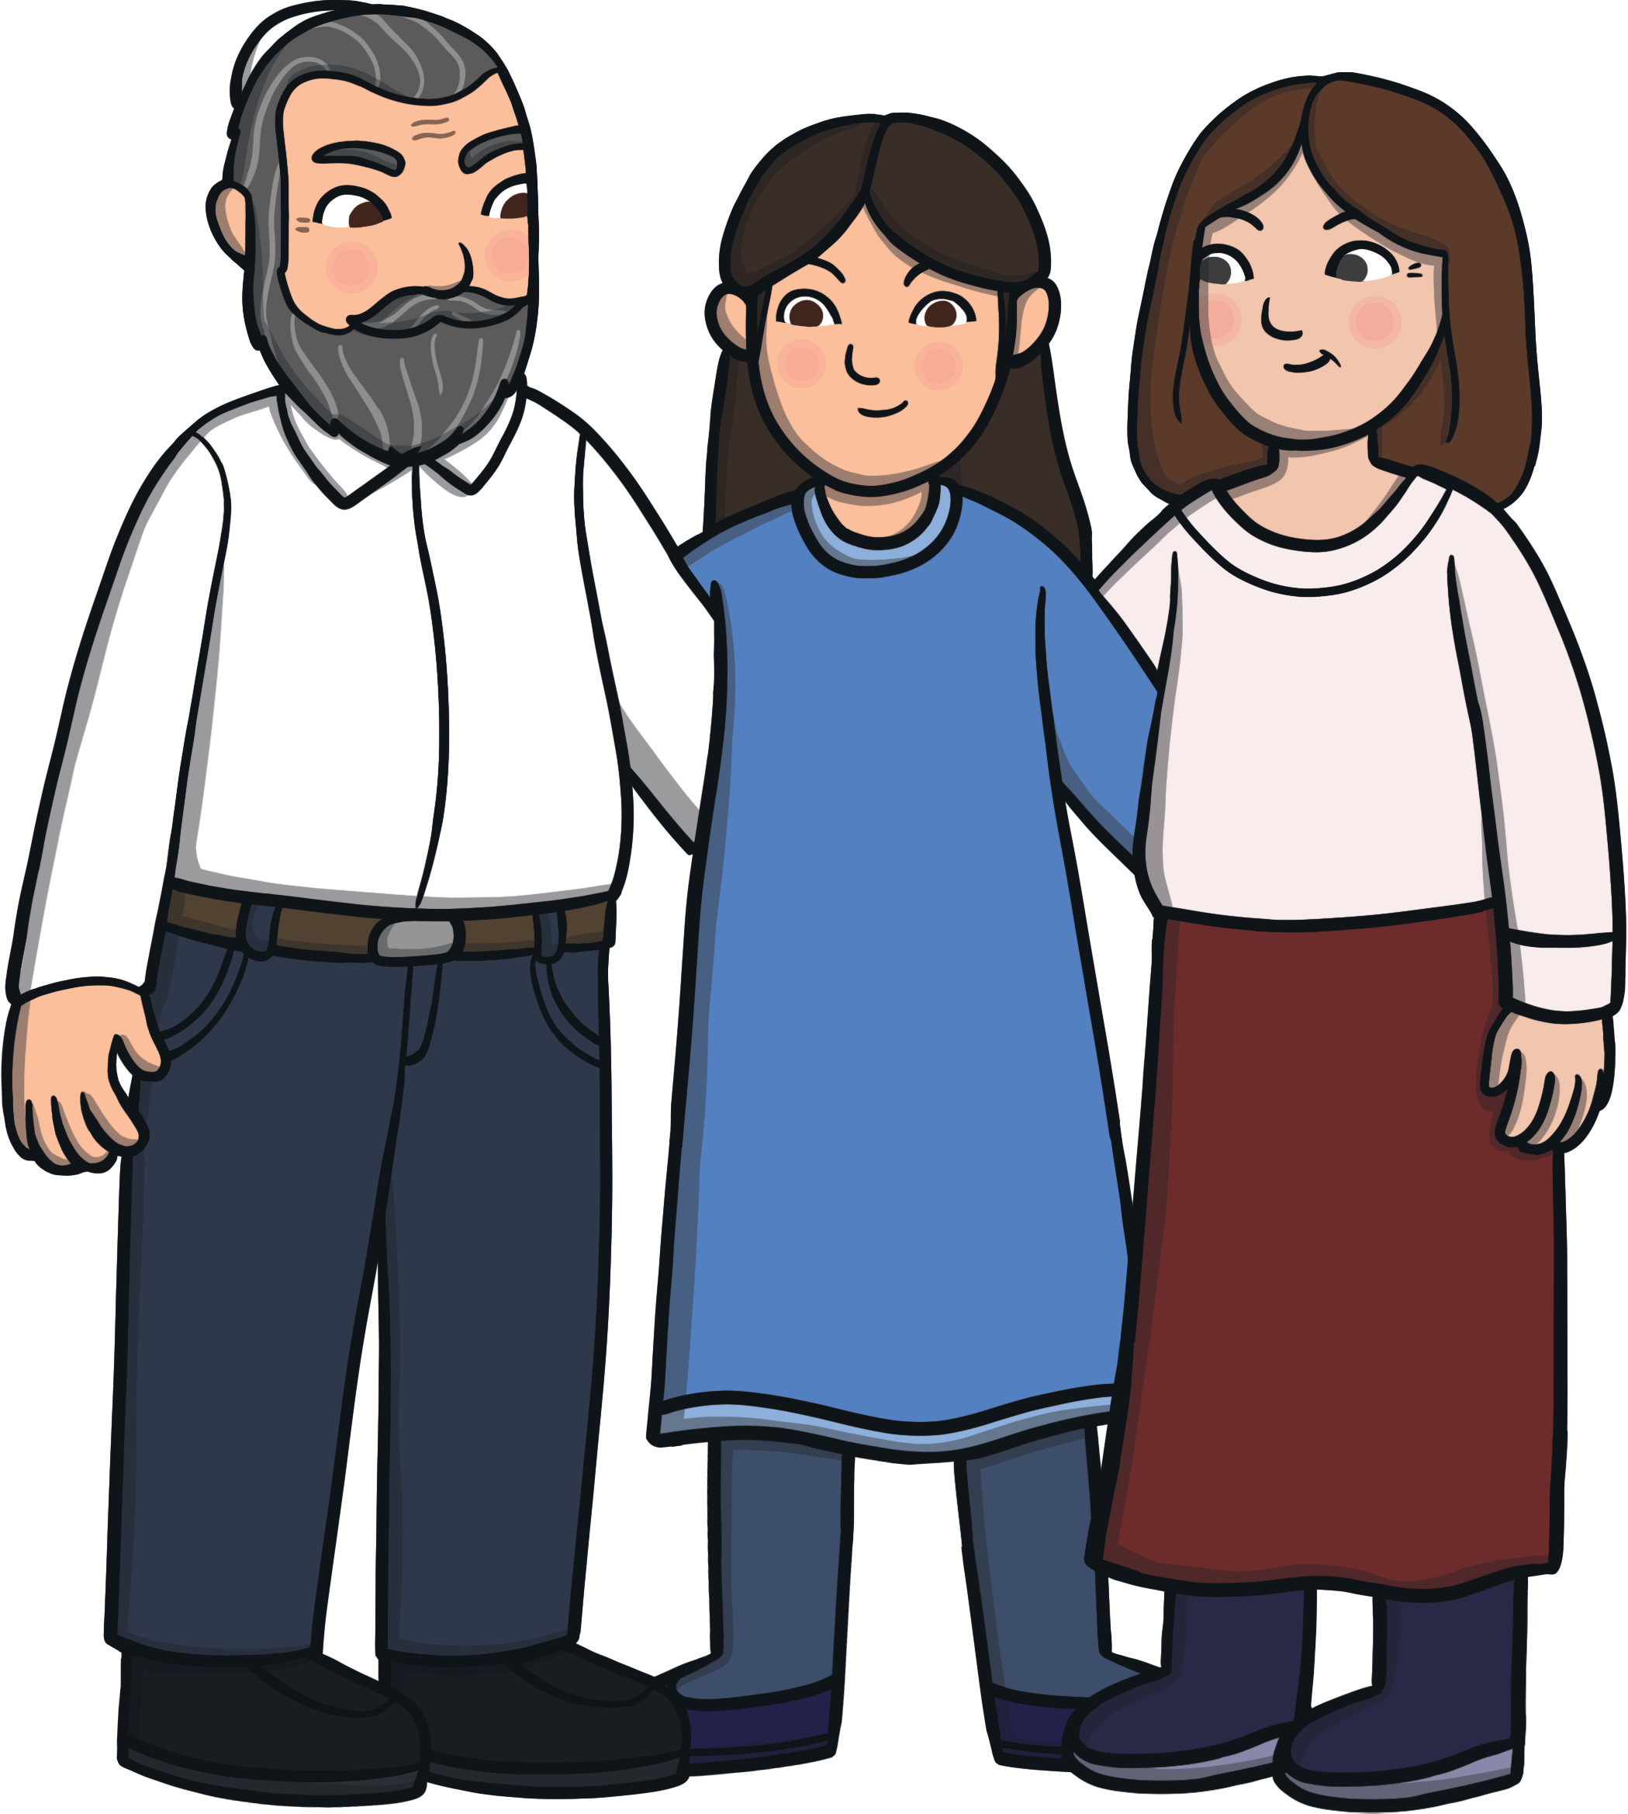
Before the Wedding
There are many traditions that can take place before and during a Jewish wedding. A tradition is something that has happened for many years and has a special meaning.
In some Jewish families, the parents have help finding a wife or husband for their son or daughter. A matchmaker, known as a shadchan, is a woman who will help them to find someone who could marry their daughter or son.
Nowadays, it is more common for Jewish people to choose their own husband and wife.

Slide 3
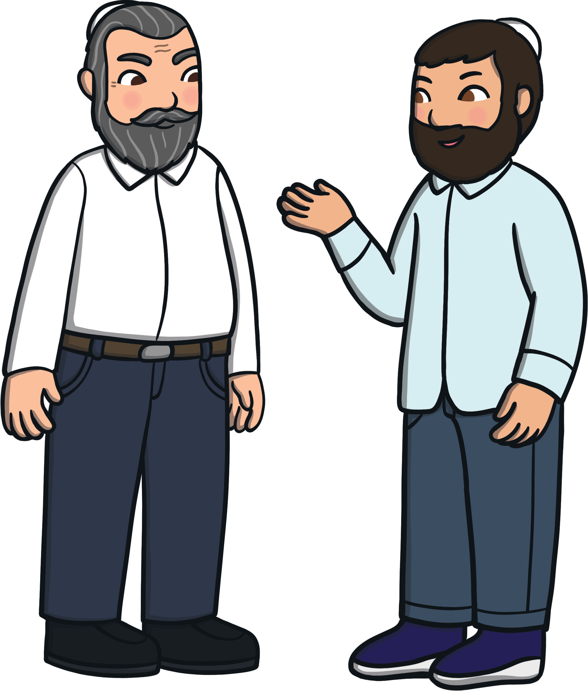
The Bride and Groom
The man who is getting married is known as the groom or ‘chatan’.
The woman who is getting married is the bride or ‘kallah’.
The groom asks the bride’s father if he can marry his daughter.

Slide 4
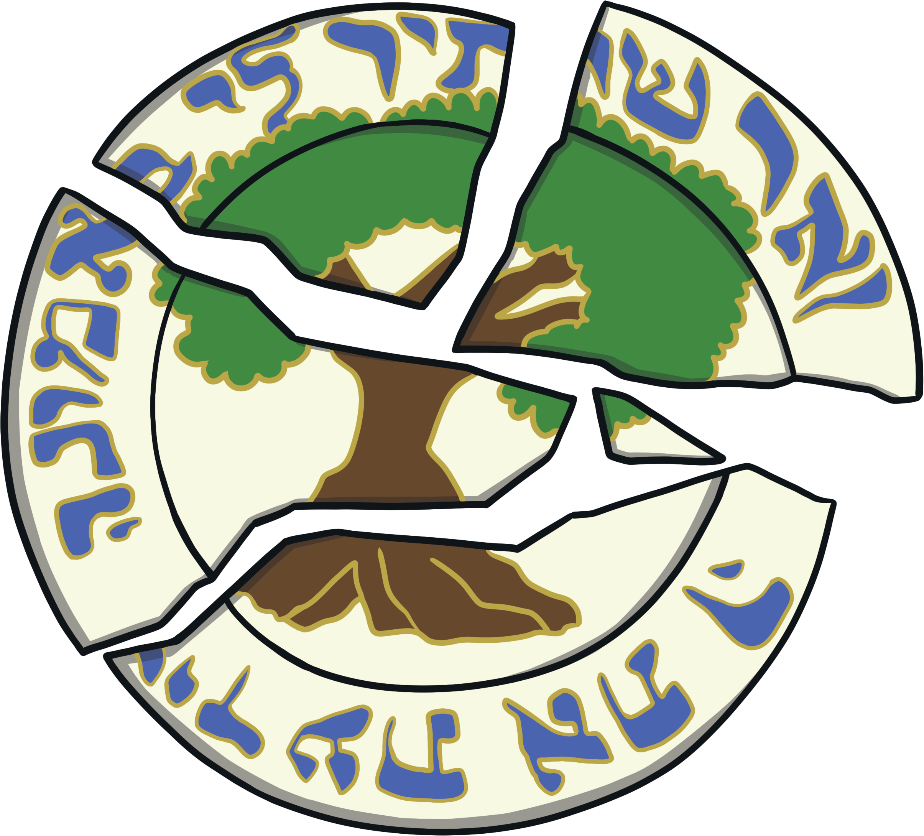
A Special Ceremony
When the couple have agreed to marry each other, they are engaged.
Then, they have a special ceremony called ‘tenaim’. A plate is broken as a sign that a broken engagement cannot be mended.
In some Jewish families, the bride and groom do not see each other in the week before the wedding.

Slide 5
A Special Ceremony for the Groom
The groom goes to the synagogue for a ceremony called ‘aufruf’. He takes part in the service where sweets are showered on him. Then, everyone has food and drink to celebrate.
Did You Know…?
A synagogue is a Jewish place of worship.

Slide 6
A Special Ceremony for the Bride
Traditionally, the bride has a special bath called a ‘mikveh’.
She says a prayer as she gets into the water.

Slide 7
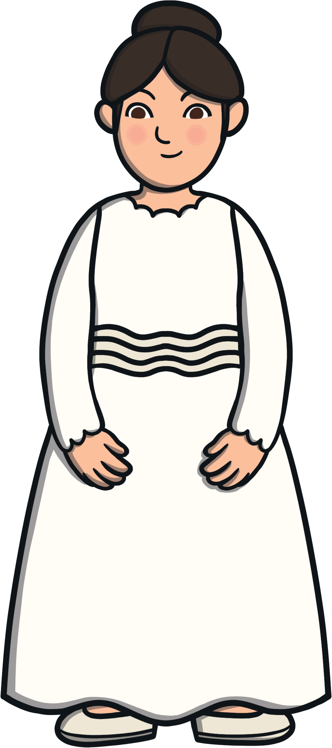
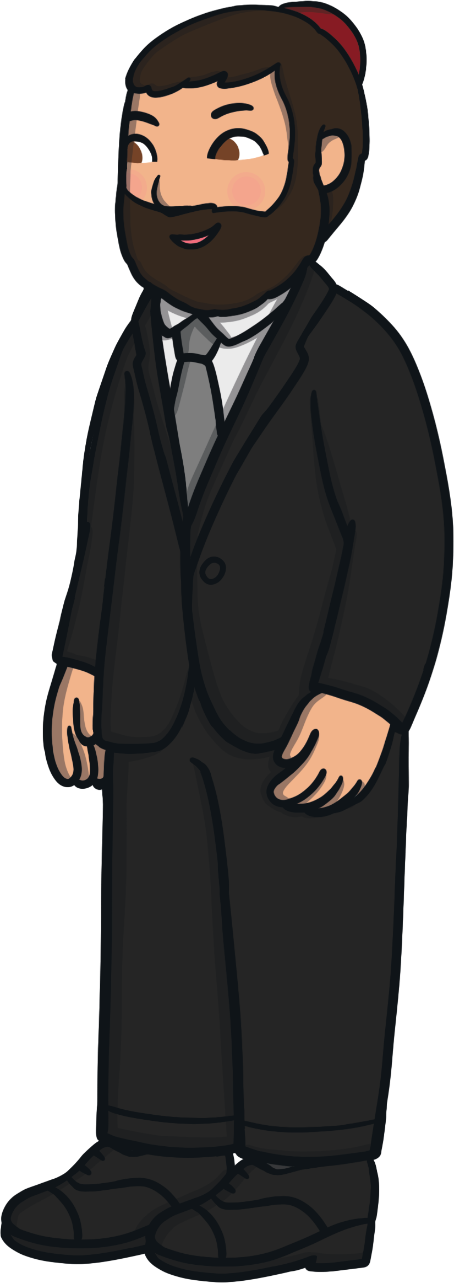
What Do People Wear?
At a Jewish wedding, men wear suits and a kippah, which is a small, round cap.
Women sometimes cover their shoulders with jackets or wraps. They take these off for the party.
The bride usually wears a white dress with a veil. The groom wears a suit.

Slide 8

The Wedding Day
Traditionally, the bride and groom don’t eat anything before the wedding.
At some Jewish weddings, the bride sits on a special seat and they both greet their guests separately in different rooms. This is called ‘kabbalat panim’. Sometimes, there is food and drink for the guests.
Nowadays, it is more common for Jewish people to choose their own husband and wife.

Slide 9
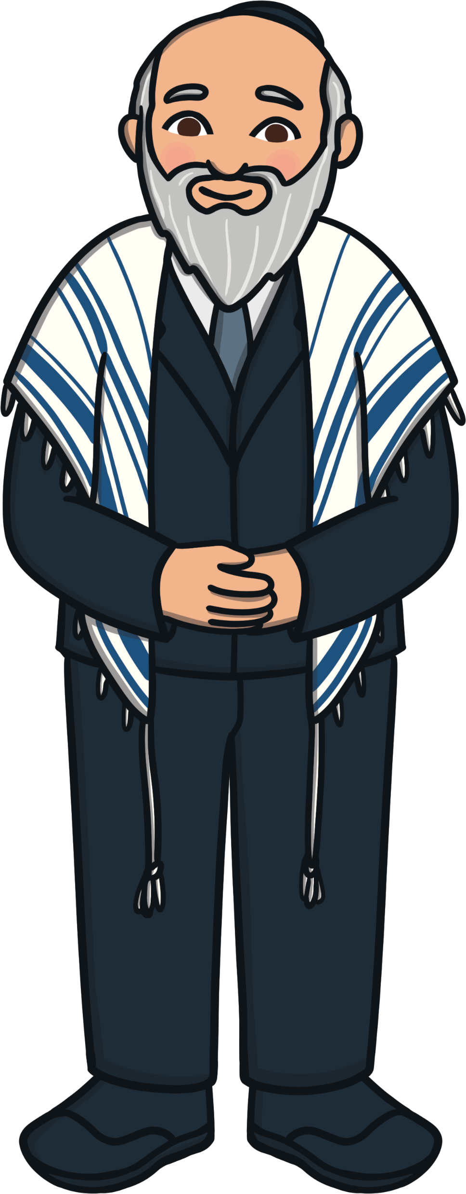

The Wedding Ceremony
The wedding ceremony usually takes place outside, under a canopy called a ‘chuppah’. The bride walks around the groom seven times under the chuppah.
The rabbi, or spiritual leader, usually takes the ceremony. At the end, the rabbi reads out seven blessings known as ‘sheva brachot’. The guests can join in.
The groom will often give the bride a gold ring as a sign of hope for a happy marriage. He also puts the veil over his bride’s face as a sign that he will protect her.

Slide 10
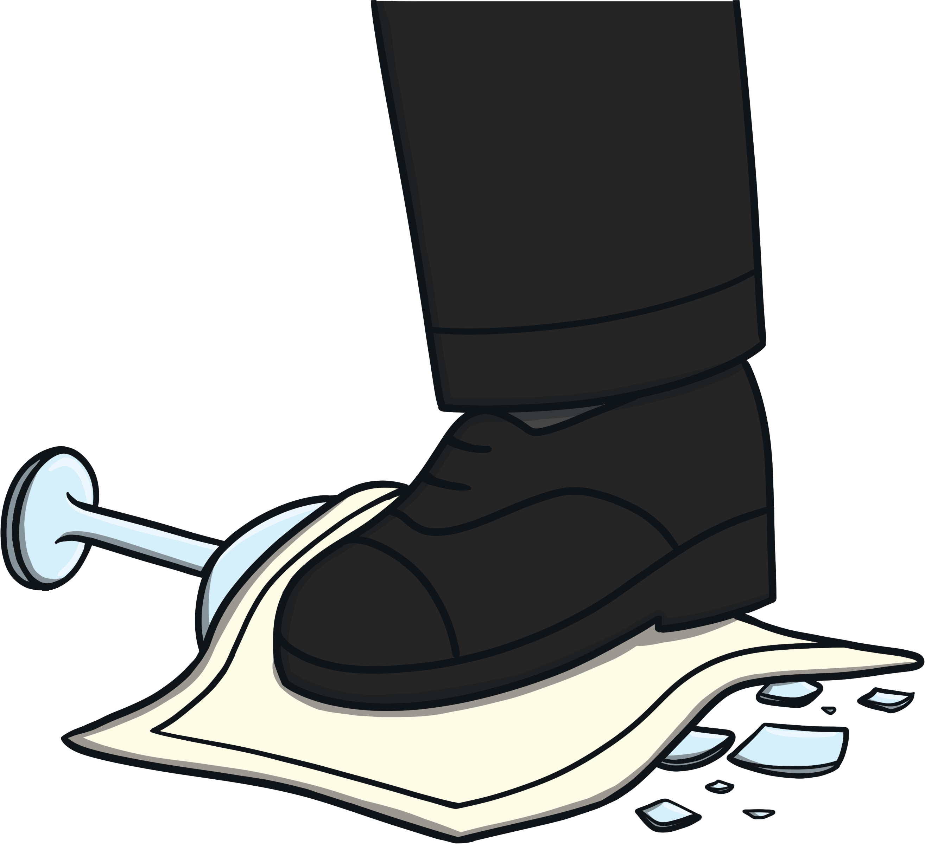
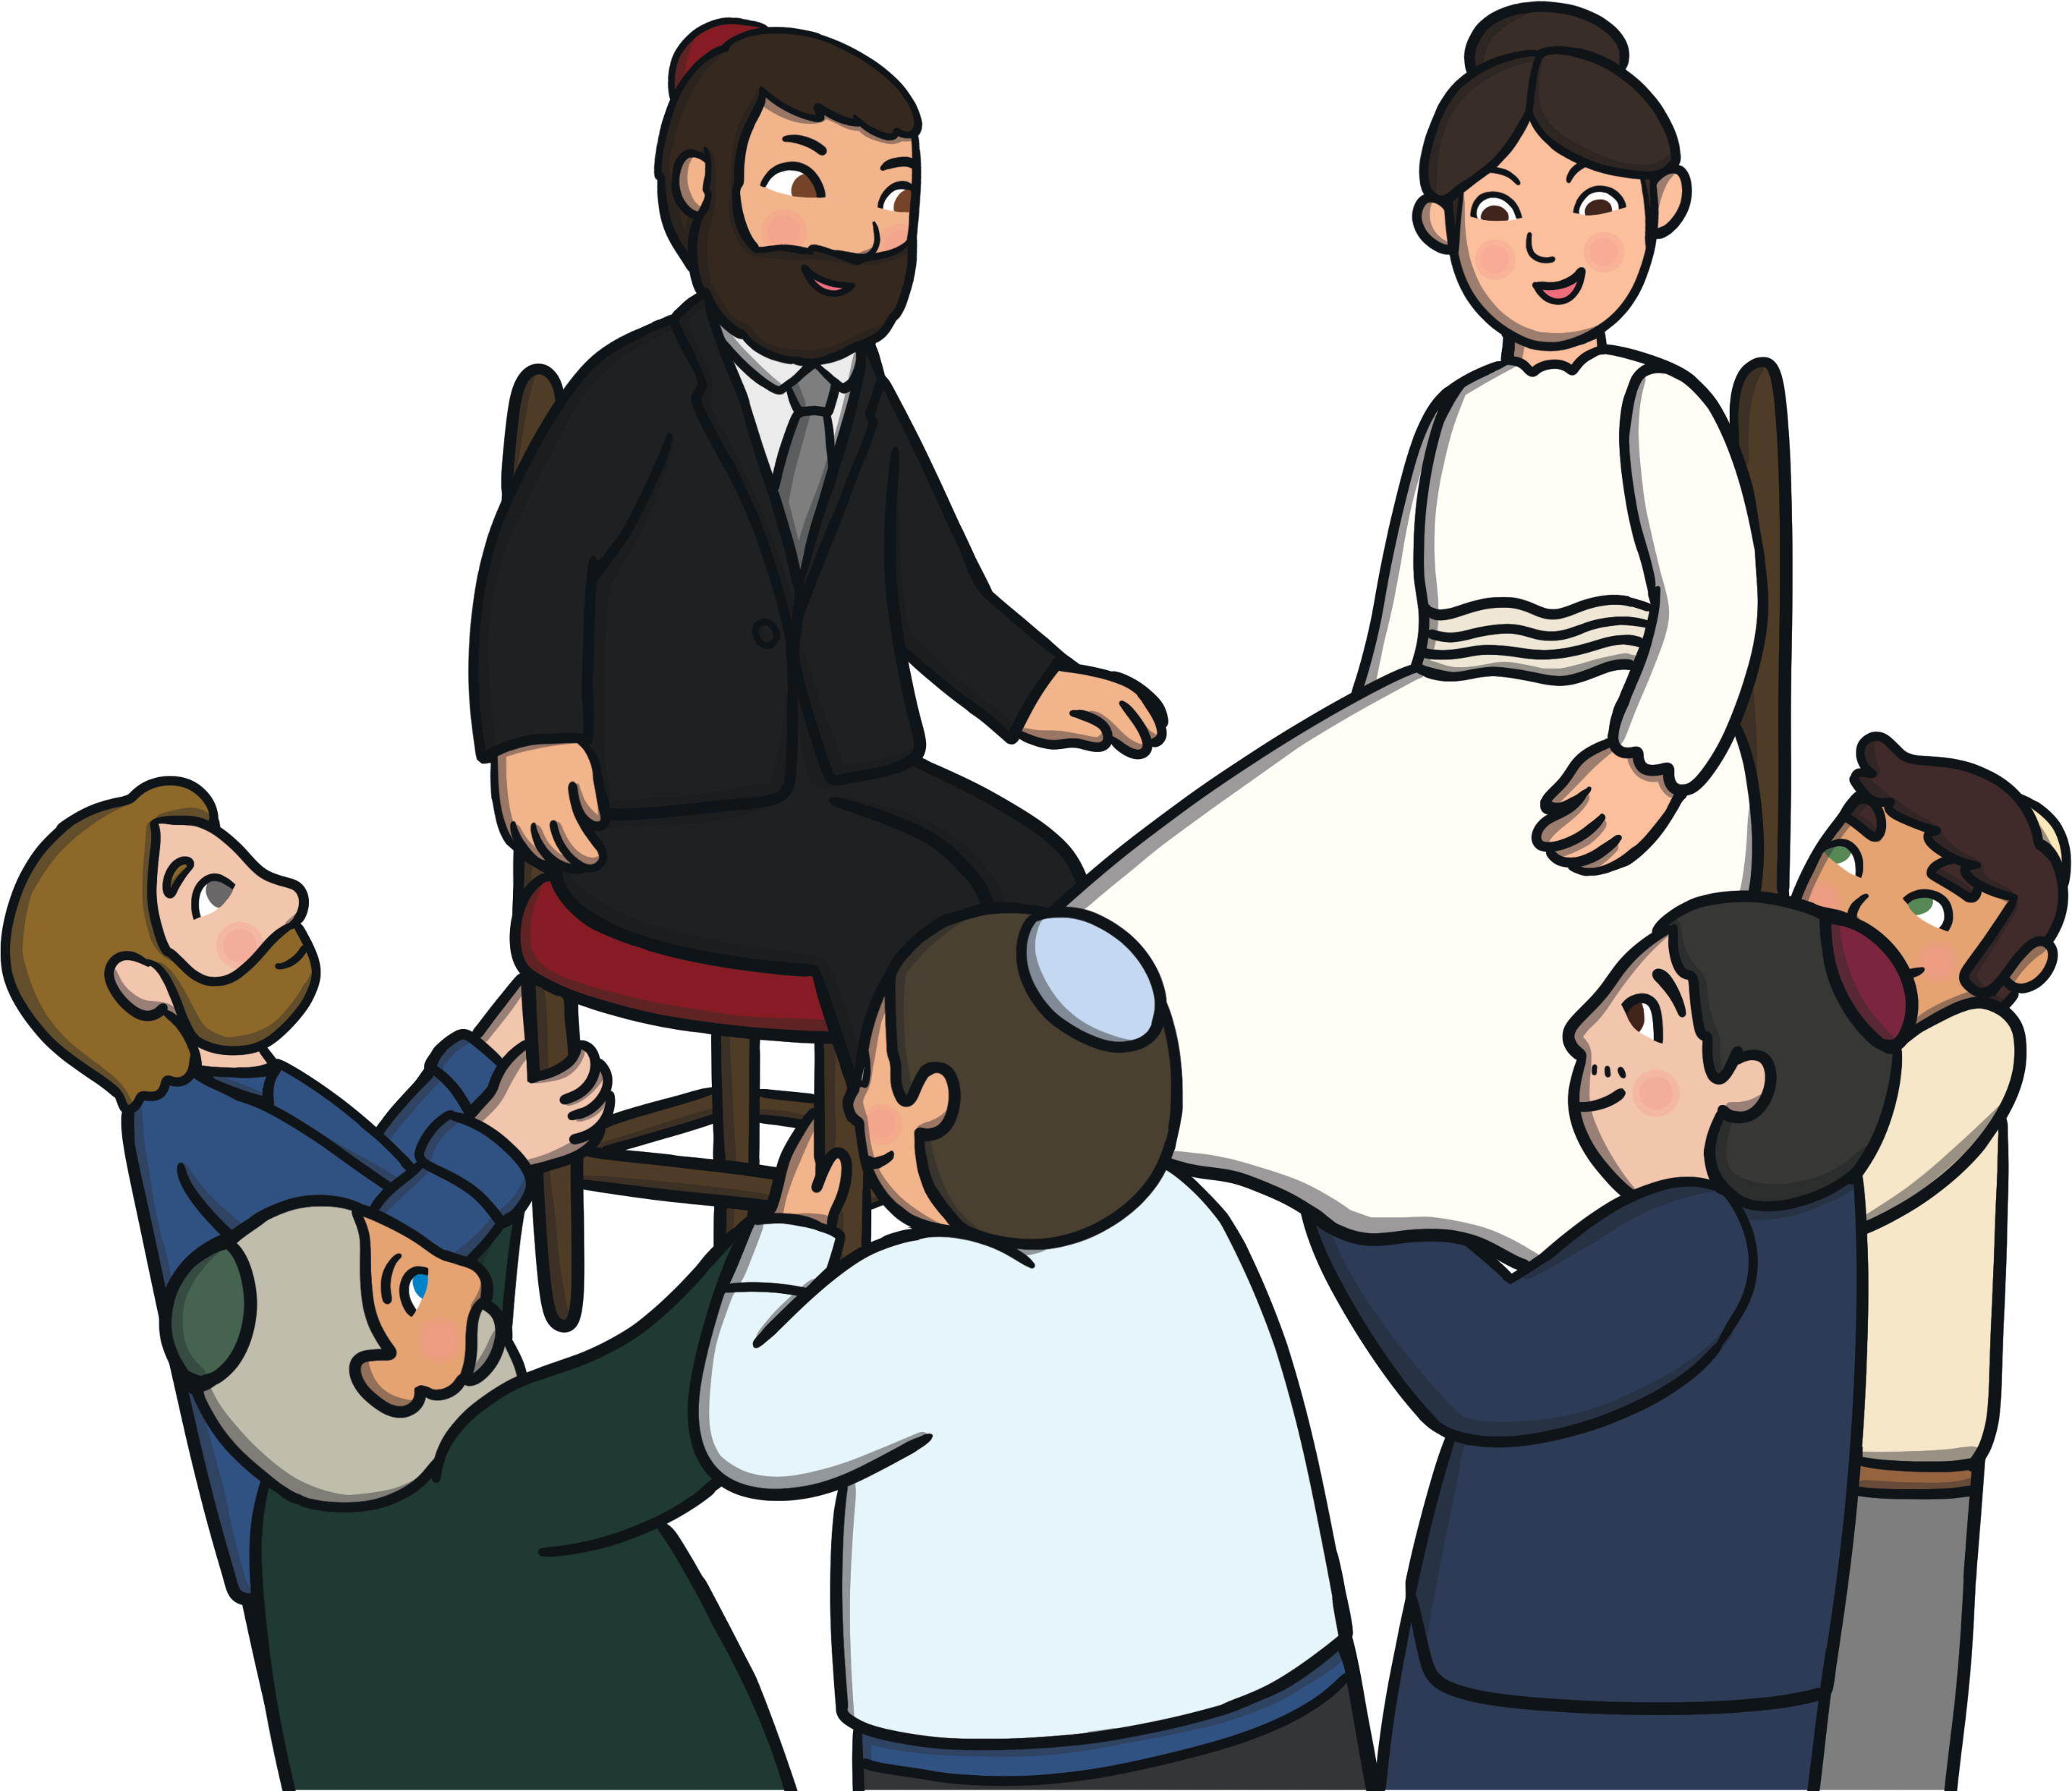
The Wedding Ceremony
At the end of the wedding ceremony, the groom stamps on a wine glass as a sign of the start of the couple’s life together. Guests shout ‘mazel tov’, which means ‘congratulations!’
A lot of dancing takes place. A very fast dance called ‘hora’ starts when the bride and groom go into the party room.
The bride and groom are carried on their chairs as part of the dancing.

Slide 11
After the Wedding
After the wedding ceremony, there is a big meal for all the guests. The groom and some other guests make speeches. Then, a band might play music for everyone to carry on dancing.
At the end of the party, the guests go home. The bride and groom go on a special holiday called a honeymoon.

