Slide 2
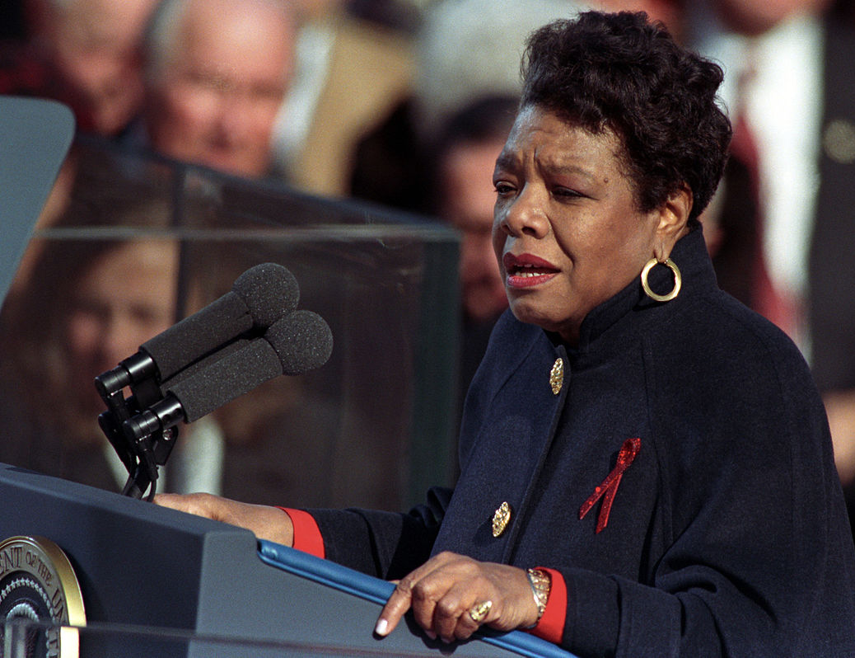
Maya Angelou
Maya was an American writer, civil rights activist, performer and professor. She is best known for writing poetry and books about her life.
This is a photograph of Maya reading one of her poems at President Bill Clinton’s inauguration in 1993. An inauguration is when someone officially becomes US president. The poem is called ‘On the Pulse of Morning’ and aims to inspire unity and responsibility towards others and our planet.
civil rights activist - A person who campaigns for the equal rights of citizens.

Slide 3
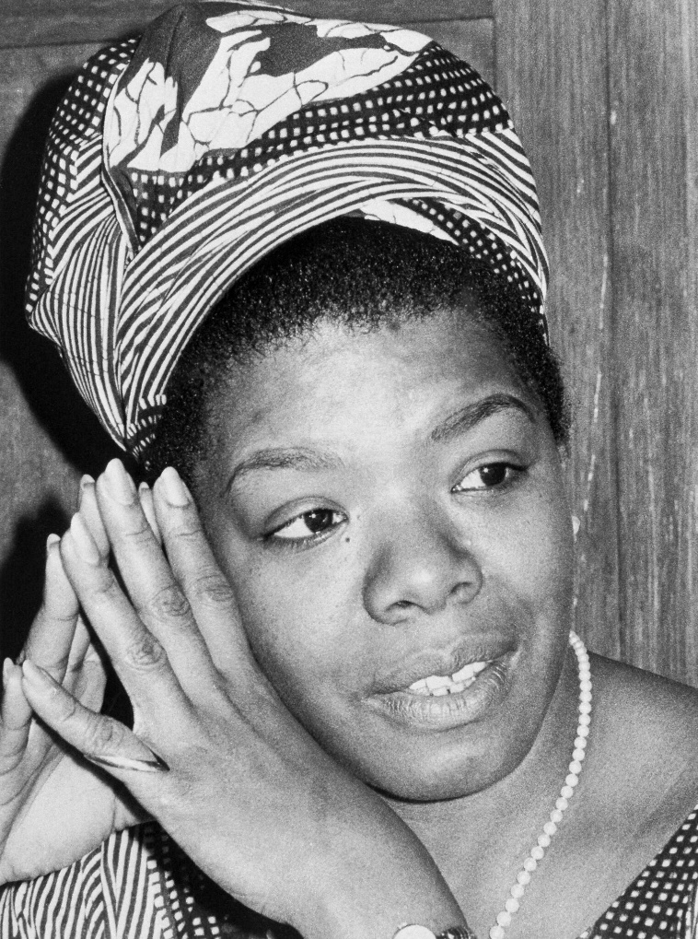
Early Life
Marguerite Annie Johnson was born on 4th April 1928 in Missouri. Her brother gave her the nickname Maya. Her parents separated when she was young. Much of her childhood was spent with her grandmother and brother in another part of America called Arkansas. Here, she encountered racism.
Think About It
Do you have a nickname given to you by a friend, sibling or parent?
During a visit to her mother’s home, Maya was attacked by her mother’s boyfriend. As a result of her experiences, she didn’t speak at all for several years.
racism - Racism is when people are not given respect, their rights, dignity or value because of their race.
“Title of Image Used” by [Author] is licensed under CC BY 2.0

Slide 4
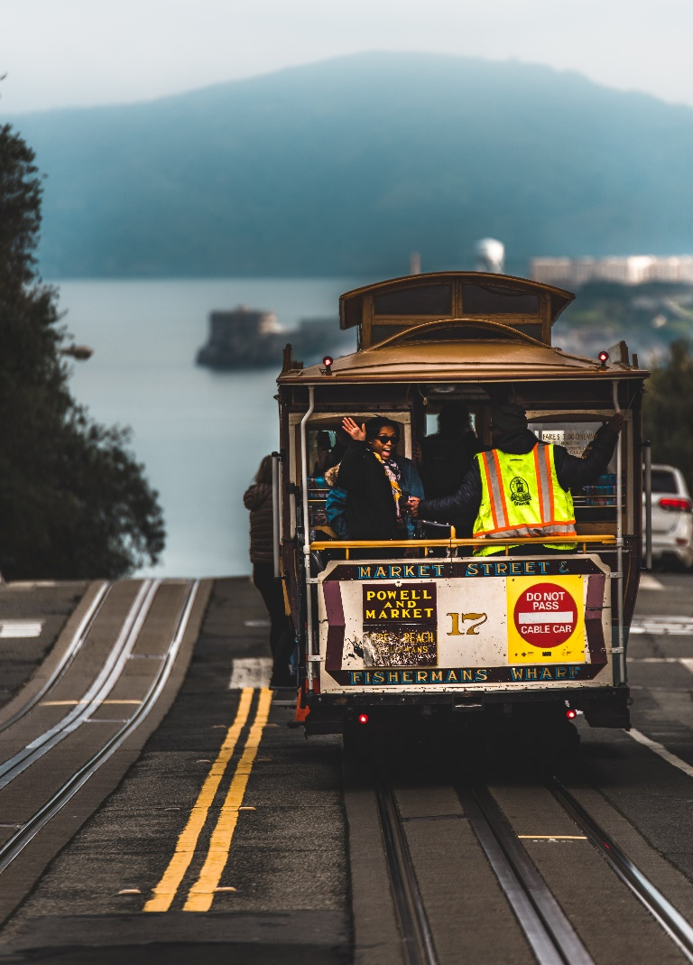
Growing Up
During the Second World War, Maya went to live with her mother in San Francisco. While attending high school, Maya also won a scholarship for dance and drama classes. At 17, she finished high school and gave birth to her son.
In her early career, Maya had many jobs, including being a cook and a dancer. She also became the first Black female cable car conductor in San Francisco.
scholarship - Money awarded to students to reduce the cost of education.
“Title of Image Used” by [Author] is licensed under CC BY 2.0

Slide 5
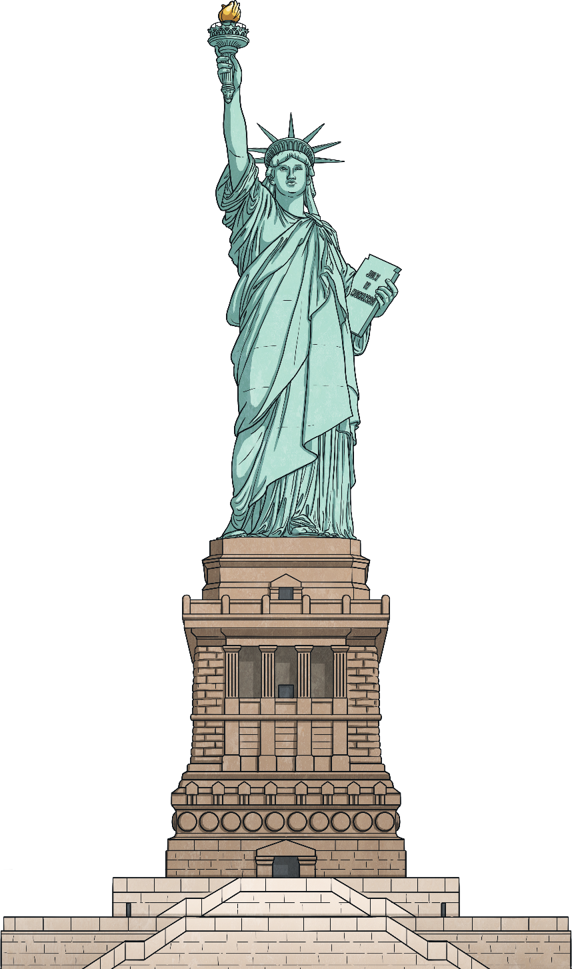
New York
In the early 1950s, Maya married Tosh Angelos before separating a few years later. They spent a year in New York, where Maya took dance classes. She began using the stage name Maya Angelou.
Maya also sang, earning a role in an opera. She went on an international tour with a show, visiting 22 countries in Europe and Africa.
In the late 1950s, Maya released her own music album of calypso songs.
Later, she returned to New York City to concentrate on writing and joined the Harlem Writers Guild.
stage name - Different from the name given to a person at birth and used when performing.
calypso - Folk music from the Caribbean.
“Title of Image Used” by [Author] is licensed under CC BY 2.0

Slide 6
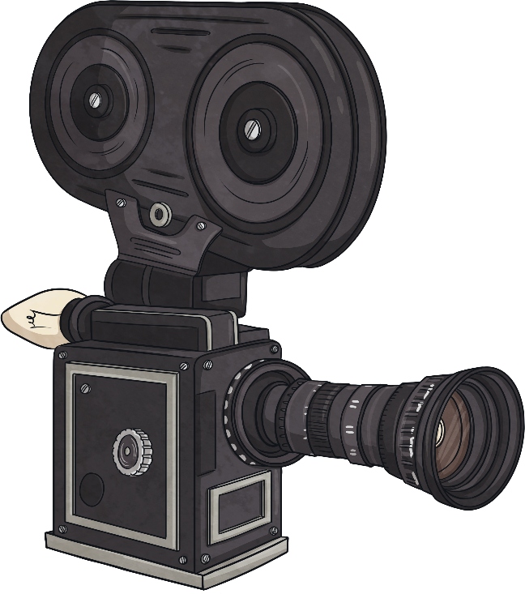
1960s and 1970s
In 1961, Maya performed in a play. In the same year, she moved to Egypt where she became a writer and editor for an English news magazine, called the ‘Arab Observer’. Maya later moved to Ghana.
In 1966, Maya moved back to America and became active in the civil rights movement. She wrote a television series about the role of African culture in American life.
Maya wrote more poetry and a film script. The script was made into a film, making her the first Black woman to achieve this goal. She also acted in films and on TV.
editor - Someone responsible for what is published. They decide which stories go in each edition.
civil rights movement - People campaigning for equal rights for all.
“Title of Image Used” by [Author] is licensed under CC BY 2.0

Slide 7

1980s and 1990s
In 1981, Maya became a professor at a university in North Carolina. She inspired students to become better writers, thinkers and citizens.
During the 1980s and 1990s, she continued to act and also directed a film. Maya also continued to write poetry and began writing children’s books.
directed - Led the making of the film.
“Title of Image Used” by [Author] is licensed under CC BY 2.0

Slide 8
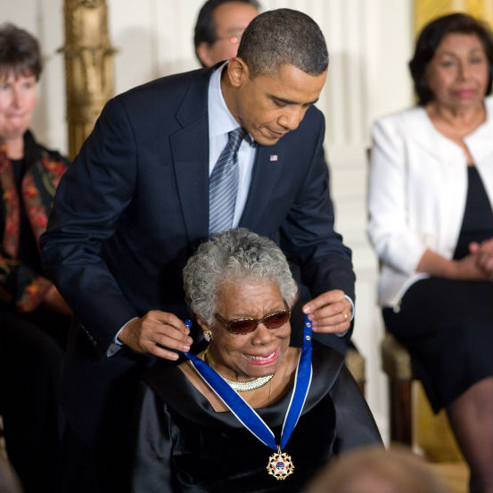
Later Life
In 2008, Maya wrote ‘Letter to My Daughter’. Although she didn’t have a daughter, it was her advice for life. Here are a few quotes:
“The human heart... tells us that we are more alike than we are unalike.”
“Try to be a rainbow in someone's cloud.”
In 2011, President Barack Obama presented Maya with the Presidential Medal of Freedom. This is America’s highest non-military honour.
Maya died on 28th May 2014 in North Carolina. She was 86.
“Title of Image Used” by [Author] is licensed under CC BY 2.0

Slide 9
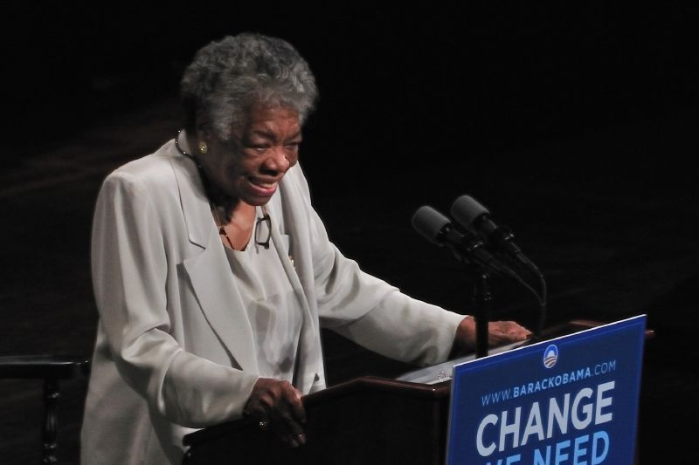
More Famous Quotes
“Make every effort to change things you do not like. If you cannot make a change, change the way you have been thinking.
You might find a new solution.”
“You may encounter many defeats but you must not be defeated. In fact, it may be necessary to encounter the defeats so you can know who you are, what you can rise from, how you can still come out of it.”
Think About It
Which of Maya’s quotes do you like the best? Why?
“The Carolina Theater, Greensboro, North Carolina, September, 2008” by [Talbot Troy] is licensed under CC BY 2.0
“Title of Image Used” by [Author] is licensed under CC BY 2.0

Slide 10
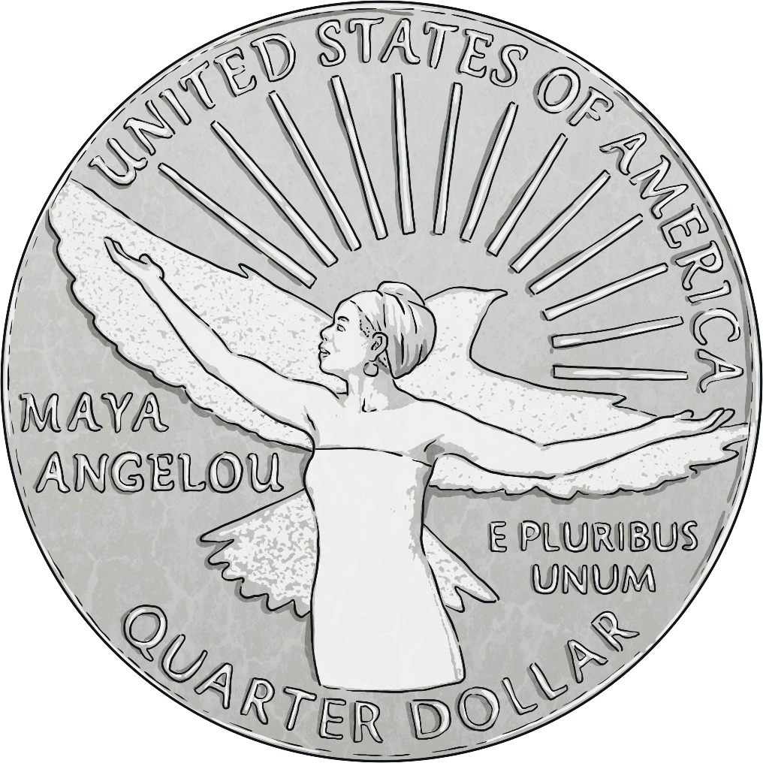
Coins
In 2021, it was announced that Maya would become the first Black woman to appear on a new series of American coins called quarters. The coins celebrate contributions made by women to the development and history of America.
The coin’s image shows Maya lifting her arms. Behind her are a bird in flight and a rising sun, which relate to her poetry.
Think About It
If you could design a new coin, who would you put on it and why?
“Title of Image Used” by [Author] is licensed under CC BY 2.0

Slide 11
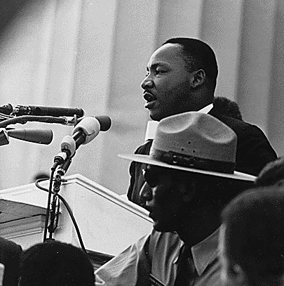
Did You Know…?
Maya was friends with Martin Luther King Jr. He was a famous civil rights activist who was killed on Maya’s birthday in 1968. For this reason, Maya didn’t celebrate her birthday for several years.
“Title of Image Used” by [Author] is licensed under CC BY 2.0

Slide 12

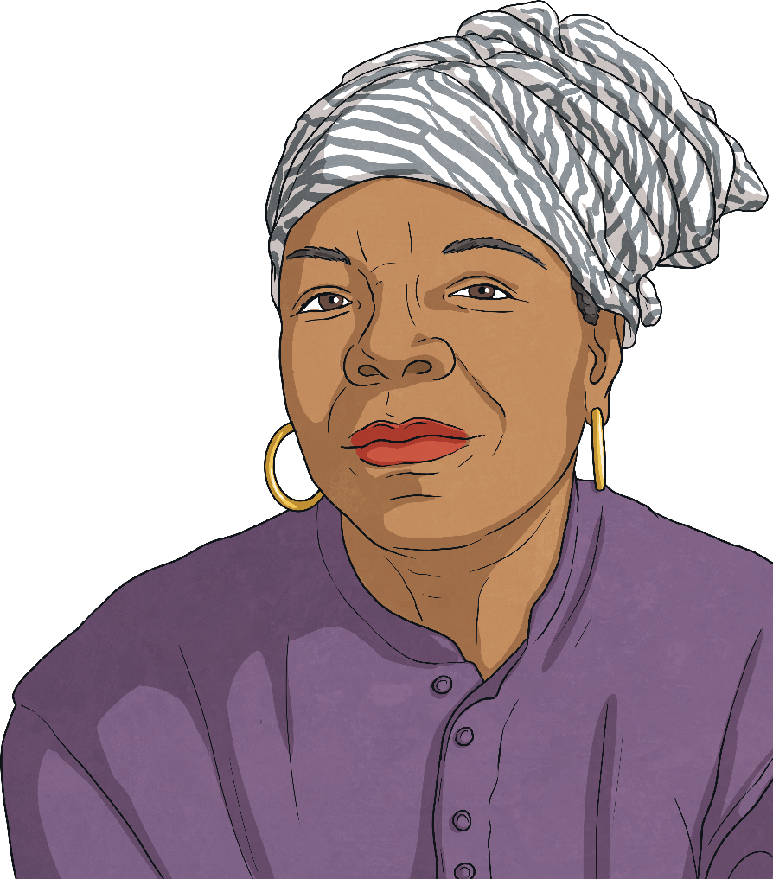
More Fascinating Facts
Maya won three Grammy awards for her spoken word albums. She was also nominated for a Tony Award for her role in a play. Tony Awards are given for acting excellence in live Broadway theatre. Broadway is an area of New York City with a high number of theatres.
Maya wrote seven autobiographies. Perhaps the most famous was her first autobiography, entitled ‘I Know Why the Caged Bird Sings’.
In an interview, she said, “I’ll probably be writing when the Lord says Maya, Maya Angelou, it’s time.”
“Title of Image Used” by [Author] is licensed under CC BY 2.0

Slide 13


Reflection
Tell your partner three facts that you’ve learnt about Maya’s life. Be ready to share your knowledge with the class.
“Title of Image Used” by [Author] is licensed under CC BY 2.0

