Slide 1
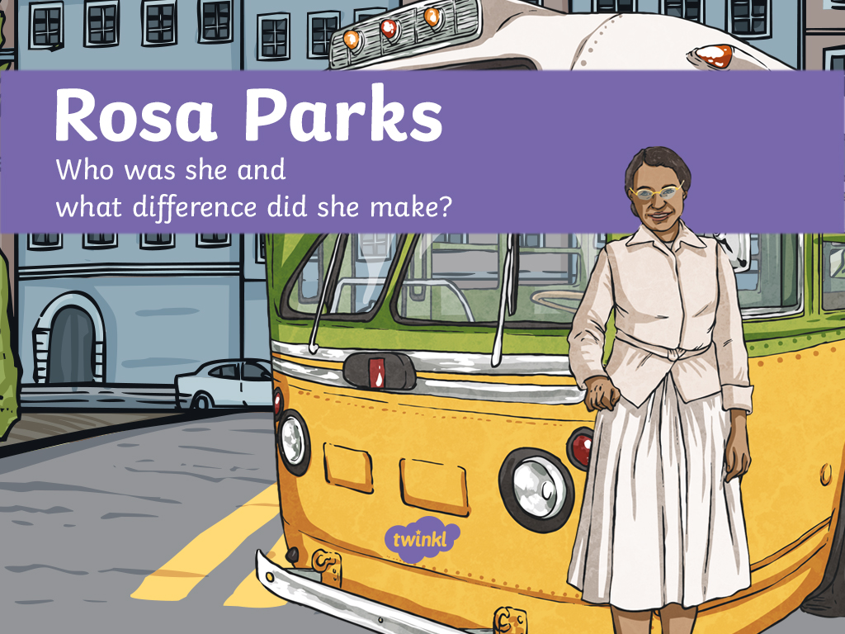

Slide 2
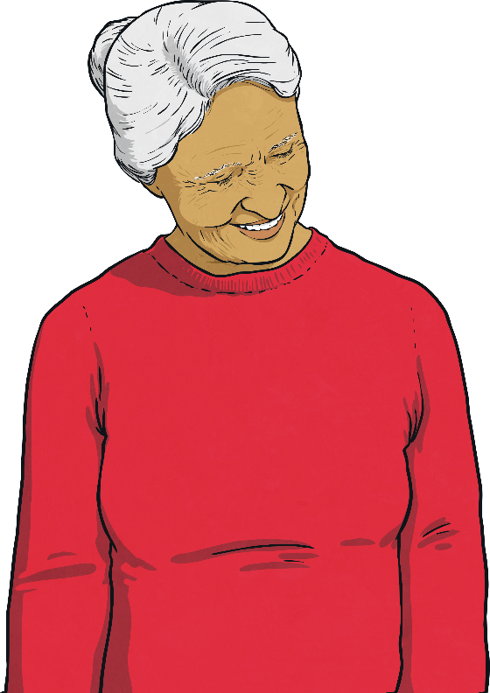
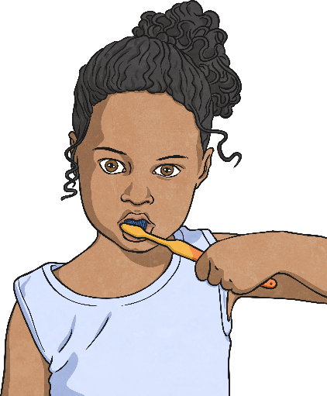
Early Years
Rosa Parks was born Rosa Louise McCauley in Alabama on February 4th 1913. Her mother was a teacher and her father was a carpenter.
Her parents separated when she was a girl. She went to live on her grandparents’ farm with her mother and younger brother where she attended church and school.

Slide 3
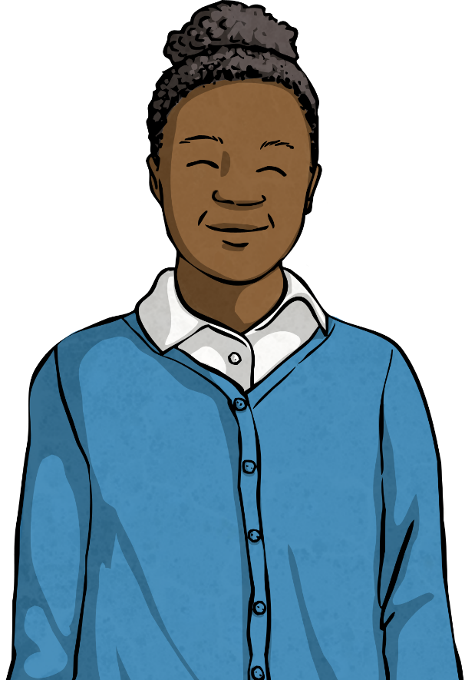
Segregation
As a child, Rosa experienced a lot of racism and saw how black and white people were separated by law.
She attended a secondary school for black children. They all had to walk to school, while the white children attended their own school and were provided with a bus to get there.
At this time in history, many other things in society were also segregated (deliberately separate for black and white people).

Slide 4
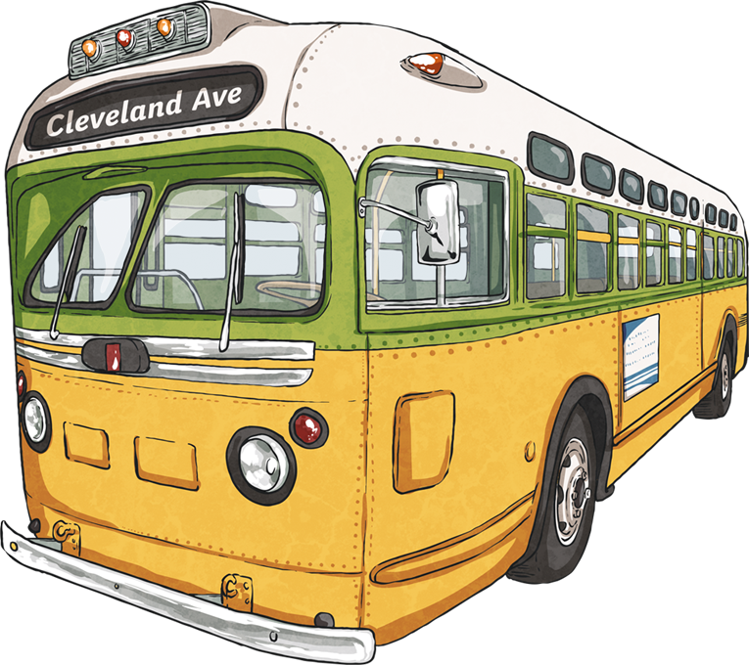
Segregation on Buses
At bus stops at this time, there had to be two lines of people: one for black people and one for white people - and the white people got to sit on a bench.
This was so that when the bus arrived, the white people could take the seats at the front of the bus first. Then, the black people could get on and use any free seats at the back of the bus.

Slide 5
The Event That Made History
On December 1st 1955, after a long day at work, Rosa boarded the bus home and sat in the first row of seats intended for black people.
By the time the bus reached its third stop, all the “white only” seats were full. Rosa and three other black people were sitting in the front row of the black section of the bus.
So, the white bus driver stepped back into the bus to tell the Rosa and the three other black people to move back to give their seats to the white people.

Slide 6
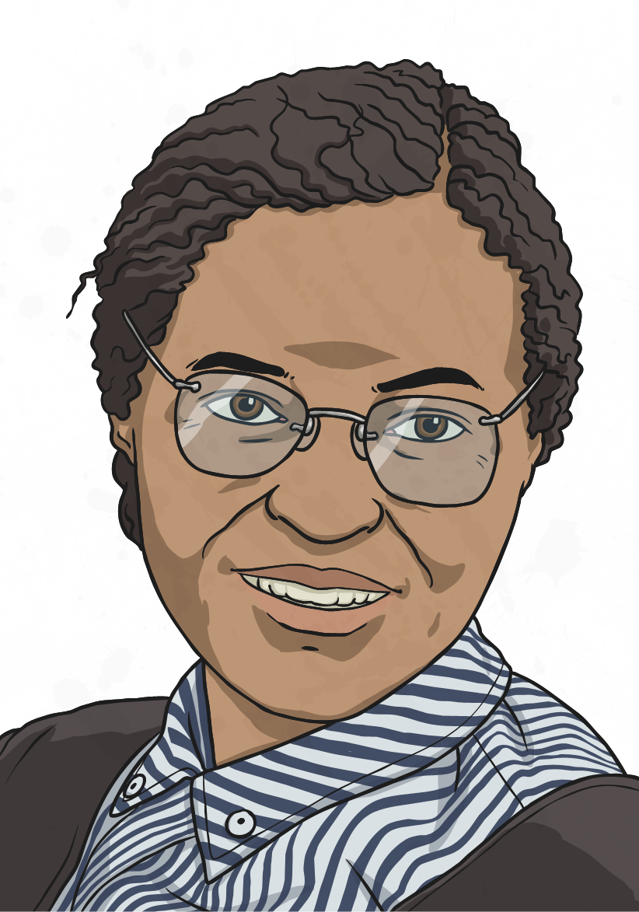
Rosa Refused to Move
After being asked to move by the white bus driver, the other three black people moved further back in the bus to give the white people their seats. However, Rosa moved to the side and not back.
The driver told Rosa that if she did not move back, then he would call the police. She told the driver to do just that - so he did.

Slide 7

Why Didn’t She Move?
Why do you think
she didn’t move?

Slide 8
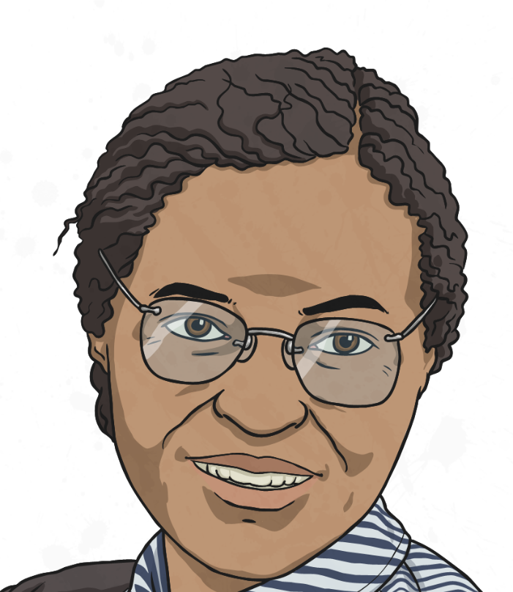
Why Didn’t She Move?
Rosa did not feel she should have to move. She was feeling more and more angry about the unfair segregation that had been happening to black people. Rosa felt that black people in society were being treated differently to white people. In some situations, people were also being injured or killed.
In her autobiography, she wrote:
“People always say that I didn't give up my seat because I was tired, but that isn't true. I was not tired physically, or no more tired than I usually was at the end of a working day. I was not old, although some people have an image of me as being old then. I was forty-two. No, the only tired I was, was tired of giving in.”

Slide 9


What Happened Next?
Indeed, the bus driver did go on to call the police and Rosa was arrested.
Three of Rosa’s friends bailed her out of prison the next day and set to work on organizing a “bus boycott” – where black people would refuse to use any buses until the situation changed.
On December 5th 1955, Rosa was charged with “violating a local ordinance” (breaking the rules) and “disorderly conduct” (causing trouble).
She was found guilty and fined.

Slide 10
The Bus Boycott
The bus boycott was supported by the black community and also some white people, who were growing tired of the unfair treatment of black people in their community.
For 381 days, 40,000 people did not use the buses in Rosa’s home city of Montgomery. They found other ways to get to work or simply walked to show their support to the cause.
There were so many people involved that this could not be ignored.
It was noticed by the newspapers and the rest of America.

Slide 11
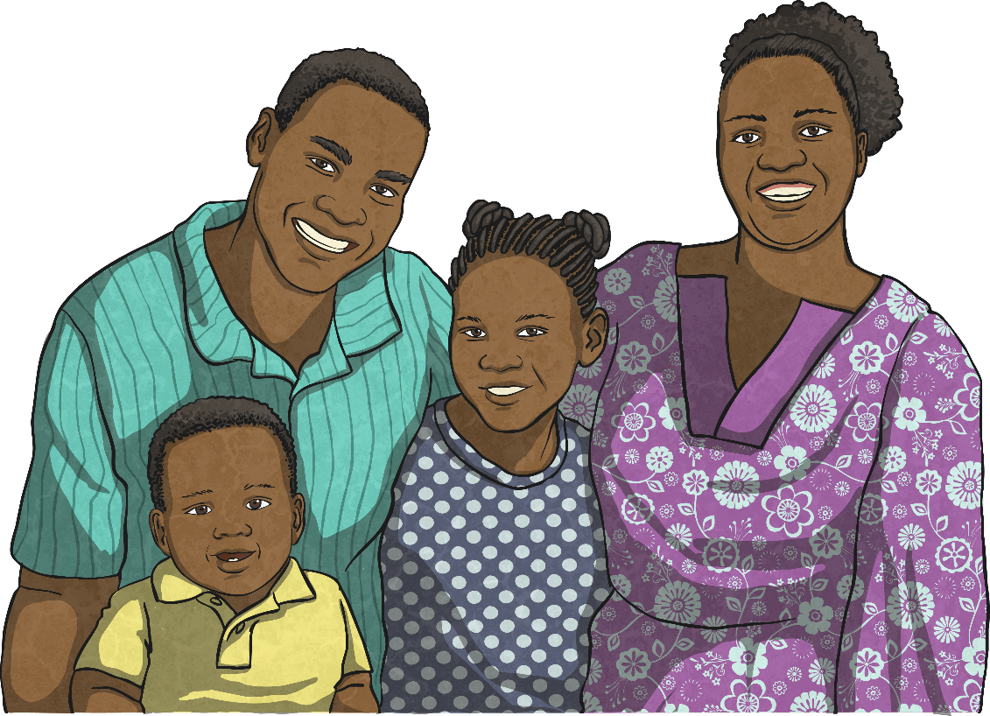
A Victory for Rosa!
Eventually, the government noticed and finally laws were passed to remove segregation from buses. The boycott officially ended on December 20th 1956.
Even though segregation was still in place in many other areas of society, such as restrooms and public buildings, this was a victory for equality. It made a significant start to improving the rights of the black people in society.

Slide 12

The Aftermath
Do you think everybody in society accepted the government’s decision after the bus segregation laws changed?
Why or why not?

Slide 13
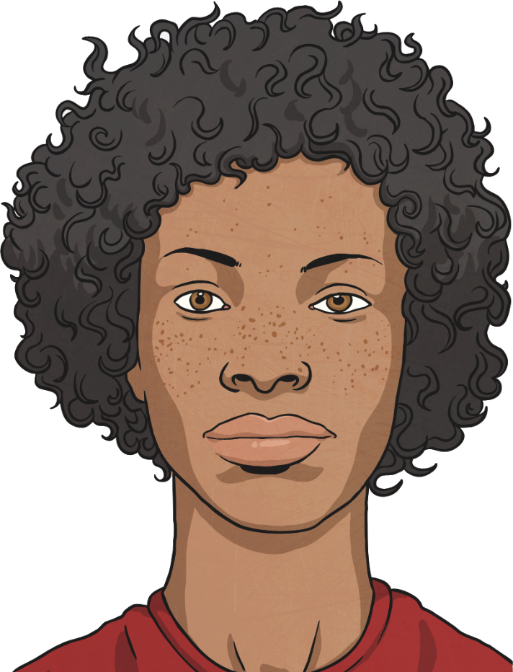
The Aftermath
Not everybody in society accepted the government’s decision after the bus segregation laws changed.
There was still a lot of violence after the laws changed. Some white people bombed black churches and homes.
Eventually things calmed down and the violence abated. However, there was still a long, long way to go to change the attitudes of some people within society.

