Slide 2
Vocabulary to Know:
Segregation: separation; keeping people apart
Boycott: avoiding as a means of protest
Discrimination: unfair treatment because of race, ethnicity, gender, or age
Assassinate: kill for political or religious reasons

Slide 3
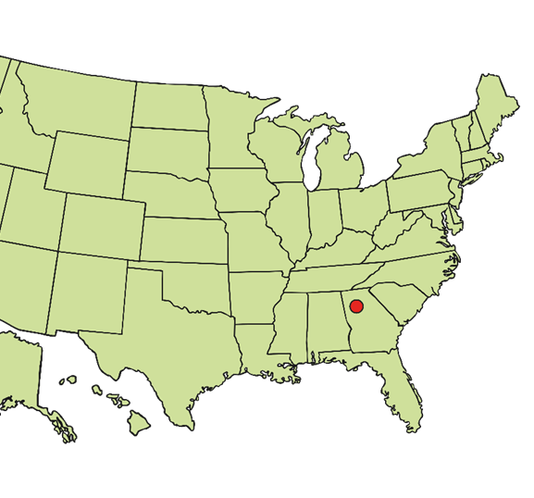
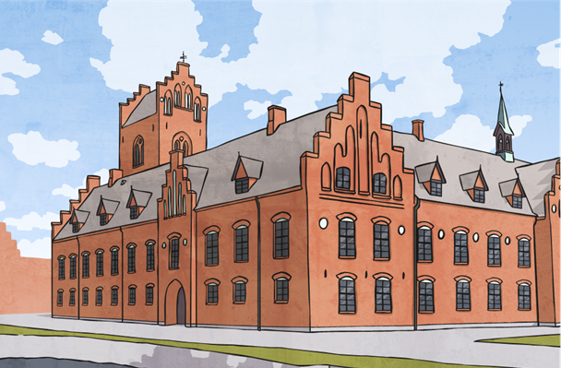
Early Life
Martin Luther King, Jr. was born on January 15, 1929 in Atlanta, GA.
He grew up in Atlanta.
He was so smart that he skipped two grades in school!
He had one brother and one sister.

Slide 4
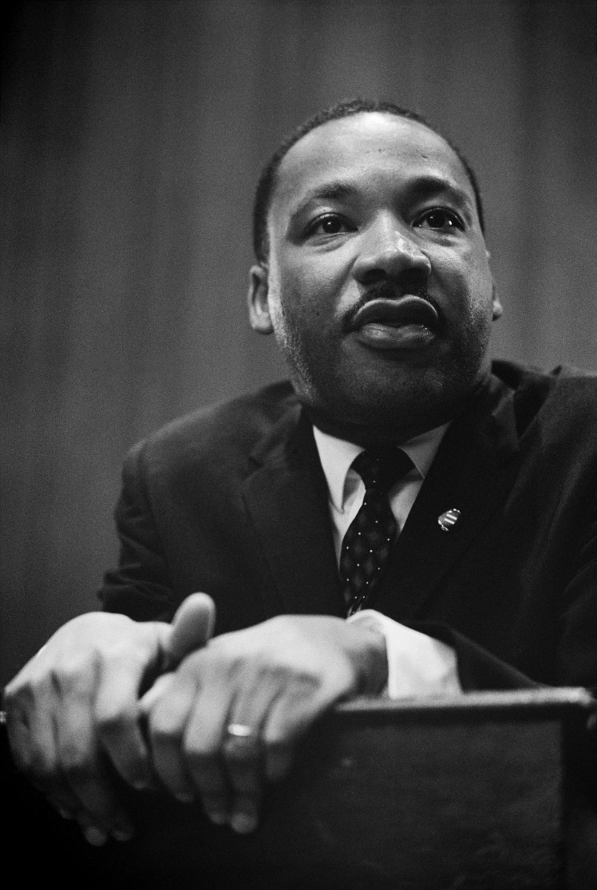
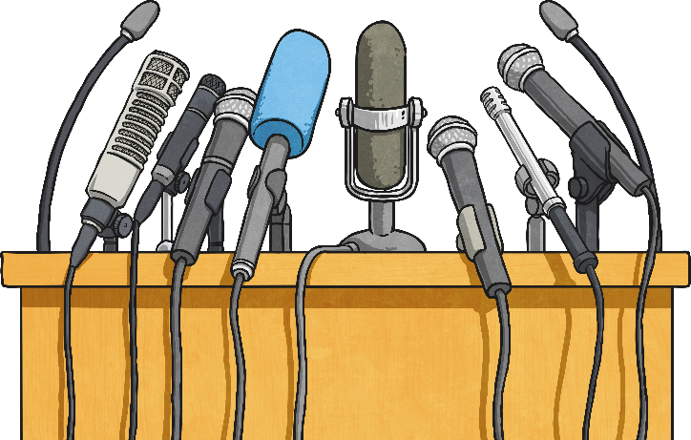
Who Was MLK?
MLK was a civil rights leader.
He led non-violent protests to help achieve equal rights for
African Americans.
He is one of the greatest speakers in American history.

Slide 5
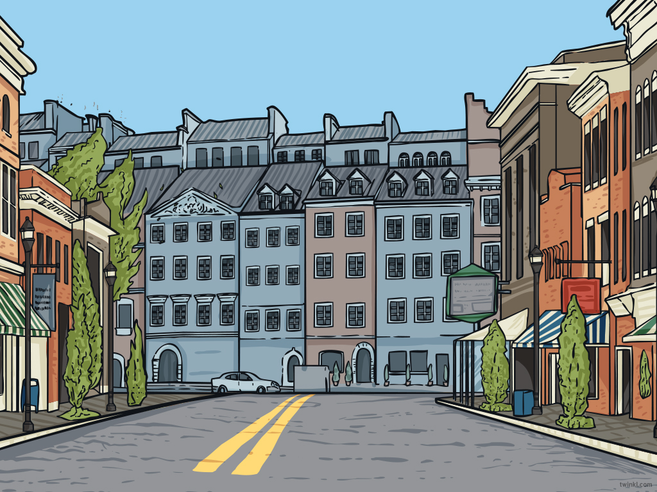
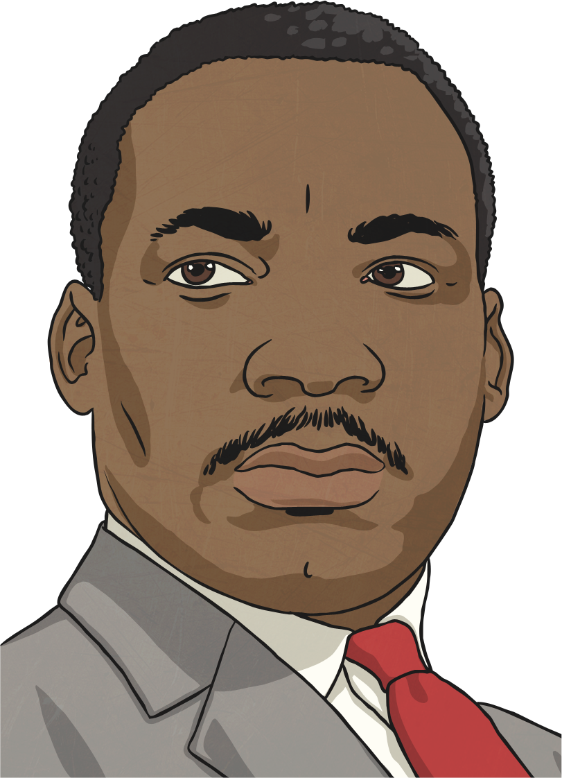
Montgomery Bus Boycotts
Martin Luther King, Jr. led the Montgomery
Bus Boycott.
The boycott began when Rosa Parks refused to give up her seat on a bus to a white man.
King organized a boycott of the public transportation system that lasted over a year.
He faced persecution for his leadership. He was accused of interfering with business and was arrested. His house was also bombed.
Eventually, the boycott was successful, and the segregation of the Montgomery buses ended.

Slide 6
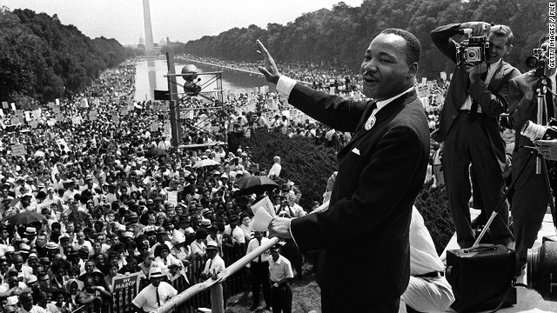
I Have a Dream…
Photo courtesy of sam_Churchill (@flickr.com) - granted under creative commons licence - attribution

Slide 7
I Have a Dream…
Martin Luther King, Jr.'s most famous speech was the
"I Have a Dream" speech.
King helped organize the “March on Washington.”
Over 250,000, people attended the march to show legislators how important it was to write good laws and policies regarding civil rights.
They wanted the government to address issues like segregation in schools, protection from police abuse, and discrimination regarding employment.
It was at the march where Dr. King gave his famous "I Have a Dream" speech.

Slide 8
The Death of Martin Luther King, Jr.
King was assassinated on April 4, 1968 in Memphis, TN.
He was standing on a balcony at his hotel when someone shot him.

Slide 9
Interesting Facts About MLK
In 1964, Martin Luther King, Jr. became the youngest person to win the Nobel
Peace Prize.
A national holiday is celebrated every
year to honor Dr. King.
Mohandas Gandhi was a major influence on MLK. He liked his non-violent way
of protesting.
Dr. King was awarded many awards, including the Congressional Gold Medal and the Presidential Medal of Freedom.

Slide 10
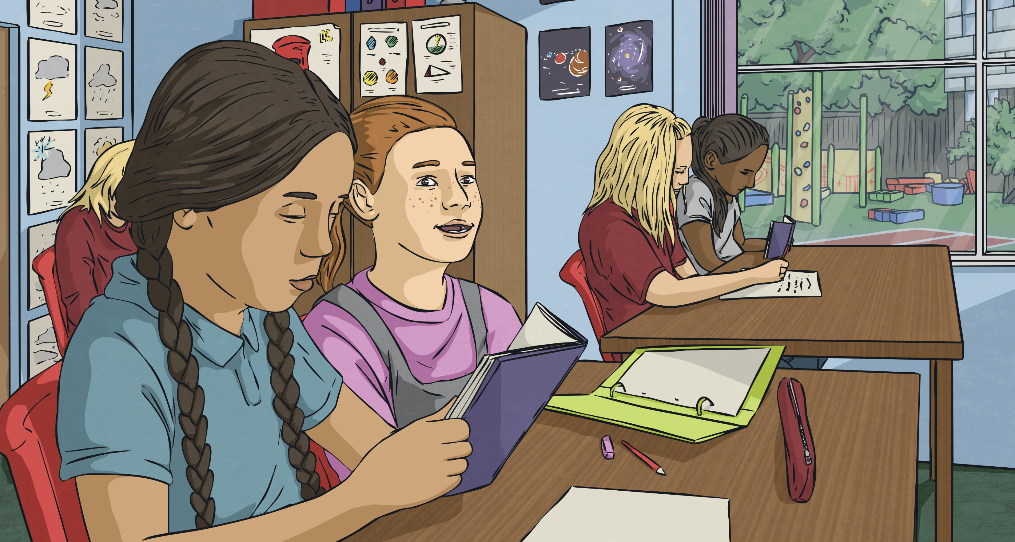
Imagine your class was segregated, meaning some of your classmates could not attend school with you because of the way they look.
How would this make you feel?

Slide 11
Important Questions
Why was it so important for Dr. King and other leaders to stand up for civil rights?
Many people threatened Dr. King. Why do you think he continued to fight for justice, even though he was in danger?
Dr. King had big dreams about making our world a better place. What things would you like to see happen that could make your world a better place?

