Slide 1
Black History Month 2025

Slide 2
Why do you think we celebrate Black History Month?

Slide 4

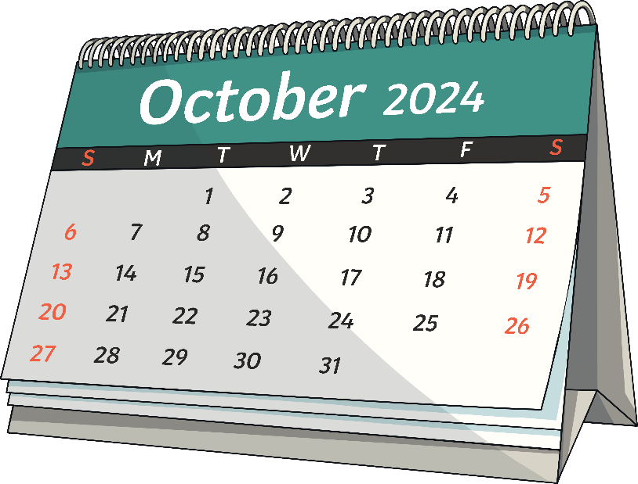
Reclaiming Narratives
Black History Month
Black History Month is celebrated in the United Kingdom every year in October.
Each year, there is a theme.
It is a celebration and recognition of the history, contributions and achievements of Black people all over the world.
Black History Month has been celebrated in the UK since 1987.

Slide 5
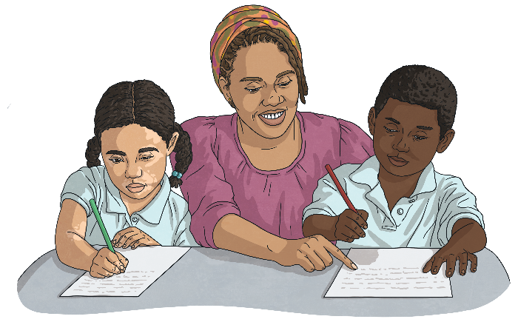

Reclaiming Narratives
Standing Firm in Power and Pride
The theme of this year’s UK Black History Month is ‘Standing Firm in Power and Pride.’
This year’s theme also inspires us to envision a future marked by ongoing empowerment, unity and progress.
‘Standing Firm in Power and Pride’ emphasises the remarkable impact of Black leaders, activists, and pioneers whose contributions have played a vital role in shaping history.

Slide 6

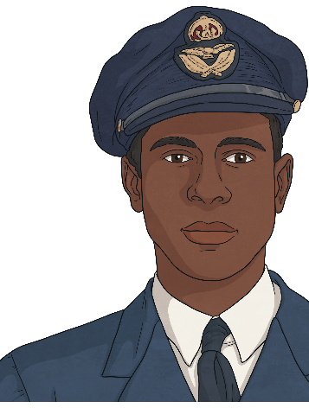
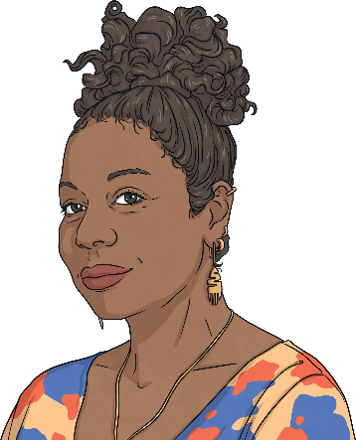
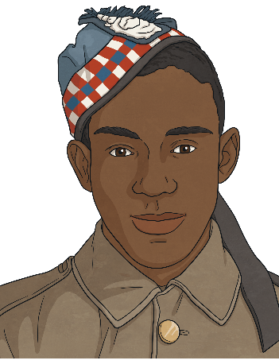
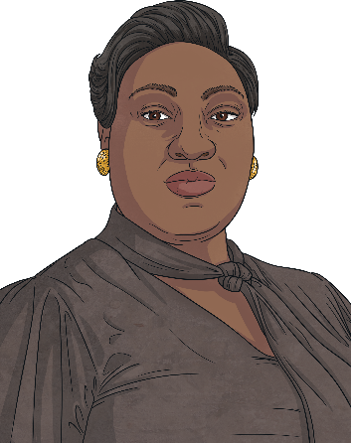
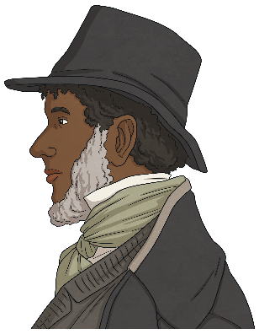
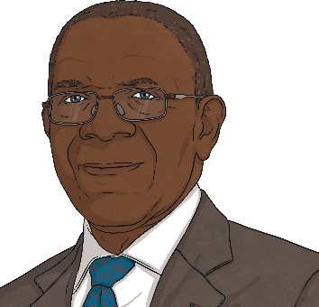
Reclaiming Narratives
What We
Will Learn
In this assembly, we will be learning about our proud heroes of service and about powerful voices of activism.

Slide 7



Reclaiming Narratives
Heroes of Service
Many Black individuals have served in the British armed forces. Discover the stories of Ulric Cross, John Simmonds and Arthur Roberts and the contributions that they made.
Ulric Cross
John Simmonds
Arthur Roberts
Click on the pictures to find out more.

Slide 8

Reclaiming Narratives
Heroes of Service
Ulric Cross was a RAF navigator during the First World War. He took part in over 80 bombing missions over Germany.
Ulric Cross
Back

Slide 9

Reclaiming Narratives
Heroes of Service
John Simmonds was a Jamaican sailor during the Battle of Trafalgar in 1805.
John Simmonds
Back

Slide 10

Reclaiming Narratives
Heroes of Service
Arthur Roberts served in both world wars, first as a soldier and then as a firefighter. He kept a diary of his experiences during the First World War.
Arthur Roberts
Back

Slide 11


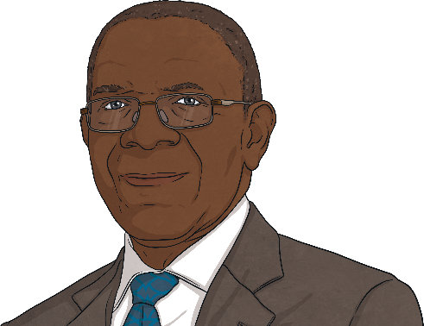
Reclaiming Narratives
Voices of Activism
Explore social justice and find out about some influential Black activists and leaders who have championed social justice and civil rights.
Stella Dadzie
Lady Phyll
Lord Bill Morris
Click on the pictures to find out more.
Do you know what an activist does?
An activist is someone who stands up for what they believe in with the hope of making a change to society.

Slide 12

Reclaiming Narratives
Voices of Activism
Stella Dadzie is an activist, author and co-founder of the Organisation of Women of Asian and African Descent (OWAAD).
Stella Dadzie
Back

Slide 13

Reclaiming Narratives
Voices of Activism
Lady Phyll (also known as Phyllis Akua Opoku-Gyimah) is an activist and co-founder of UK Black Pride.
Lady Phyll
Back

Slide 14

Reclaiming Narratives
Voices of Activism
Lord Bill Morris was a pioneering secretary of the Transport and General Workers’ Union who advocated for inclusivity in his role in the House of Lords.
Lord Bill Morris
Back

Slide 15
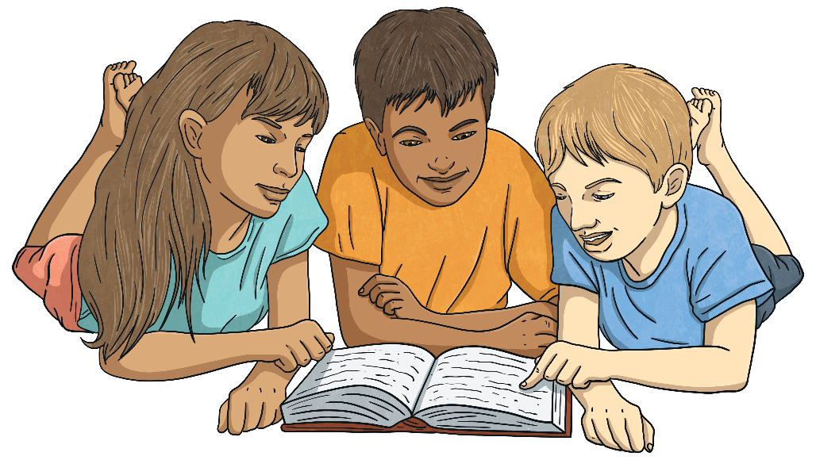
Reclaiming Narratives
Time to Think
The theme of this year’s UK Black History Month is ‘Standing Firm in Power and Pride’.
What can we learn from Black individuals who have stood firm in the face of unfairness or challenge?

Slide 16


