Slide 1

Bishopton Primary
Welcome

Slide 2
Vision
Building and Promoting Success

Slide 3
Values
Fairness – everybody getting what they need in order to be successful
Inclusion – opportunity for all
Honesty – be truthful to yourself and others
Challenge – high expectation for all
Global Citizenship – creating a sustainable future

Slide 4
Values
We aim to demonstrate these values as we:-
Enable everyone to achieve by providing high quality teaching and learning experiences that take account of individual need
Promote a safe, welcoming, nurturing ethos of equality, fairness, respect, equity and excellence that represents and values all members of the school community
Provide leadership opportunities at all levels that allows everyone to develop skills for learning, life and work
Provide a stimulating curriculum that is consistent with Local and National guidelines; is broad, balanced, coherent, challenging and progressive

Slide 5
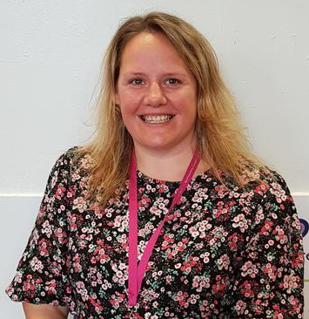
Staff
Mrs McNaught Head Teacher
Mrs Davidson
Depute Head Teacher P4-P7
Ms McLaren
Depute Head Teacher P1-3
Miss McDowall
Principal Teacher
Mr McAvoy
Principal Teacher

Slide 6
Staff
Miss Cuthill P1C
Miss Murray P1M
Miss Wilson P1W
Mrs O’Neill P1S
Mrs McAvoy P1P

Slide 7
Joining our Bishopton School Community
People who help us...
Janitorial Staff: Mr Purdue & Mr Russell
Clerical Staff: Mrs McKechnie, Mrs Provan & Mrs Jack
Home Link: Paul Harrison
Educational Psychologist: Wendy O’Neill
Catering Manager: Pauline Ferguson
Bishopton Library: Margaret Winters

Slide 8
Primary One Transition
When your child starts Primary 1 they will already have had two years of education. We have spent time discussing your child's progress and next steps so that P1 is not a fresh start, but a continuation of their learning journey; building on what they have already been doing in nursery. We will also carry out our own observations and assessments over the course of the year.
At Bishopton Primary, we ensure that all pupils experience a coherent curriculum through the delivery of high- quality learning and teaching.

Slide 9
The Learning Journey
Broad General Education provides your child with a wide range of knowledge, skills and exciting experiences that they can draw on as their lives, careers and job opportunities continue to change.
Curricular Areas in the broad general education are planned around a nationally agreed programme of experiences and outcomes (often called Es and Os). These describe the knowledge, skills, attributes and capabilities that young people are expected to develop.
Learning in the broad general education may often span a number of curriculum areas (for example a literacy project planned around science and technology might include outdoor learning experiences, research and the use of ICT). There is likely to be themed and project learning, as well as wider opportunities to show how skills and knowledge can be used in challenging, different and interesting ways. The term often used for this is interdisciplinary learning.

Slide 10
Play Pedagogy
For most children, learning in Primary 1 will feel very familiar as Play Pedagogy and Outdoor Learning are parts of daily life for our infant pupils just as it is in Nursery.
Children will not sit at a desk all day but move around the flexible learning space within our P1 environment. There will be some timetabling of curricular areas to ensure that all pupils have a wide a range of planned learning experiences in a wide range of environments both indoors and outdoors.
Play is important for the early stages of brain development and playing with your child can help build relationships for later life. But no matter what age we are, play helps to develop important skills for learning, life and work. Encouraging play is one of the best things you can do for your child, whatever their age, and it's free!
COVID 19 – Movement between classes and environments may be restricted due current guidelines.

Slide 11
School Lunch
All children in Scotland from P1 to P3 are entitled to a free school meal.
Children select their lunch option electronically every morning.
They will be vegetarian and allergy specific options if required.
The lunch menu can be viewed online, enabling parents to help their child choose their meal in advance.
Children are also welcome to bring a packed lunch if that is their preference.
COVID 19 – Due to current guidelines only a ‘Grab and Go’ or packed lunch option will be in place. This will be a choice or cold sandwich, a drink, a piece of fruit and a packet of crisps.

Slide 12

Parents
PARENT COUNCIL - We have a very supportive parent council within our school who are dedicated to supporting us to create a wonderful learning environment for the children and staff. They communicate regularly with parents.
PARENT ZONE – Here is a link to Education Scotland’s Parent Zone. https://education.gov.scot/parentzone

Slide 13
The School Day
School starts at 9.00 am
Playtime 10.30-10.45am,
Lunchtime 12.15-1.15pm
School finishes at 3.15pm(your child will leave via their base door in the infant playground)
COVID 19 – Please see your letter for additional information as this will be different at the start of term.

Slide 14
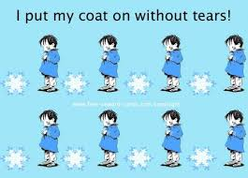
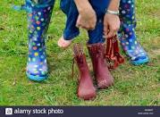
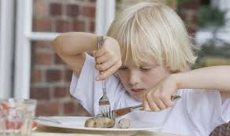
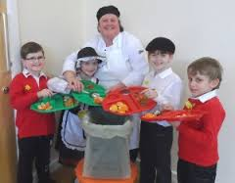

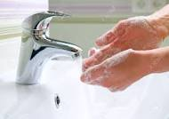
Be Prepared for P1
Talk to your child positively about school
Discuss the school day – what to expect
Encourage independence – changing clothes, shoes and jackets
Practise turn taking, sharing, focussing on a game or task
Recognise their own name on labels
Put name tags on all clothing and shoes

Slide 15
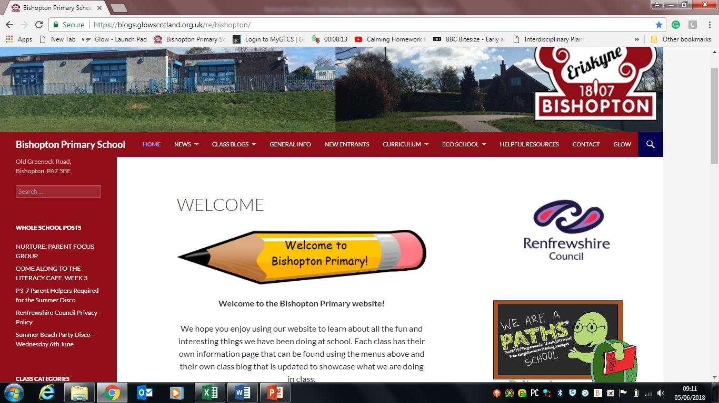
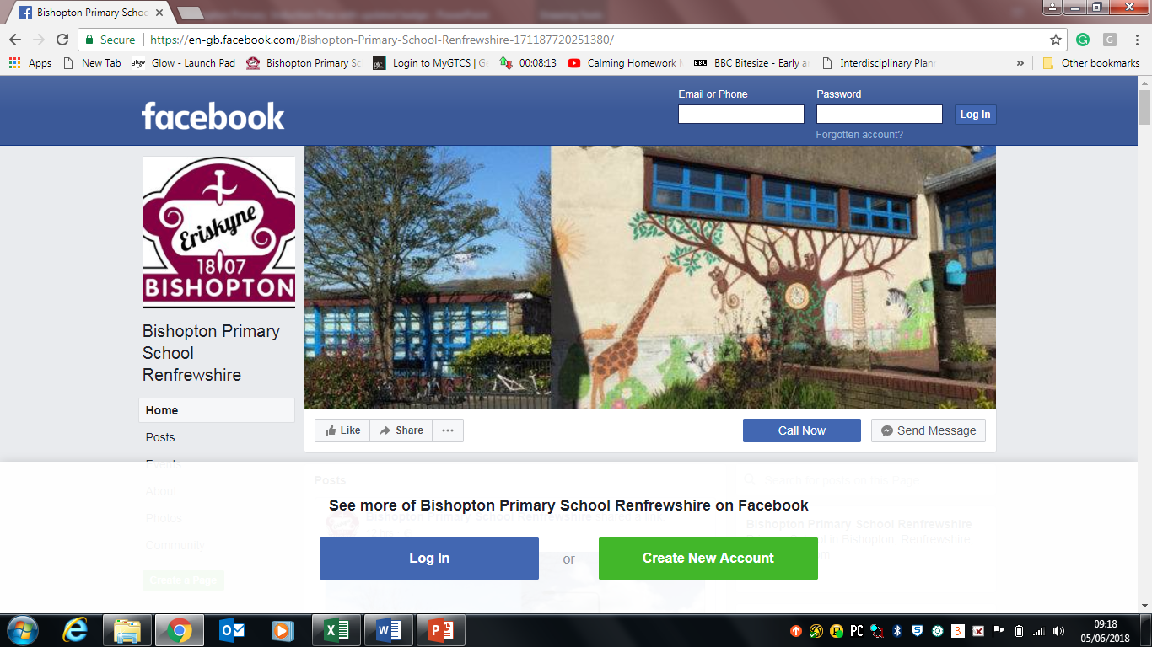
Communication
School website Blog, Twitter and Facebook

Slide 16


Support
Free school meals and clothing grants
http://www.renfrewshire.gov.uk/article/3338/Free-school-meals-and-clothing-grants
Home to school transport
http://www.renfrewshire.gov.uk/article/3486/Home-to-school-transport

Slide 17

Online stories:
Being Kind – https://www.youtube.com/watch?v=kAo4-2UzgPo
Selfish Crocodile- https://www.youtube.com/watch?v=0-NhjfJ_RZI
The Hare and the Tortoise - https://www.youtube.com/watch?v=01WM87zeIzY
The Little Red Hen - https://www.youtube.com/watch?v=2E72TZy0LNo
The Lion and the Mouse -https://www.youtube.com/watch?v=0F2dNzIf4jo
It’s My Turn https://www.youtube.com/watch?v=xJBk9mJwkeI
No Matter What- https://www.youtube.com/watch?v=tD6e3rxL9Is
Online resources:
Managing feelings- https://www.bbc.co.uk/bitesize/articles/zmmgrj6
Questions when drawing - https://minds-in-bloom.com/8-questions-to-ask-children-about-their/
Tips with drawing - https://www.booktrust.org.uk/news-and-features/features/2017/july/tips-for-talking-about-drawing-with-children/
Starting school- https://www.bbc.co.uk/teach/starting-primary-school/zvbthbk
Big hopes big future - https://www.home-start.org.uk/Pages/Category/big-hopes-big-future
Starting school- https://www.parentingacrossscotland.org/news-events/posts/how-well-do-we-prepare-young-children-for-the-move-to-primary-school/
Go explore app- mindfulness- https://www.bbc.co.uk/mediacentre/latestnews/2020/cbeebies-mindulness-app

Slide 18

BE AT THE HEART OF YOUR CHILD’S LEARNING

Slide 19


