Slide 2
Wraparound Spelling
Tuesday 18th February 2020
Wraparound Spelling
How we teach our spehling
speling
spelling

Slide 3
Aims
Share the spelling results from August 2019 to January 2020
The theory and practice of Wraparound Spelling
How we deliver the programme
The benefits of the new programme
Pupil Voice – What do the pupils think?
What do we do now?
What you can do to help your child
Any questions and feedback

Slide 4
P3-7 Spelling Age Median Comparison
14
0:00
12
+1:01
10
+0:06
+1:00
8
+1:02
6
+ 12 years
+ 12 years
9 years 7 months
10 years 7 months
9 years 1 month
9 years 6 month
4
8 years 6 months
7 years 6 months
7 years 5 months
6 years 3 months
2
0
P3
P4
P5
P6
P7
August
January

Slide 5
P7 Spelling Age Comparison
60
50
40
30
20
46
53
10
15
11
10
7
0
Same as actual age or above
1-11 months below actual age
12 months or more below actual age
August
January

Slide 6
The Theory and Practice of Wraparound
While we use our eyes to read, the starting point for spelling is sound. What a child must do to become a reader (and speller) is to figure out how the words s/he hears and knows how to say, connect to letters on the page. Writing is a code humans invented to represent speech sounds. Children have to crack that code to become readers and spellers.
Children should not see a word before trying to spell it. They will hear it, split it into how many sounds there are and attempt to spell it by stretching it.
e.g. catch = c-a-t-ch (4 sounds)
begging = b-e-gg-i-ng (5 sounds)
Notes:
It is common for children to find spelling more challenging that reading.
Reading – you can see the word and decode it. In doing so, children can visually break down the word and have that support of seeing the letters and sounds.
Spelling – children have to encode the word. In doing so, they have to build the word up, without seeing it.

Slide 7
Can you tell me different ways to make the sound ‘s’?
The SOUND ‘s’ can be made in a number of ways:
•s = sun
•ss = glass
•Soft c:
ci = circle
ce = palace
cy = cycle
•sc = scissors
•st = castle
•se = house
Is it any wonder that spelling is hard?

Slide 8
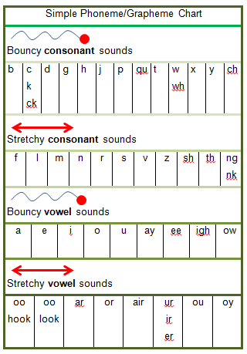
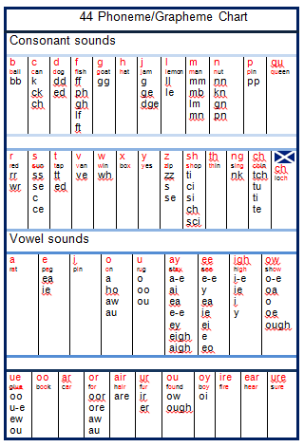
Notes:
All classes will have a ‘sound chart’ to enable them to encode words and build them up using the sounds. All pupils should will been introduced to the sounds appropriate to their stage and are assessed to make sure they know these sounds. The sounds and their alternatives are covered and recovered as they move through primary school.

Slide 9
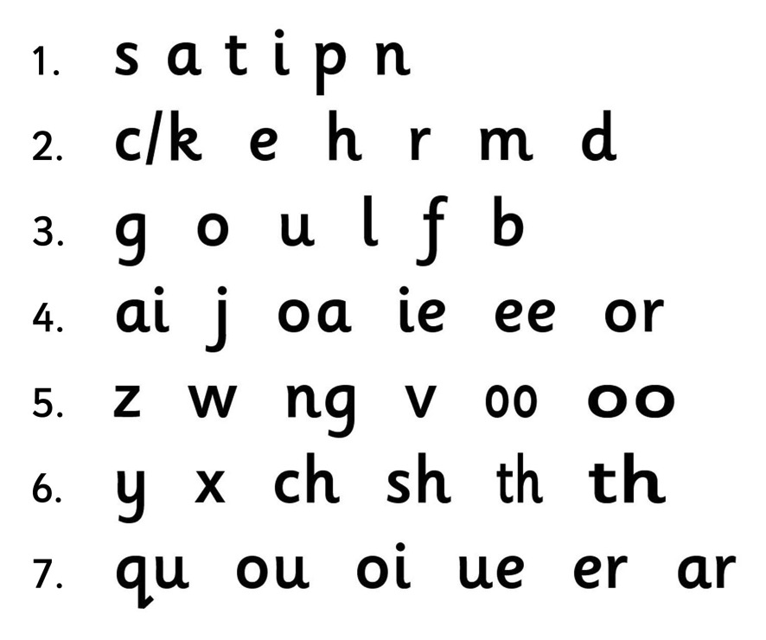
Letter Sounds
Notes:
All classes will have a ‘sound chart’ to enable them to encode words and build them up using the sounds. All pupils should will been introduced to the sounds appropriate to their stage and are assessed to make sure they know these sounds. The sounds and their alternatives are covered and recovered as they move through primary school.

Slide 10
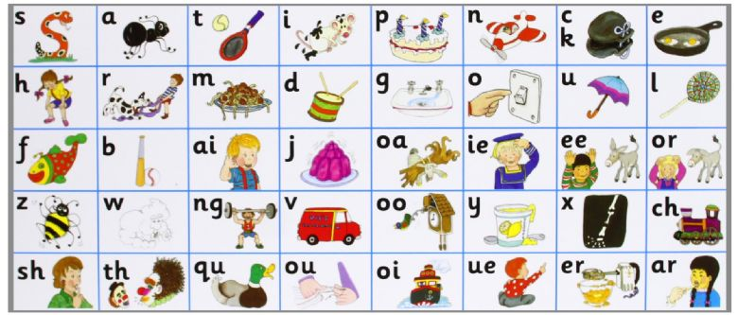
Letter Sounds
Notes:
All classes will have a ‘sound chart’ to enable them to encode words and build them up using the sounds. All pupils should will been introduced to the sounds appropriate to their stage and are assessed to make sure they know these sounds. The sounds and their alternatives are covered and recovered as they move through primary school.

Slide 11
Crown Time
Dialect and accent have a great place in life.
In spelling they can cause problems.
In spelling, if we don’t pronounce words accurately, then it can be difficult to sound out how a word is constructed.
So……
In crown time we speak the Queen’s English.
We must repeat and model good pronunciation when we hear words spoken incorrectly.

Slide 12
Technical Terms
Phoneme | The sounds used in speech.
Grapheme | How the sounds of words are represented in writing.
Digraph | Two sounds which together make one sound. These cannot be ‘sounded out’ individually. ch ai n s aw
Trigraph | Three sounds which together make one sound. b r igh t
Split digraph | Sounds which are split by another letter but together make one sound. Below, the A sound is made by the a and e, but split by the p. Sometimes called ‘magic e’ sh a p e

Slide 13
Introducing Our Special Friends
Many of our words have special friends!
Close friends – chicken, lightning (digraphs and trigraphs)
Distant friends – tape, grape (split digraphs)
Some have both - chocolate
We use the terms above to make it more ‘child friendly’.

Slide 14
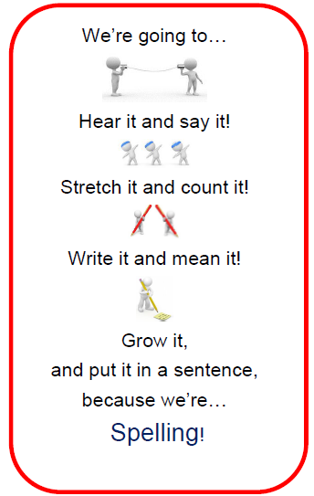
Weekly Class Structure

Slide 15
Wraparound Spelling - Monday
Use new spelling list for the week.
Say the first word (do not write it yet) and ask the children
to count the number of sounds in the word.
Reading goes from concrete written word to abstract thought and sound.
Spelling goes from abstract thought and sound and as it is written it takes on its concrete form.
C-a-t (3 sounds) Ch-a-t (3 sounds)
Notes:
Cat = c – a – t
Chat = ch – a – t
change = Ch – a – ng - e

Slide 16
Talk about how you write each sound as you write the word on the board.
Refer to the sound chart for alternative ways of writing a sound. If a sound is made up of more than one letter, these are referred to as special friends.
i.e. special friends = oo; ee; ch; igh

Slide 17
Stretch with Special Friends
Ask the children to identify the ‘special friends’ and underline them.
Model sounding out the word (stretch) and then saying it.
c – a – t = cat
Ask the children to repeat it.
Ask the children to attempt to write the word.
Once they have done this, you write it on the board and ask them to tick each correct sound.
✓ ✓ ✓
ch – a – t = chat

Slide 18
Grow the Word: Roots and Shoots
Focus word: watch (root)
Growing and shrinking words: watches, watching, watchers, stopwatch, wristwatch etc.
Focus word: photograph
Growing and shrinking words: photographs, photo (prefix), photographer, photogenic

Slide 19
Why ‘grow’ the words?
It adds to a child’s use of vocabulary.
It shows regular changes: tenses, plurals, verb endings, affixes (morphological awareness)
This maintains learning and puts it into long term memory.
All children in the class start with the same word. Growing the words allows for differentiation and challenge. This approach enables EVERY CHILD to experience success. Those who find spelling hard can stick with the shorter root word. A child who finds the root word too easy uses a word that was grown.
Notes:
plural spelling (add s, es, irregular .e.g. man = men, feet, foot
past tense (adding ‘ed’ sometimes you double the consonant, swim = swam)
present tense (adding ‘ing’)
compound words
looking at how the word meaning and part of speech changes when we grow it

Slide 20
Spiral Phonics
Doing this means that we are creating an upward spiral of provision so some pupils during the lesson will revise, focus on the lesson and setting the scene for further learning.

Slide 21
The word in context
Ask the children to put the word into a sentence to show what the word means.
Word: watch
Pupil: I have a watch.
Teacher: I have a watch. Why?
Pupil: I have a watch so that I can tell the time.
Teacher: I have a watch so that I can tell the time.
Teacher: How many words are in the sentence?
Pupils: 11

Slide 22
Sentence Structure
Give children the opportunity to hear and rehearse good sentence structure.
Encouraging them to rehearse good sentence structure helps them to write more accurately and not write a stream of consciousness which is often not purposeful or coherent.
If they count the number of words before they write, they can check that none are missing.

Slide 23
A sentence a day (dictation)
Use one of the sentences and practice each day.
E.g. The kitchen was wet. (Why?)
The kitchen was wet because I left the tap running.
Say the sentence several times. (10 words)
Ask the children to count the number of words in the sentence.
Ask children to write it down.
Then you write it and ask them to check it. They should tick capital letters and punctuation too.
✓✓ ✓ ✓ ✓ ✓ ✓ ✓ ✓ ✓ ✓ ✓
The kitchen was wet because I left the tap running.

Slide 24
Syllables (Tuesday)
If some of the words have more than one syllable, circle the vowel sounds and clap out the syllables. Draw a dividing line to show syllable divisions.
This is an important strategy for spelling longer words.
Each syllable must contain a vowel sound.
unhappily

Slide 25
Rhymes (Tuesday)
Ask pupils to look for words which rhyme with the focus word.
Accept nonsense words as well as real words but make sure the pupils know the difference.
This is a useful strategy for reducing the amount of encoding needed in a word if they know how the rhyme in the rhyming word is written.
Take the opportunity (if it arises) to show that some rhymes have different phonic patterns.
e.g. eight and plate

Slide 26
Parts of Speech (Wednesday)
Look at some of the words in the spelling list and show the pupils how to identify the parts of speech. The parts of speech you concentrate on will depend on the stage of your pupils.
First Level: nouns, proper nouns, verbs, adverbs, adjectives
Second Level: +, conjunctions, prepositions, uncountable nouns, collective nouns, contractions, proper adjectives, abstract nouns, articles

Slide 27
Parts of Speech (Wednesday)
Show pupils how when we change the part of speech, the spelling often is altered.
Noun | Verb | Adjective | Adverb
Respect Respect should be shown to your parents. | Respect I respect my teachers. | Respectful He walked at a respectful distance. | Respectfully He spoke respectfully.
Invitation He gave me an invitation to the party. | Invite I want to invite you to my party. | Inviting It was such an inviting room. | Invitingly She smiled invitingly at the children.

Slide 28
Cues (Wednesday)
If there are words that the pupils are finding difficult, then work with them to find a cue to aid memorising it.
i.e. necessary
one collar - two sleeves
It is necessary to have one collar and two sleeves on a shirt.

Slide 29
Cues Cont. (Wednesday)
Because
Big
Elephants
Can
Always
Understand
Small
Elephants
Could/Would
Oh
U
Lucky
Duck

Slide 30
Roots and shoots (Thursday)
This is revising some of the work done on Monday but in more explicit detail by growing and shrinking words by looking for the root word and adding or taking away prefixes and suffixes.
Talk about how the prefixes and suffixes change the meaning of the root word and sometimes the spelling.

Slide 31
Roots and shoots (Thursday)
international
inter | national | international
Between, jointly | countries | Involving two or more countries

Slide 32
Games, Assess and Rectify (Friday)
The focus is on the original word however during the quiz time, the pupils can write any shoot or root words. They may be given a final score of 10/10 +9
•Children are given the base word. e.g. spell ‘pet’
•All children spell pet.
•For those who find this easy, it takes a matter of seconds. They then spend the remaining time
challenging themselves on their shoot words.
•For those who find pet difficult, they are involved to
the same level as all of their peers. The positive
impact this has on their self esteem will be
substantial. They are also then encouraged to try
to go beyond this. There is no ceiling
automatically placed on them.
An opportunity should be given to correct any mistakes.

Slide 33
Pupil Voice
We asked the pupils if they enjoyed the new programme and if they thought it had helped them to improve.

Slide 34
Do you enjoy the new spelling programme?

Slide 35
Do you think the new spelling programme has helped you with your spelling?
The same as before
Yes
No

Slide 36
I enjoy it because it is challenging to get the roots and shoots for each word.
I like how we get to stretch the words and sound them out before we write them.

Slide 37
I like learning about the different parts of speech - adverbs, verbs ,nouns and adjectives. It makes me more aware of words I choose to put in a sentence.
I like making up dictation sentences instead of just writing the words out.

Slide 38
Syllables help with not just spelling but also pronunciation. Looking at spelling in more than one way is a positive. Helps you think of more words using roots and shoots.
I like that we all have the same words and no more groups.
It takes longer to do in class.
It helps my reading.

Slide 39
How useful is looking at words
that rhyme?
When you rhyme it encourages us to look at different spellings for the same sound.
I like having rhyming competitions
to see who can get the most.

Slide 40
It takes longer to do in class.
It takes longer to do.
It has helped because we have done more work on it every day.

Slide 41
It takes longer to do in class.
I like how we use special friends.
It takes longer to do in class.
I am more confident.
I am learning things I never knew before.
It is fun!

Slide 42
What next for the school?
In January we used the spelling test results to decide who would continue with the same spelling words and who would move to their own spelling sounds.
We will continue to embed the Wraparound Spelling programme and routines for all stages and individuals.
We will continue to monitor and record the progress of all pupils.

Slide 43
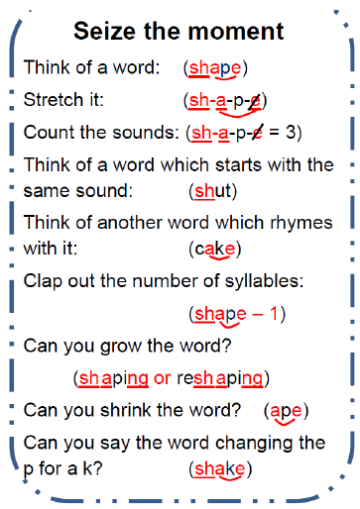
What can you do to help your child?

Slide 44
Any questions?

Slide 45
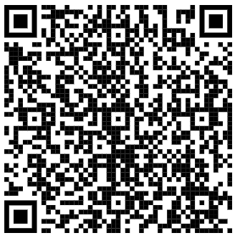
Thank you. Please complete the feedback by visiting https://bit.ly/366ArU2 take a paper copy or use the link on the School Blog.

