Slide 1
Bishopton Primary
Welcome

Slide 2
Day 1 Plan
Welcome & housekeeping
Vision and values
Guest Speakers
Question time
Dining hall sampler menu (10.10 - 10.30am)
Leave by dining hall doors - to confirm Collection door Day 2

Slide 3
Day 1 Plan (pupils)
Infant department
Groupings with a Primary 1 teachers
Structured play
Picture story – colour
Dining hall sampler menu (10.20 - 10.50am)
Leave by dining hall doors - to confirm Collection door Day 2

Slide 4
Vision
Building and Promoting Success

Slide 5
Values-We all share the following values
Fairness – everybody getting what they need in order to be successful
Inclusion – opportunity for all
Honesty – be truthful to yourself and others
Challenge – high expectation for all
Global Citizenship – creating a sustainable future

Slide 6
Staff
Head teacher Mrs McNaught
Depute Head teacher Mrs Davidson P4-7
Depute Head teacher Mr Collins P1-3
Principal Teachers Miss McDowall & Mr McAvoy
All staff both teaching and non teaching work to achieve this vision and adhere to these values

Slide 7
Joining our Bishopton School Community
People who help us...
Bishopton Library Margaret Winters Home Link Mr P Harrison
Catering Manager

Slide 8
The Learning Journey
Broad General Education provides your child with a wide range of knowledge, skills and exciting experiences that they can draw on as their lives, careers and job opportunities continue to change.
Curricular Areas in the broad general education are planned around a nationally agreed programme of experiences and outcomes (often called Es and Os). These describe the knowledge, skills, attributes and capabilities that young people are expected to develop.
Learning in the broad general education may often span a number of curriculum areas (for example a literacy project planned around science and technology might include outdoor learning experiences, research and the use of ICT). There is likely to be themed and project learning, as well as wider opportunities to show how skills and knowledge can be used in challenging, different and interesting ways. The term often used for this is interdisciplinary learning.

Slide 9
Supporting your child

Slide 10
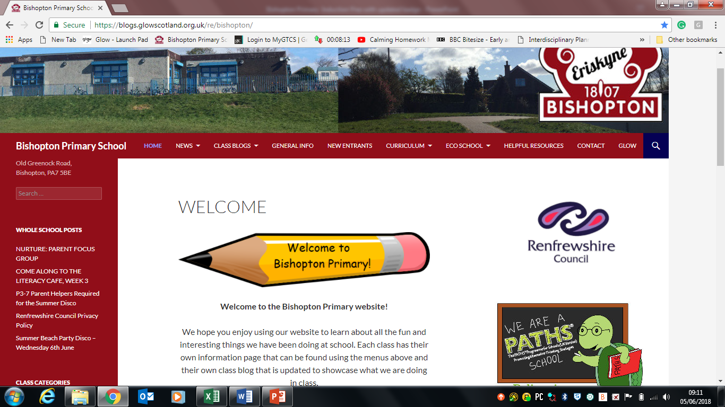
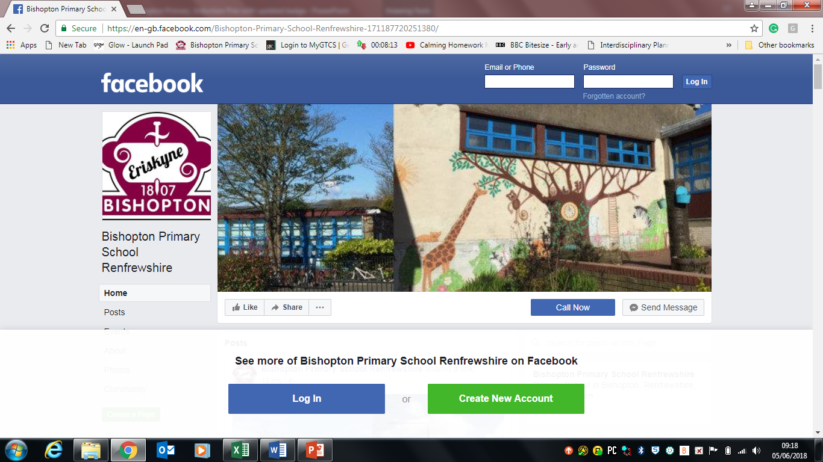
Communication
School website Blog, Twitter, Facebook and paper!

Slide 11
Useful Information
Class structure and organisation for 2018 6 Primary 1 classes 3x 17, 3x18
Early years classroom assistant
Uniform please label your childs uniform including book bags (discreetly)!
Gym shoes worn from Day 1 – label & wear
Clothing Suitable for Outdoor Learning - labeled
Water bottles – Labeled
School starts at 9.00 am (prompt) – 15th August 2017
Playtime 10.30-10.45am, Lunchtime 12.15-1.15pm (children can go home)
School Finishes at 3.15pm(your child will leave via their Base door in the infant playground)
Please ensure your child and their teacher knows who is collecting them each day and/or aftercare provision. In addition, what their lunch options are. Pupils going home for lunch can be collected from their class teacher at the side gate
(Ashy Path).

Slide 12
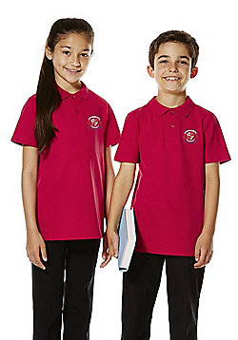
Support
Free school meals and clothing grants
http://www.renfrewshire.gov.uk/article/3338/Free-school-meals-and-clothing-grants
Home to school transport
http://www.renfrewshire.gov.uk/article/3486/Home-to-school-transport

Slide 13
Holiday Homework
Children and young people have a right to play. The UN Convention on the Rights of the Child states (in Article 31) that every child should have:
... the right to rest and leisure, to engage in play and recreational activities appropriate to the age of the child and to participate freely in cultural life and the arts.
United Nations Convention on the Rights of the Child
There is lots of information available about the health and wellbeing benefits of play. Active play helps to build strong bones and muscles. Children and young people explore their feelings through play, and this can help them build resilience and cope with stress.
Play is how young children make sense of the world. There is also evidence to show that play in early childhood can influence the way your child's brain develops, helping to co-ordinate their mental and physical capabilities. Through play, children and young people of all ages develop problem-solving skills, imagination and creativity, language and observation skills, and memory and concentration. Children and young people use play to test their theories about the world and their place in it.
"Play creates a brain that has increased flexibility and improved potential for learning later in life."
Lester & Russell, 2008

Slide 14
All primary 1 to primary 3 school children are now entitled to a free school meal
http://www.renfrewshire.gov.uk/schoolmealinfo

Slide 15
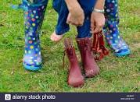
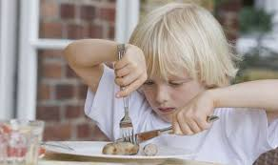
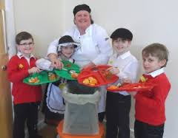
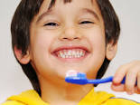
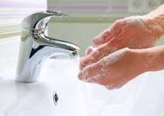
Independence day!
Have fun support your child over the holidays in learning to:-
Recognise their own name labels
Putting on their own coat, shoes wellies
Tidying up belongings
Brushing teeth
Going to toilet, using a urinal/washing hands thoroughly
Scrapping plates/recycling food waste
Using a knife and fork correctly.

Slide 16
Looking for ideas...
Play, Talk Read
Read, Write Count

Slide 17
Be at the HEART OF YOUR child's LEARNING

Slide 18
Please avoid the crush on the first day – it can be unsettling for your children.
My first day at school!

Slide 19
Questions?
If you would prefer you can write them on a 'sticky note' or catch myself or my colleagues after the taster lunch.
August 2018
Primary 1 Parent Information Evening

