Slide 1

Bargarran Primary School
New Entrants
August 2026

Slide 2


Welcome Everybody
2.Here we are together, joining in this song.
Even those who feel that their
singing’s not that strong.
And as we sing may every person
know that they belong,
Gathering in this place
1.Here we are together, now we can begin.
The youngest and the oldest,
the only child, the twin.
Some who’re feeling left out,
and some who’re feeling in.
Gathering in this place.
Chorus
Welcome everybody,
it’s good to see you here x 3
Gathering in this place.
3. Here we are together, with our hopes and fears
Bringing many feelings,
our laughter and our tears.
And now it’s time for everyone
to tell the world “WE’RE HERE!”
Gathering in this place.

Slide 3
Bargarran Primary School
New Entrants
August 2026
Meet Your Buddy ☺

Slide 4

Welcome to Bargarran Primary

Slide 5
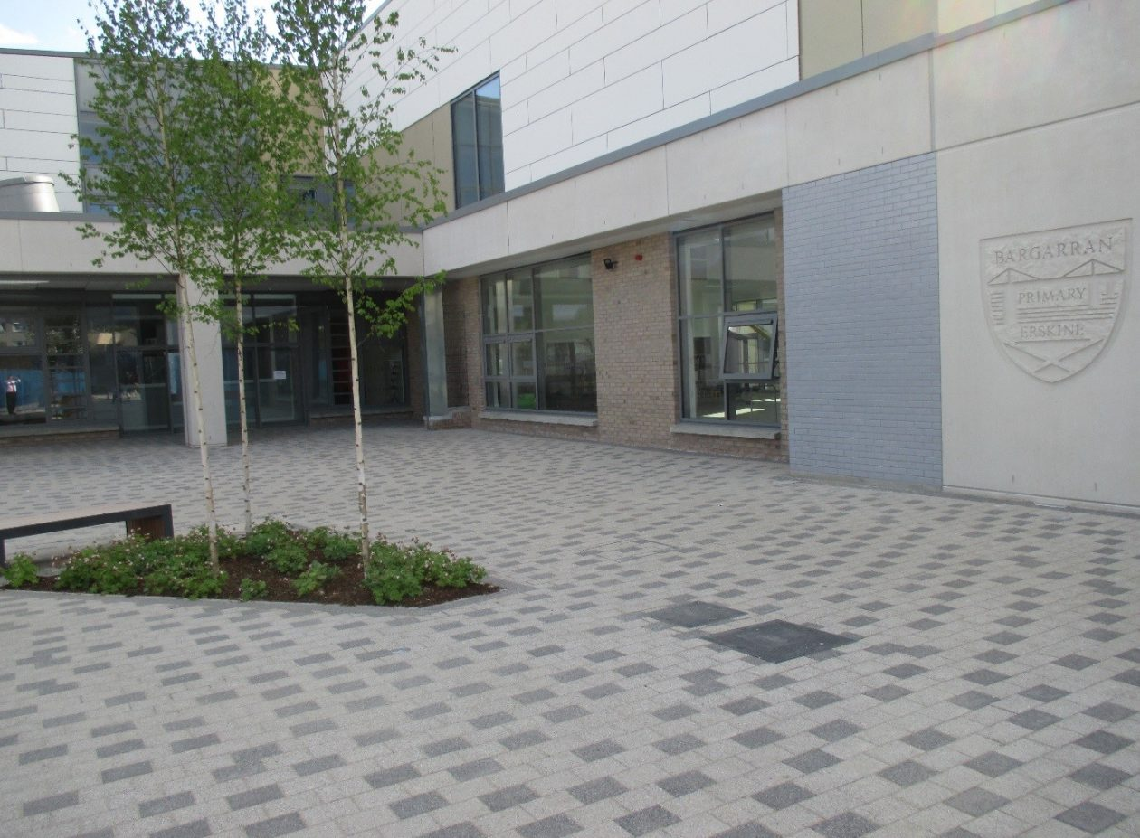
Thank you for choosing Bargarran Primary as your child’s school.
Our aim is to provide you with as much information regarding the school, staff and daily routine as possible, in order to address any concerns or queries you may have.
Please discuss the various points of information with your child in order to ensure a smooth transition to school.

Slide 6
Contents
Staff
Learning Environment
Curricular Areas
What this looks like in P1
The School Day
Keeping you Informed/
Supporting Your Child
How you can help
Preparing for School

Slide 7
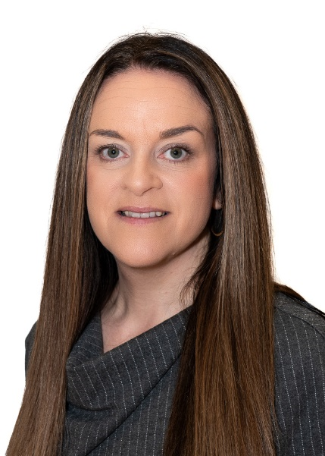
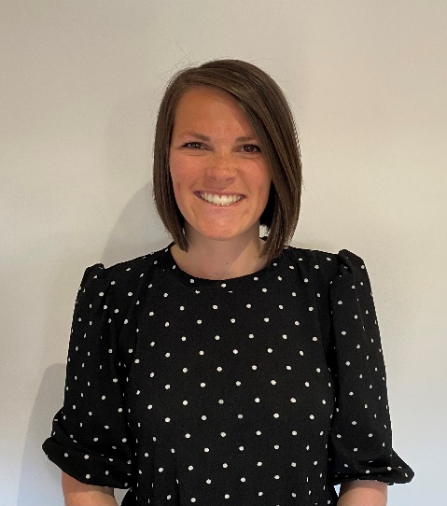
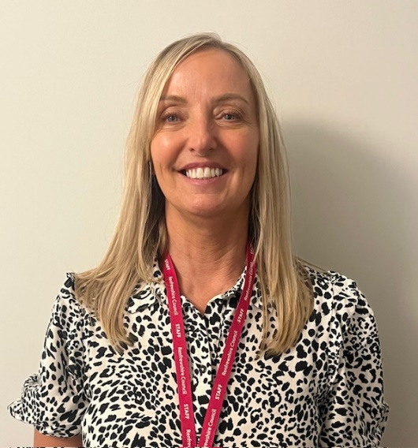
Our Management Team
K Ross
Head Teacher
(Acting)
J. Thompson
Depute Head Teacher
S. Kennedy
Depute Head Teacher

Slide 8

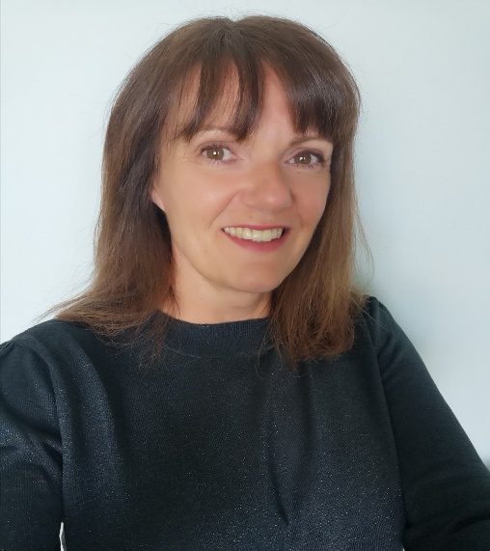
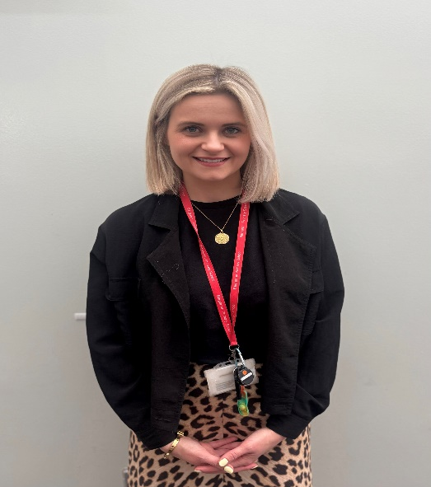
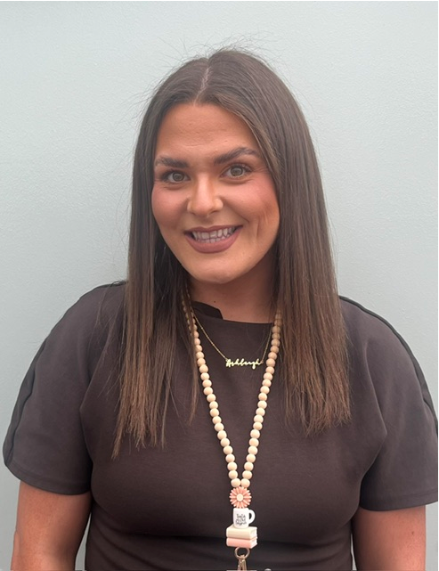
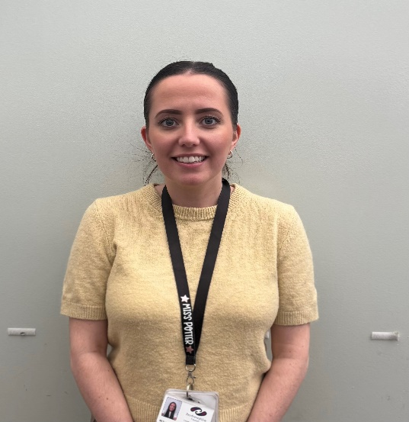
Current Primary 1, Primary 2/1 and Primary 2 Teachers
C. Harris/
A. McManus
P2/1 Teachers
M. Potter
P2 Teacher
D. Hunter
P1 Teacher

Slide 9
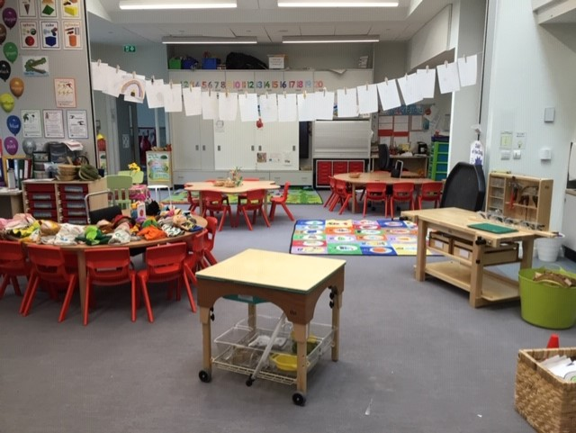
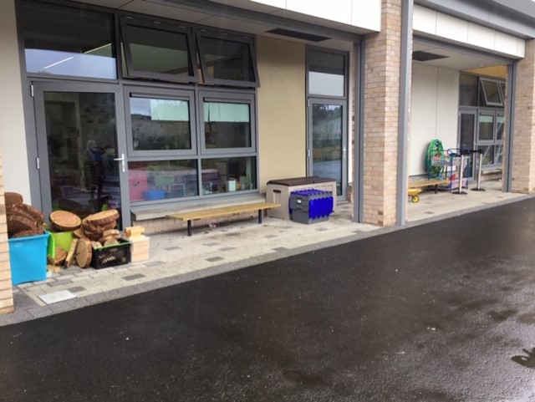
Our Learning Environment
Teaching and Learning takes place both indoors and outdoors.

Slide 10
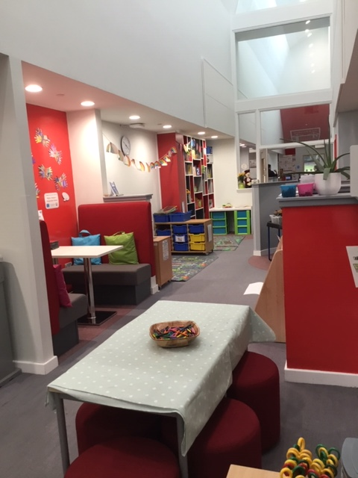
Our Primary 1 and 2 Base

Slide 11
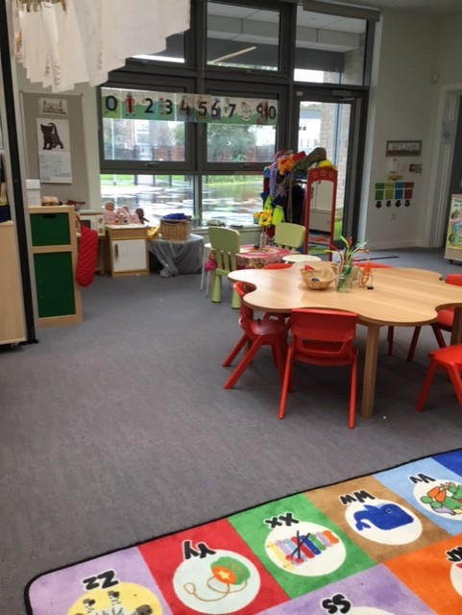
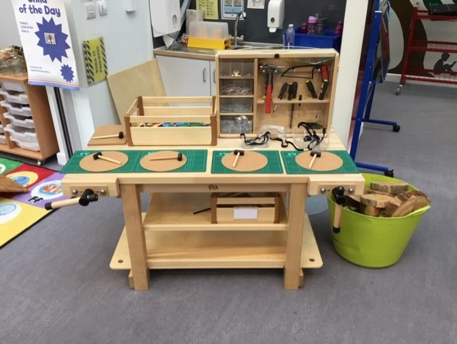
Our Primary 1 and 2 Base

Slide 12
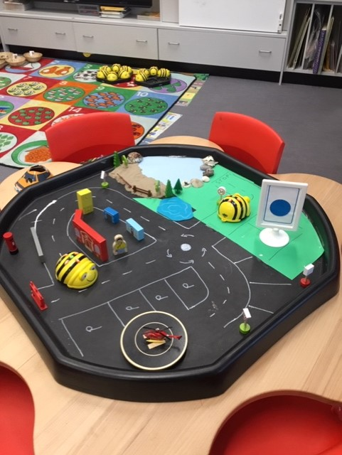
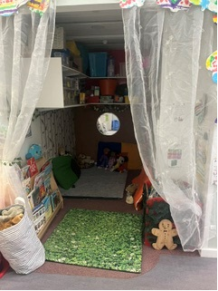
Our Primary 1 and 2 Base

Slide 13
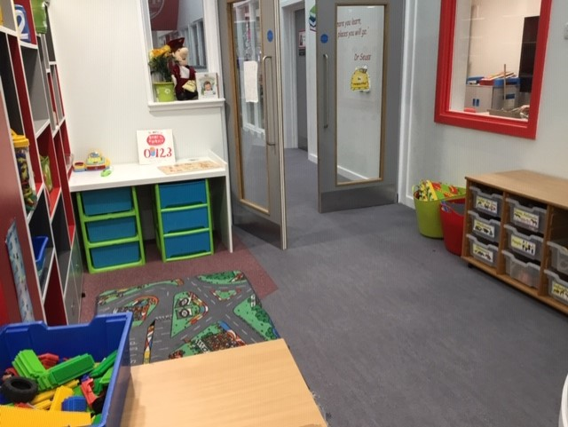
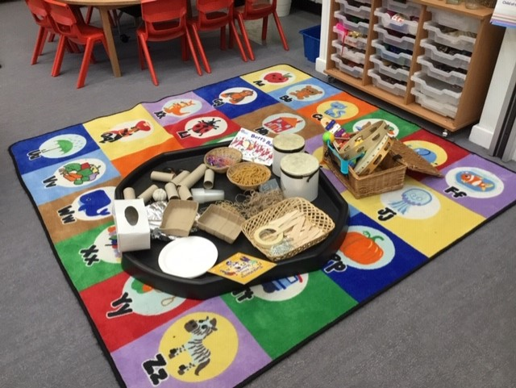
Our Primary 1 and 2 Base

Slide 14
Curriculum
There are 8 curriculum areas: expressive arts, languages and literacy, health and well-being, mathematics and numeracy, religious and moral education, social studies, sciences and technologies.
There are three key areas that all teachers are responsible for developing children’s skills: Health and Well-being; Literacy and Numeracy.

Slide 15

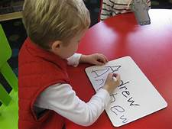
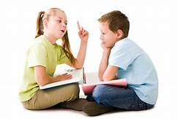
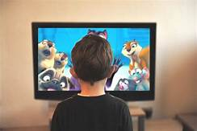
Literacy
Literacy ... is an essential part of our everyday lives. It helps us to understand and interpret our world through what we hear, see, say, write and read. Literacy is also about using and making sense of technology, films and other media.
www.educationscotland.gov.uk

Slide 16
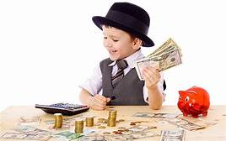
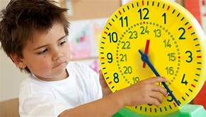
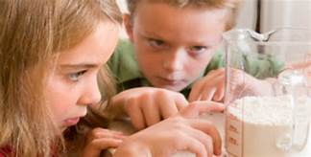
Numeracy
Numeracy ... is about counting and numbers as well as understanding measurement, money, weight, an awareness of time and how to handle information.
www.educationscotland.gov.uk

Slide 17
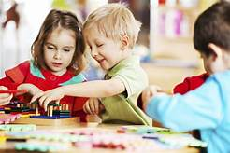
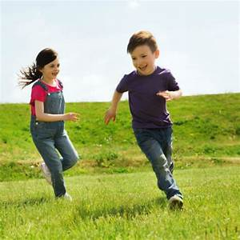
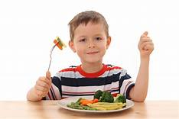
Health and Wellbeing
Health and Wellbeing ... is about learning how to lead healthy and active lives, becoming confident, happy and forming friendships and relationships with others that are based on respect. It is also about managing feelings and having the skills to meet challenges, make good choices and manage change.
www.educationscotland.gov.uk

Slide 18
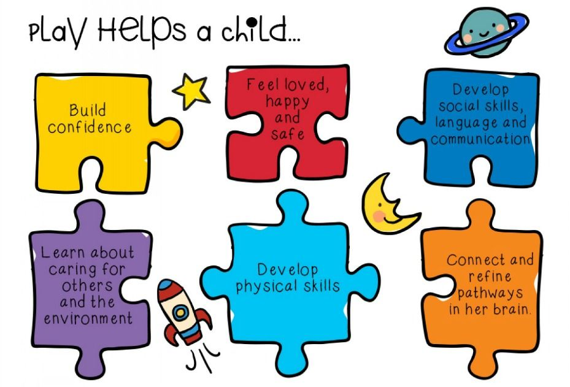
Learning in Primary 1
Throughout the day your child will be involved in play-based learning, independent tasks and teacher-led direct teaching. Key areas of the curriculum include Literacy, Numeracy and Health and Wellbeing.

Slide 19
Inspection Report February 2025
Practice worth sharing more widely
Play Pedagogy effectively supporting children’s learning and engagement.
. Staff develop learning environments which provide purposeful, creative and curious provocations for children. Children in P1 and P2/1 regularly take part in child-led, adult-led and child-initiated play.
Pupil voice is evident on their ‘My Learning Journey’ wall. Teachers use observation evidence to ensure that children know that their views are valued and acted upon to inform future provocations. Children’s floor books show that learners are fully involved in planning for learning and reflect on successes and next steps.
Teachers challenge children by providing open ended tasks and a variety of meaningful resources. Children enjoy learning outdoors as part of this approach which has enhanced their confidence, curiosity and creativity.
The overall impact has been that children are very independent, motivated and fully engaged in their learning.

Slide 20
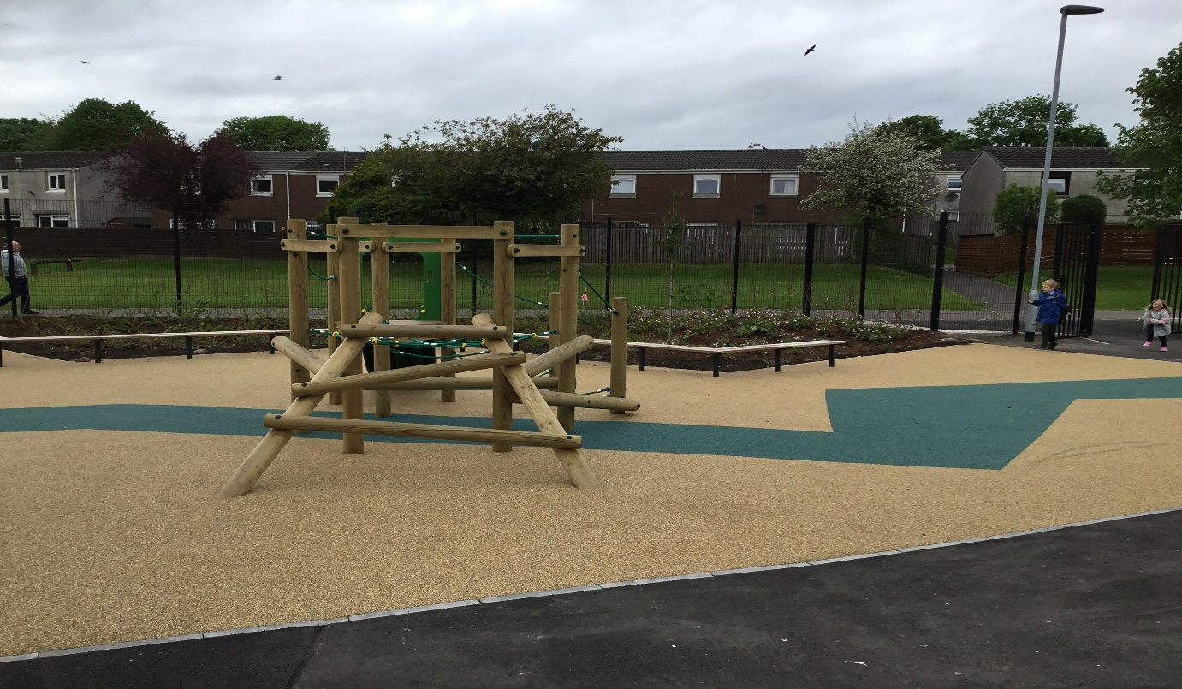
The School Day
Start: 9am
Interval:10.30am
Lunch: 12.15-1pm
Finish: 3pm
For the first day only
P1 children will have a staggered entry.
Parents will be informed of allocated times and classes by the end of June.
Please meet your child’s class teacher by the P1 entry doors on the first day of school.
These are located in this part of the playground.

Slide 21
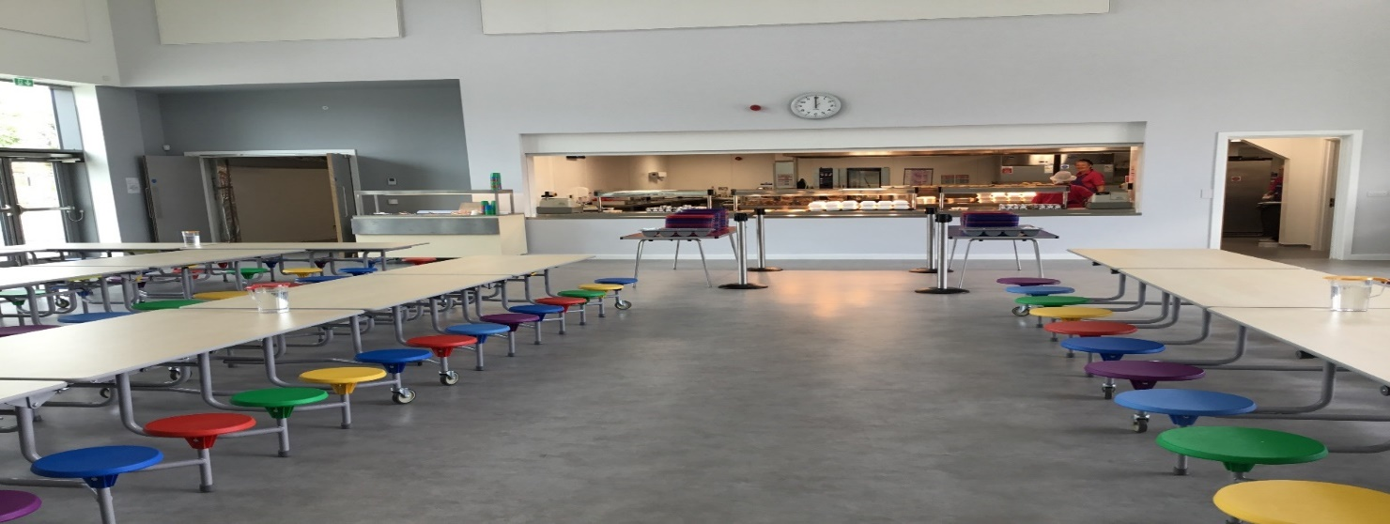
Lunchtime Arrangements
All children in P1-5 are entitled to a free school meal.
Children order their lunch at the start of each day.
All children will eat together in the lunch hall
Should your child have dietary requirements, please contact the school office.

Slide 22

Example Menu

Slide 23
Interval Arrangements
Prior to interval Primary 1 have time to eat their snack. Pupils will have the opportunity to play outside in most weather conditions and should therefore come to school with appropriate outdoor clothing.
Lunch Arrangements
Children having a school lunch and children having a packed lunch all sit together in the lunch hall.
When the children have finished eating their lunch they go out into the playground until the bell rings.
The playground is supervised at all times.
Wet Intervals/Lunch Arrangements
In adverse weather conditions intervals will be taken indoors and classes will remain in their bases where they will be supervised by members of staff and Primary 7 monitors.

Slide 24
Keeping You Informed
School Homework Diary
Red Homework Folder
Meet the Teacher Event
Phonic Information Event
Parent/Carer &Teacher Evenings
Written Reports
Home Liaison Folders
School Website
Class Dojo/School Dojo

Slide 25
Supporting Your Child
Transition information
Nursery Transition
Primary 1 teachers
GIRFEC meetings
Primary 7 buddy
Support staff
Community Wellbeing Support
Educational psychologist
Positive relationships with children
Positive relationships with parents and carers

Slide 26
How can you help?

Slide 27
Getting Involved
Parent Partnership - Formal
Discuss educational issues
Receive and discuss H.T Report
Involved in appointing senior staff
Parent Partnership – Fundraising
Organise events
Purchase equipment for school
Contribute to excursions
Purchase gifts for children

Slide 28

Preparing Your Child for School
Encourage your child to be independent.
Practise buttoning jackets and pulling up zips.
Make sure your child is confident in using the toilet.
Help your child develop his/her social skills – learning to share, take turns and helping to tidy up!
Talk to them about starting school and what to expect.
Encourage them to talk about any concerns and pass on any relevant information.

Slide 29

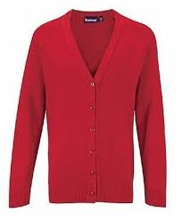
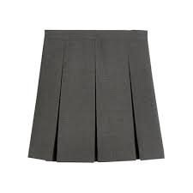
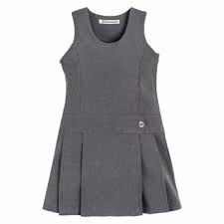
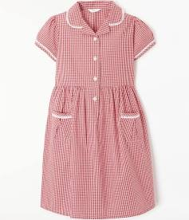


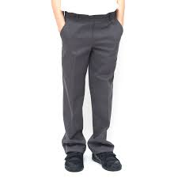

i
School Uniform
Grey pinafore, skirt or trousers
White shirt and tie or white polo shirt
Red or grey sweatshirt, cardigan or jumper
Providers include:
Baru
Schoolwear Made Easy
Myclothing.com
It is preferable that children come to school wearing black outdoor shoes (preferably with Velcro fastenings) and change into black plimsolls for wearing indoors and for P.E

Slide 30

i
P.E Days
Indoor P.E
Black shorts
Polo shirt or plain white or red T-shirt/badged.
Providers:
Children should bring their shorts/jogging trousers to school on P.E days to change into.
Baru
Schoolwear Made Easy
Myclothing.com

Slide 31

School Checklist
School bag and pencil case
Water bottle
Snack for interval
Packed lunch (if required)
T-Shirt (or polo shirt) and shorts/jogging trousers for P.E days
NO TOYS FROM HOME
NAMES ON ALL ITEMS PLEASE!

Slide 32
Finally…
Please ensure you have completed the Primary One
Induction Microsoft form.
Date of next Transition Day – Thursday 28th May 11.00 -11.45am (children only)
Information regarding classes, staffing and first day arrangements to follow.
Please check the Bargarran School Webpage regularly for updates.
Do not hesitate to get in touch if you require any further information regarding your child starting school.
Depute Head Teacher
Bargarran Primary
bargarranenquiries@renfrewshire.gov.uk

Slide 33
Thank You

Slide 34

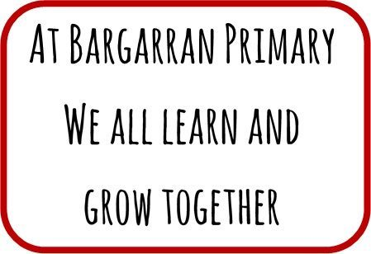
Bargarran Primary School
Our values:
Be happy
Be honest
Be kind
Be respectful
Be responsible
Be all you can be!
Our school vision:
Our school motto:
A Bridge to a Bright Future

Slide 35
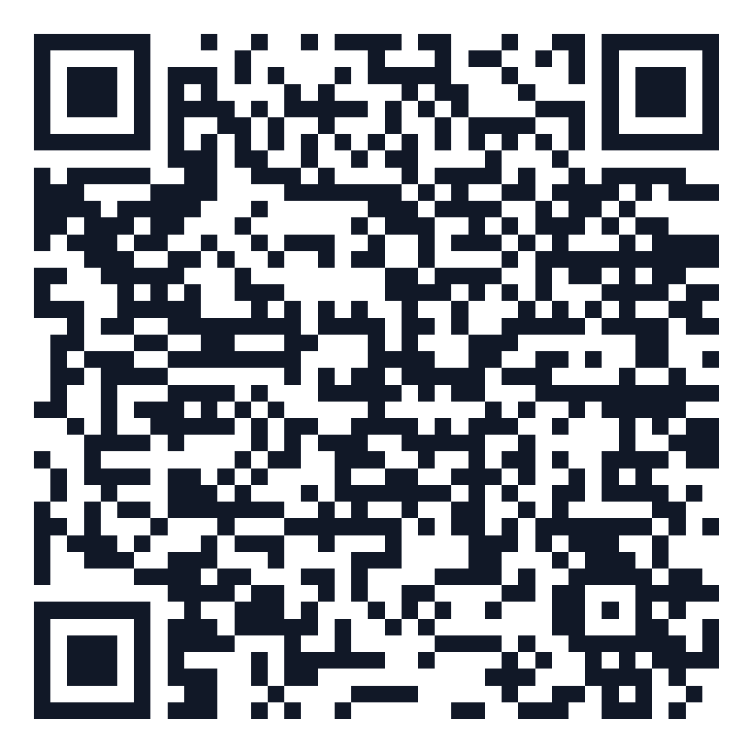
Social, emotional and personal skills

