Slide 1

Bargarran Primary School New Entrants August 2025
Information

Slide 2
Bargarran Primary School New Entrants August 2025
Meet Your Buddy ☺

Slide 3

Welcome to Bargarran Primary

Slide 4
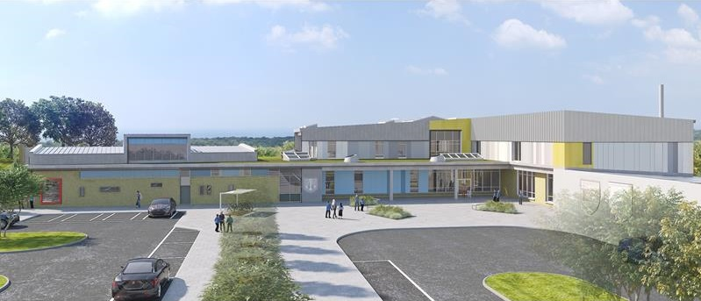
Thank you for choosing Bargarran Primary as your child’s school.
Our aim is to provide you with as much information regarding the school, staff and daily routine as possible, in order to address any concerns or queries you may have.
Please discuss the various points of information with your child in order to ensure a smooth transition to school.

Slide 5
Contents
Staff
Learning Environment
The School Day
Curricular Areas
Keeping you Informed/Supporting Your Child
Preparing for School

Slide 6
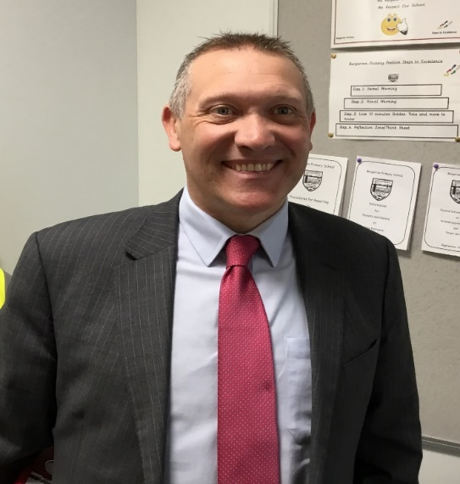
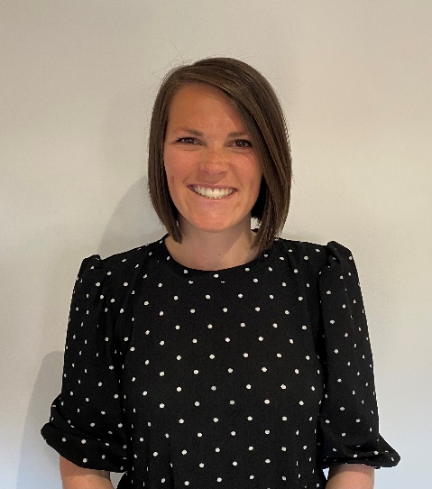
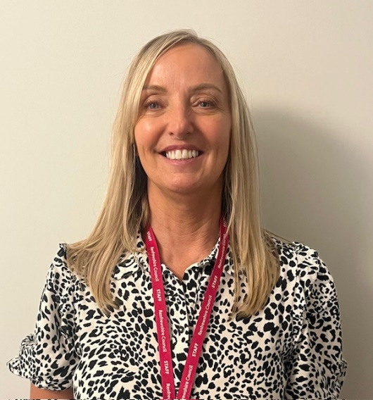
Our Current Management Team
A. Lyle
Head Teacher
J. Thompson
Depute Head Teacher
S. Kennedy
Depute Head Teacher

Slide 7

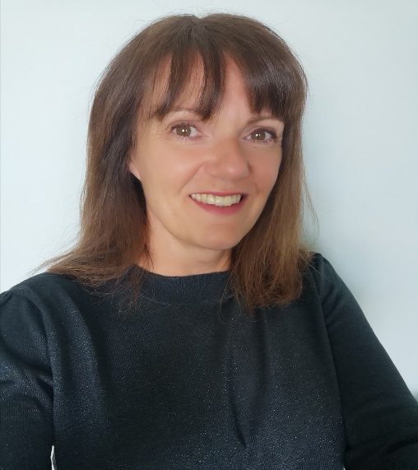
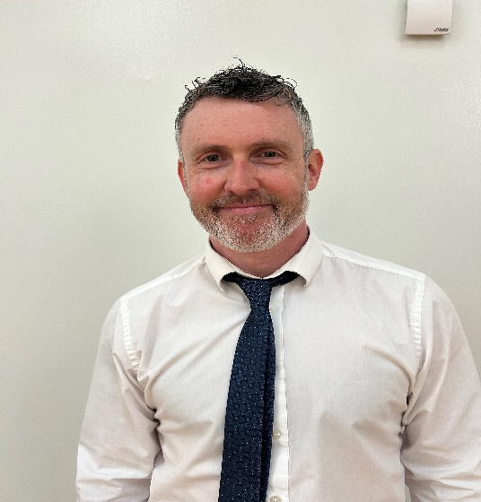
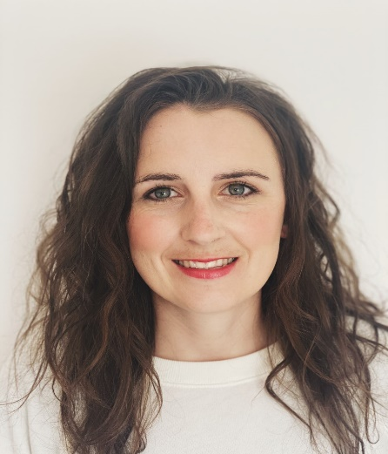
Current Primary 1 and Primary 2/1 Teachers
D. Hunter
P1 Teacher
J. Martindale
P2/1 and NCC Teacher
J. Russell
P2/1

Slide 8
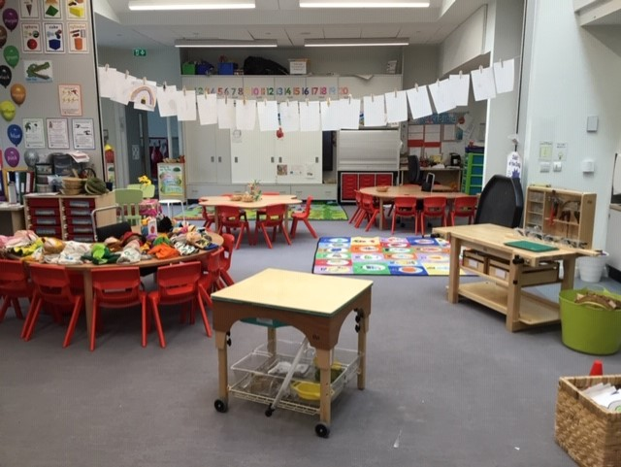
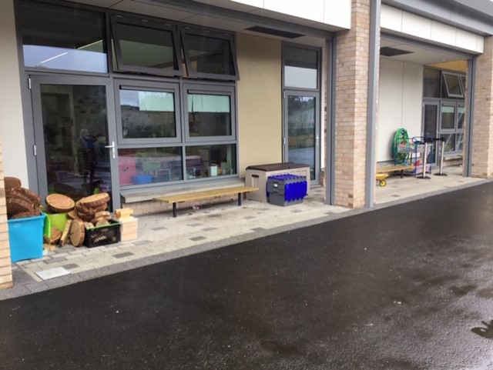
Our Learning Environment
Teaching and Learning takes place both indoors and outdoors

Slide 9
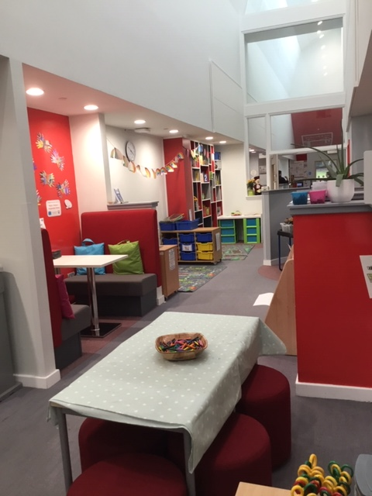
Our Primary 1 and 2 Base

Slide 10
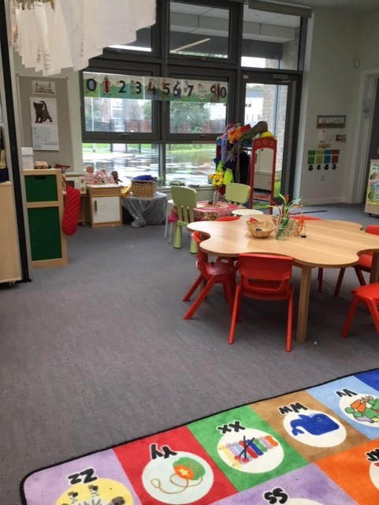
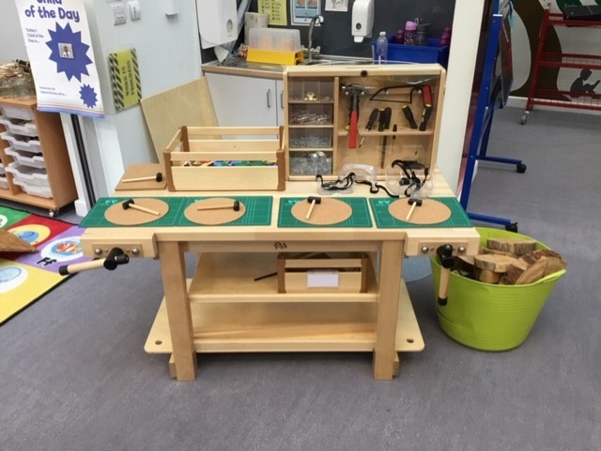
Our Primary 1 and 2 Base

Slide 11
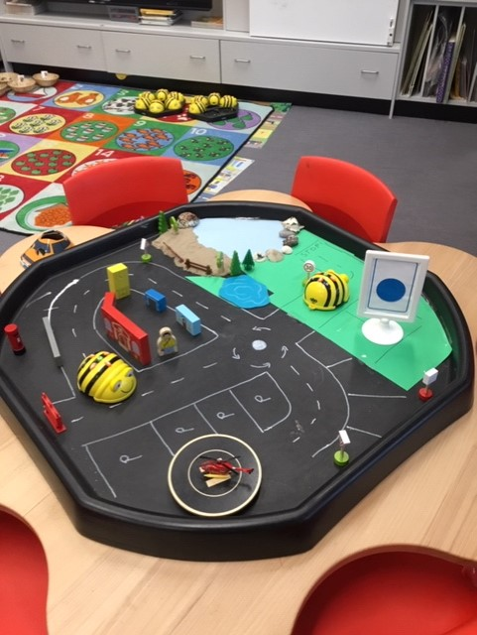
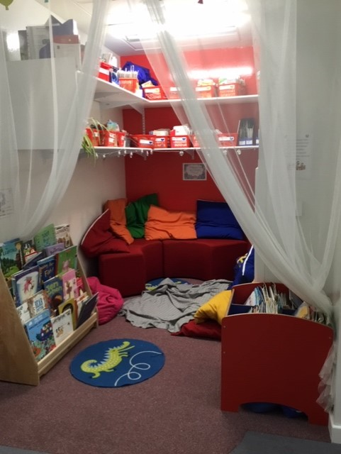
Our Primary 1 and 2 Base

Slide 12
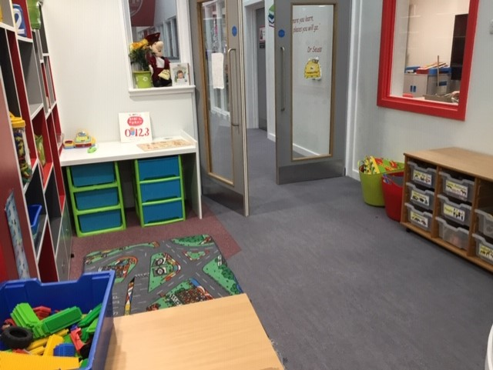
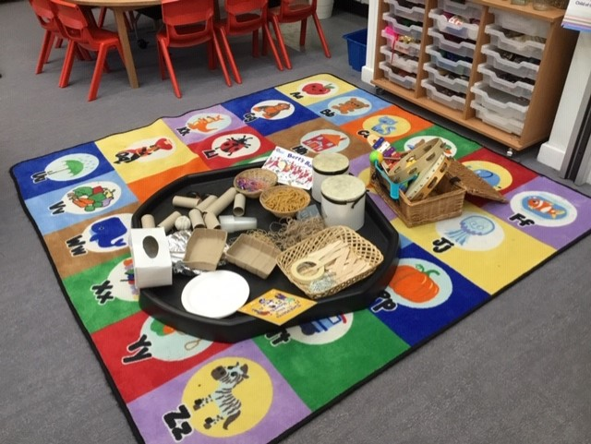
Our Primary 1 and 2 Base

Slide 13
Inspection Report February 2025
Practice worth sharing more widely
Play Pedagogy effectively supporting children’s learning and engagement.
. Staff develop learning environments which provide purposeful, creative and curious provocations for children. Children in P1 and P2/1 regularly take part in child-led, adult-led and child-initiated play.
Pupil voice is evident on their ‘My Learning Journey’ wall. Teachers use observation evidence to ensure that children know that their views are valued and acted upon to inform future provocations. Children’s floor books show that learners are fully involved in planning for learning and reflect on successes and next steps.
Teachers challenge children by providing open ended tasks and a variety of meaningful resources. Children enjoy learning outdoors as part of this approach which has enhanced their confidence, curiosity and creativity.
The overall impact has been that children are very independent, motivated and fully engaged in their learning.

Slide 14
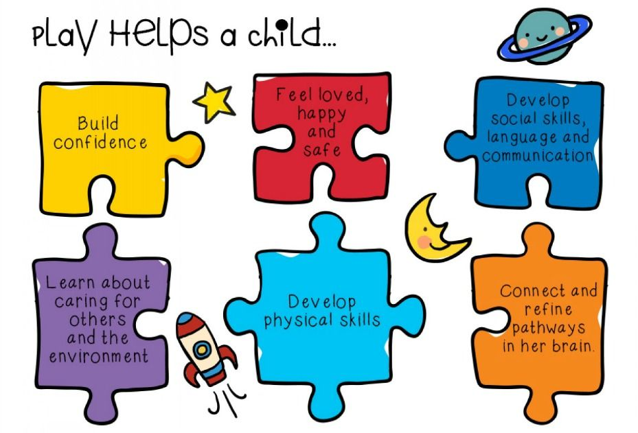
Learning in Primary 1
Throughout the day your child will be involved in play-based learning, independent tasks and teacher-led direct teaching. Key areas of the curriculum include Literacy, Numeracy and Health and Wellbeing.

Slide 15
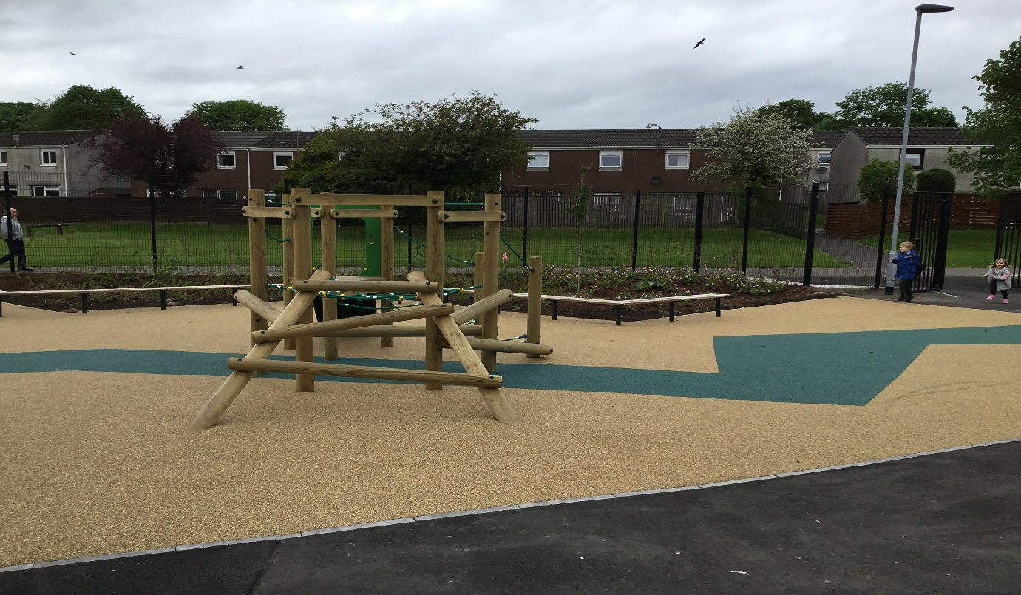
The School Day Start: 9am Interval:10.30am Lunch: 12.15-1pm Finish: 3pm For the first day only P1 children will have a staggered entry. Parents will be informed of allocated times and classes by the end of June. Please meet your child’s class teacher by the P1 entry doors on the first day of school. These are located in this part of the playground.

Slide 16
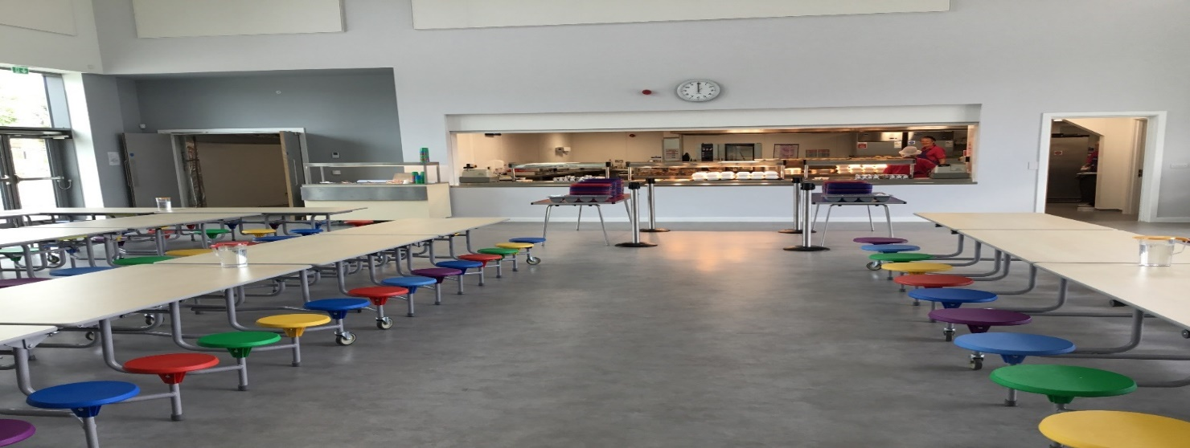
Lunchtime Arrangements All children in P1-5 are entitled to a free school meal. Children order their lunch at the start of each day. All children will eat together in the lunch hall Should your child have dietary requirements, please contact the school office.

Slide 17

Example Menu

Slide 18
Interval Arrangements Prior to interval Primary 1 have time to eat their snack. Pupils will have the opportunity to play outside in most weather conditions and should therefore come to school with appropriate outdoor clothing. Lunch Arrangements Children having a school lunch and children having a packed lunch all sit together in the lunch hall. When the children have finished eating their lunch they go out into the playground until the bell rings. The playground is supervised at all times. Wet Intervals/Lunch Arrangements In adverse weather conditions intervals will be taken indoors and classes will remain in their bases where they will be supervised by members of staff.

Slide 19

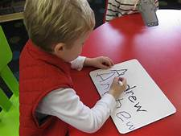

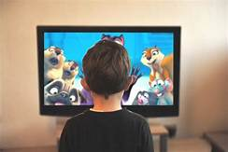
Literacy
Literacy ... is an essential part of our everyday lives. It helps us to understand and interpret our world through what we hear, see, say, write and read. Literacy is also about using and making sense of technology, films and other media.
www.educationscotland.gov.uk

Slide 20


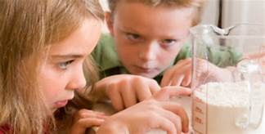
Numeracy
Numeracy ... is about counting and numbers as well as understanding measurement, money, weight, an awareness of time and how to handle information.
www.educationscotland.gov.uk

Slide 21
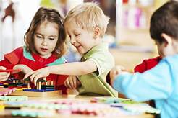
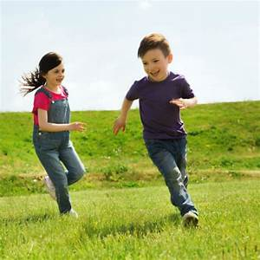
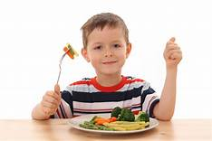
Health and Wellbeing
Health and Wellbeing ... is about learning how to lead healthy and active lives, becoming confident, happy and forming friendships and relationships with others that are based on respect. It is also about managing feelings and having the skills to meet challenges, make good choices and manage change.
www.educationscotland.gov.uk

Slide 22
Keeping You Informed
School Homework Diary
Red Homework Folder
Meet the Teacher Event
Parent/Carer &Teacher Evenings
Written Reports
Home Liaison Folders
School Website
School App - Newsletters
Class Dojo

Slide 23
Supporting Your Child
Transition information
Nursery Transition
Primary 1 teachers
GIRFEC meetings
Primary 7 buddy
Support staff
Community Wellbeing Support
Educational psychologist
Positive relationships with children
Positive relationships with parents and carers

Slide 24
How can you help?

Slide 25
Getting Involved
Parent Council - Formal
Discuss educational issues
Receive and discuss H.T Report
Involved in appointing senior staff
Parent Council – Fundraising
Organise events
Purchase equipment for school
Contribute to excursions
Purchase gifts for children

Slide 26

Preparing Your Child for School
Encourage your child to be independent.
Practise buttoning jackets and pulling up zips.
Make sure your child is confident in using the toilet.
Help your child develop his/her social skills – learning to share, take turns and helping to tidy up!
Talk to them about starting school and what to expect.
Encourage them to talk about any concerns and pass on any relevant information.

Slide 27

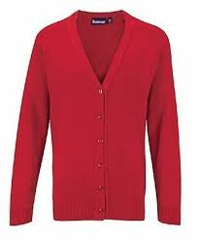
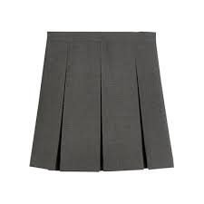
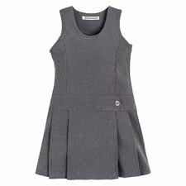
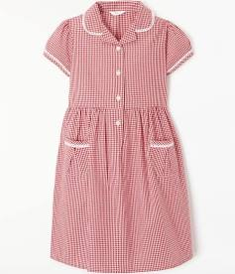


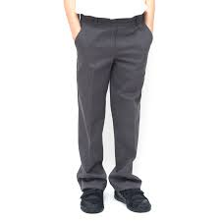

i
School Uniform
Grey pinafore, skirt or trousers
White shirt and tie or white polo shirt
Red or grey sweatshirt, cardigan or jumper
Providers include:
Tesco Uniforms for Schools
Schoolwear Made Easy
28 Wallneuk Road, Paisley
It is preferable that children come to school wearing black outdoor shoes (preferably with Velcro fastenings) and change into black plimsolls for wearing indoors and for P.E

Slide 28

i
P.E Days
Indoor P.E
Black shorts
Polo shirt or plain white or red T-shirt
Providers:
Children should bring their shorts/jogging trousers to school on P.E days to change into.
Tesco Uniforms for Schools
Schoolwear Made Easy
28 Wallneuk Road

Slide 29

School Checklist
School bag and pencil-case
Water bottle
Snack for interval
Packed lunch (if required)
T-Shirt (or polo shirt) and shorts/jogging trousers for P.E days
Names on all items PLEASE!

Slide 30
Finally…
Please complete any forms and return to the school office.
Date of next Transition Day – Thursday 29th May 11.00 -11.45am (children only)
Information regarding classes, staffing and first day arrangements to follow.
Please check the Bargarran School Webpage regularly for updates.
Do not hesitate to get in touch if you require any further information regarding your child starting school.
Depute Head Teacher
Bargarran Primary
bargarranenquiries@renfrewshire.gov.uk

Slide 31
Thank You

Slide 32


Bargarran Primary School
Our values:
Be happy
Be honest
Be kind
Be respectful
Be responsible
Be all you can be!
Our school vision:
Our school motto:
A Bridge to a Bright Future

