Slide 1
Supporting Our Children
Parent Workshop
Part 2 – Home Learning
Autism Spectrum Disorder

Slide 2
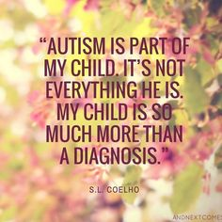
Supporting Our Children
By the end of today’s session:
Recap of ASD Needs
Demand Avoidance and Oppositional Defiance
Responding to sensory needs
Establishing positive routine and structure at home
Meltdowns at home after a day at school

Slide 3
Supporting our Children
Recap on Autism Spectrum Disorder

Slide 4
Supporting our Children
Recap on ASD
Autism, or autism spectrum disorder (ASD), refers to a broad range of conditions characterised by challenges with social skills, repetitive behaviours, speech and nonverbal communication.
There are 56,000 autistic people in Scotland.
We know that there is not one autism but many subtypes. As autism is a spectrum disorder, each person with autism has a distinct set of strengths and differences.
Autism differences are often accompanied by sensory sensitivities and medical issues such as toileting, seizures or sleep disorders as well as anxiety, depression and attention issues.
Autism usually appears by age 2 or 3. Research shows that introducing support early in the child’s life leads to positive outcomes later in life for people with autism.

Slide 5
Supporting our Children
Recap on ASD
The video on the next page was taken from World Autism Awareness Week 2020.
The clip lasts about 5minutes and the content provides an excellent overview of what living with autism can be like. It also provides 10 handy tips on how we can support those with autism in their daily lives.
The video is embedded in the next slide. To play it, you need to make sure you are viewing the presentation as a slide show, which you will find as a tab option at the top if you are not already doing so.
If the video does not play within the slideshow, the link is at the top of the page which you can copy and paste into your search engine.

Slide 6
Supporting our Children
Recap on ASD
https://youtu.be/C0yYFyHAG3s

Slide 7
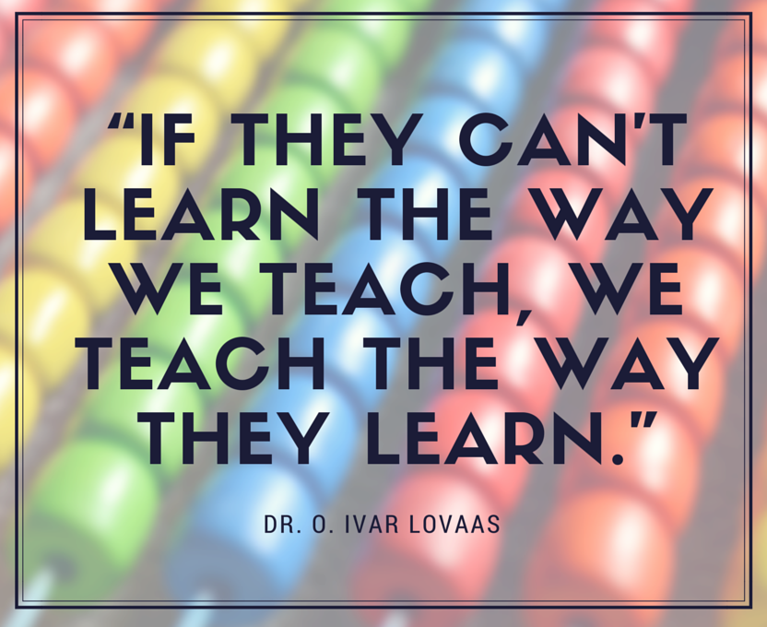
Supporting our Children
Pathological Demand Avoidance (PDA)

Slide 8
Supporting our Children
Pathological Demand Avoidance (PDA)
The video on the next page is a great overview of Pathological Demand Avoidance.
The clip lasts about 5minutes and is delivered by a UK Youtuber called Purple Ella. She provides a breakdown of what PDA is and the strategies that can be used to support those with PDA. You may also find her page useful for future reference.
The video is embedded in the next slide. To play it, you need to make sure you are viewing the presentation as a slide show, which you will find as a tab option at the top if you are not already doing so.
If the video does not play within the slideshow, the link is at the top of the page which you can copy and paste into your search engine.

Slide 9
Supporting our Children
https://youtu.be/aUeeyivGuW8
Pathological Demand Avoidance (PDA)

Slide 10
Supporting our Children
Pathological Demand Avoidance
Pathological Demand Avoidance (PDA) is a complex autism spectrum condition which is categorised by high anxiety and a need to be in control.
Parents and teachers tell us that it’s vital to understand how PDA differs from more typical autism spectrum conditions. Strategies which work well for children with autism can make things worse for children with PDA.
AVOIDANCE of ordinary demands is the most debilitating characteristic of PDA.
It’s driven by the child’s uncontrolled ANXIETY which can feel like a PANIC ATTACK.
Children will often respond by saying No, even if it’s something they actually enjoy.
Other tactics to avoid demands may be:
Delaying Distracting Negotiating Explosive behaviour
Falling on floor Shouting Charming Making excuses

Slide 11
Supporting our Children
Pathological Demand Avoidance
These steps may be helpful when working with individuals with PDA:
Remember that ANXIETY is what drives the behaviour of an individual with PDA.
If you always consider the anxiety rather than the behaviour you are more likely look for solutions and try to help. Also remember that sometimes anxiety stops individuals with PDA doing the things they want to do as well as the things they don’t.
Use a flexible, non-directive approach. Use phrases such as,
“I wonder how we might……..”, “I wonder if anyone can do this?”
Be aware of your facial expressions.
Individuals with PDA can be hyper sensitive to tone of voice and facial cues which can often cause anxiety.

Slide 12
Supporting our Children
Pathological Demand Avoidance
These steps may be helpful when working with individuals with PDA.
Offer choices. This gives the illusion of control and lowers anxiety. “Would you like to do X or Y first?” “Would you like to sit here or here to do your work?”
Use challenges: I bet you can’t finish this work before me!”
Praise indirectly: Let them hear you talking about them in a positive way. Or send postcards home to celebrate success.
Use areas of interest to engage and motivate: Look for ways to weave hobbies and interests into work.

Slide 13
Supporting our Children
Pathological Demand Avoidance
These steps may be helpful when working with individuals with PDA.
Reduce pressures and pick your battles. There will be days when anxiety is too high for an individual to comply with any demands. This is fine. You will have good and bad days. Look for ways you can support so that work gets done, i.e. offer to scribe, or finish things for them.
Have a sense of humour! Be prepared to take the mickey out of yourself too!!
Depersonalise Rules. “I am afraid you can’t go outside as its slippery and our Health and Safety rules forbid it” or “It’s the law”
Show empathy and sympathy: “I know you find maths really hard. I do too. Shall we work on this together?”
Use surprise or spontaneous rewards. “I love the fact you have worked hard, you can go on the computer now!

Slide 14
Supporting our Children
Pathological Demand Avoidance
These steps may be helpful when working with individuals with PDA.
Try to find a balance between routine and spontaneity. This will be dependent on the individual’s mood and anxiety levels. But lots of individual’s with PDA like surprise and don’t like routine if too rigid or set by others.
Use Complex Language. Sometimes it is possible to disguise a demand by wrapping it in complex language and making suggestions which allow the individual with PDA to think that they are in control.
Rewards need to be individualised, quick and personalised. Often group rewards are ineffective and don’t motivate the individual with PDA. You need to make sure they are motivational and change regularly.
Most importantly! Remember that everyone with PDA is different and should be treated with an individual approach!

Slide 15
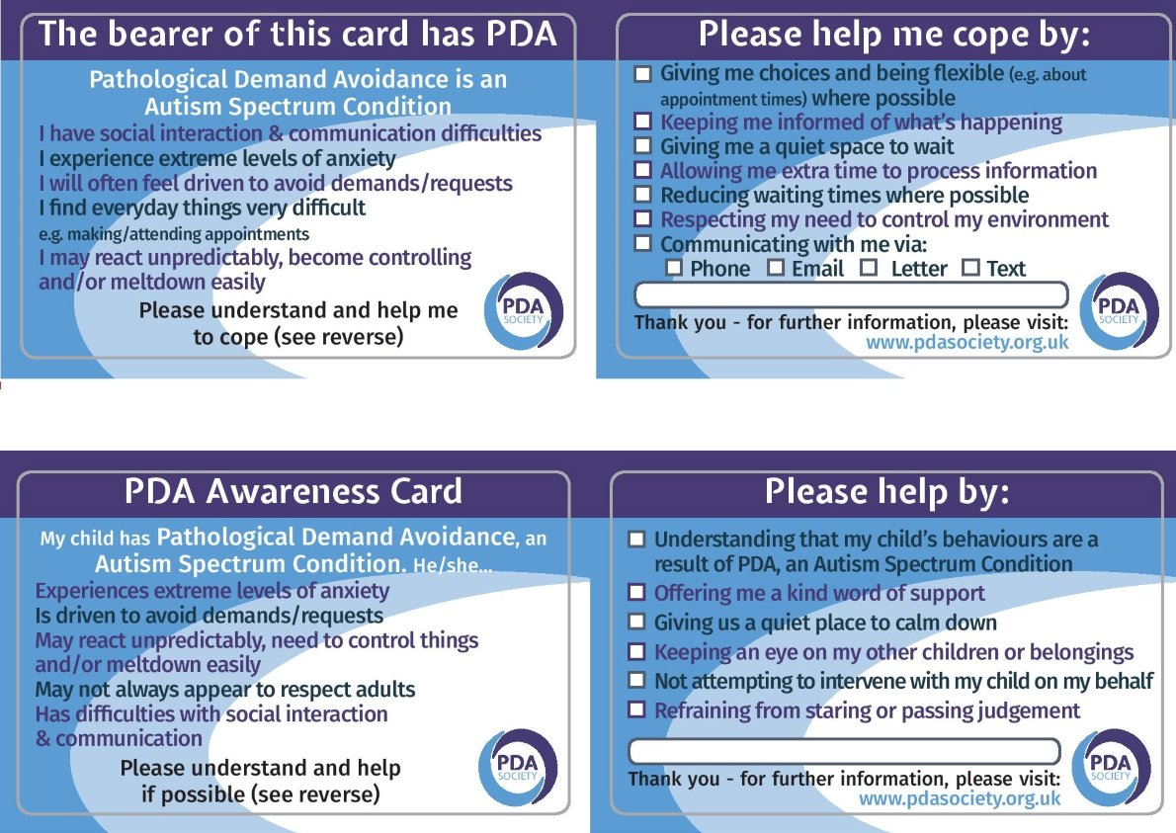
Supporting our Children
PDA

Slide 16
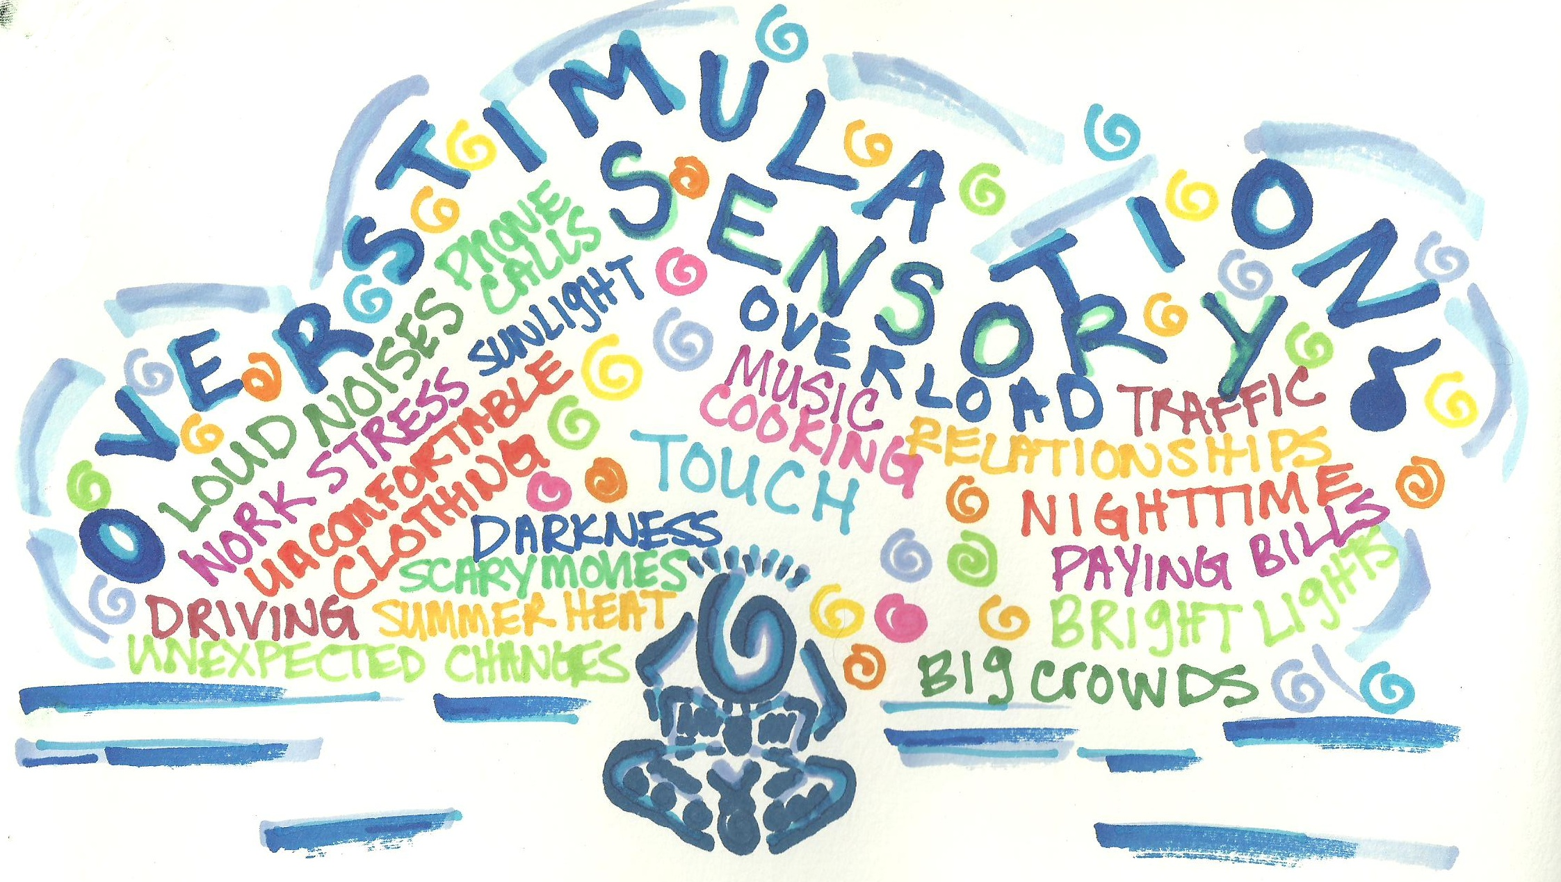
Supporting our Children
Autism and sensory differences

Slide 17
Supporting our Children
A
Autism and sensory differences
The brain needs sensory information to operate. It needs sound, vision, smell, taste, touch and movement
The way our brain organises this information affects our behaviour and the way we learn.
People with ASD usually have differences in how they react to sensory input
sensory seekers sensory avoiders

Slide 18
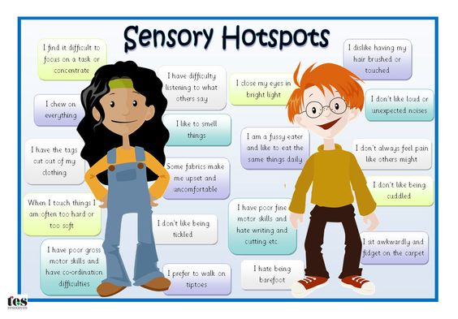
Supporting our Children
Autism and sensory differences

Slide 19
Supporting our Children
Autism and sensory differences
The video on the next page illustrates how overwhelming sensory processing can be.
The clip lasts about 1 minute and is delivered by the National Autistic Society. You may also find their website useful for future reference.
The video is embedded in the next slide. To play it, you need to make sure you are viewing the presentation as a slide show, which you will find as a tab option at the top if you are not already doing so.
If the video does not play within the slideshow, the link is at the bottom of the page which you can copy and paste into your search engine.

Slide 20
Supporting our Children
Autism and sensory differences
https://youtu.be/ycCN3qTYVyo

Slide 21
Supporting our Children
Autism and sensory differences
Examples of how to support those with hyper-sensitivities
Dimmed lights
Sunglasses to block overhead fluorescent lighting
Ear plugs or headphones in noisy environments
Closed door or high-walled work areas to block distracting sights and sounds
Avoidance of strongly scented products
Food options that avoid personal aversions (e.g. intensely spicy, textured, cold, hot, etc.)
Clothing that accommodates sensitivities (e.g. to tight waistbands and/or scratchy fabric, seams and tags)
Request for permission before touching

Slide 22
Supporting our Children
Autism and sensory differences
Examples of how to support those with hypo-sensitivities
Visual support for those who have difficulty processing spoken information
Sensory-stimulating toys (e.g. safe chewies and fidgets)
Opportunities for rocking, swinging and other sensory stimulating activities
Strong tasting and/or textured foods, cold beverages, etc.
Firm touch (according to preference)
Weighted blankets
Fun opportunities to practice physical skills (catching, dancing, jumping, running, etc.)
Furniture arrangements that reduce chances of bumping into sharp or hard surface

Slide 23
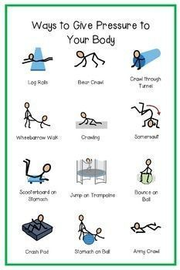
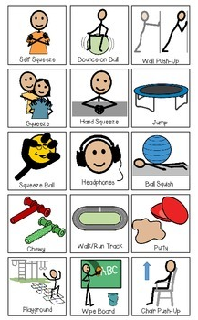
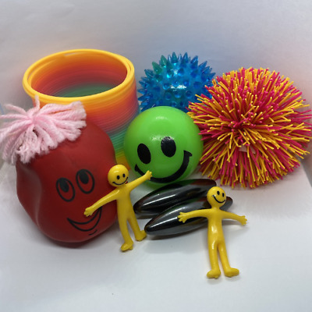
Supporting our Children
Leanne
Methods of Support

Slide 24
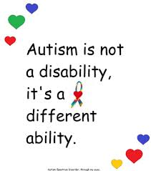
Supporting our Children
Structure at Home

Slide 25
Supporting our Children
Structure at home
The Need for Routine at Home
Children with ASD may like repetitive actions. You may notice them creating repetition themselves.
Routine may come naturally to children with autism and it’s not hard for them to learn a productive routine in the place of an unproductive one.
Routine can perhaps relieve stress. Children with ASD may have a particularly stressful life as they try to make sense of their surroundings. Adding routine may relieve the child’s stress.
Language using ‘Now’ and ‘Next’ to support the processing of instructions as demonstrated on the next slide

Slide 26
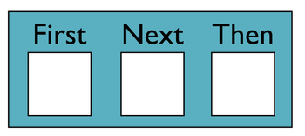
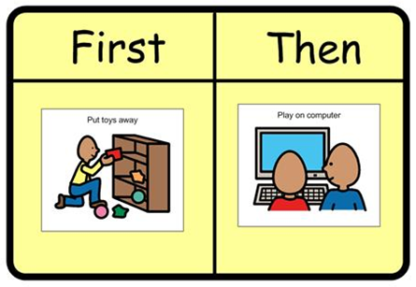
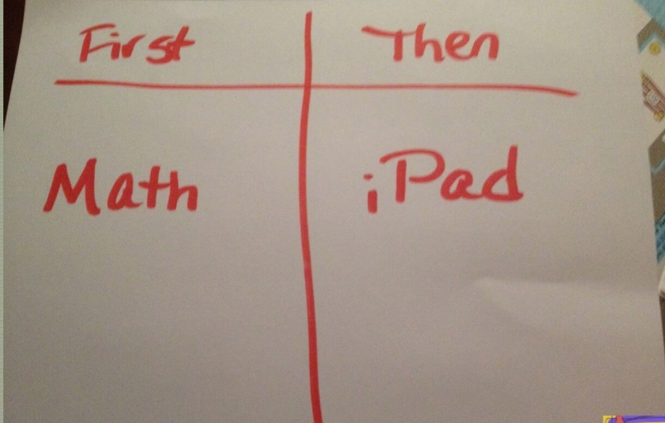
Supporting our Children
Structure at home

Slide 27
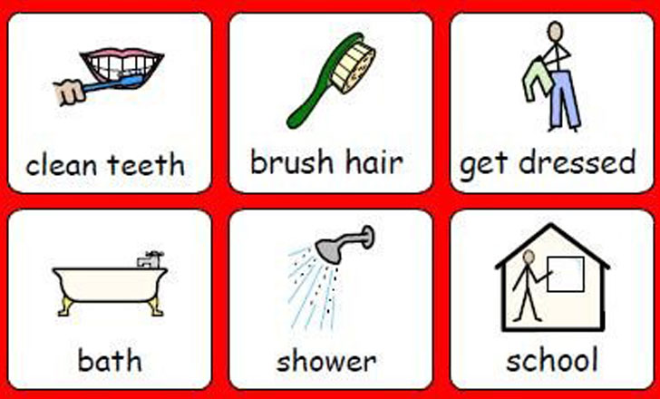
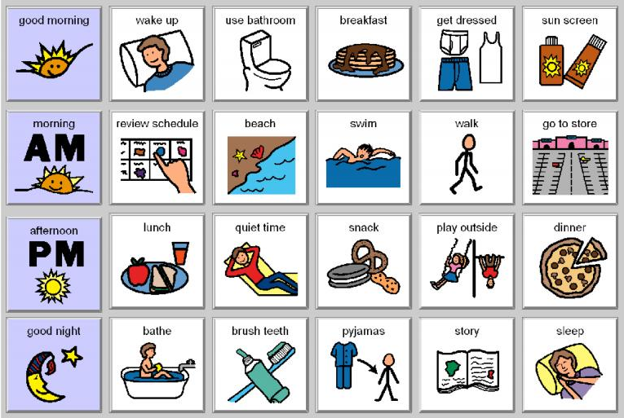
Supporting our Children
Structure at home
Visual supports are a communication tool that support the use of structure and routine. The encourage independence, build confidence, improve understanding and avoids frustration.

Slide 28
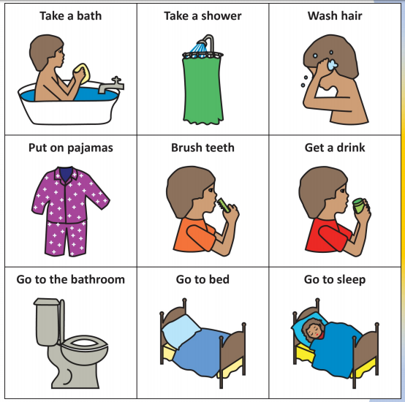
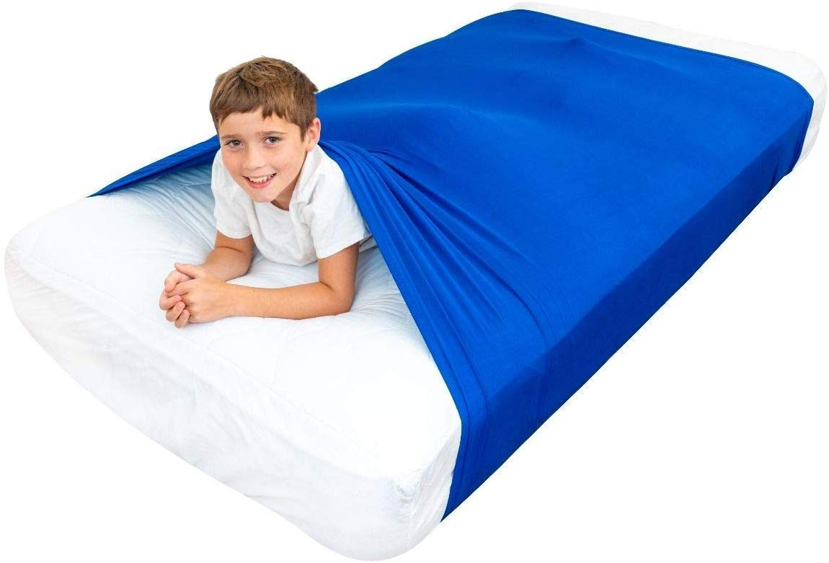
Supporting our Children
Structure at home
Even in the presence of a calming, consistent bedtime routine, some children may just have difficulty switching their minds off.
Children with autism may be hypersensitive to light and sounds when trying to fall asleep at night.
Avoid any substances that may be stimulants before bed, including caffeine and sugar.
Blue light that is emitted from electronic devices can cause difficulty sleeping, so try to limit the use of electronics at night and make sure that screens are off at least an hour before bedtime.
Possibly Provide a dark, quiet sleeping environment – heavy, blackout curtains and a white noise machine set to a low level may help.

Slide 29
Supporting our Children
Ger
After School Meltdown

Slide 30
Supporting our Children
The video on the next page illustrates how meltdowns can effect children and young people with autism.
The clip lasts about a minute and a half and is delivered by Ambitious about Autism. You may also find their YouTube page useful for future reference.
The video is embedded in the next slide. To play it, you need to make sure you are viewing the presentation as a slide show, which you will find as a tab option at the top if you are not already doing so.
If the video does not play within the slideshow, the link is at the bottom of the page which you can copy and paste into your search engine.

Slide 31
Supporting our Children
https://youtu.be/zseDI1V-BqU

Slide 32
Supporting our Children
After School Meltdown
What is a meltdown?
A meltdown is an intense response to an overwhelming situation. It happens when someone becomes completely overwhelmed by their current situation and temporarily loses control of their behaviour. This loss of control can be expressed verbally (eg shouting, screaming, crying), physically (eg kicking, lashing out, biting) or in both ways.
A meltdown is not the same as a temper tantrum. It is not bad or naughty behaviour. When a person is completely overwhelmed, and their condition means it is difficult to express that in another way, it is understandable that the result is a meltdown.
Meltdowns are not the only way an autistic person may express feeling overwhelmed. They may also refuse to interact, withdrawing from situations they find challenging or avoiding them altogether.

Slide 33
Supporting our Children
After School Meltdown
Here are some tips to try when your child returns from school…
Leave the questions for later.
It’s no big secret that busy is the new normal, and sometimes this leads to immediate questions about what kids learned during the school day, how much homework needs to get done and what happened during break times. Most kids need time to decompress and zone out before discussing the daily play-by-play.
A simple greeting and a hug or high-five is a great way to connect and provide emotional space from the school day. “I’m so happy to see you!” is a good after school greeting.
Prioritise Downtime.
Kids need time to play, hang out, read or create on their own terms. Unstructured time is the first thing to go when families get busy, and that can have big repercussions for kids.
After school routines may include plenty of time for kids to unwind and engage in free play.

Slide 34
Supporting our Children
After School Meltdown
Be present
We worry about the impact of screen time on the developing brain but we forget that our own screen time use can negatively impact our relationship with our kids. It’s important for us to disconnect from our phone and other screens when our kids come home from school.
The best way to reconnect with our kids is to be present when they are in our presence. Listen with intent. Let your child speak without attempting to fix any identified problems. Often, children need someone to listen while they work through their feelings and problem-solve out loud.
Play together
Spending time playing quietly together or reading together helps ease kids out of the overwhelming feelings that the end of the day brings and into a calmer state of mind.

Slide 35
Supporting our Children
After School Meltdown
Snack it up
Get ahead of the hunger crash by planning the after school snacks in advance. Many children come home starving and dehydrated, even if they communicate otherwise. This is not the time to try new foods. Put out snacks they enjoy with a glass of water and sit with them while they refuel.
Create a homework/after school routine.
Prevent homework wars by setting up a clutter-free spot to work and trying to do the homework at the same time each day. Set a timer and allow for plenty of breaks. If your child is struggling, write a note to the teacher and close the books for the day. Homework may be something they don’t have to do.
School can be very stressful for our children with Autism and may need additional time after school by being outdoors to release energy and self regulate.

Slide 36
Supporting our Children
Useful contacts and Websites
New Post Diagnostic Support Service – Scottish Autism
https://www.scottishautism.org/services-support/family-support/information-resources/post-diagnosis-support-carers
Different Minds
https://differentminds.scot/get-involved/
National Autistic Society – Renfrewshire Branch
https://www.autism.org.uk/directory/n/nas-renfrewshire-branch
https://www.autismlinks.co.uk/support-groups/group-support-scotland/nasrenfrewshirebranch?region=
Always Included (based in Johnstone)
Facebook – A.I 079 2522 1811
Renfrewshire Carers Centre
https://renfrewshirecarers.org.uk/carer-training/

Slide 37
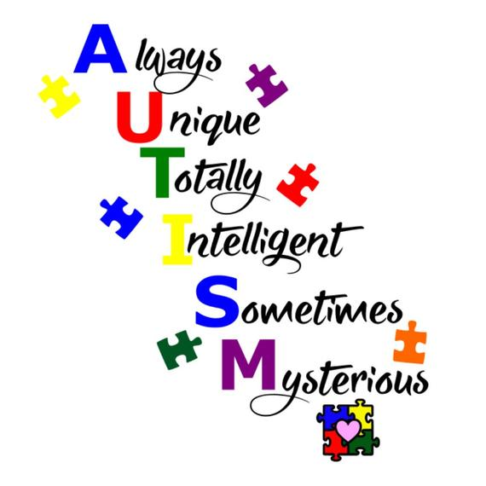
Supporting our Children

