Slide 1
Normalising Anxiety Course Overview

Slide 2
Fight Flight or Freeze response
Fight Flight Freeze – A Guide to Anxiety for Kids - Bing video

Slide 4
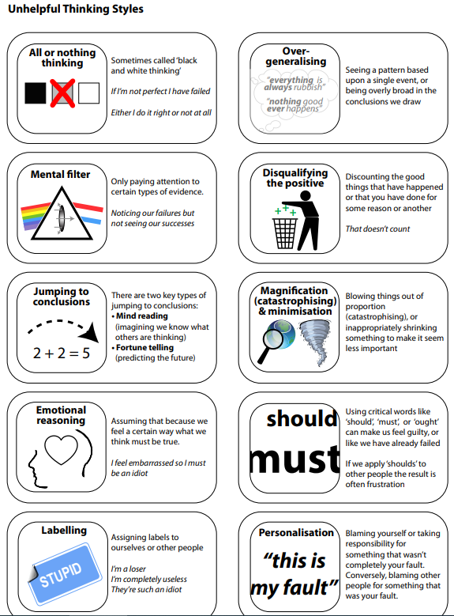

Slide 6
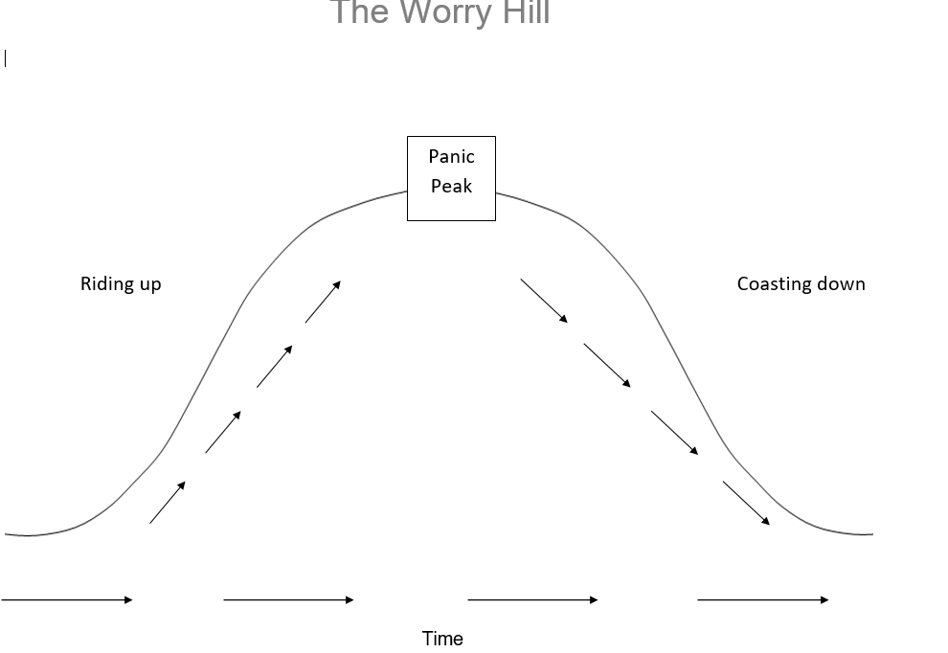

Slide 7
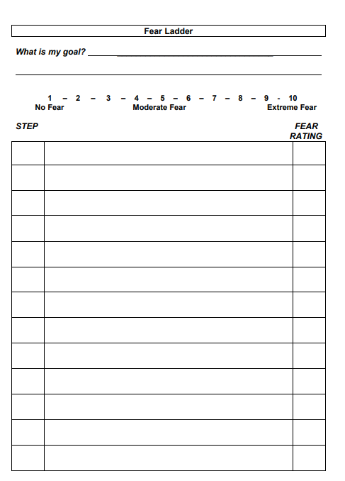

Slide 8
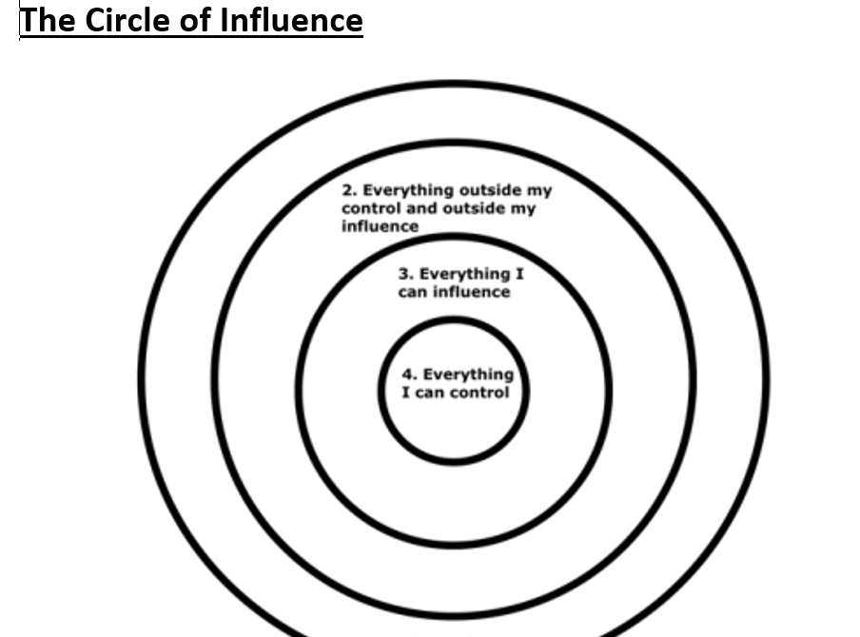

Slide 9
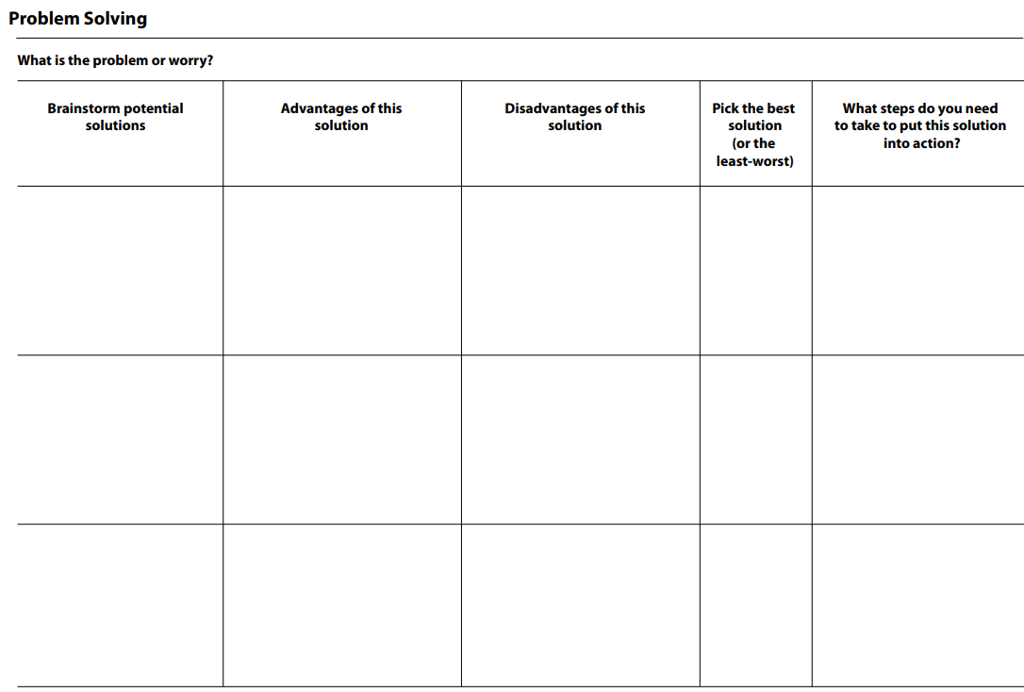

Slide 10
