Slide 1
Afternoons
Philip Larkin

Slide 2
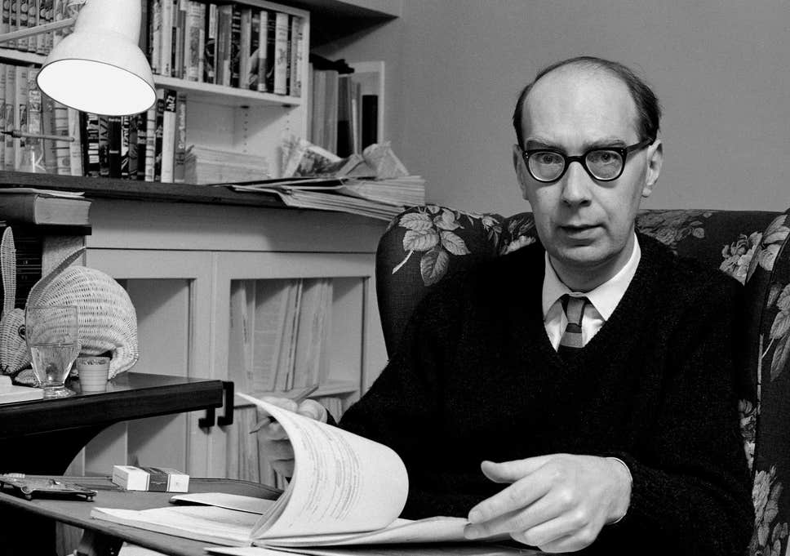
Philip Larkin
Philip Arthur Larkin (9 August 1922 – 2 December 1985) was an English poet, novelist, and librarian. His first book of poetry, The North Ship, was published in 1945, followed by two novels, Jill (1946) and A Girl in Winter (1947), and he came to prominence in 1955 with the publication of his second collection of poems, The Less Deceived, followed by The Whitsun Weddings (1964) and High Windows (1974). He contributed to The Daily Telegraph as its jazz critic from 1961 to 1971, articles gathered in All What Jazz: A Record Diary 1961–71 (1985), and he edited The Oxford Book of Twentieth Century English Verse (1973). His many honours include the Queen's Gold Medal for Poetry. He was offered, but declined, the position of Poet Laureate in 1984, following the death of Sir John Betjeman.

Slide 3
See Think Wonder

Slide 4
Afternoons
This is a melancholy poem, which reflects on the subject of marriage. The poem deals with Larkin’s view on young mothers watching their children playing in a playground and he concludes that marrying young leads to the mothers losing their identities. Larkin’s description of young mothers taking their children to a playground seems normal but the narrator’s point of view on life is expressed. What seems like an ordinary, everyday occurrence highlights the theme of change and how it cannot be avoided, like the passing of time.

Slide 5
Read the poem
Think about and answer the following:
At the beginning of the poem, what does Larkin observe – describe what he sees
List the chores which the young mothers must complete in a day and explain what Larkin is saying about their lives
What might the message of Larkin’s poem be? What is he saying about motherhood/marriage?

Slide 6
Comprehension Questions
During what season is the poem set? Why might this be significant?
Who does the poem focus on in the first stanza – mother or child?
List as many ‘skilled trades’ as you can
In the final stanza, what are the children doing?

Slide 7
Techniques
Contrast
Word Choice
Enjambment
Parenthesis
Alliteration (sibilance)
Symbolism
Juxtaposition

Slide 8
Discuss and answer the following questions:
What is the significance of “In the hollows of afternoons”?
What is meant by “Behind them, at intervals/Stand husbands”?
What does the line “(But the lovers are all still in school)” suggest?
What does Larkin mean when he says the women are “To the side of their own lives”?

Slide 9
Language questions
Why is the poem entitled ‘Afternoons’?
Explore the connotations of the following words
“summer is fading”
“New recreation ground”
“Young mothers assemble”
“Hollows of afternoons”
“At intervals”
“Their beauty has thickened”
“Something is pushing them/To the side of their own lives”
“so intent”
“expect”
What do you think of the collective noun in the following phrase: “An estateful of washing”
Do you find the language in the poem positive or negative? Explain your answer fully with reference to the poem
What image is created in the lines:
“At swing and sandpit
Setting free their children”

Slide 10
Structure
Why is the season of autumn important?
Summarise the content of each stanza
What tense is the poem written in and what impact does this have?
What might you say about the rhythm and rhyme scheme?
In the second stanza, how does Larkin use prepositions? What is the effect?
How does Larkin use juxtaposition?
Why are the words “Our Wedding” capitalised?
Can you find any links between the structure of the poem and the structure of life?

Slide 11
Annotations
Stanza 1

Slide 12
Title - Afternoons
Women in the afternoon of their lives
Something that is always the same – inevitable
Something ordinary

Slide 13
Summer is fading
Seasons used to represent (symbolise) stages of life
Summer no longer at its peak – like the women
Metaphor for progression of life
Summer is usually a happy time but it is coming to an end – sense of losing
A sad tone is created
“fading”- gradual, don’t notice
“fading” – growing dimmer – less beautiful, vanishing like the mothers’ beauty

Slide 14
The leaves fall in ones and twos
Sign of autumn
Not always noticeable
Gradual, continual decay

Slide 15
From trees bordering
“bordering” – stop escape?
Mothers are also bordering – the children are protected in the middle

Slide 16
The new recreation ground
Newly built, ordinary, fun for kids
“new” – new stage
“recreation” – children, recreation of species?

Slide 17
In the hollows of afternoons
Assonance highlights the emotions – not busy, a brief rest
The mothers are unfulfilled
“hollows” – emptiness, adds to the mood of loss

Slide 18
Young mothers assemble
“young” – not long out of school, don’t have youthful lives
“mothers assemble” – formal connotations, routine, school, everyday, regimented, no pleasure

Slide 19
At swing and sandpit
Sibilance – gains momentum – energy and vigour of children

Slide 20
Setting free their children.
“setting free” – independent, don’t need mothers so much
Enjambment of stanza 1 reinforces how age can creep up and how dull afternoons seem to drag on

Slide 21
Annotations
Stanza 2

Slide 22
Behind them, at intervals
Women’s eyes on children
Women in front, marking territory?
Are the husbands supporting them? Or not important?
Effects of passage of time
Physical and emotional distance, only see them at certain times – no romance

Slide 23
Stand husbands in skilled trades
Boring, dull yet steady
Working class
Not professionals

Slide 24
An estateful of washing
(estateful – amount of)
Ordinary, humdrum tasks now fill their lives
Symbolises the domestic drudgery of their lives
“estateful” – an uneventful place to live

Slide 25
And the albums, lettered
Symbolic of hopes and dreams

Slide 26
Our Wedding, lying
Children are important now
Happened recently?
‘lying’ – discarded, pun? Promises were a lie?

Slide 27
Near the television:
Stories on TV/entertainment, like it happened to someone else
TV gets more attention than them

Slide 28
Before them, the wind
Wind of change? Weather changing

Slide 29
Is ruining their courting-places
Disturbed by wind
Enjambment suggests life (unbroken cycle) goes on, its changed for them but new generation is discovering it

Slide 30
Before them, the wind Is ruining their courting-places
Women see their past slipping away

Slide 31
Annotations
Stanza 3

Slide 32
That are still courting-places
Repetition – doomed to repeat parents’ lives
The courting-places are no longer for the mothers

Slide 33
(But the lovers are all in school)
Parenthesis – brackets remind us that the kids aren’t at that stage yet
The next generation are learning (about life?)

Slide 34
And their children, so intent on
Children’s demands are disrupting their lives
“intent” – single-minded about learning/knowledge

Slide 35
Finding more unripe acorns
“unripe acorns” – innocent, unaware of what is to come
Will grow into an oak – still young
Symbolises search for knowledge and growth
Child to adult takes time but flies by

Slide 36
Expect to be taken home
Children are demanding and mothers feel obligation to them

Slide 37
Their beauty has thickened
No longer young
Lost their figures/youthful beauty
Weightiness, rooted to the spot

Slide 38
Something is pushing them
Not specific – is it the children?
‘pushing’ – forceful, no control
A cynical tone

Slide 39
To the side of their own lives
“To the side” - Women are no longer the focus, they are looking on
“own lives” – no real control over the direction, focus only on family

Slide 40
Overall Points

Slide 41
Contrast between old and new. Newness is an unattractive idea in the poem, it’s a reminder of what the women find slipping from them. The new makes them feel old and different
Present participles (-ing) – indicates the gradualness with which this change is creeping over them. It also appears continuous

Slide 42
Critical Essay Question
Choose a poem which creates a mood of hope or despair or mystery.
With reference to appropriate techniques, explain how the mood is created and discuss how it enhances your appreciation of the poem as a whole.

Slide 43
Plan – Vivid sense of time/place to highlight central concerns of poem
Intro – TART + BO
P1 – playground
P2 – the house/estate
P3 – seasons
Conc - TARRT
2 quotes per paragraph

