Slide 1
Welcome to our Curriculum Evening
29.8.24

Slide 2
Plan for today
Introduction and welcome
Time to see the children’s classrooms and ask any questions.

Slide 3
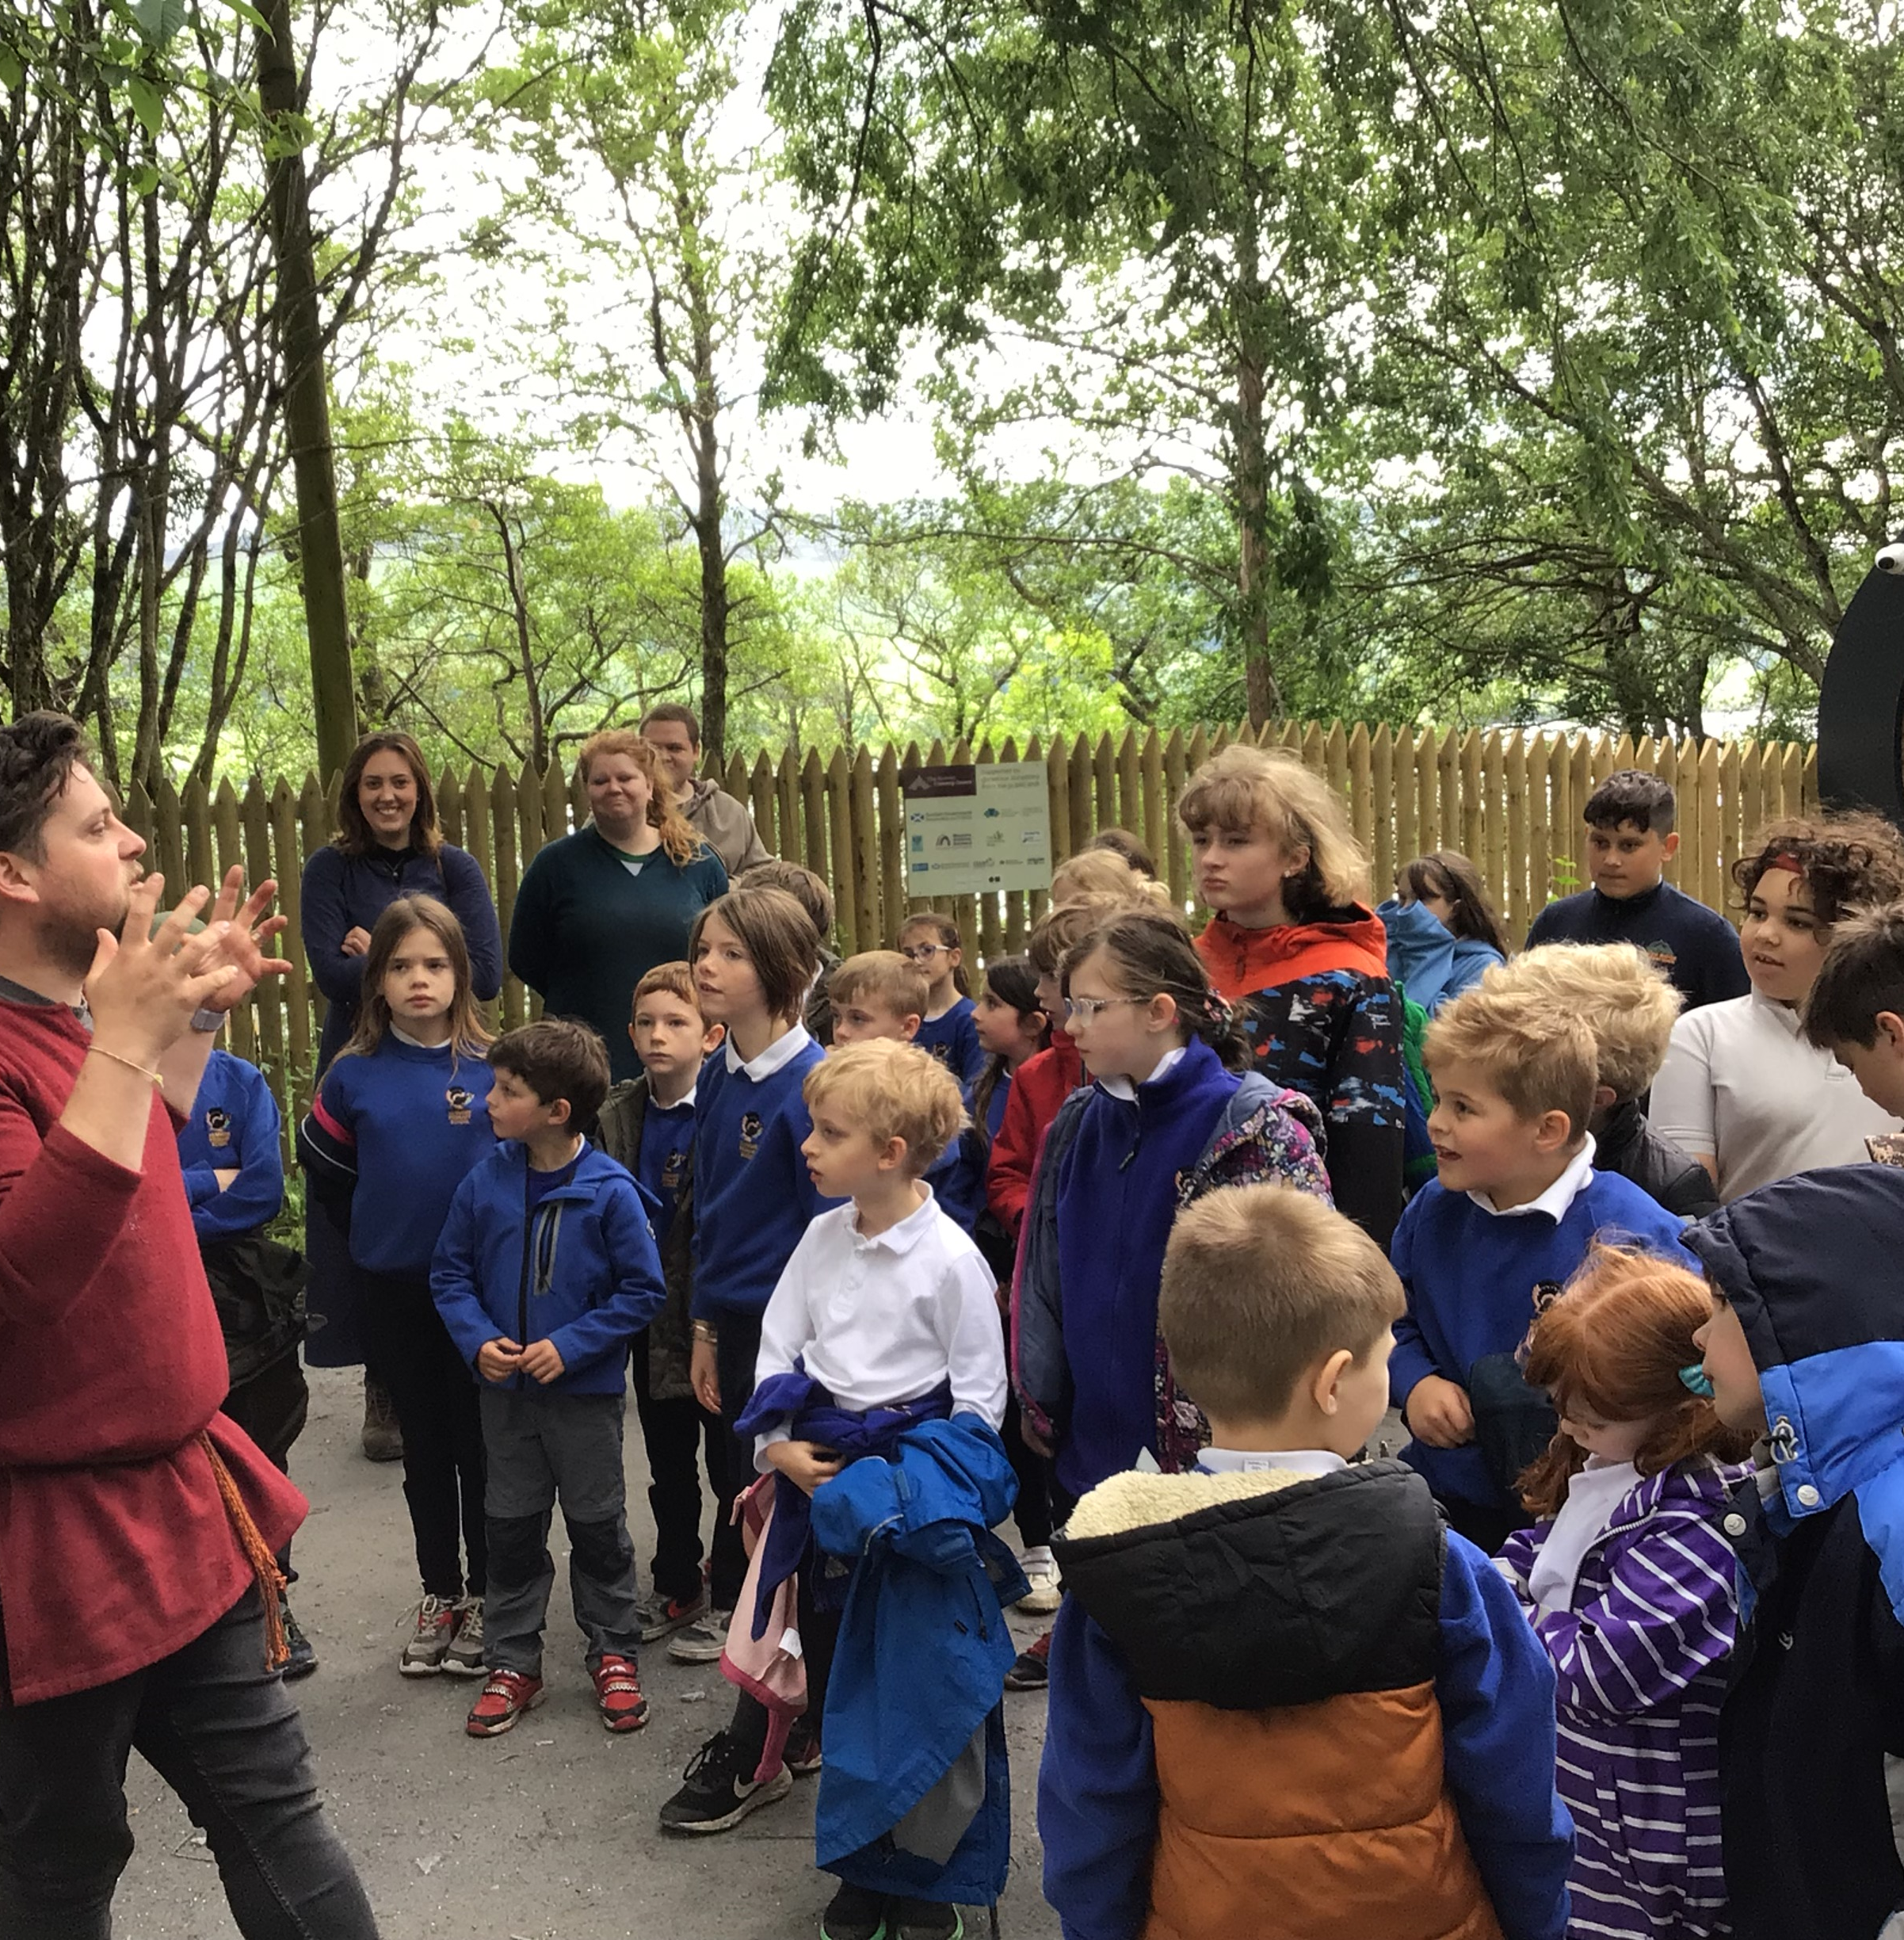
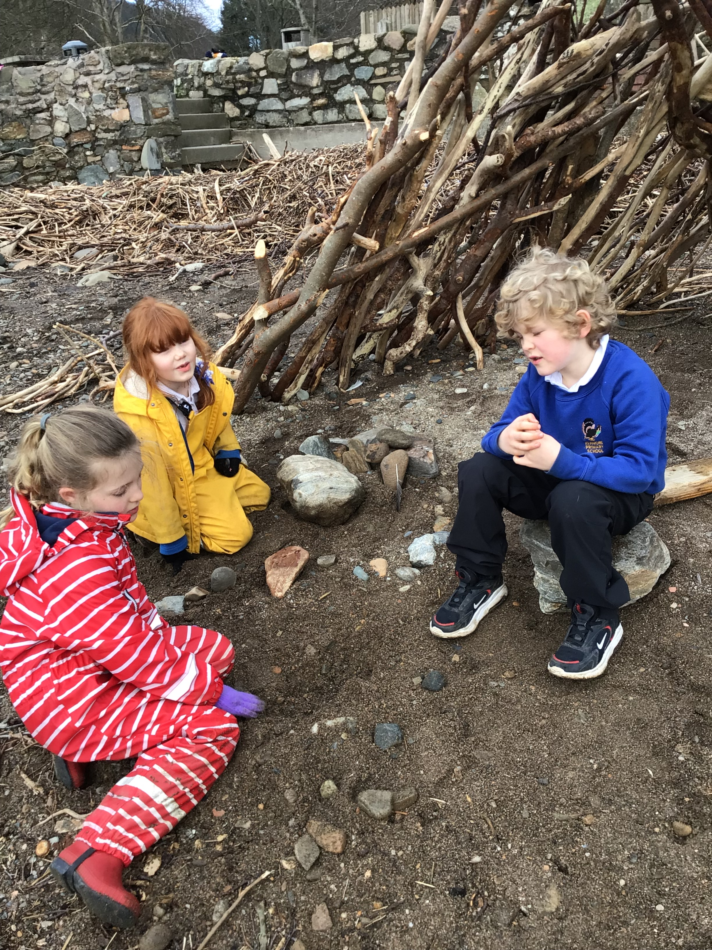
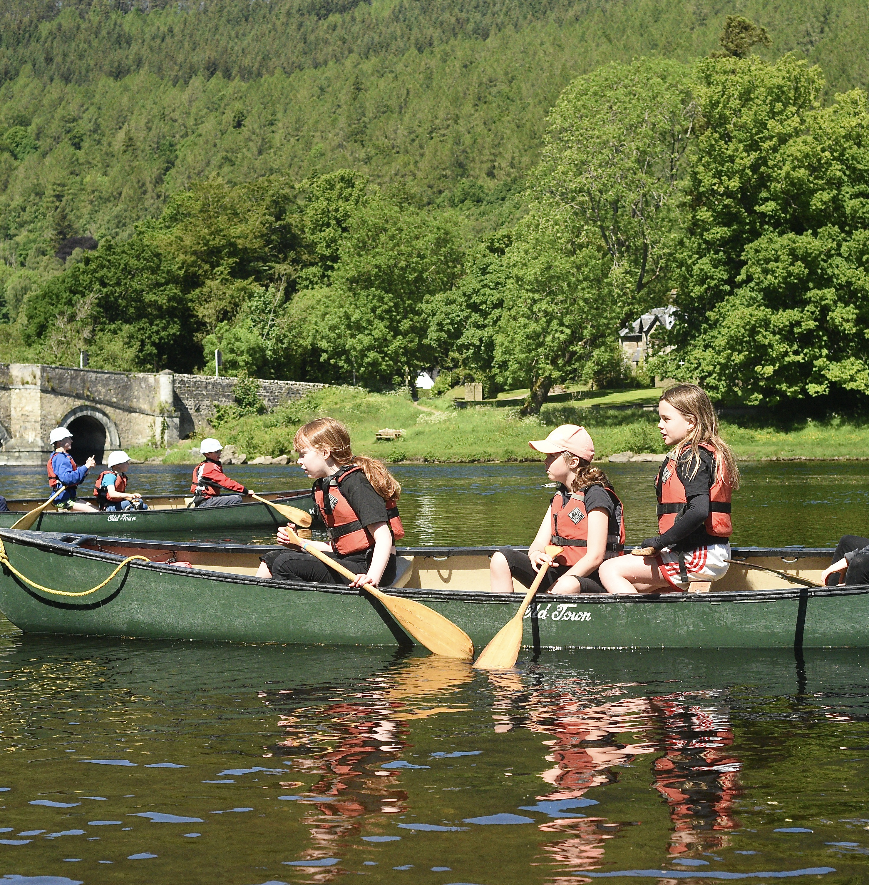
Last Session
Last year we had a great year with a lot of amazing experiences. This year we are hoping to build upon this and create learning experiences which are relevant, meaningful and children want to study.

Slide 5
Opportunities for personal achievement
Sports – skiing, kayaking, Wee Robbie, cricket, rugby, orienteering, Forest schools.
Competitions in the arts, school shows,
Own targets in skills for learning, life and work.

Slide 6
Our Values
Rights of the Child
Be
kind
Be
respectful
Be
responsible
42 rights
Rights Respecting School
Assemblies
Throughout our curriculum
Ethos and life of the school as a community

Slide 7
We don't have a clear vision … yet!

Slide 8
Interdisciplinary Learning
4 showcases for the 4 terms which we invite you to join us at.
Bundled around different areas of the curriculum
Term 1 – The Healthiest Town – Health and Wellbeing
Forest School runs all year and develops really quality life and work skills.

Slide 9
Our improvement plan
To improve our curriculum by creating a shared vision and designing a curriculum which fits our school context.
To increase our understanding of what it means to be a nurturing school.
To make our learning more visible and increase our parental involvement and enagegment in learning

Slide 10
Health & Wellbeing
Maths and Numeracy
Literacy
Curriculum areas and subjects
Modern Languages
Expressive Arts
Social Studies
RME
Science
Technologies

Slide 11
How can you help?
Keep in touch
Attend Parent Council and events
Volunteer
Add your skills to the curriculum
Help us define the vision
Follow us on Twitter!

Slide 12
Please watch the video we presented at The Healthiest Town Speaker event.
https://youtu.be/YvTF94FNEpQ?si=3emPI1xwaBcqdpvH

Slide 13
Task- What do you want the school to be like for your child? At the next Parent Council we will be asking parents their thoughts on this.

