Slide 1

UCAS Information Evening 2020
Security marking: PUBLIC

Slide 2

The role of UCAS
Central organisation through which applications are processed for entry to full-time higher education (HE) courses in England, Wales, Scotland and Northern Ireland
It operates on behalf of all full-time courses at member institutions

Slide 3
Course providers
350+ universities and colleges:
  4 in Northern Ireland
  15 in Wales
  19 in Scotland
  324 in England
  one in mainland Europe
  at the time of checking
35,000+ courses available

Slide 4
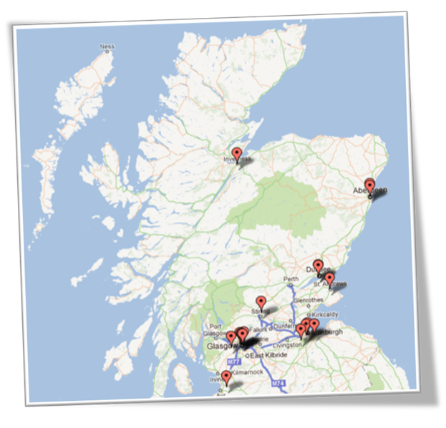
Abertay University, Dundee
Edinburgh Napier University
Glasgow Caledonian University
Glasgow School of Art
Heriot-Watt University, Edinburgh
Open University in Scotland
Queen Margaret University, Edinburgh
Robert Gordon University, Aberdeen
Royal Conservatoire of Scotland, Glasgow
SRUC (formerly Scottish Agricultural College)
University of Aberdeen
University of Dundee
University of Edinburgh
University of Glasgow
University of St Andrews
University of Stirling
University of Strathclyde
University of the Highlands and Islands
University of the West of Scotland

Slide 5
Why higher education?
Opportunities while studying:
Chance to study a subject they are passionate about.
Achieve a qualification that could lead to their chosen career.
Grow in confidence, make lifelong friends, and gain independence and important life skills that will widen their prospects.
With a degree, they’ll have:
  the opportunity to follow their career path
  better job prospects, as many employers target graduates
  higher earning potential
Notes:
Higher Education – referring to University level

Slide 6

The applicant journey
Notes:
3 part process where ownership is on the young person but ultimate aim is them achieving success, which can present itself in a range of ways (degree, job, skills, experiences, opportunities, networks)

Slide 7

Research – it’s free!
Register in the UCAS Hub to explore options – find favourite courses and search for virtual events
UCAS Higher Education Exhibit – trip in S5 (hopefully!)
University prospectus and website
Learning from others – speak to current students, student videos, blogs and case studies
The UCAS career finder tool is ideal for considering options after education
Notes:
Student ownership required here
UCAS Virtual Exhibition - Tue 29 September 2020 - 10:00 to 16:00 – book online (for S5 pupils looking at applying this year)

Slide 8


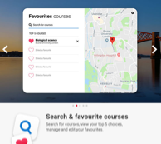
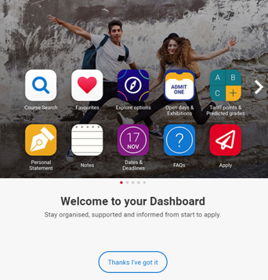

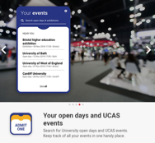
The UCAS Hub
Notes:
One stop shop to access everything UCAS related

Slide 9
Choosing the right course for you
What does the course cover?
Courses with the same title may be very different.
Look carefully at the core course content, and the range of optional studies/modules available.
Which modules are the most interesting and relevant to career aspirations?
See if the course or university/college offers any internship, placement, or study abroad opportunities.
How is the course taught – structured teaching, or more independent research? How many lectures are there, and how much group work will be done in seminars?
How is the course assessed?
Notes:
First Step is deciding what it is that the young person wants to study
Which modules are the most interesting and relevant to applicants career aspirations?
How many lectures are there and how much group work will be done in seminars?
What combination of exams, coursework or presentations is the course assessed by?
Who are the tutors and are they experts in areas the applicant wants to learn about?
What subject areas do they specialise in?
Can applicants study abroad or get help with work placements?
Basing their choice considering all factors discussed

Slide 10
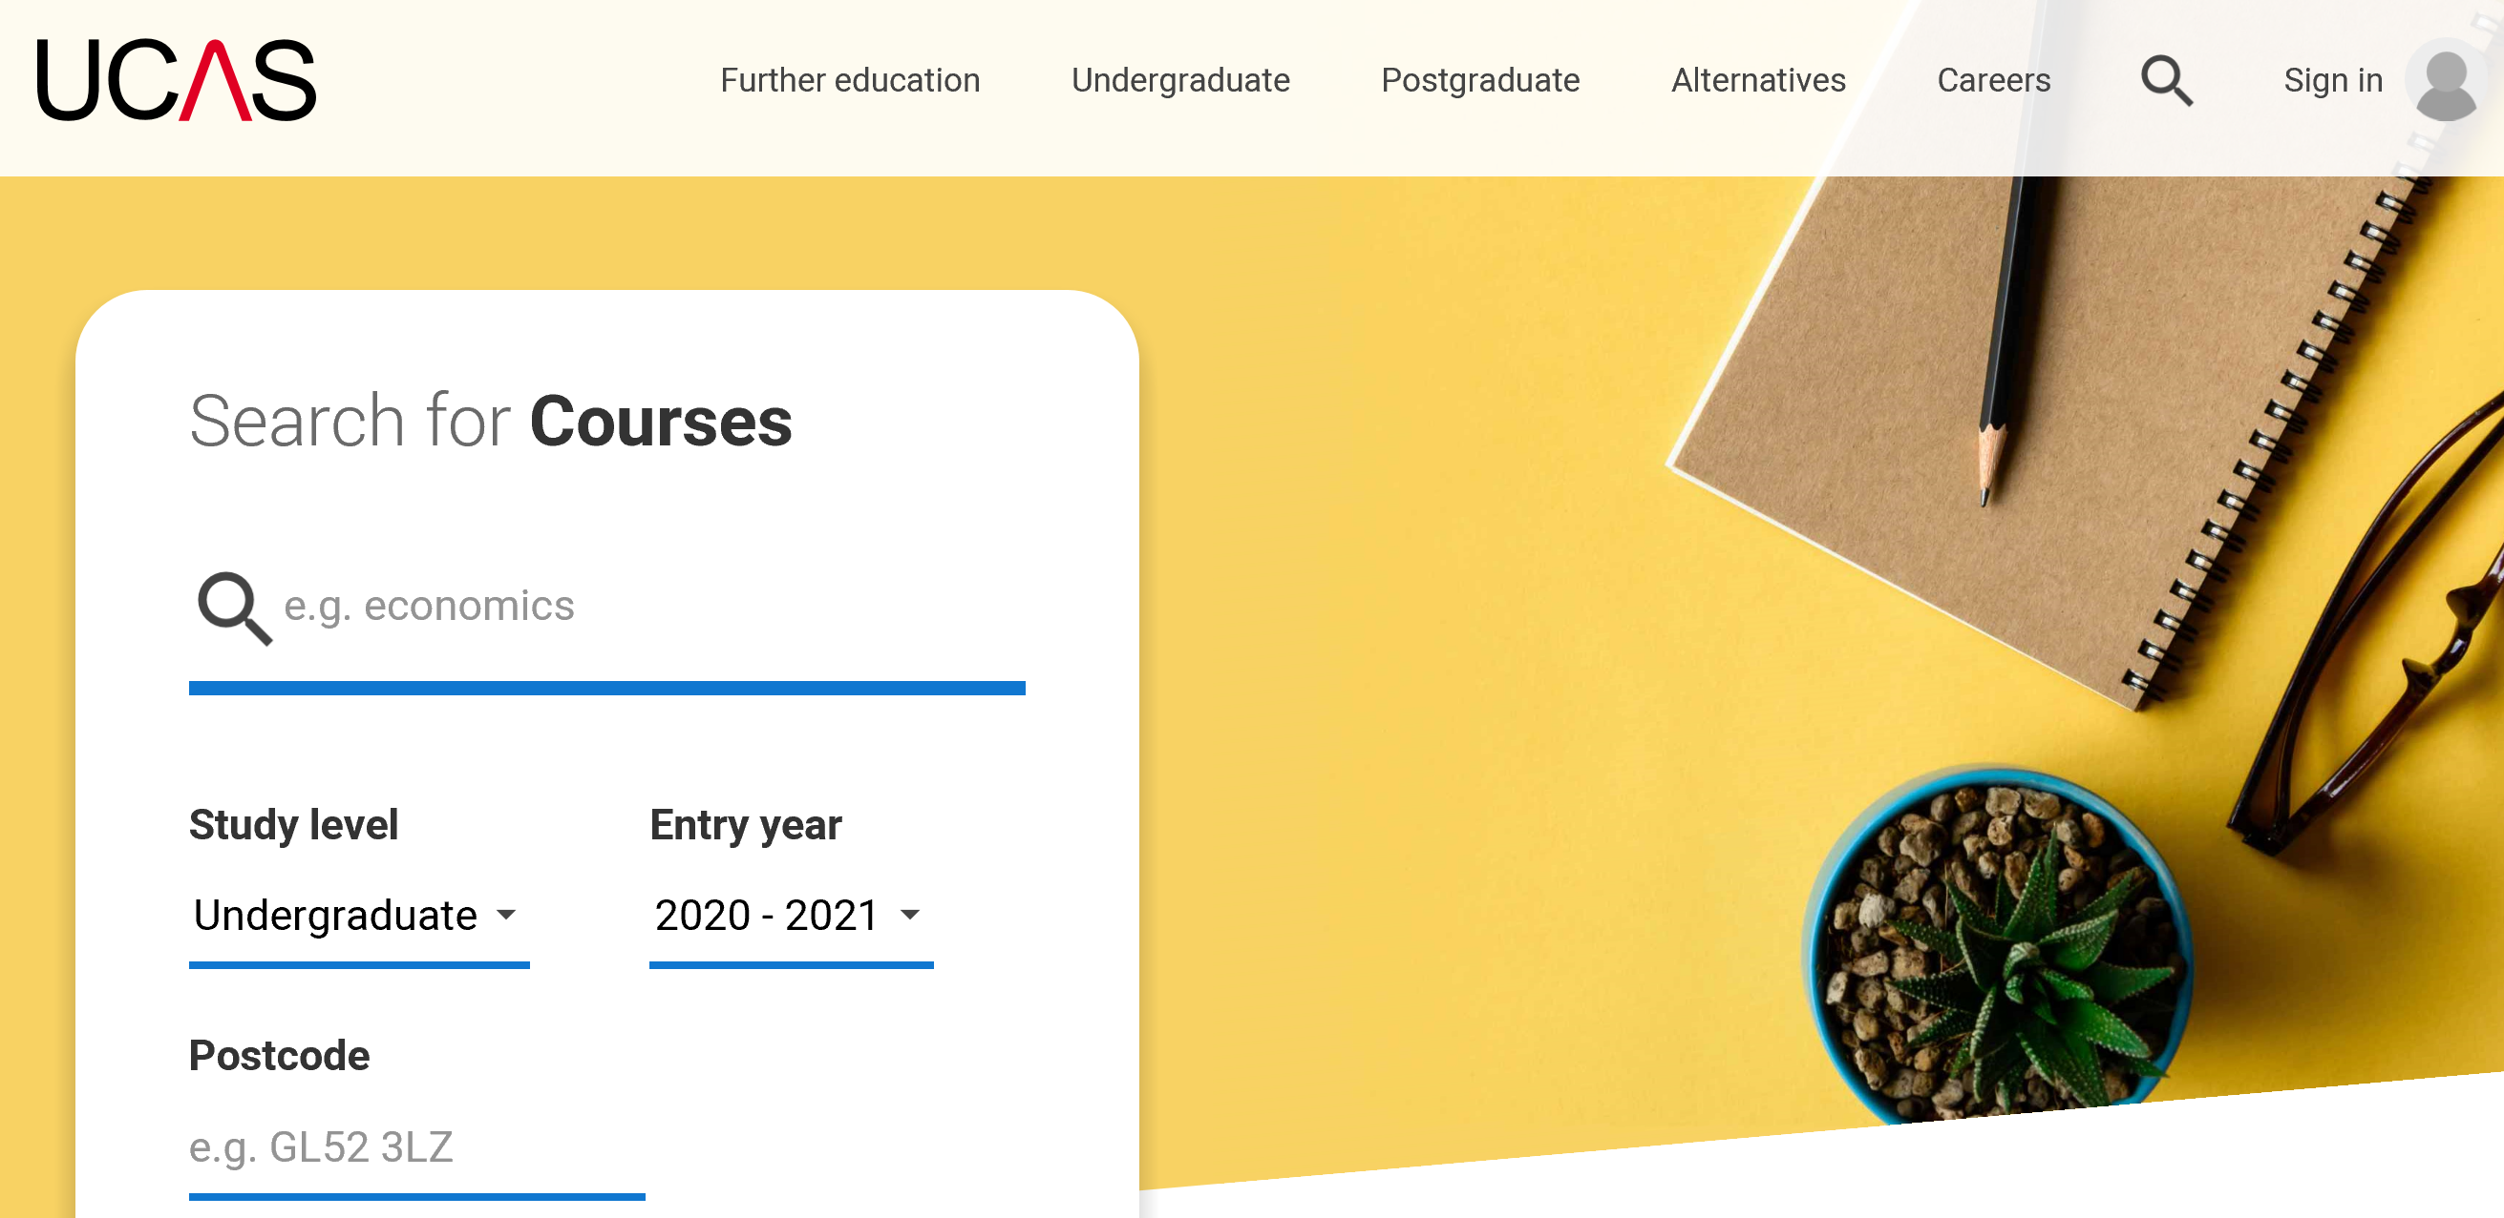
Researching Courses
Your son or daughter can use the UCAS search tool at search.ucas.com
Key features include:
mobile-friendly design
advanced filtering and sorting options
ability to shortlist and save searches
free text search
Notes:
Great tool as a first step in doing their research
Type in Maths for example and it will bring up all related courses
Young person can then research the course in more detail directly with uni

Slide 11
Choosing the right university for you
Style – from traditional, with a focus on subject-based courses and research, to modern universities with a greater focus on vocational courses.
Location – some are based in large cities, others in smaller towns. This can have a major influence on the environment and lifestyle on offer.
Size – larger universities can have more than 20,000 students, whereas some of the smallest have only a few thousand.
Culture and facilities – influenced by a range of factors, including the diversity of students who attend.
What graduates do – all universities collect destination statistics. It can be interesting to find out the types of jobs or further study students go on to.
Tuition fees – vary between course providers. Check if there are any scholarships/bursaries available.
Living costs – accommodation, transport, and food can vary enormously.
Notes:
Do they have sports facilities or societies to join?
How near home, a city center or the countryside are they?
Is it campus based?
What are transport links like?

Slide 12

Notes:
Virtual this year

Slide 13
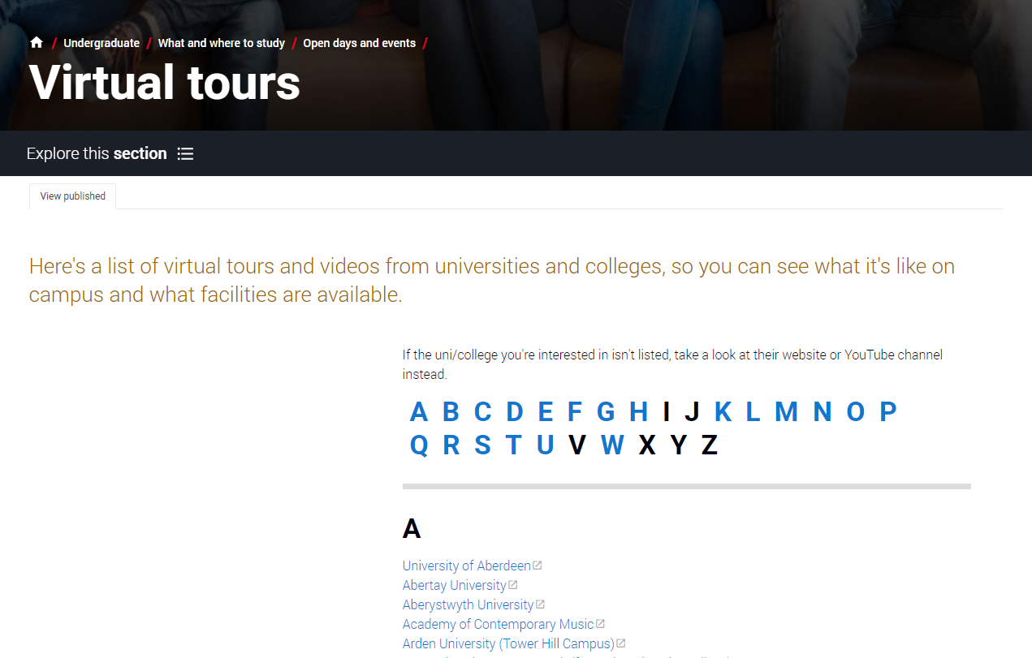
Virtual tour search & open days
Notes:
Youtube has clips for virtual purposes this year
No harm in driving down and just having a look around
Virtual open days are being advertised on UCAS website as shown in screenshot above and through the Hub

Slide 14
Contact the University
Phone or email the admissions office for up to date information.

Slide 15





Apply key facts…
Simple application cost:
  one choice – £20
  two to five choices – £26
It’s an online application.
5
Maximum of five choices.
Equal consideration.
Choice restrictions:
medicine, veterinary medicine/science, dentistry
(maximum of four)
Oxford or Cambridge
‘Invisibility’.
Notes:
Equal consideration – must be in my the deadline to ensure this
UCAS operates an invisibility policy. This means that each university that your son/daughter applies to can't see which other institutions have also received an application from them. They will only be able to see this information after the applicant has made their firm and insurance decisions.

Slide 16
When to apply for 2021 entry
19 May UCAS Undergraduate Apply opens for 2021 entry.
8 September First day for receipt of completed applications.
1 October Deadline for Conservatoire applications
15 October Application deadline for courses in medicine, veterinary medicine/science, and dentistry, and courses at Oxford or Cambridge.
15 January Equal consideration application deadline.
25 February Extra opens.
30 June Last date for applications before Clearing.
* All 18:00 (UK time)
Notes:
Those studying Law or Medicine/Dentistry or to Oxbridge will be required to sit entrance tests, which young people have been made aware about.
Extra - If you included five choices on your application, have received decisions from all five, and weren’t accepted, or if you declined the offers you received, you will be able to use Extra.
Clearing - Clearing matches applicants to university places that are yet to be filled. It's available to anyone who has made a UCAS Undergraduate application and doesn't hold any offers

Slide 17
School Deadlines
June Register online. The buzzword is crieff21
Oct 2nd First draft of personal statement due and Oxbridge, Conservatoire, Medicine, Dentistry applications completed and sent off
Nov 6th Final draft of personal statement and information for references forwarded to Guidance Teacher
Nov 27th UCAS application completed and paid online. Guidance Teacher can now add your reference
Dec 18th All references approved and applications sent to UCAS
Notes:
Support appreciated in ensuring young people meet these

Slide 18
Completing the UCAS application
A student registers at: ucas.com/apply
Sections to complete:
1. Personal details
2. Additional information
3. Student finance
4. Choices
5. Education
6. Employment
7. Personal statement
8. Referee details
Teacher/ adviser adds their reference
Applications are sent to UCAS
Universities/ colleges make their decisions
Notes:
At this stage all students should have registered, completed sections 1-6 (deadline for 18.9.20)
Pupil is responsible for checking their decisions
Worth noting that in their application there is a box they have to tick to ensure we can see what their offers are

Slide 19
The personal statement
The only section the applicant has full control over.
Their only chance to market themselves individually.
Maximum of 4,000 characters, or 47 lines.
One personal statement for all choices.
Minimum of 1,000 characters.
No spelling/grammar check.
No formatting.

Slide 20

The personal statement
The only section the applicant has full control over.
Their only chance to market themselves individually.
One personal statement for all choices.
  Maximum of 4,000 characters, or 47 lines.
  Minimum of 1,000 characters.
  No spelling/grammar check.
  No formatting.

Slide 21
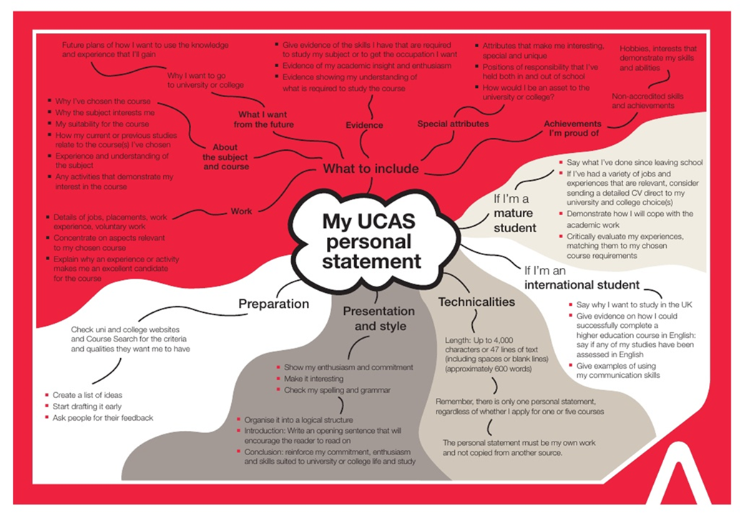
School Support
The only section the applicant has full control over.
Their only chance to market themselves individually.
One personal statement for all choices.
  Maximum of 4,000 characters, or 47 lines.
  Minimum of 1,000 characters.
  No spelling/grammar check.
  No formatting.
PSE LESSONS
University Speakers
Guidance Teachers
REACH/ACES

Slide 22

The personal statement
The ABC method
Activity: What have you done?
Benefit: What skills have you gained?
Course: How will this prepare you for the course?
Notes:
Deadline for this is 2nd October

Slide 23

Funding
Fee Code – UK applicants are 02
Notes:
Scottish students do not have to pay fees if studying in Scottish universities, but this is not done automatically – still have to apply through SAAS
Loans and bursaries are also available through SAAS

Slide 24



Decisions
Universities and colleges will review the:
They may also ask for:
And make one of three decisions:
personal statement
    Unconditional offer
Admissions test
qualifications
Interview
    Conditional offer
reference
    Unsuccessful
Portfolio/audition
Notes:
Unconditional – place is theirs
Conditional –will have to achieve a certain grade in a certain subject for example to be awarded with a place
Unsuccessful – place has not been offered

Slide 25
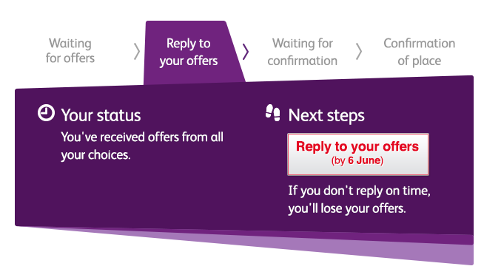

Tracking applications
Track allows applicants to:
follow the progress of their application 24/7
see their choices and personal information
view their offers
reply to offers online
In Track, a student can hold up to two offers:
  firm – if they meet the conditions of the offer they will be placed
  insurance – if they are not placed with their firm choice, they may be placed with their insurance choice
  Track will show their reply date
Notes:
If an applicant does not receive offers at the same time as their friends – this is normal. Each institution makes offers in different ways and at different rates.
Applicants do not have to have an insurance choice if they are certain they would only be interested in one of their offers.
Applicants cannot swap between their insurance and firm choices.
The insurance choice disappears once they have been placed with their firm choice.
Firm choice – definitely where they want to go
Insurance – if they have a conditional and do not meet these conditions for their firm choice, they may have their insurance choice as a back up (should they meet the conditions)
Students have to respond by the reply date, regardless of offer, as if not offer will be retracted.

Slide 26

Other options
Extra (25 Feb – 4 Jul)
  Used all five choices and had no offers.
  Add Extra choices for consideration one at a time in Track.
Clearing (5 Jul – 19 Oct)
Apply after 30 June, receive no offers, decline all offers, not met conditions.
Find vacancies from July, and add one choice in Track.
Adjustment (up to five days in Aug)
Placed with firm choice, and did better than expected.
Register in Track, then find another university or college. The new university or college adjusts the record.

Slide 27

What should your young person be doing now?
research
extracurricular activities
work experience
go beyond the syllabus
focus on this year’s studies
Notes:
Level of responsibility has to be passed on to them at this time, in preparation for going to university

Slide 28
How can you support them?
Research
Use the parents/guardians’ section of the UCAS website at www.ucas.com/parents.
Sign up
Sign up for updates from UCAS, and get everything you need to know about the application process direct to your inbox.
Open days
Attend virtual events and open days – you may have a different perspective.
Be proactive
Make sure they read everything carefully that is sent to them and don’t book family holidays at key times!

Slide 29
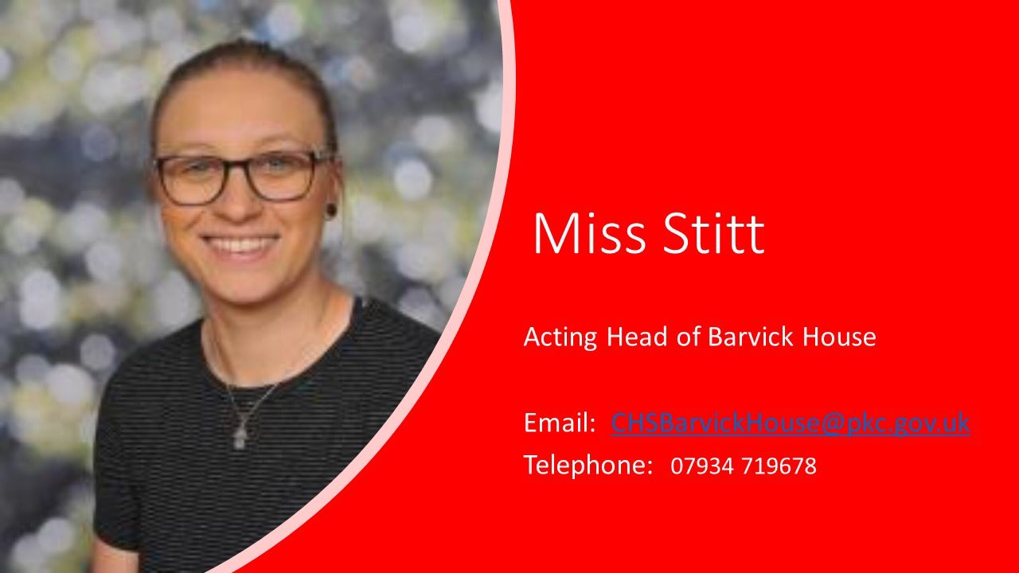

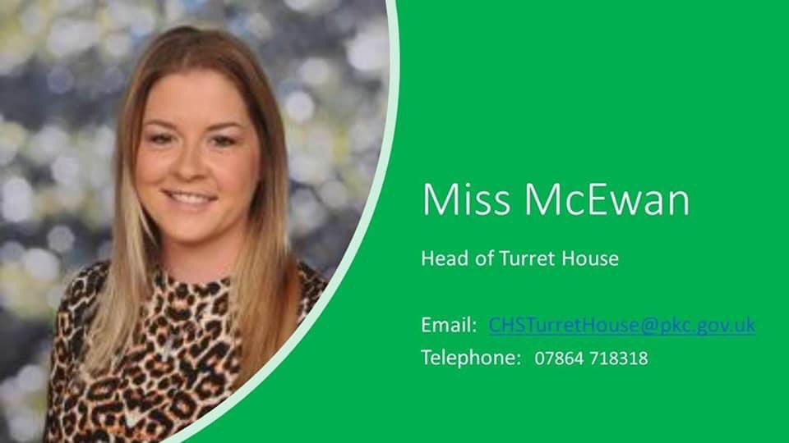
Barvick – Miss Stitt
Kelty – Mr Duncan
Turret – Miss McEwan
Notes:
3 Guidance Teachers, one per house
Weekly PSE session but can email us at any time

