Slide 1
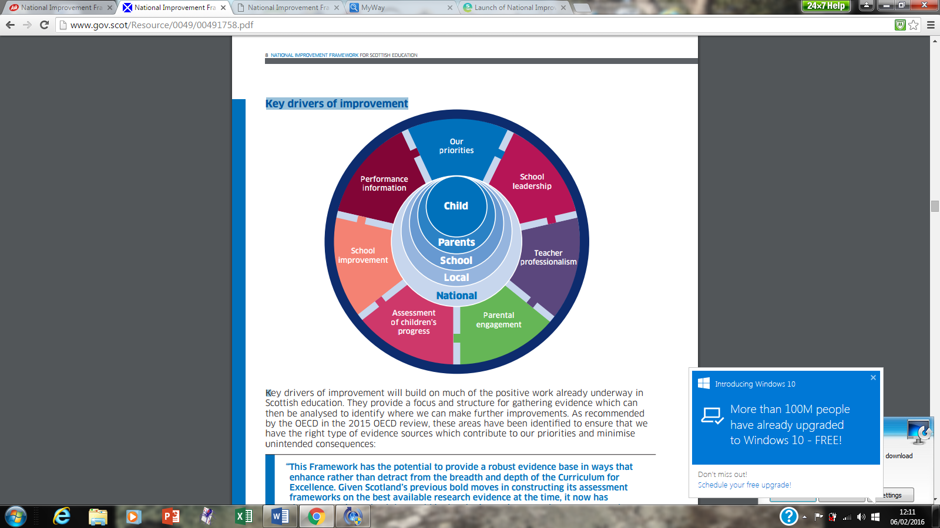
Aberuthven Primary School – Rationale - Key Drivers of Improvement 2023-26
Over the next 3 years we plan to:
-Build on Outdoor Learning Opportunities for our pupils
-Continue to embed Rights Respecting Schools and Self -Regulation values across our School community.
-Continue to develop the breadth of digital technology across all stages to support and enhance learning and teaching.
-Review and strengthen our Teaching, Learning & Assessment approaches, offering continuity across our whole school community.
We plan to:
-Review current planning and assessment tools and documentation to ensure high quality teaching and learning opportunities for all of our pupils.
-Review Class Teacher feedback and ensure quality, regular, ongoing learner conversations across all curricular areas.
-Continue to work alongside partners to ensure appropriate additional support for pupils as needed..
Empower all stake holder within our school community by:
-Encourage pupils to confidently discuss their learning, including next steps with all adults across the school community, not just their Class Teacher.
-Encourage all stake holders to contribute to, engage with and reflect upon our quality improvement priorities.
-Continue to promote and explore ways to engage our Parents in the life of our school. In particular, consider online and virtual opportunities.
Staff will:
-Engage in quality, relevant CPD.
-Participate in our School self-evaluation and moderation process.
-Take part in HT, Peer and Self-Observations.
-Engage in quality improvement discussion/feedback.
-Take part in target setting and moderation of our School Quality Improvement priorities.
-Review Teaching, Learning & Assessment.
Staff will continue to:
-Engage in our School Self-Evaluation and moderation process.
-Engage in PKC ERD process and identify next steps in their own professional development.
-Seek out and engage with appropriate CPD and quality professional discussion.
-Engage with update GTCS Standard for Professional Development.
-Engage in collegiate and whole staff meetings, focusing on whole school priorities.
We plan to:
-Review current planning and assessment tools and documentation to ensure high quality teaching and learning opportunities for all of our pupils.
-Review Class Teacher feedback and ensure quality, regular, ongoing learner conversations across all curricular areas.
-Ongoing review of tracking and monitoring documentation, regular tracking meetings and collegiate discussion.
-Continue to promote and explore ways to engage our Parents in the life of our school. In particular, consider online and virtual opportunities.
-Continue to provide high level of communication across our whole school community.
-Continue to seek feedback from our Parents and Families.
-Review opportunities to access opportunities such as Parent Contact Meeting etc through digital means.

