Slide 1
Nethybridge 2026
23 -27 March 2026

Slide 3
Accompanying Staff
Dunning
Blackford & Aberuthven

Slide 4
Transport by Docherty’s Bus
Monday 23rd March
Leaving Blackford at 9am
Leaving Aberuthven at 9.15am
Leaving Dunning at 9.30am
Friday 27th March
Pick up from Nethybridge at 10.30am
Arriving Dunning approx. 1pm
Arriving Aberuthven approx. 1.15pm
Arriving Blackford approx. 1.30pm
PACKED LUNCH NEEDED
ON Monday 23rd

Slide 5
Please label everything!

Slide 6
MEDICATION
Inhalers
Please name and these can be kept in the child's possession.
Other Medication
Please name and hand to a member of staff attending the trip. A medication consent form will need to be completed.

Slide 7
Extras
Spending Money £15 Max
This should be put in a purse/wallet or a named envelope and given to a member of staff for safe keeping.
Children are restricted to 1 drink and 1 sweet per evening
If wishing to buy a hoodie (on the first night) - £30 extra
Mobile Phones & Electronic Equipment
DO NOT BRING MOBILE PHONES! (There is no reception or wifi)
Phones and other electricals will be confiscated and kept in a locked cupboard for safekeeping.
Clothing
Label all clothing. All lost property will be available for 1 week.

Slide 8


Slide 15
£25 limit

Slide 20
Activity Groups
Max 10 children per group
1 instructor (first aid trained)
School staff will rotate around the groups (taking photos/ encouraging etc) and at least 1 will remain in the building at all times.

Slide 21
Activities
May include:
Zip wire
Adventure course
Indoor climbing
Abseiling
Archery
Raft building
Forest adventure
Ariel runway
Canoe
Silver Maze
Free time:
Use of gym hall
Swimming pool – lifeguards on duty
Games room
Table tennis
Outdoor Pitches and Tennis
(Require 20p/50p coins)
Air hockey
Table football

Slide 23
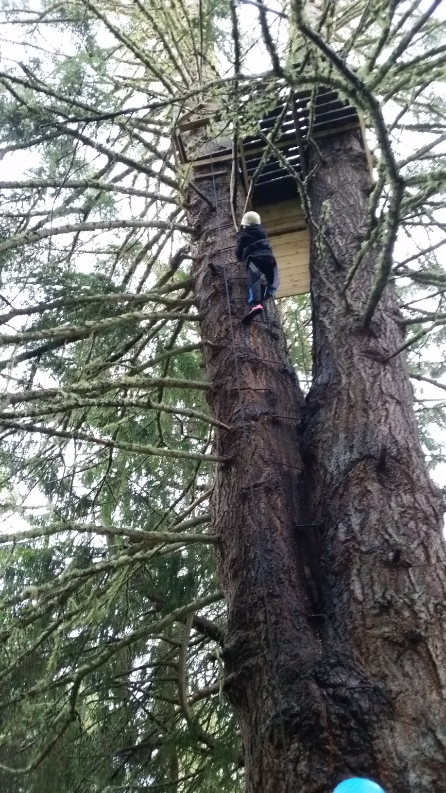
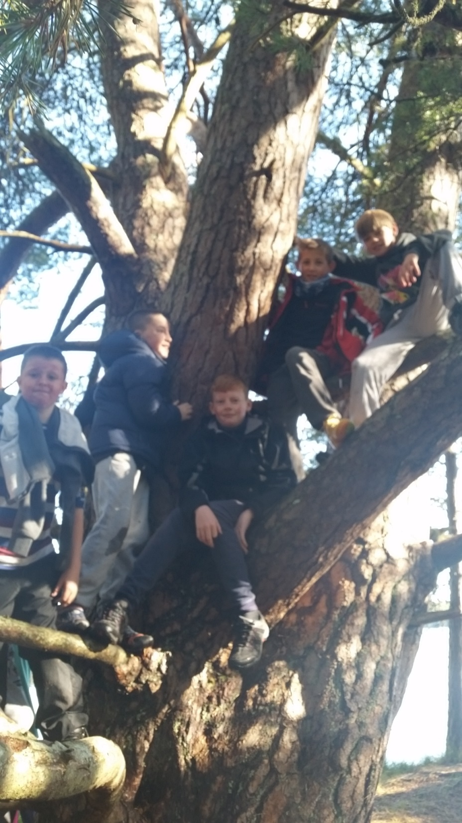

Slide 27
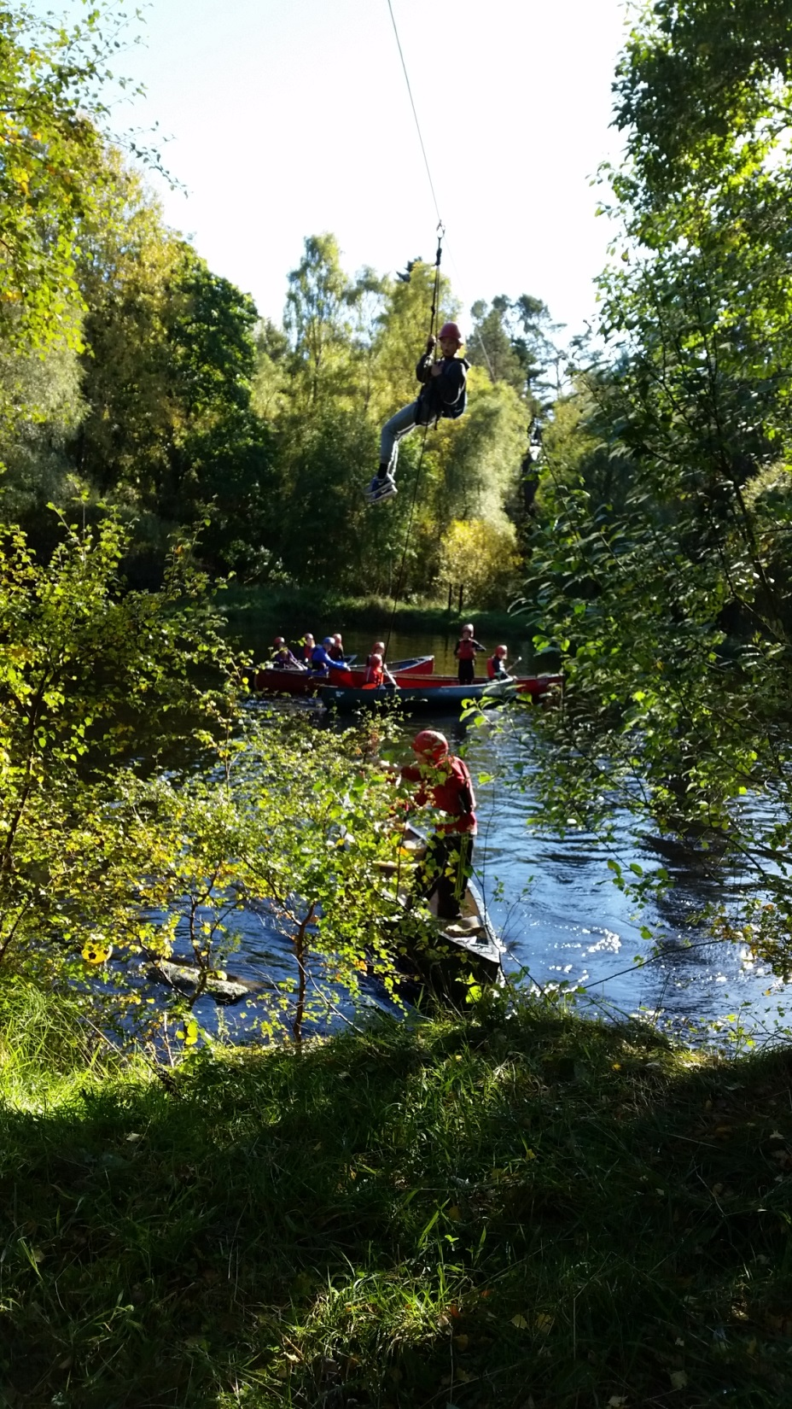
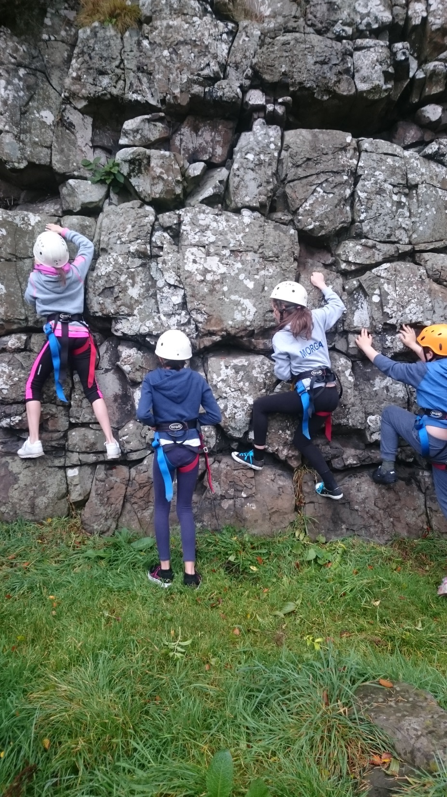

Slide 35
