Slide 1
Counting
Learn Its
Its Nothing New
Calculations

Slide 2
Counting
Learn Its
Its Nothing New
Calculations

Slide 3

Reading Numbers
I can read 1 digit numbers.
Step
1

Slide 4
Reading Numbers
Step
1
I can read 1 digit numbers.
Remember to:
Say what you see!

Slide 5
Reading Numbers
Step
1
1
one

Slide 6
Reading Numbers
Step
1
3
three

Slide 7
Reading Numbers
Step
1
6
six

Slide 8
Reading Numbers
Step
1
8
eight

Slide 9
Reading Numbers
Step
1
2
two

Slide 10
Reading Numbers
Step
1
4
four

Slide 11
Reading Numbers
Step
1
7
seven

Slide 12
Reading Numbers
Step
1
10
ten

Slide 13
Reading Numbers
Step
1
5
five

Slide 14
Reading Numbers
Step
1
9
nine

Slide 15
Well done!

Slide 16
Counting
Learn Its
Its Nothing New
Calculations

Slide 17

Learn Its
I can add doubles.
Step
1&2

Slide 18
Step
1&2
1 + 1 = 2
3 + 3 = 6
2 + 2 = 4
4 + 4 = 8
5 + 5 = 10

Slide 19

Get your whiteboards ready!!

Slide 20
Let’s wire the numbers up!!
+
2
2

Slide 21
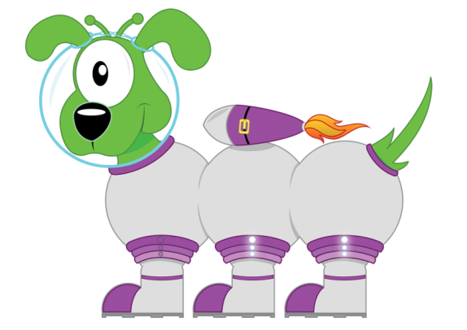
Well...
4
+
2
2

Slide 22
Good Luck!!
+
3
3

Slide 23

How did you go?
6
+
3
3

Slide 24
What number am l hiding?
+
5
5

Slide 25
Did you get it?
10
+
5
5

Slide 26
+
1
1

Slide 27
Well then...
2
+
1
1

Slide 28
3 + 3 = 6

Slide 29
3 + 3 = 6

Slide 30
4 + 4 = 8

Slide 31
4 + 4 = 8

Slide 32
1 + 1 = 2

Slide 33
1 + 1 = 2

Slide 34
Well done!

Slide 35
Counting
Learn Its
Its Nothing New
Calculations

Slide 36

Its Nothing New
I double 1 digit numbers.
Step
1

Slide 37
Its Nothing New
What is the double of 2?

Slide 38
Its Nothing New
What is the double of 2?
4

Slide 39
Its Nothing New
What is the double of 3?

Slide 40
Its Nothing New
What is the double of 3?
6

Slide 41
Its Nothing New
What is the double of 1?

Slide 42
Its Nothing New
What is the double of 1?
2

Slide 43
Its Nothing New
What is the double of 4?

Slide 44
Its Nothing New
What is the double of 4?
8

Slide 45
Its Nothing New
What is the double of 5?

Slide 46
Its Nothing New
What is the double of 5?
10

Slide 47
Well done!

Slide 48
Counting
Learn Its
Its Nothing New
Calculations

Slide 49

Calculations
I know when to add some more.
Step
1

Slide 50
Remember to:
See that there are a group of objects
See that we need to add some more
See that there must be a greater amount once they are added
F
A
B

Slide 51

How many footballs are there?
F

Slide 52
How many footballs are there?
6
F

Slide 53
If l add 2 more, how many will there be?
F

Slide 54
If l add 2 more, how many will there be?
8
F

Slide 55
How many pencils are there?
F

Slide 56
How many pencils are there?
7
F

Slide 57
If l add 1 more how many will there be?
F

Slide 58
If l add 1 more how many will there be?
8
F

Slide 59

How many apples are there?
F

Slide 60
How many apples are there?
5
F

Slide 61
If l add 3 how many will l have?
F

Slide 62
If l add 3 how many will l have?
8
F

Slide 63
Well done, you have now completed your CLIC session!

