Slide 1
Unseen movie analysis
Spiderman homecoming

Slide 2
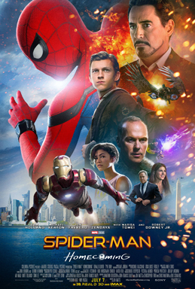
Title
Placement
The title is in the middle under the images the
Title contrasts with the background so it stands out
Font
Sans serif shows that the movie is going to be
A superhero movie as Spiderman is a superhero
Franchise
Spiderman is a well known name and people who like Spiderman will want to watch this movie to see what it is like also people who like marvel might like this as Spiderman is a marvel super hero

Slide 3
Image placement
The actors are placed in the middle main actors are at the back of the poster and the bad guy is at the bottom right. You get to see peter parker and tony stark not in costume and also in costume
Colour
The colours of the costumes is contrasting are well with the blue and white background so if a person seen this poster from a long distance
They would be attracted to this one because it quite colourful and easy to see and read.

Slide 4
Genre markers
We can tell the movie is going to be a action movie because we can see Spiderman and ironman and normally superhero movie are have a fight scene with the villain . It is also
A superhero film as it called Spiderman homecoming so we know that the main focus will be on Spiderman.

Slide 5
Institutions
Realse date
They released the movie In the summer when a the children are off on their summer break and the parents can do something with there kids

