Slide 1
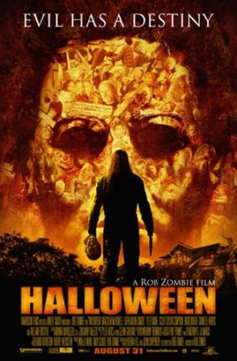
Halloween Movie Poster Analysis

Slide 2
Font
The font of the title is san serif which means it has a ‘block’ style to it. This shows that the film will have some kind of heavy (as the title) action to it. The title is also at the bottom of the poster in the centre, which helps it to draw attention to itself. It also is in orange in a black background which helps it to ‘pop’ even more and grab the audience’s attention.

Slide 3
Colours
The colours of the poster are a varying shade of orange throughout and also black. The orange can represent fire which is destructive and that is reflected in the film. It can also be the representation of Halloween which is ironic as the title is ‘Halloween’ and is about a killer emerging on the Halloween holiday. The black shows that death, evil and mystery may also be a big part of the film, representing the horror genre of it.

Slide 4
Costume
In the poster you can see that the character is right in the centre, which gives an idea to the audience of who will be the main character. If you look closely, you can see that the character is facing backwards, which highlights the fact that we never see Michael Myer’s face, as it Is hidden from the audience. We can also see that he has a mask in his left hand, a typical ‘villain’ costume theme, with a knife in his other hand, again showing the evil nature of his character to the audience, and foreshadowing the fact he might be a killer in this movie.

Slide 5
Tag Line
The tag line is ‘EVIL HAS A DESTINY’ which again represents and highlights the horror genre of the film. It foreshadows the fact that oh Halloween something impure and evil will emerge, which may have a bad ending in the end. It foreshadows the events that will happen and take place, saying that evil has a fate and it will happen no matter how hard you will try to fight it.

Slide 6
Actors/ Director
At the top of the title you can see that it says ‘A Rob Zombie Film’ and he is a famous American musician, filmmaker and screenwriter. He rose to fame by being the founding member of his heavy metal band called ‘White Zombie’. This is an eye-catcher for the audience as some may be more influenced to see the movie because they may know of Rob Zombie’s work or know of his band and may be a fan of him, making it more likely for people to watch the film.

Slide 7
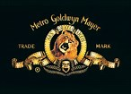
Company Logos
At the bottom of the poster you see all the company logos. Most of them are really known. This shows that the film has been funded by very famous and well know movie companies, showing that the film is valid and isn’t just a crappy school project created by someone not known of and not an actual director.

