Slide 1
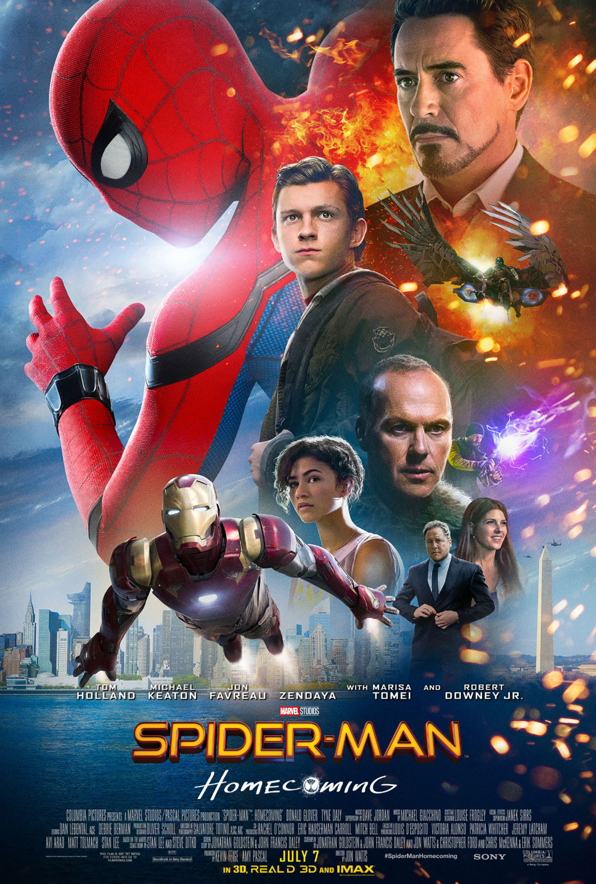
TITLE: “Spider man homecoming”
.Recognised as a franchise that already exists
FONT: SAN SERIF is used because the capital letters are bold to show the masculine domination
Placement : is in the centre at the bottom to draw attention because it encourages audience to come and see the movie and the colour of the title is showing yellow which stands for bright, energy, sun, creativity

Slide 2
Image placement
The main character is in the middle of the poster which helps audience to see that they have a key role.
Also they see the character in a different costume which reflect the idea of the movie which is spider man. In the background shows a big city where actions happen.
And the characters wearing the sci-fi suits shows the audience that there also includes high tech technology.

Slide 3
Colour
This poster uses contrasting colours RED which symbolises love, power, strength, anger, danger.
BLUE symbolises security, trust, intelligence, fear, masculinity
BLACK which means protection, mystery

Slide 4
Famous faces
Peter (Tom Holland) has been seen in many other movies which will attract more people to come see the movie and Michael Keaton has been seen in Batman as a villain which will attract more audience

Slide 5
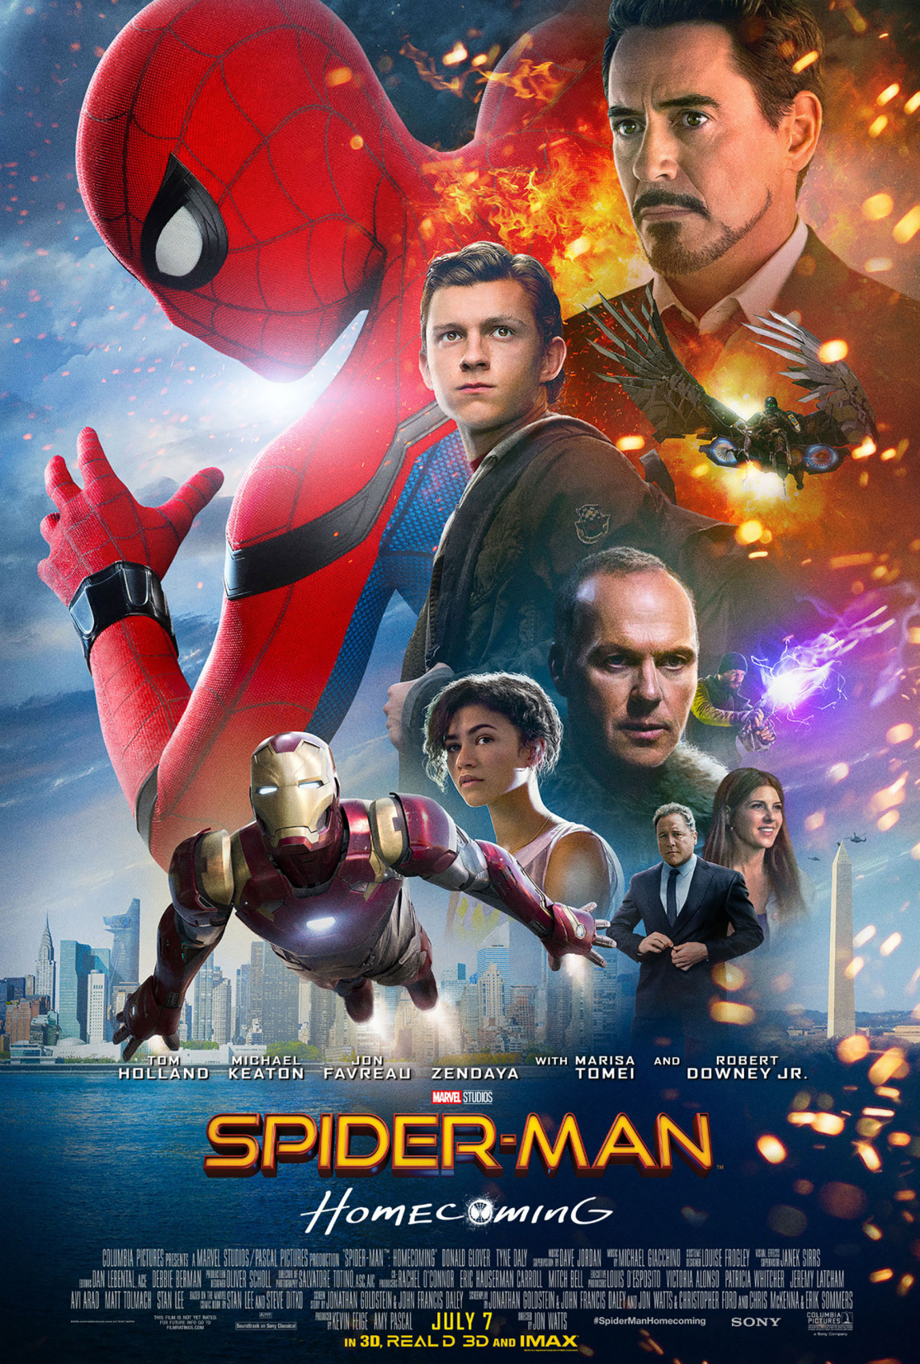
Genre
Including the high-tech suits and the fire sparks at the right-side of the poster and the spider man suit makes the audience soon realise that it is high-technology spider man movie which encourages the high-tech movie fans to come and see the movie. And the people wearing the smart suits will encourage the audience the classic movie to come and watch it

Slide 6
Tag line
“homecoming” Peter Parker returns home to live with his Auntie May and he tries to return to his normal daily routine and to prove himself to be more than a friendly neighbourhood superhero. Peter must soon put his powers to test when the evil vulture emerges to threaten everything that he holds dear

Slide 7
Institution
The names of the actors to attract more audiences

