Slide 1
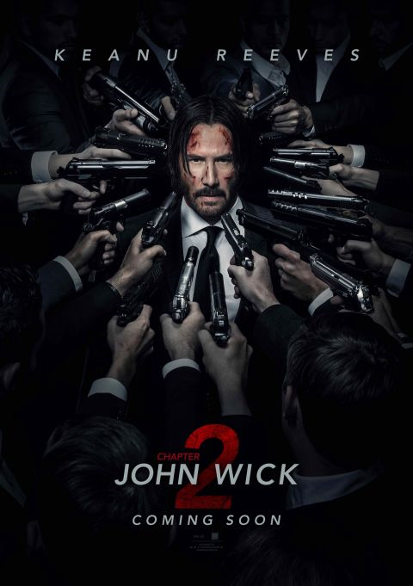
Poster Analysis
By
Cameron Darren Charles Angus
James Steven Paul Simpson

Slide 3
Image Placement:
John wick in centre of poster with armed men surrounding him suggesting that he will be hunted in this film.
The title of the film is at the bottom of the poster as it is the only space were there are no guns
The people holding all the guns have their faces facing the other direction or have them cropped out this lets us know that they are not important
There is a spotlight on John Wick showing he is a main character in the film

Slide 4
Colour/Costume :
The red of the chapter two shows it will have a lot of anger and vengeance including blood
This poster has a lot of black this lets the audience know this film will be dark and have a lot of death and mystery
The use of suits in the poster tells us it has a classical style to it and is mostly to do with the rich and high class

Slide 5
Actors :
The poster of this film only mentions Keanu reeves simulating his importance to this role

Slide 6
Genre :
The amount of guns in the poster gives us a obvious picture that this will include action.
The blood on john wicks face lets us know that the film will in include violence

Slide 7
Lighting/Camera Angles:

Slide 8
Colour :

Slide 9
Colour :

