Slide 1
Jumanji
Nicole Kerr and mairead anton

Slide 2
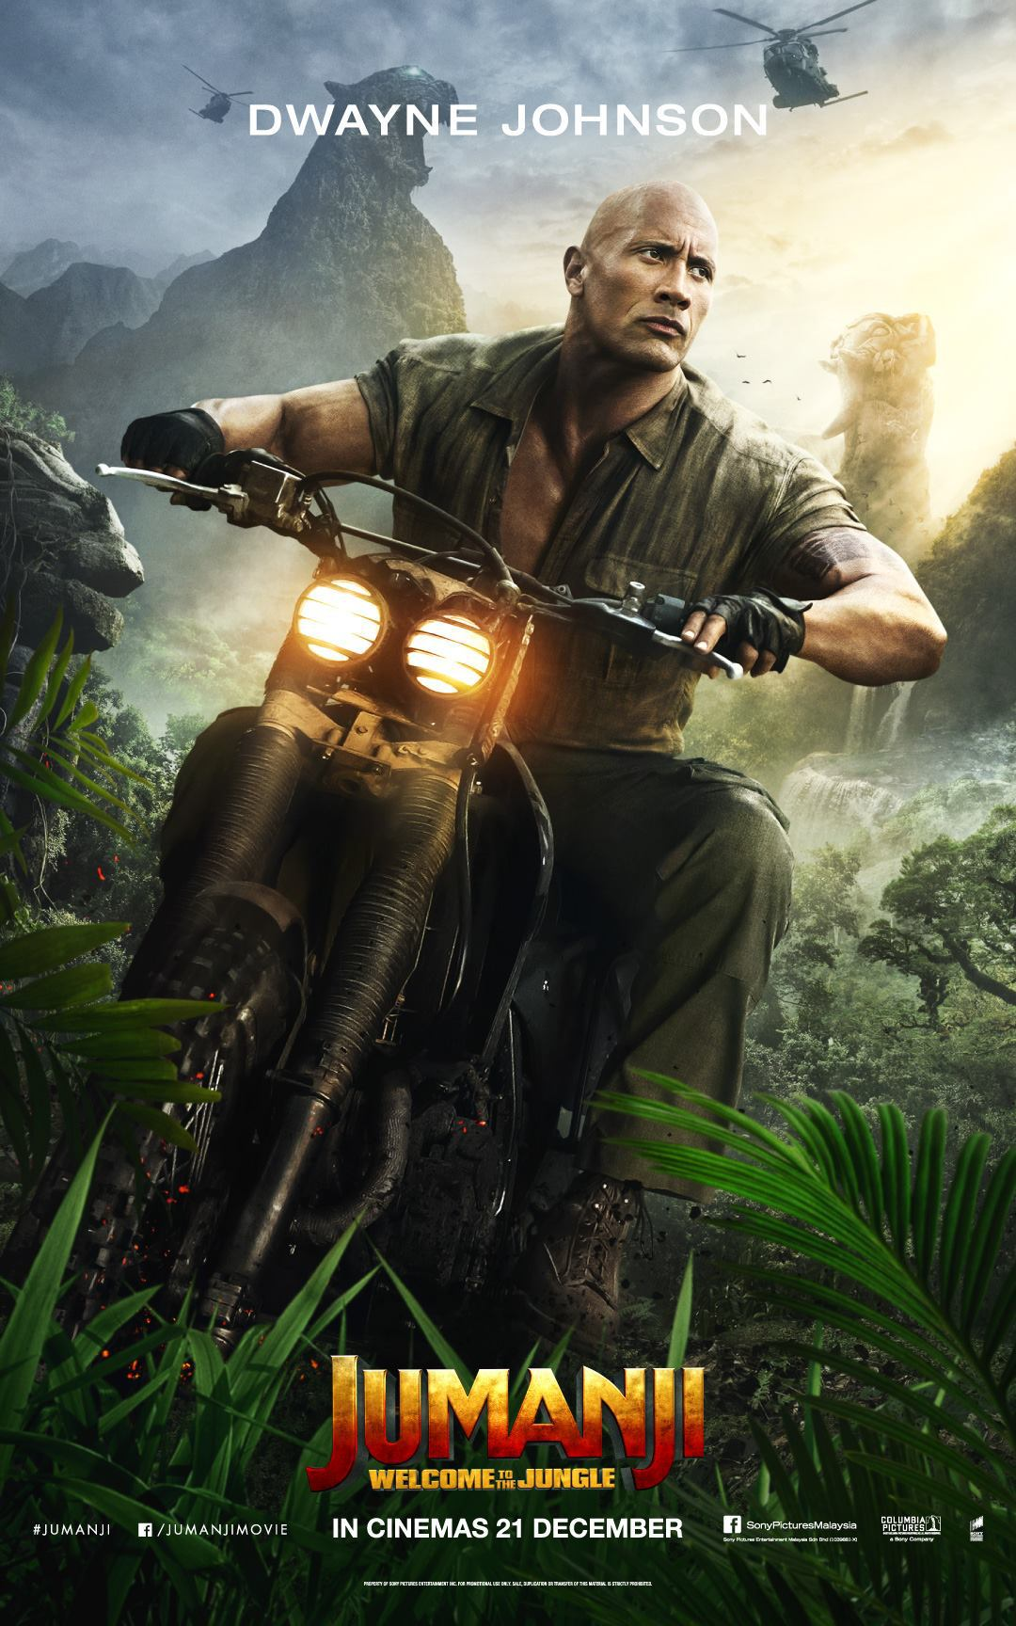
Font/colour
The font used is sans serif which is usually associated
with action films suggesting this film is action packed
  Title is placed at the bottom centre of the poster underneath the main character leading our eyes upwards
  The main title colour is faded from yellow to red this could suggest many things for example red represents danger and warning suggesting they characters will come across danger of some sort .
  The tagline is welcome to the jungle which indicates the jungle theme
  The film is set to be released on the 21st of December just in time for Christmas
  There is a slight hint of orange in the middle to help blend the colours together which represents courage and friendliness this suggests there is a team involved .
  The yellow at the top represents sun suggesting heat which is linked to the jungle aspect of the poster.

Slide 3
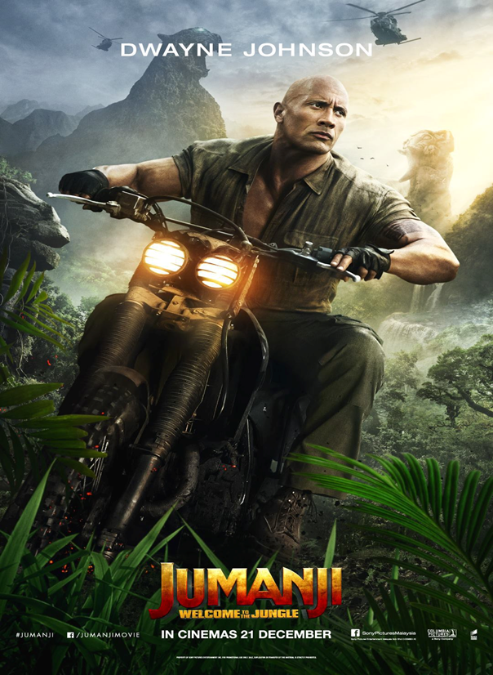
Costume/Placement
the main character is placed in the middle of the poster on a motorbike and there are helicopters above him suggesting action within the film
He is surrounded by tropical plants with mountains in the background and a slight fog suggesting it is set in the jungle
The character is wearing a khaki coloured shirt and trousers with hiking boots this again suggests a jungle theme as these would be used to blend in with the surroundings

Slide 4

Lighting/Camera shots
The light in the poster is coming from the top right and it is dim suggesting night time
There is also light coming from the headlights on the main characters motorbike again suggesting night fall.
Long camera shots we can tell this by the fact you can see his whole body
The camera is also aimed at an upwards angle so you can see the sky above him and get a better idea of where it is set.

Slide 5
Actors/COMPANY LOGOS
Dwayne Johnsons name is placed at the top in the centre above the picture of him which will attract attention as he is a very famous actor this will make people interested as he has had many other big roles in other action films
the companies that made the film are listed along the bottom of the poster (Colombia pictures and Sony) these are all big companies who have made other big films which could again make people want to come and see the movie

