Slide 1
UNSEEN ANALYSIS: FILM POSTERS

Slide 2
Today I am identifying techniques in my advert so that I can understand how to analyse a film poster.
I’ll know I’ve got it when I can:
Name techniques that my advert uses.
Explain why they are effective in conveying a message.
Detail why these techniques make the advert successful.

Slide 3
ANALYSIS OF A MEDIA TEXT Total marks — 10
You should select from ONE of the following media texts: Film Poster; Magazine Cover; Advertisement
Media texts are made with particular purposes and for specific audiences. With reference to purpose and/or audience explain in detail how relevant key aspects of media literacy have been used in one of the following media texts.
In your answer you must refer to at least two* of the following key aspects:
Language
Representation
Categories
Narrative
Audience
Institutions
Society
*at least two means you must cover a MINIMUM of two aspects but you can write something for as many as you can from the aspects listed and still achieve 10 marks.
Notes:
Candidates have the option of three texts; film poster, magazine cover or print advert.

Slide 5
1. Title
Institution - Recognised as a franchise that already exists.
Font - Uses the same font as the other star wars films
Placement - Is in the centre at the bottom to draw attention.
THINK:
What meanings are being conveyed through use of fonts or image placement?

Slide 6
2. Image Placement
The main character is placed in the centre of the poster. This helps the audience know that they will have a key role in the film and that the story will centre on them.
THINK:
Why are the pictures placed where they are?

Slide 7
3. Representation
Colour
This poster uses contrasting colours RED and BLUE to highlight the different sides in the film. Red represents evil and blue represents innocence.
THINK:
Why have they used certain colours?
What do those colours mean?

Slide 8
4. Famous faces:
Han Solo has been in the other Star Wars films so this might encourage other people to go and see the film. He is played by Harrison ford who has been in lots of other films like Indiana Jones.
THINK:
Are there any recognisable famous faces on the poster? What impact would this have?

Slide 9
5. Genre:
Including robots and space ships makes the audience know that this is a sci-fi film. The audience expects certain things because of the genre and this fulfils their expectations and encourages sci-fi fans to see the film.
THINK
What genre markers are used? (Clues included to tell you the genre.)

Slide 10
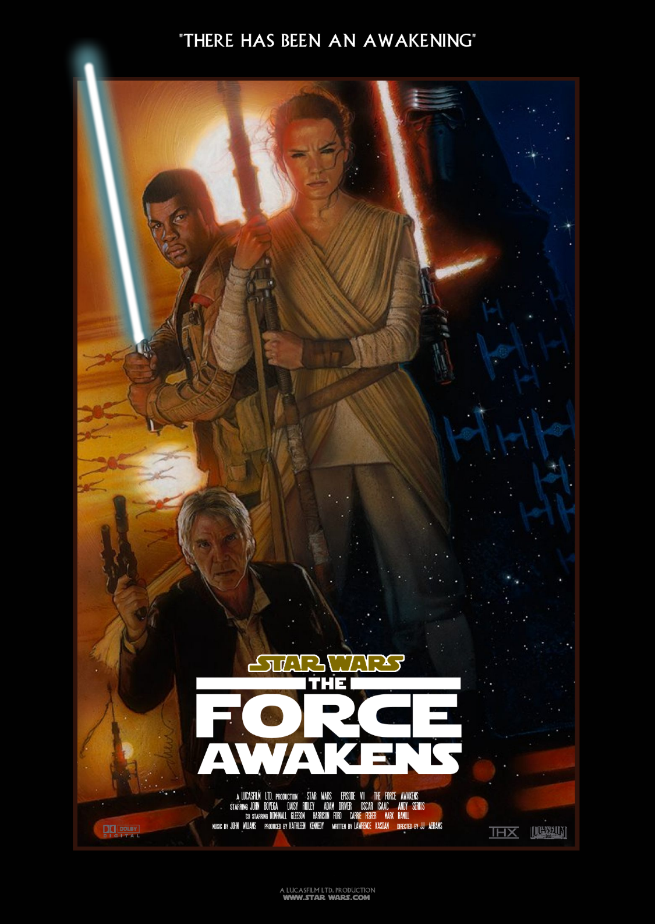
6. TAG LINE
A memorable dramatic phrase that will sum up the tone and idea of a film, or to reinforce and strengthen the audience's memory of a film.
Here, “There has been an awakening” has been used to tell the audience that something has arisen after a period of absence.
It creates an enigma (puzzle/question) that the audience will want to solve by watching the film. It will encourage Star Wars fans to see the film as they are familiar with the franchise and this was the first release of a Star Wars film in many years. This could also link to the franchise being started again.
THINK
What does the tag line tell you about the movie?

Slide 11
7. INSTITUTION:
There will be information on the poster about actors, directors, companies etc. As you already know, this is institutional information. You can make comment on this in your response.
THINK
Actors?
Directors (any information on other films they’ve directed on the poster?
Companies? (IMAX, DISNEY ETC)
Ratings?
Release date? (What would be the benefit of releasing a film in December?)

Slide 12
2. Image placement
4 Famous faces
3 Colour
5. Genre
1. Title
6. Tag Line
7. Institution

Slide 13
Task:
In a small group you will be analysing film posters.
You must work together to make comments on each covering the aspects we have discussed.
You will have FIVE minutes at each station.
Try your best to use media language and fully analyse.

Slide 19
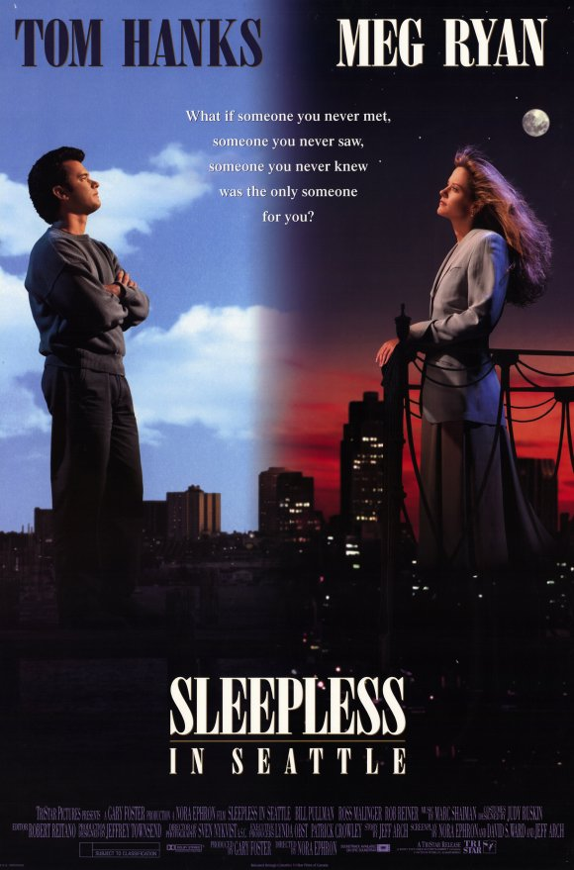

Slide 20
SQA N5 WEBINAR LINK FOR REFERENCE / UNDERSTANDING STANDARDS https://www.sqa.org.uk/sqa/files_ccc/National5Media29082017.mp4

