Slide 1
Disclaimer
The presentation you are about to see contains deliberate mistakes with spelling, grammar and punctuation.
Please point them out as we go through the lesson.

Slide 2
how to write an essay by me
im about to save your lives

Slide 3
construction
essays have 3 parts
an introduction, body and conclusion
red is for the introduction and conclusion
blue is for the body
X marks the example spot
Like treasure for pirates but teachers
wow

Slide 4
PLANNING IN 10 MINS
Draw a line down the middle
Lable one column ‘main ideas’
Write down ‘main ideas’ in that column
Write down all the golden pirate treasure evidence in the other column
Done.

Slide 5
planning
Your essay is pretty much done
You have the first sentence of each para
All you gotta do is write it

Slide 6
introduction
Keep it short (max 5-6 lines)
we want the key points not your life story
Map out the essay
SQA needs a map to find the examples
they are happy example pirates
but no examples or quotes in the introduction
Make them work for it
they ain’t gettin’ your example gold unless they work for it
this is the sqa
they’re comin’ for yo examples

Slide 7
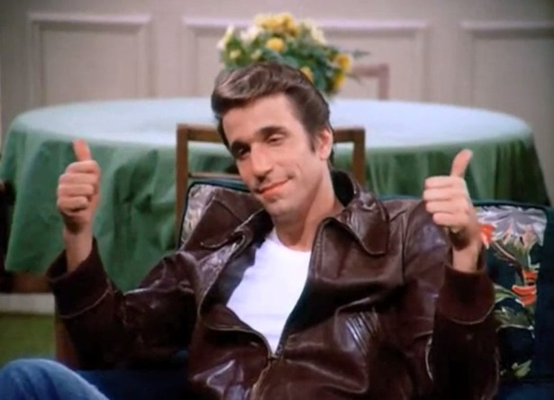
construction
< put the main idea of the paragraph here.
Tell them what you’re on about
But make sure it is still part of the question
Paragraphs: PEER – point, evidence, explain, respond.
It’s like an essay inside an essay
essayception

Slide 8
Quotations (gets it’s OWN slide) wow important
Very important
These are part of your
example gold
Give em’ a smooth introduction
Like Bond
blend them in because spies shouldn’t stand out

Slide 9
conclusion
Longer than your introduction
Remind SQA what you’re actually talking about
say the same thing but differently
no more quotes or examples
they got all their gold examples
No more for the greedy SQA
Wooohooo I got all my exampleessssss

Slide 10
You’re done
congratulations

