Slide 1
Counting
Learn Its
Its Nothing New
Calculations

Slide 2
Counting
Learn Its
Its Nothing New
Calculations

Slide 3
Reading Numbers
I can read 3d multiples of 100.
Step
5

Slide 4
I can read 3d multiples of 100.
200
Say the hundreds digit, then say “hundred”.
Step
5

Slide 5
I can read 3d multiples of 100.
400
Say the hundreds digit, then say “hundred”.
Step
5

Slide 6
I can read 3d multiples of 100.
700
Say the hundreds digit, then say “hundred”.
Step
5

Slide 7
I can read 3d multiples of 100.
300
Say the hundreds digit, then say “hundred”.
Step
5

Slide 8
I can read 3d multiples of 100.
500
Say the hundreds digit, then say “hundred”.
Step
5

Slide 9
I can read 3d multiples of 100.
800
Say the hundreds digit, then say “hundred”.
Step
5

Slide 10
I can read 3d multiples of 100.
600
Say the hundreds digit, then say “hundred”.
Step
5

Slide 11
Well done!

Slide 12
Counting
Learn Its
Its Nothing New
Calculations

Slide 13
Learn Its
I can add and subtract pairs of numbers.
Step
5

Slide 14
Step
5
4 + 2 = 6
9 + 2 = 11
5 + 2 = 7
4 + 3 = 7
6 + 2 = 8
5 + 3 = 8
7 + 2 = 9
6 + 3 = 9

Slide 15
Get your whiteboards ready!!

Slide 16
Let’s wire the numbers up!!
+/-
9
2

Slide 17
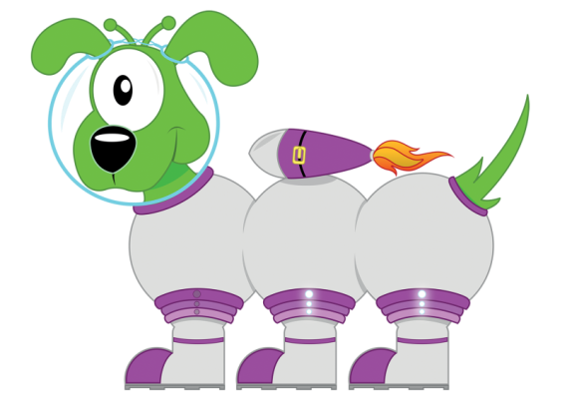
Well...
11
+/-
9
2

Slide 18
Good Luck!!
7
+/-
5

Slide 19
How did you go?
7
+/-
5
2

Slide 20
What number am l hiding?
+/-
5
3

Slide 21
Did you get it?
8
+/-
5
3

Slide 22
7
+/-
3

Slide 23
Well then...
7
+/-
4
3

Slide 24
+/-
5
3

Slide 25
Success?
8
+/-
5
3

Slide 26
Last try!
+/-
6
3

Slide 27
Well...
9
+/-
6
3

Slide 28
11 - 9 = 2

Slide 29
11 - 9 = 2

Slide 30
2 + 4 =6

Slide 31
2 + 4 =6

Slide 32
7 - 5 = 2

Slide 33
7 - 5 = 2

Slide 34
9 - 7 = 2

Slide 35
9 - 7 = 2

Slide 36
10 - 5 = 5

Slide 37
10 - 5 = 5

Slide 38
10 - 6 = 4

Slide 39
10 - 6 = 4

Slide 40
Well done!

Slide 41
Counting
Learn Its
Its Nothing New
Calculations

Slide 42
Its Nothing New
I can double 2d multiples of 10.
Step
2

Slide 43
I can double 2 digit multiples of 10.
Step
2
Remember to:
Double the tens digit.
Add 0 to the end.

Slide 44
I can double 2 digit multiples of 10.
Step
2
Double 10 is...
Remember to:
Double the tens digit.
Add 0 to the end.

Slide 45
I can double 2 digit multiples of 10.
Step
2
Double 10 is...
20
Remember to:
Double the tens digit.
Add 0 to the end.

Slide 46
I can double 2 digit multiples of 10.
Step
2
Double 40 is...
Remember to:
Double the tens digit.
Add 0 to the end.

Slide 47
I can double 2 digit multiples of 10.
Step
2
Double 40 is...
80
Remember to:
Double the tens digit.
Add 0 to the end.

Slide 48
I can double 2 digit multiples of 10.
Step
2
Double 20 is...
Remember to:
Double the tens digit.
Add 0 to the end.

Slide 49
I can double 2 digit multiples of 10.
Step
2
Double 20 is...
40
Remember to:
Double the tens digit.
Add 0 to the end.

Slide 50
I can double 2 digit multiples of 10.
Step
2
Double 30 is...
Remember to:
Double the tens digit.
Add 0 to the end.

Slide 51
I can double 2 digit multiples of 10.
Step
2
Double 30 is...
60
Remember to:
Double the tens digit.
Add 0 to the end.

Slide 52
Well done!

Slide 53
Counting
Learn Its
Its Nothing New
Calculations

Slide 54
Calculations
Step
6
I can read a number sentence.

Slide 55
Remember to:
read your number sentence
say “add” for ”+”
say “equals” for ”=“
F
A
B

Slide 56
I can read a number sentence.
Step
6
4 + 2 =
“four add two equals”

Slide 57
I can read a number sentence.
Step
6
6 + 2 =
“six add two equals”

Slide 58
I can read a number sentence.
Step
6
4 + 3 =
“four add three equals”

Slide 59
I can read a number sentence.
Step
6
9 + 2 =
“nine add two equals”

Slide 60
I can read a number sentence.
Step
6
5 + 3 =
“five add three equals”

Slide 61
Well done, you have now completed your CLIC session!

