Slide 1
Counting
Learn Its
Its Nothing New
Calculations

Slide 2
Counting
Learn Its
Its Nothing New
Calculations

Slide 3
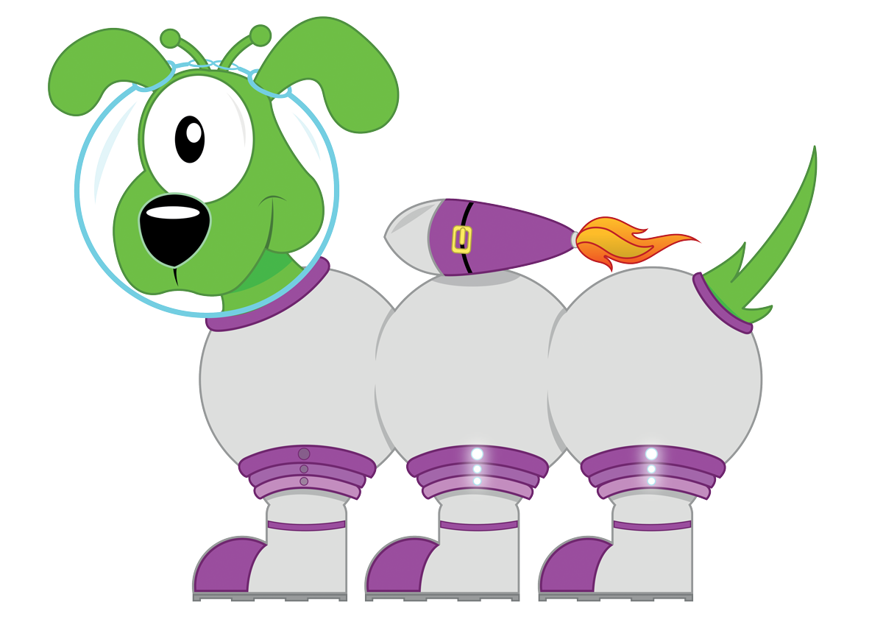
Squiggleworth
I can partition a 2 digit number.
Step
1

Slide 4
Step
1
I can partition a 2 digit number.
56
5
6
Remember to:
write the 2 digit number
copy the units digit
copy the tens digit… with a zero on the end

Slide 5
Step
1
I can partition a 2 digit number.
56
5
6
Remember to:
write the 2 digit number
copy the units digit
copy the tens digit… with a zero on the end
6

Slide 6
Step
1
I can partition a 2 digit number.
56
5
6
Remember to:
write the 2 digit number
copy the units digit
copy the tens digit… with a zero on the end
50
6

Slide 7
Step
1
I can partition a 2 digit number.
47
4
7
Remember to:
write the 2 digit number
copy the units digit
copy the tens digit… with a zero on the end

Slide 8
Step
1
I can partition a 2 digit number.
47
4
7
Remember to:
write the 2 digit number
copy the units digit
copy the tens digit… with a zero on the end
7

Slide 9
Step
1
I can partition a 2 digit number.
47
4
7
Remember to:
write the 2 digit number
copy the units digit
copy the tens digit… with a zero on the end
40
7

Slide 10
Step
1
I can partition a 2 digit number.
94
9
4
Remember to:
write the 2 digit number
copy the units digit
copy the tens digit… with a zero on the end

Slide 11
Step
1
I can partition a 2 digit number.
94
9
4
Remember to:
write the 2 digit number
copy the units digit
copy the tens digit… with a zero on the end
4

Slide 12
Step
1
I can partition a 2 digit number.
94
9
4
Remember to:
write the 2 digit number
copy the units digit
copy the tens digit… with a zero on the end
90
4

Slide 13
Step
1
I can partition a 2 digit number.
31
3
1
Remember to:
write the 2 digit number
copy the units digit
copy the tens digit… with a zero on the end

Slide 14
Step
1
I can partition a 2 digit number.
31
3
1
Remember to:
write the 2 digit number
copy the units digit
copy the tens digit… with a zero on the end
1

Slide 15
Step
1
I can partition a 2 digit number.
31
3
1
Remember to:
write the 2 digit number
copy the units digit
copy the tens digit… with a zero on the end
30
1

Slide 16
Well done!

Slide 17
Counting
Learn Its
Its Nothing New
Calculations

Slide 18

Learn Its
I can add and subtract doubles.
Step
6

Slide 19
Step
6
2x Table
x 2 = 2
x 2 = 4
x 2 = 6
x 2 = 8
x 2 = 10
x 2 = 12
x 2 = 14
x 2 = 16
x 2 = 18
10 x 2 = 20
6 + 6 = 12
7 + 7 = 14
8 + 8 = 16
9 + 9 = 18

Slide 20

Get your whiteboards ready!!

Slide 21
Let’s wire the numbers up!!
+
6
6

Slide 22
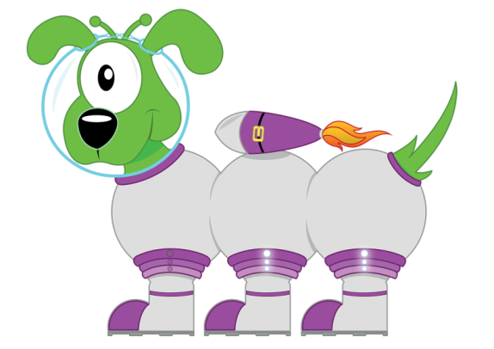
Well...
12
+
6
6

Slide 23
Good Luck!!
14
+
7

Slide 24

How did you go?
14
+
7
7

Slide 25
What number am l hiding?
+
8
8

Slide 26
Did you get it?
16
+
8
8

Slide 27
18
+
9

Slide 28
Well then...
18
+
9
9

Slide 29
x
5
2

Slide 30
Success?
10
x
5
2

Slide 31
Last try!
x
6
2

Slide 32
Well...
12
x
6
2

Slide 33
18 - 9 = 9

Slide 34
18 - 9 = 9

Slide 35
2 x 4 =8

Slide 36
2 x 4 =8

Slide 37
14 - 7 = 7

Slide 38
14 - 7 = 7

Slide 39
9 x 2 = 18

Slide 40
9 x 2 = 18

Slide 41
16 - 8 = 8

Slide 42
16 - 8 = 8

Slide 43
12 - 6 = 6

Slide 44
12 - 6 = 6

Slide 45
Well done!

Slide 46
Counting
Learn Its
Its Nothing New
Calculations

Slide 47

Halving Numbers
I can find half of 3, 5, 7 & 9.
Step
1

Slide 48
I can find half of 3, 5, 7 & 9.
Step
1
Remember to:
share the objects into 2 piles
check each pile has the same amount
see if there is a spare one

Slide 49


I can find half of 3, 5, 7 & 9.
Step
1
What is half of 3?
Lets share them…

Slide 50
I can find half of 3, 5, 7 & 9.
Step
1
There is only 1 left, what will we do?

Slide 51
I can find half of 3, 5, 7 & 9.
Step
1
We could half it!

Slide 52
I can find half of 3, 5, 7 & 9.
Step
1
What is half of 5?
Lets share them…

Slide 53
I can find half of 3, 5, 7 & 9.
Step
1
There is only 1 left, what will we do?

Slide 54
I can find half of 3, 5, 7 & 9.
Step
1
We can cut it in half!

Slide 55
I can find half of 3, 5, 7 & 9.
Step
1
What is half of 7?
Lets share them…

Slide 56
I can find half of 3, 5, 7 & 9.
Step
1

Slide 57
I can find half of 3, 5, 7 & 9.
Step
1
What is half of 9?
Lets share them…

Slide 58
I can find half of 3, 5, 7 & 9.
Step
1

Slide 59
Well done!

Slide 60
Counting
Learn Its
Its Nothing New
Calculations

Slide 61

Calculations
Step
10
I can make groups of 2, 5 or 10.

Slide 62
Remember to:
Step
10
count out one pile of that group size
keep counting out more piles of that group size
keep going until there are not enough objects for another pile
F
A
B

Slide 63
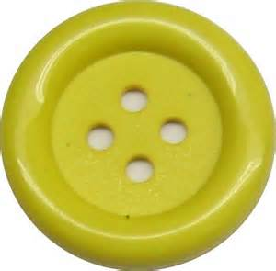
I can make groups of 2, 5 or 10.
Step
10
Please put these buttons into piles of 5

Slide 64
I can make groups of 2, 5 or 10.
Step
10
Please put these buttons into piles of 5

Slide 65
I can make groups of 2, 5 or 10.
Step
10
Please put these buttons into piles of 5

Slide 66
I can make groups of 2, 5 or 10.
Step
10
Please put these buttons into piles of 5

Slide 67
I can make groups of 2, 5 or 10.
Step
10
Please put these buttons into piles of 5

Slide 68

I can make groups of 2, 5 or 10.
Step
10
Please put these sweets into piles of 2

Slide 69
I can make groups of 2, 5 or 10.
Step
10
Please put these sweets into piles of 2

Slide 70
I can make groups of 2, 5 or 10.
Step
10
Please put these sweets into piles of 2

Slide 71
I can make groups of 2, 5 or 10.
Step
10
Please put these sweets into piles of 2

Slide 72
I can make groups of 2, 5 or 10.
Step
10
Please put these sweets into piles of 2

Slide 73
I can make groups of 2, 5 or 10.
Step
10
Please put these sweets into piles of 2

Slide 74
I can make groups of 2, 5 or 10.
Step
10
Please put these sweets into piles of 2

Slide 75

I can make groups of 2, 5 or 10.
Step
10
Please put these cars into piles of 10

Slide 76
I can make groups of 2, 5 or 10.
Step
10
Please put these cars into piles of 10

Slide 77
I can make groups of 2, 5 or 10.
Step
10
Please put these cars into piles of 10

Slide 78
Well done, you have now completed your CLIC session!

