Slide 1
Counting
Learn Its
Its Nothing New
Calculations

Slide 2
Counting
Learn Its
Its Nothing New
Calculations

Slide 3

Counting Multiples
I can count in 10’s.
Step
1

Slide 4
Step
1
I can count in 10’s.
10
20
30
40
50
60
70
80
90
100

Slide 5
Step
1
I can count in 10’s.
30
40
50
60
70
80
90
100
110
120

Slide 6
Step
1
I can count in 10’s.
20
30
40
50
60
70
80
90
100
110

Slide 7
Well done!

Slide 8
Counting
Learn Its
Its Nothing New
Calculations

Slide 9

Learn Its
I can add doubles.
Step
1&2

Slide 10
Step
3
2 + 3 = 5
1 + 2 = 3
3 + 2 = 5
2 + 1 = 3
10 x 1 = 10
10 x 4 = 40
10 x 7 = 70
10 x 2 = 20
10 x 5 = 50
10 x 8 =80
10 x 3 = 30
10 x 6 = 60
10 x 9 = 90
10 x 10 = 100

Slide 11

Get your whiteboards ready!!

Slide 12
Let’s wire the numbers up!!
+
8
2

Slide 13
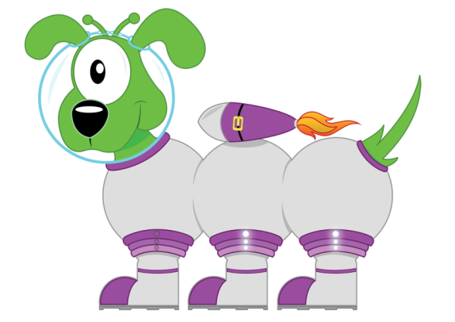
Well...
10
+
8
2

Slide 14
Good Luck!!
+
7
3

Slide 15

How did you go?
10
+
7
3

Slide 16
What number am l hiding?
+
1
2

Slide 17
Did you get it?
3
+
1
2

Slide 18
x
10
1

Slide 19
Well then...
10
x
10
1

Slide 20
x
10
3

Slide 21
Well then...
30
x
10
3

Slide 22
x
10
5

Slide 23
Well then...
50
x
10
5

Slide 24
2 + 3 = 5

Slide 25
2 + 3 = 5

Slide 26
2 + 1 = 3

Slide 27
2 + 1 = 3

Slide 28
1 + 1 = 2

Slide 29
1 + 1 = 2

Slide 30
10 x 1 = 10

Slide 31
10 x 1 = 10

Slide 32
10 x 2 = 20

Slide 33
10 x 2 = 20

Slide 34
10 x 9 = 90

Slide 35
10 x 9 = 90

Slide 36
10 x 4 = 40

Slide 37
10 x 4 = 40

Slide 38
10 x 7 = 70

Slide 39
10 x 7 = 70

Slide 40
10 x 3 = 30

Slide 41
10 x 3 = 30

Slide 42
10 x 5 = 50

Slide 43
10 x 5 = 50

Slide 44
10 x 6 = 60

Slide 45
10 x 6 = 60

Slide 46
10 x 8 = 80

Slide 47
10 x 8 = 80

Slide 48
10 x 9 = 80

Slide 49
10 x 9 = 90

Slide 50
Well done!

Slide 51
Counting
Learn Its
Its Nothing New
Calculations

Slide 52

Its Nothing New
I double 1 digit numbers.
Step
1

Slide 53
Its Nothing New
What is the double 4?

Slide 54
Its Nothing New
What is the double 4?
8

Slide 55
Its Nothing New
What is the 3 x 2?

Slide 56
Its Nothing New
What is the 3 x 2?
6

Slide 57
Its Nothing New
What is the double of 1?

Slide 58
Its Nothing New
What is the double of 1?
2

Slide 59
Its Nothing New
Double 4?

Slide 60
Its Nothing New
Double 5?
10

Slide 61
Well done!

Slide 62
Counting
Learn Its
Its Nothing New
Calculations

Slide 63

Calculations
Step
3
I can share the same amount of objects between 2 people.

Slide 64
Remember to:
take turns giving each person one at a time
check at the end that both people have the same amount
F
A
B

Slide 65



take turns giving each person one at a time
check at the end that both people have the same amount
Share out
the cars…
F

Slide 66
take turns giving each person one at a time
check at the end that both people have the same amount
Share out
the cars…
F

Slide 67
take turns giving each person one at a time
check at the end that both people have the same amount
Share out
the cars…
F

Slide 68
take turns giving each person one at a time
check at the end that both people have the same amount
Share out
the cars…
F

Slide 69
take turns giving each person one at a time
check at the end that both people have the same amount
Share out
the cars…
F

Slide 70
take turns giving each person one at a time
check at the end that both people have the same amount
Share out
the cars…
F

Slide 71
take turns giving each person one at a time
check at the end that both people have the same amount
How many do
they have
each?
F

Slide 72
Well done, you have now completed your CLIC session!

