Slide 1
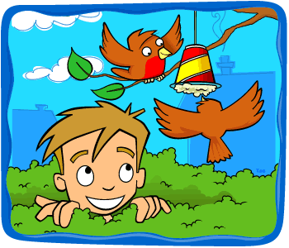
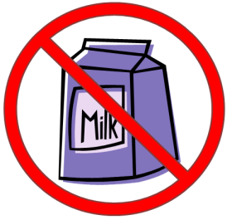
Make Quick and Easy Bird (fat) Cakes
(Recipe from National Trust; Images from RSPB)
Orkney is home to lots of different birds throughout the year. One way to encourage them to your garden is to hang a tasty cake from a tree.
What you need
String/Twine
Mixing bowl
Scissors
Lard or suet (room temperature)
Handful of bird seed
Handful of peanuts (unsalted)
Grated cheese or raisins
Dry leftovers (oats, bread or cake)
Old clean yoghurt pots (cupcake cases work too!)
Things to avoid
Milk (Birds can’t digest milk)
Mouldy bread
Important notes
Not suitable for children with nut allergies.
Note that bird seed, including peanuts bought for birds, is not suitable for human consumption.
Note that the fat cakes will melt in hot temperatures
When you’ve hung your cake(s) up, why not take a photo of it and send it to your teacher or ask an adult to tweet it to @STEM_Orkney on Twitter.

Slide 2
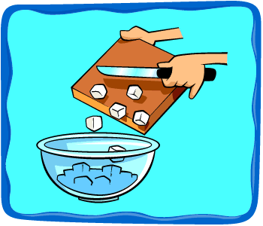
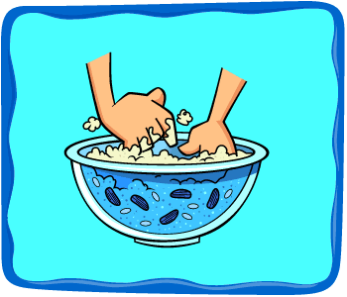
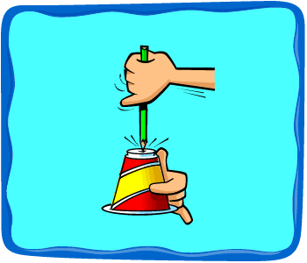
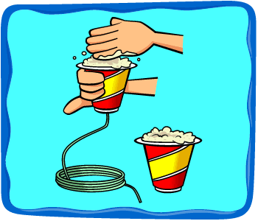
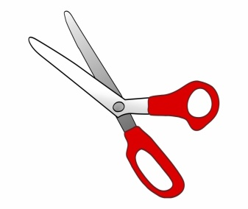
Method (What to do)
Cut the lard/suet into small pieces (you might want to ask an adult to help you)
Mix all ingredients together in a bowl. Use about double the amount of dry ingredients compared to lard/suet
Make a small hole in the bottom of each of your yoghurt pots. Thread a length of string/twine through the hole and tie a knot to secure it.
Pack each pot tightly with the mixture. Put it in the fridge until it’s set hard. This takes around 1 hour.
Once it’s fully set, carefully cut away the yoghurt pot and recycle it. It should crack off OK if the mixture is cold enough. (you might want to ask an adult to help you)
Tie the string over a tree or shrub branch. Make sure you pick somewhere away from cats! If you find it’s a bit crumbly, next time add a little more fat and a little less dry mixture.

