Slide 1
ST. Thomas' Primary School
This Photo by Unknown author is licensed under CC BY-SA-NC.
Digital REMOTE Learning Plan
September 2021

Slide 2
NLC DiGITAL CONTRACT
Please read the digital contract/ code of conduct carefully with your child.
Please note that you do not have permission to screenshot or record the teacher when they are on a live chat.
Please encourage your child to use our digital school responsibly and respectfully. This is important to be allowed ongoing access.

Slide 3
How will I know what my child should learn each week?
CHILD PROTECTION
Child protection - Online safety
We want everyone to be safe, just like being in school, if you see anything in your Meet with pupils that raises child protection concerns, you should follow our usual child protection procedures. Consider the following points when delivering learning online:
• Use your glow account only or school email.
• Do not share the URL or code of your meeting publicly
• When in a meet use the chat for class purposes only
• Follow normal classroom behaviour agreements – develop online rights charters!
• School Facebook and Twitter accounts should be closed/locked to members only.
With increased use of digital technologies, children may be exposed to more risks online. As part of learning and teaching children and young people should be taught online safety. We should also be alert to signs that individuals or groups are using the current crisis as an opportunity for the criminal or sexual exploitation of children.
Further advice and guidance on online safety can be found at the CEOP, thinkuknow website https://www.thinkuknow.co.uk/
When your child/children is learning from home their teacher will communicate through the class team. This will be through the message post section.
The teacher will still be teaching face to face in class during the core school hours. Instant replies will not be practical during school core hours.
Teachers will upload homework on a Monday or signpost where the children can access activities appropriate to their age/stage on the NL Virtual Team.
The main school learning offer during isolation will be on NL Virtual Classroom/Homework/Teams Communication and Feedback.
N.B.-Children learning from home can work to their own pace and in line with family circumstances at that specific time. Completed tasks and activities should be returned to the class teacher using Teams, Assignments as directed by the class teacher.

Slide 4
What is the Teacher Role in the Virtual learning?
The teacher will plan the weekly Homework lessons/activities and upload in the class team on a Monday as Homework.
The teacher will plan and resource lessons and support your child's learning in areas across the curriculum. They will also give feedback on learning submitted to school or through Microsoft Teams Assignments.
Please note the teacher will still be teaching in class from 9.00 – 3.00 p.m and therefore instant access on a 1:1 is not always practical. Any questions should be directed through the class teams chat bar. The teacher will endeavor to pick these up and reply at the earliest opportunity in line with classroom commitments.

Slide 5
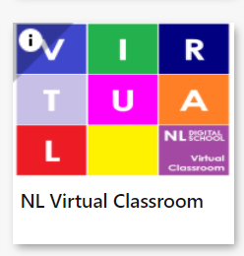
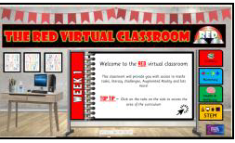
NLc VIRTUAL CLASSROOM
Access to the NL Virtual Classrooms is through Glow Launch Pad.
It is recommended not to use Internet Explorer browser.
After logging into Glow click on the North Lanarkshire Council Launch Pad and click on the NL Virtual Classrooms App.
The Virtual Classrooms App has colour coded tiles which link to the current Weekly Interactive Classrooms for each stage. The colours enable Schools to discretely direct children to appropriate learning.
Children can access the Virtual Classrooms via their Glow login.
The Interactive Classrooms include learning and experiences for Literacy, Numeracy, Health and Wellbeing and STEM.
These are accessed by clicking on the icons shown within the Interactive Classroom. You may need to select open browser for all links to work.

Slide 6
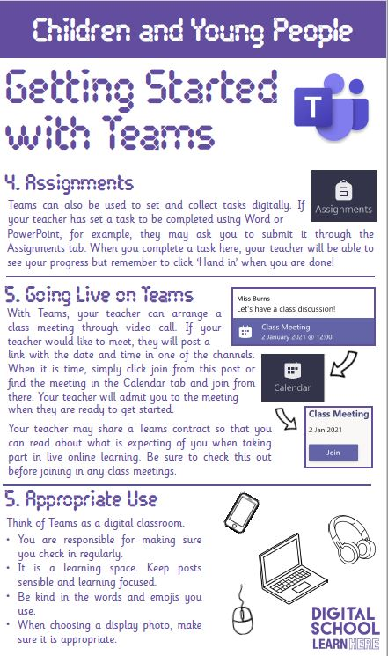
What Will My Child be expected to do?
Have all their log ins ready for Glow, Sumdog and Giglets.
Work as independently as possible in line with the tasks provided. (This will vary depending on the child)
Upload a photo or document of completed work to Assignments on Teams (when the teacher issues an assignment)- Younger children with packs- arrangements will be made for these to be collected if you cannot upload.
Please note- Adults from home would not be in class with children in normal times so we ask that only children are on live chats with teachers to discuss their learning. If you would like to discuss anything with us, please contact the school for a call or a video chat with a member of the senior leadership team. Thank you. Email – enquiries-at-st-thomas@northlan.org.uk

Slide 7
LOGINS REQUIRED AT HOME
Mrs. Preston, Mrs. Dunn and Miss Dignam will also be attending some live chats each week (Assembly) to check in with the children on their well-being and learning. We will also be viewing the learning submitted on Teams too and looking for our St. Thomas' Superstar Awards! Children will be invited to attend school assembly each Tuesday at 11.00 a.m

Slide 8
Need support?
Access our website -
https://blogs.glowscotland.org.uk/nl/stthomas/
Select the tab- DIGITAL SUPPORT
Contact us at
enquiries-at-st-thomas@northlan.org.uk
Phone 01698 274960 and request a call back or a video webex meeting
We are always here and happy to help!
St. Thomas' Family School

