Slide 1
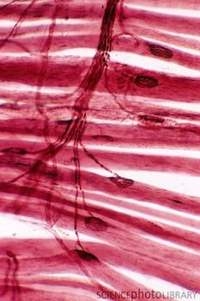
The cells of the nervous system and neurotransmitters at synapses
Key Area 4
Notes:
1 period

Slide 2
Learning Intentions
Describe the structures and functions neurons.
Name the different types of neurons.
Describe the structure and function of the myelin sheath.
Explain how nerve impulses are transmitted between neurons.
Notes:
1 period

Slide 3
Cells of the Nervous system
The nervous system consists of a complex network of nerve cells called neurons which receive and transmit electrical impulses from one part of the body to another.
– they are a means of communication and control.
In addition, glial cells support and maintain the neurons.
There are 3 types of neurones:
sensory
inter
motor

Slide 4
Structure of Neurons
The 3 types of neurone share the same basic structures:
1. a cell body
2. one axon
3. several dendrites
These are thread like cytoplasmic extensions (called fibres) of the cell body.

Slide 5
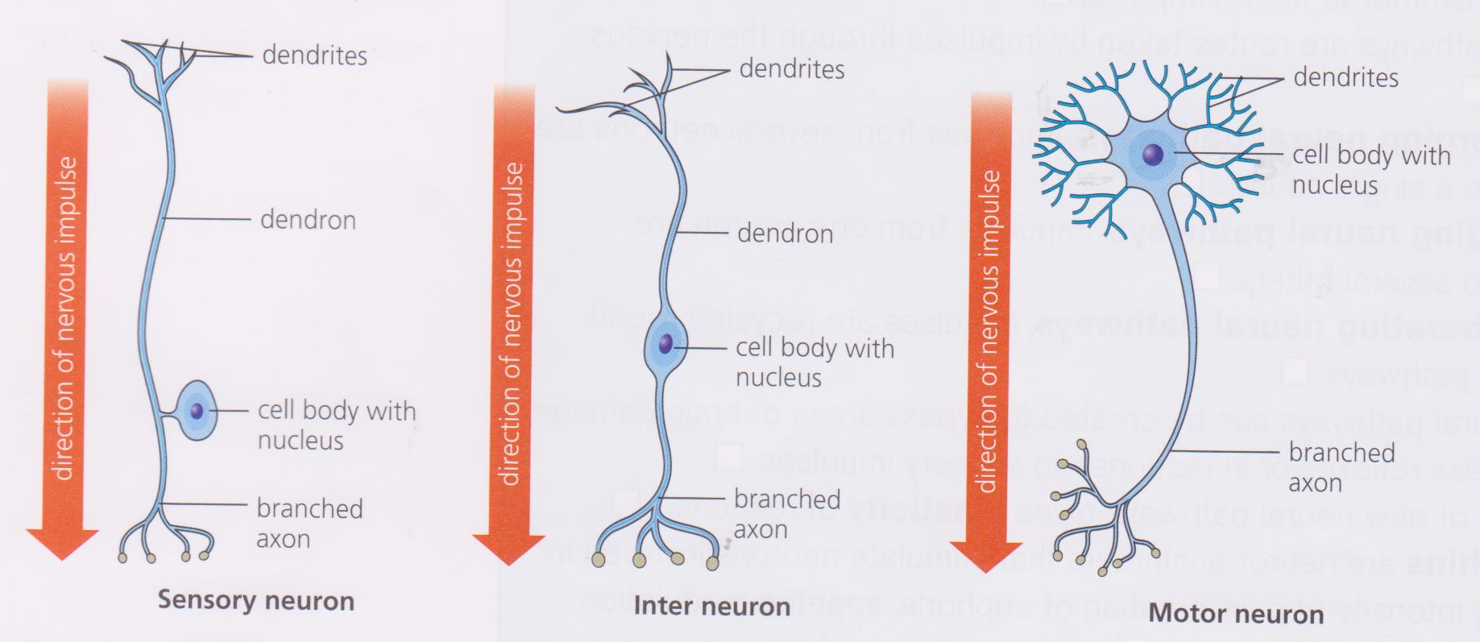
Direction of nerve impulse
The direction in which a nerve impulse travels is always:
dendrites
cell body
axon
Sensory neuron
Inter neuron
Motor neuron

Slide 6
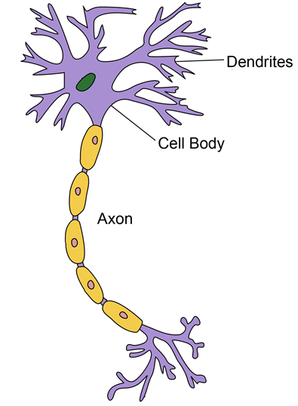
Dendrites
nerve fibres which receives impulses and passes them towardS the cell body.
Cell body
contains the nucleus and most of the cytoplasm. Synthesises neurotransmitters.
Axon
a single nerve fibre which carries impulses Away from a cell body onto the next neurone in the sequence or to the effector. The axon ends at a junction called the synapse.
Notes:
The dendrites of a sensory neuron transmit information from receptors and converge into one elongated fibre, sending nerve impulses to the cell body.
Inter and motor neurones have several short dendrites that transmit nerve impulses from other neurons to cell bodies
Cell body – Contain clusters of ribosomes required to make proteins including the enzymes needed to make neurotransmitters.
Axon can be up to 1m in length
Centrioles – have a role in cell division – spindle fibres develop from these at each pole.
The cell body contains all the usual organelles except for centrioles. This means that it cannot divide and needs to function throughout the life of its owner. If neurones are damaged, regeneration is very poor. Hence paralysis after an accident is usually for life.
Axons of sensory and inter neurone carry impulses from the cell body to other neurones
Axons of motor neurones carry impulses from the cell body to effectors and can be very long

Slide 7
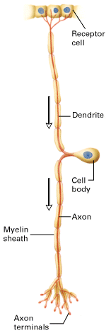
Sensory Neuron
These neurones pass information from sense receptors to neurones in the central nervous system (CNS).
A single dendrite receives information from sense receptors and transmits a nerve impulse towards the cell body.
From the cell body, a single axon carries the nerve impulse into the spinal cord where the impulse is transmitted to the dendrites of an inter neurone.
e.g. in the skin

Slide 8
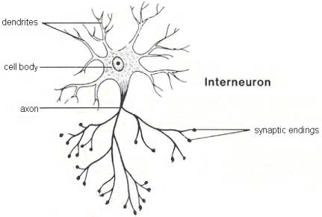
Inter Neuron
Carry impulses from sensory neurone to the motor neurone. Found completely within the CNS.
These vary in shape but, in general, have several dendrites and an axon extending from the cell body, allowing impulses to be passed to a large number of other neurons.

Slide 9
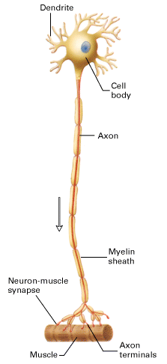
Motor Neuron
Transmit impulses from the CNS to an effector organ (muscle or gland).
These the cell body and several short dendrites lie embedded in the CNS. One axon extends from the cell body, passing out of the CNS to reach the effector organ.
Some axons of motor neurones are extremely long (over 1 metre), extending from the spinal cord to the muscles and glands at the tips of your fingers and toes.

Slide 10
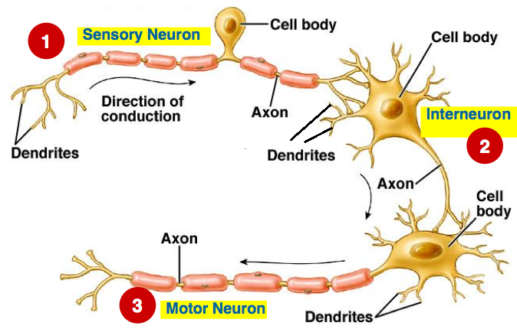
Sense receptor
CNS
effector

Slide 11
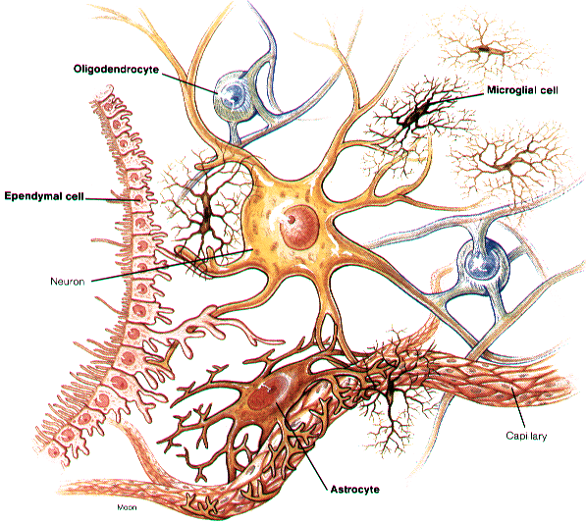
Glial Cells
There are several types of glial cells which have numerous functions.
They do not transmit nerve impulses but are essential to provide neurons with….
1. Some provide a physical support for neurons
2. Some carry out the process of myelination
More about this in a minute
Notes:
3. They do this by helping to control the chemical composition of the fluid surrounding the neuron.

Slide 12
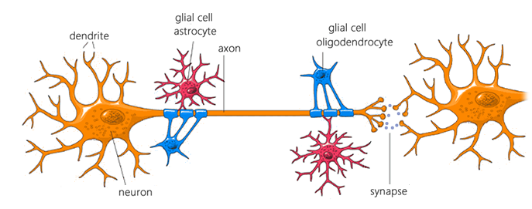
Glial cells
Glial cell produces myelin sheath and physically supports the neuron
Glial cell
Glial cell
neuron is supported physically and chemically by glial cells

Slide 13
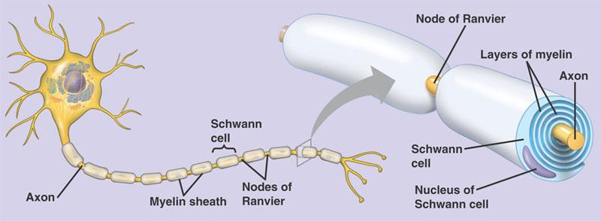
FYI: Nerves with no myelin sheath are described as being unmyelinated
Myelination
The axons of nerve fibres are insulated by a layer of fatty material called the myelin sheath.
The myelin sheath is formed from special glial cells which wind their membrane around the axon many times.
The myelin sheath greatly increases the speed at which impulses are transmitted along a neuron (from node to node).
Glial cell
Glial cell
Nucleus of glial cell
Notes:
Nodes of Ranvier, also known as myelin sheath gaps, are periodic gaps in the insulating myelin sheath of myelinated axons where the axonal membrane is exposed to the extracellular space.
The myelin sheath of long nerves was discovered and named by German pathological anatomist Rudolf Virchow in 1854. French pathologist and anatomist Louis-Antoine Ranvier later discovered the nodes, or gaps, in the myelin sheath that now bear his name.

Slide 14
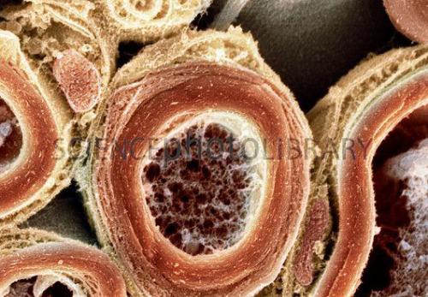
Nucleus of glial cell
axon
Myelin sheath

Slide 15
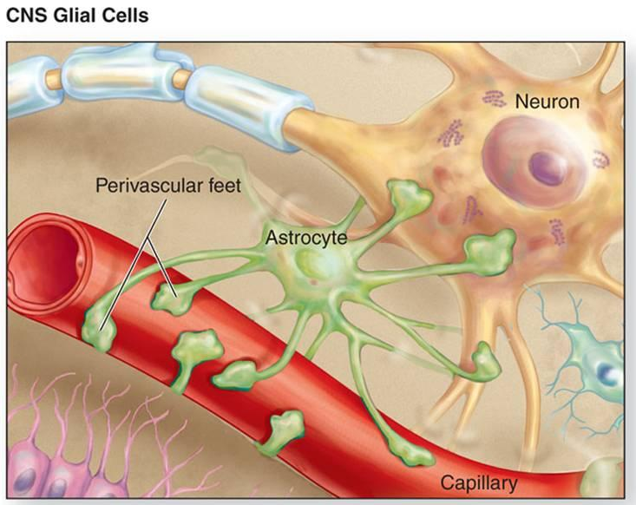
Quick Research homework…
Find out about glial cells and the blood brain barrier (see page 254 of textbook).

Slide 16

Myelination & Development
Myelination is not complete at birth but continues from birth into adolescence.
As a result responses to stimuli in the first two years of life are not as rapid or co-ordinated as those of an older child or adult.
Notes:
Myelination in Infants
Temperature control – young babies do not have a fully effective ‘thermostat’ because the hypothalamus is not fully myelinated until about 6 months. Hence, infants do not have good control of body temperature at birth.
Motor control – similarly neurones in the spinal cord are not fully myelinated until around 2 years so they are unable to fully control their lower body. Myelination is completed in the upper limbs before the lower limbs.

Slide 17
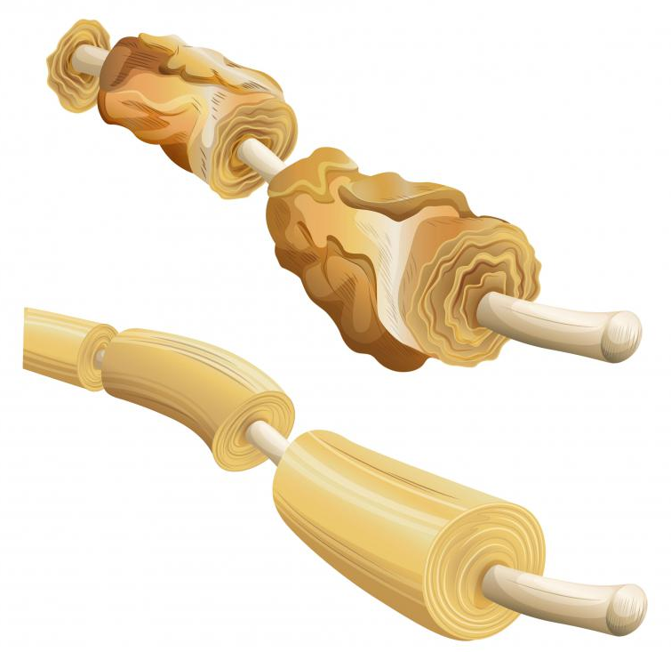

Myelination & Disease
Certain diseases damage or destroy the myelin sheath causing a loss of co-ordination.
These include: Multiple Sclerosis (MS), Poliomyelitis (polio) or Tay-Sachs disease (TSD)
Find out more about these conditions on page 255
Notes:
Multiple sclerosis is an incurable autoimmune disease of the CNS.
It is an autoimmune disorder in which the myelin sheaths of nerve cells in the brain and spinal cord are attacked and damaged by the body’s immune system.
This affects the nerve fibre function by slowing (or even stopping) the impulse, so affected individuals slowly lose the ability to control their muscles.

Slide 18
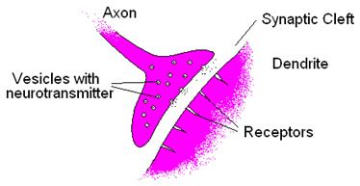
Synaptic Cleft
Neurons are separated from each other by tiny microscopic gaps.
The junction where two neurons meet (axon on one cell and dendrite of the next) is called the synapse.
The synapse allows the transmission of nerve impulses between neurons.
The narrow space which separates the plasma membranes of the two neurones is called the synaptic cleft.
Neurons connect with other neurons at the synaptic cleft.
Notes:
1897 – Sir Charles Sherrington
Studied nerve impulses between neurones and found that:
Impulses move in one direction
There is a short delay in transmission – this led to the ‘synapse gap’ theory
Synapse and Neurotransmitters
The point where two nerve fibres meet is called a synapse. At the synapse the nerve fibres do not touch. Instead there is a tiny gap called the synaptic cleft (approx. 20 nm where one nm = one millionth of a millimetre). Chemicals must diffuse across the synaptic cleft to pass the impulse onto the next neurone. These chemicals are called neurotransmitters of which there are many different kinds, the best known of which are acetylcholine and noradrenaline.

Slide 19
Neurotransmitters
The nerve cell before the synapse is called the presynaptic neuron.
The one after the synapse is called the postsynaptic neuron.
Neurons also connect with muscle fibres and endocrine glands cells via spaces similar to synaptic clefts.
For a nerve impulse to cross the synaptic cleft, chemicals called neurotransmitters have to enter the synapse.
Neurotransmitters relay messages within and out with the brain from neuron to neuron.
Neurotransmitters are stored in vesicles.
Can you name any from a pervious unit?
acetylcholine noradrenaline (norepinephrine)

Slide 20
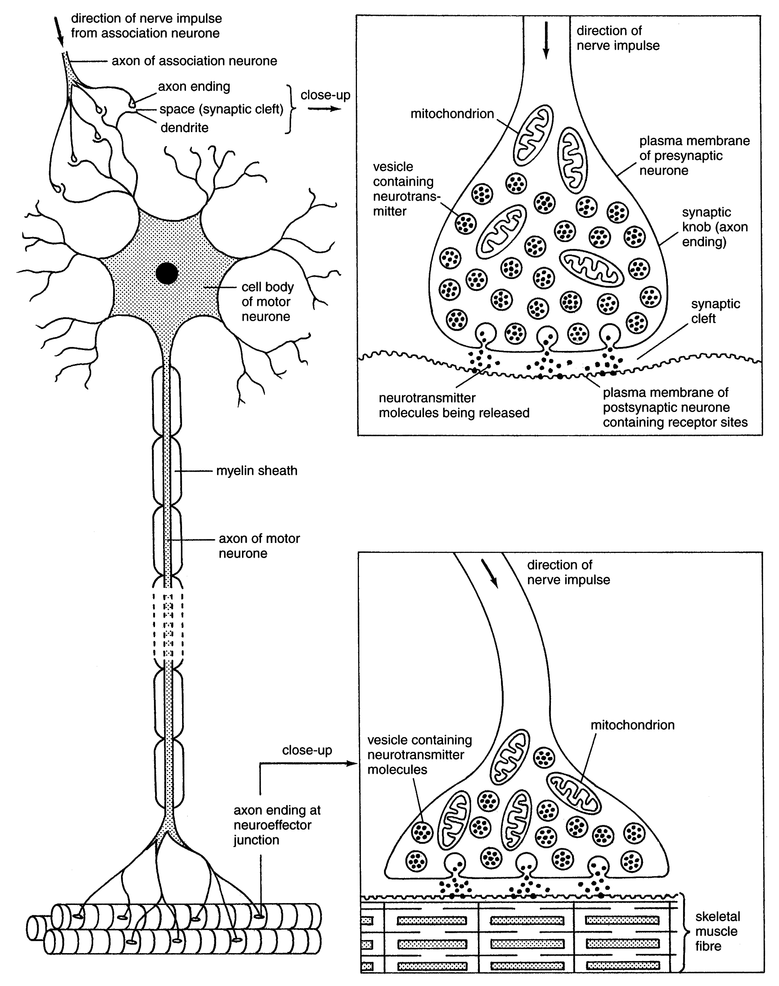
Chemical transmission at a synapse
inter neuron
The plasma membranes of the two neurons at a synapse are very close to one another and the axon endings (synaptic knob) contain a rich supply of vesicles full of one type of neurotransmitter.
When a nerve impulse arrives at the presynaptic membrane and reaches the axon endings it stimulates several vesicles which move to and fuse with the membrane.
The vesicles release their neurotransmitters into the synaptic cleft (good example of exocytosis!).
The neurotransmitters then diffuse across the cleft and bind with receptor sites on the membrane of the postsynaptic membrane (bit like a lock and key) which transmits the impulse through the postsynaptic neuron.
Motor neuron

Slide 21
Key Points: Chemical transmission at a synapse
postsynaptic neuron is activated and impulse is transmitted along the neuron
Neurotransmitter combines with receptor on....
neurotransmitter is released into cleft
Impulse reaches nerve (axon) endings of presynaptic neuron
Use the jumbled statement to help you complete your summary flow diagram

Slide 22
Key Points: Chemical transmission at a synapse
Direction of a nerve impulse
Impulse reaches nerve (axon) endings of presynaptic neuron
Arrival of impulse causes vesicles to fuse with presynaptic membrane
Learn
Me!
neurotransmitter is released into cleft
Neurotransmitter diffuses across synaptic cleft
Neurotransmitter combines with receptor on....
Nerve endings of postsynaptic neuron
postsynaptic neuron is activated and impulse is transmitted along the neuron

Slide 23
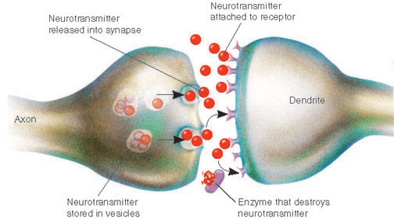
Synapse animations....
http://www.bbc.co.uk/schools/gcsebitesize/science/aqa_pre_2011/human/thenervoussystemrev2.shtml
https://www.youtube.com/embed/XfeaMbTKdV8?modestbranding=1
Enzyme that degrades neurotransmitter

Slide 24
Learning Intentions
Describe the two different ways neurotransmitters can be removed from the synaptic cleft.
Explain excitatory and inhibitory signals.
Explain weak stimuli and summation of stimuli.
Explain how neurons are arranged into different types of neural pathways
Notes:
1 period

Slide 25
Removal of neurotransmitters
After the synapse…
The postsynaptic membrane remains excited for a short period of time.
Neurotransmitters are rapidly removed from the synaptic cleft once the impulse has been transmitted
This prevents continuous stimulation of postsynaptic neurons. (It also allows the neuron to respond to new signals, making precise control possible).
Removal of neurotransmitters can be achieved in two different ways…
Notes:
The continual synthesis and removal of neurotransmitters requires a neurone to use enormous amounts of energy (ATP) supplied by numerous mitochondria.
Neurones, therefore have a very high metabolic rate.
This is why the brain is so easily damaged as a result of a lack of oxygen for no more than a few minutes.
It is also worth noting that drugs such as nicotine, alcohol, cocaine, ecstasy and heroin produce their effects by influencing synaptic transmission

Slide 26
Removal of Neurotransmitter
Enzyme degradation
  Some neurotransmitters can be broken down into non-active products by enzymes in the postsynaptic membrane
  e.g. acetylcholine non-active products.
  The non-active products are reabsorbed by the presynaptic neurone and can be resynthesised or stored in vesicles.
cholinesterase

Slide 27
Removal of Neurotransmitter
  Re-uptake of neurotransmitters
Other neurotransmitter are reabsorbed directly by the presynaptic membrane and stored in vesicles for future use
e.g. noradrenaline (norepinephrine).
Energy for both of these processes is released from mitochondria which are abundant in the pre-synaptic cytoplasm.

Slide 28
Excitatory and Inhibitory signals
We know that neurotransmitters bind with receptors.
It is the type of receptor which determines whether a signal is excitatory or inhibitory.
A neuron can have many synapses with other neurons.
It is the sum of the excitatory and inhibitory signals that determines the overall effect and whether the impulse is passed on (‘fired’).
Notes:
1897 – Sir Charles Sherrington
Studied nerve impulses between neurones and found that:
Impulses move in one direction
There is a short delay in transmission – this led to the ‘synapse gap’ theory
Synapse and Neurotransmitters
The point where two nerve fibres meet is called a synapse. At the synapse the nerve fibres do not touch. Instead there is a tiny gap called the synaptic cleft (approx. 20 nm where one nm = one millionth of a millimetre). Chemicals must diffuse across the synaptic cleft to pass the impulse onto the next neurone. These chemicals are called neurotransmitters of which there are many different kinds, the best known of which are acetylcholine and noradrenaline.

Slide 29
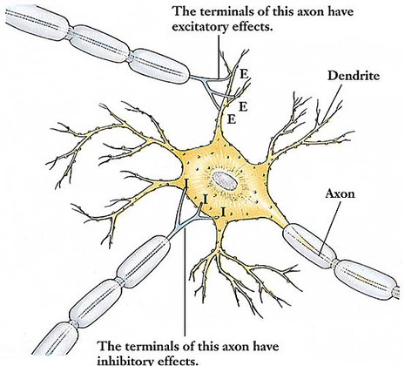
Impulse arrives at synapse with excitatory receptors (E)
Impulse passes to next neuron if the sum of the excitatory signals exceeds the inhibitory ones
Impulse arrives at synapse with inhibitory receptors (I)

Slide 30
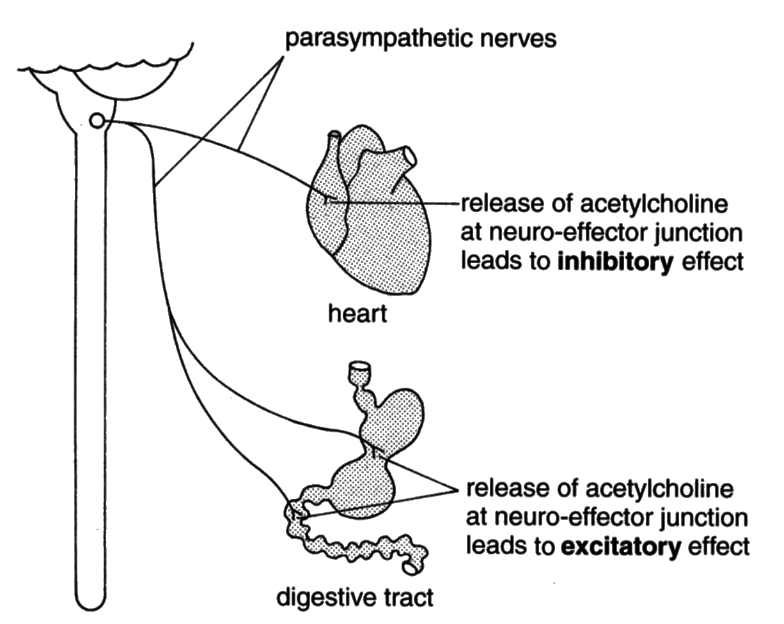
Example of inhibitory/excitatory effects: Acetylcholine
The diagram shows how the release of the same neurotransmitter at parasympathetic nerve endings results in two different effects.
Parasympathetic nerves
Release of acetylcholine at a parasympathetic nerve’s neuro-effector junction with the heart, combines with receptor sites of the type which pass on an inhibitory signal. As a result the rate and force of contraction of cardiac muscle decreases.
See also table 19.2 on page 257
Release of acetylcholine at a parasympathetic nerve’s neuro-effector junction with the digestive tract’s muscle, combines with receptor sites of the type which pass on an excitatory signal. As a result the rate of peristalsis increases.
Therefore, the type of signal which is transmitted (either inhibitory or excitatory), depends on the type of RECEPTOR SITE present in the postsynaptic membrane with which the neurotransmitter combines.
Notes:
Release of acetylcholine at a parasympathetic nerve’s neuro-effector junction with the heart, combines with receptor sites of the type which pass on an inhibitory signal. As a result the rate and force of contraction of cardiac muscle decreases.
Release of acetylcholine at a parasympathetic nerve’s neuro-effector junction with the digestive tract’s muscle, combines with receptor sites of the type which pass on an excitatory signal. As a result the rate of peristalsis increases.

Slide 31
Threshold
In order for an nerve impulse to be fired there is a minimum number of neurotransmitter molecules needed to transmit the nerve impulse across the synaptic cleft. This is called the threshold.
Weak stimuli fail to release enough neurotransmitter molecules and so the impulse fails to be transmitted across the synaptic cleft to the postsynaptic neuron.
Summation
If many weak stimuli reach a target neuron together, then their effect can be summated (added together) so that threshold is reached and an impulse can be triggered.
Learn!
Notes:
Think of a light pull....
Requires a minimum force; gentle or hard = same effect as long as minimal force is met. Any ‘extra’ force has no effect.

Slide 32
Frequency of impulses
Impulses are ‘all or none’. If enough neurotransmitter is released to reach threshold the impulse is fired. Each nerve impulse transmitted is EQUAL in size.
The number of impulses transmitted per second i.e. the frequency, determines the intensity of the stimulus.
For example, in relation to a sound stimulus:
 | Loud stimulus |  | High impulse frequency |  | Many impulses |  | Brain perceives the sound as ‘loud’
The converse applies to a quiet stimulus.
Notes:
Maximum 200 firings per second
Relate to light pull or toilet flush – all or none…

Slide 33
Weak Stimuli
Key point
Summation of weak stimuli can release enough neurotransmitter so that threshold is reached and an impulse is triggered.
Notes:
1897 – Sir Charles Sherrington
Studied nerve impulses between neurones and found that:
Impulses move in one direction
There is a short delay in transmission – this led to the ‘synapse gap’ theory
Synapse and Neurotransmitters
The point where two nerve fibres meet is called a synapse. At the synapse the nerve fibres do not touch. Instead there is a tiny gap called the synaptic cleft (approx. 20 nm where one nm = one millionth of a millimetre). Chemicals must diffuse across the synaptic cleft to pass the impulse onto the next neurone. These chemicals are called neurotransmitters of which there are many different kinds, the best known of which are acetylcholine and noradrenaline.

Slide 34

Find out about….
Related Topic
Working with your partner, each of you should research one of the following…..
Curare
Strychnine
…..then be ready to share key points.
See page 259

Slide 35
Testing your knowledge
Collect a white board.
Test yourself by trying the questions on page 259 of the textbook, without your notes.

Slide 36
Extended Answer Question
Describe the function and mechanism of neurotransmitter action at the synapse.
                (7)
Notes:
CfE Specimen paper
Could be issued as homework

Slide 37
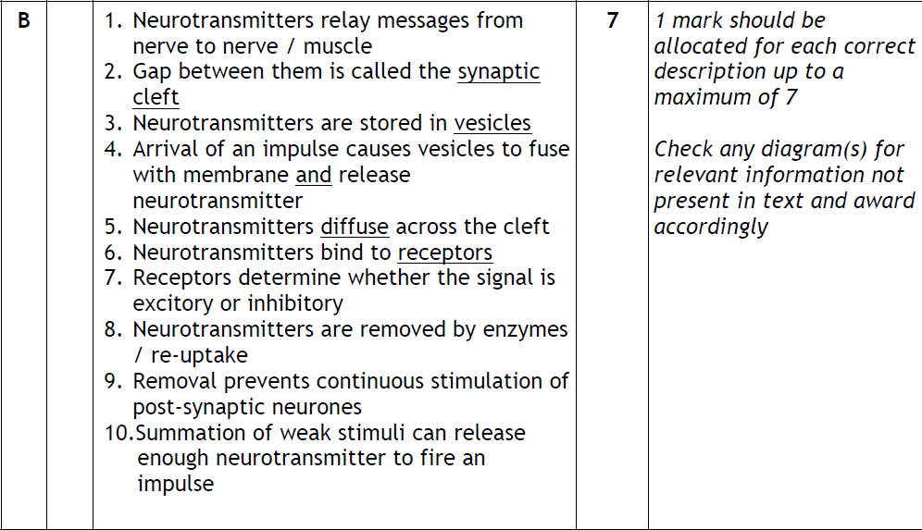
Marking Scheme

Slide 38
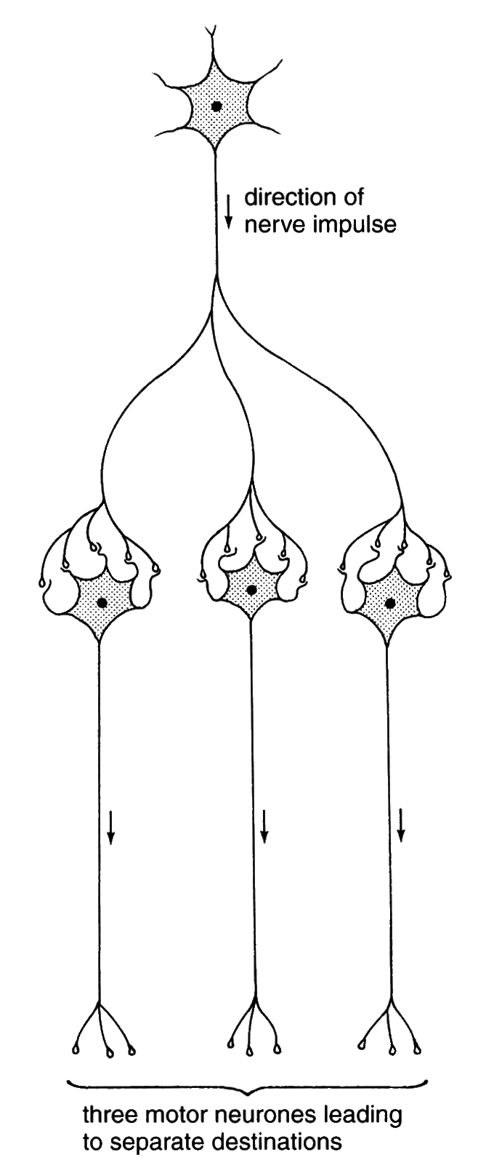
Complex Neural Pathways
Enable the nervous system to carryout its many complex functions.
Diverging neural pathways
This is where one neuron is linked to several neurons.
This allows impulses from the CNS to be sent to several destinations (effectors/ muscles) at the same time.
What does diverge mean?
To branch out from a common point
Diagrams must show direction of impulse

Slide 39
Examples of a diverging pathways
Fine motor control e.g. of the hands when playing the piano and temperature control.
Motor area in the cerebrum
Nerve impulses sent to several muscles at the same time
EFFECTORS
Upper arm muscles
Forearm muscles
Hand muscles
Finger muscles
Permits finger muscles to work in a co-ordinated way (fine motor control)
Hypothalamus detects e.g. drop in temperature
Nerve impulses sent to several effectors at the same time
Permits effectors to work together in a co-ordinated way in order to increase body temperature
EFFECTORS
sweat glands
skin arterioles
skeletal muscles

Slide 40
Exam question
Explain how diverging pathways allow humans to perform a task such as threading a needle (2 marks).
Nerve impulse is transmitted to several points/destinations/effectors at the same time/simultaneously (1mk)
This permits finger muscles to work in a coordinated way/permits fine motor control (1mk)

Slide 41
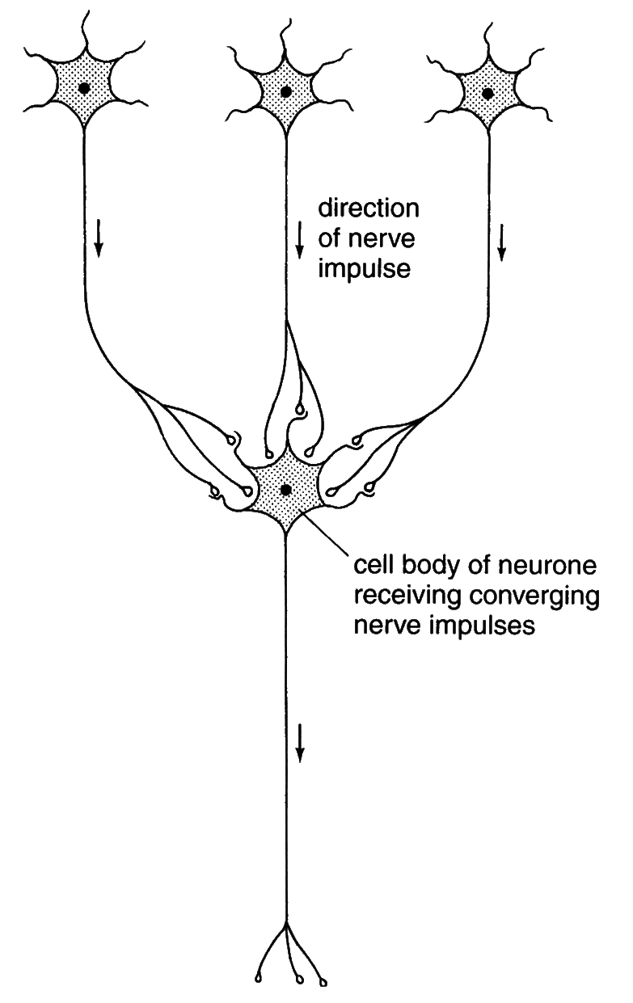
“Summation”
Converging Neural pathways
This has several neurons come together, and link to one neuron.
This allows neurotransmitters from a number of nerve cells to be brought together making it more likely that the threshold is reached and the impulse is triggered.
Converging neural pathways increase the sensitivity to excitatory or inhibitory signals.
What does converge mean?
To come together and meet at a common point
Diagrams must show direction of impulse.

Slide 42
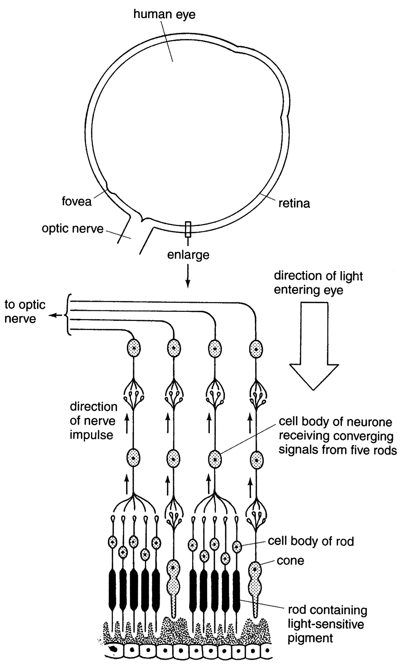
Example of a converging neural pathway
Rods in Retina of eye
The nerve impulse transmitted by one rod in dim light is weak and would fail to reach threshold so the transmission of the impulse would not occur.
However the convergent arrangement of several rods allow many impulses to be transmitted at the same time releasing enough neurotransmitter to reach threshold.
The impulse crosses the synapse and is then transmitted via the optic nerve to the brain.
Notes:
Rods and cones are visual receptors present in the retina of the eye.
They contain pigments which breakdown in the presence of light.
In each case this breakdown forms a chemical which triggers a=off nerve impulses along a pathway of neurons.
The pigment present in cones is not very sensitive to light. Bright light (e.g. daylight) is needed to break it down and trigger off the transmission of nerve impulses.
The pigment in rods is so sensitive to light that it reacts in very dim light. It is quickly rendered temporarily inactive in bright light.
As the intensity of light entering the eye decreases, cones cease to respond and rods take over.
Unlike cones, several rods form synapses with the next neuron in the pathway.

Slide 43
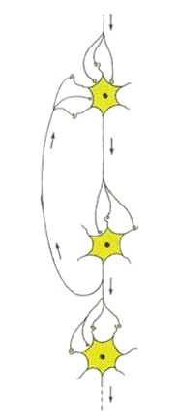
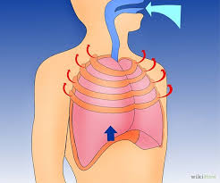
Reverberating neural pathways
Neurons later in a neural pathway possess axon branches that form synapses with neurones earlier in the pathway.
This can be used to send the impulse back through the circuit.
Impulses can therefore be recycled back through the pathway continuously which brings about repeated activities e.g. breathing movements which repeats for a lifetime.
Impulse is recycled allowing continuous stimulation
Breathing muscles continuous in their action

Slide 44
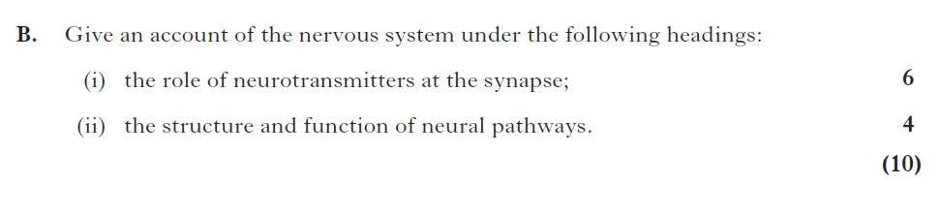
Extended Answer Question

Slide 45
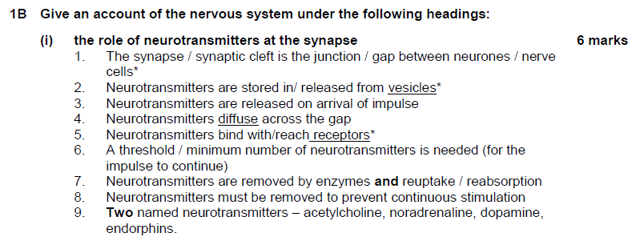
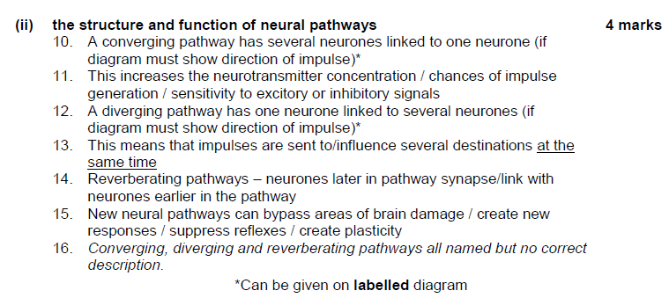

Slide 46
Testing your knowledge
Collect a white board.
Test yourself by trying the questions on page 267 of the textbook, without your notes.

Slide 47
Learning Intentions
To investigate neurotransmitters, mood and behaviour.
To investigate the action of recreational drugs.
Notes:
1 period

Slide 48
Neurotransmitters, mood and behaviour
& The mode of action of recreational drugs
Collect:
Pupil handout
A3 info sheet (extract from bright red book)
Textbook pages 267-278
Take your time to read the available resources and study the diagrams – make brief notes for each section on your handout.

Slide 49
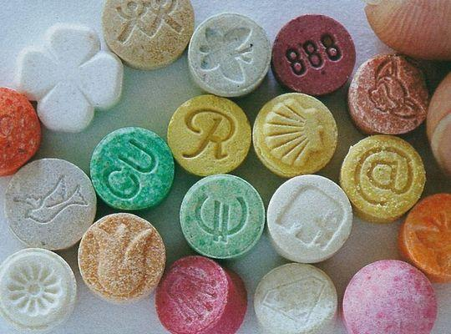
Find out about….
Working with your group, each of you should research one of the following…..
Cocaine
Cannabis
Ecstasy (NDMA)
Alcohol
Nicotine
…..then be ready to share key points.
See page 272-274 onwards
Notes:
Class activity – supressing blink reflex and auditory distraction (time allowing)

Slide 50
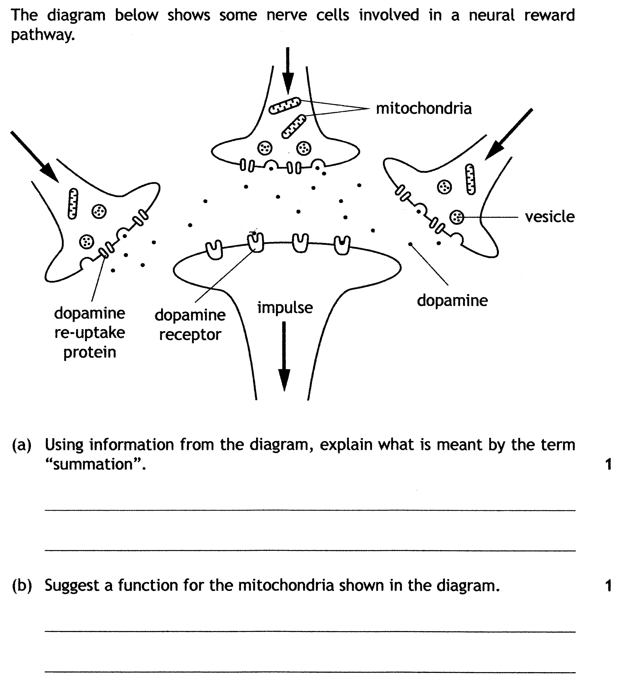
Practice Questions
Enough / increased/more/a higher concentration of dopamine /neurotransmitter (is released) to trigger an impulse/reach threshold.
or Many/a series of weak stimuli trigger an impulse/reach threshold.
provides energy/ATP to make/ release neurotransmitter or dopamine/form vesicles/allow vesicles to move/allow vesicles to fuse with the membrane/to reuptake neurotransmitter.
Notes:
CfE 2015 Qu 9
Do not accept weak impulses instead of stimuli.

Slide 51
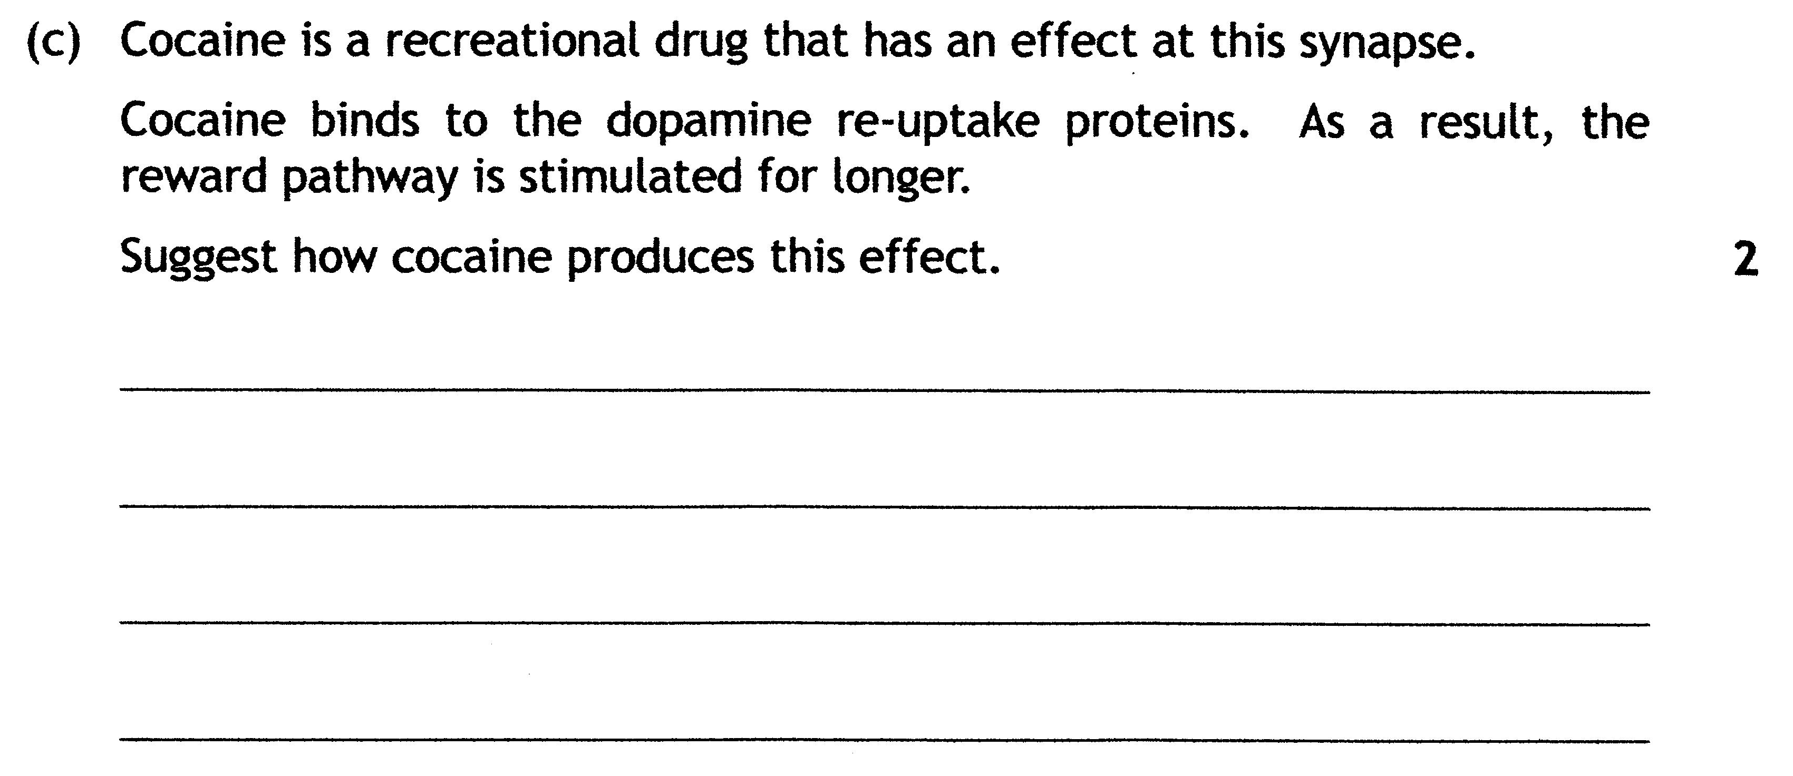
(Cocaine) blocks/inhibits/acts as an antagonist to the re-uptake proteins.
or (Cocaine) prevents the proteins from reabsorbing/taking up/ removing dopamine. 1 mark
Dopamine/neurotransmitter remains in the synapse/at the receptors.
or Dopamine/neurotransmitter continues to stimulate receptors/fire impulses. 1 mark
Notes:
Do not accept cocaine binds to/ attaches to the re-uptake proteins.
Do not accept agonist.
Do not accept dopamine continues to stimulate the reward pathway.

Slide 52
Extended Answer Question
Describe how recreational drugs can affect the brain.
(8)

Slide 53
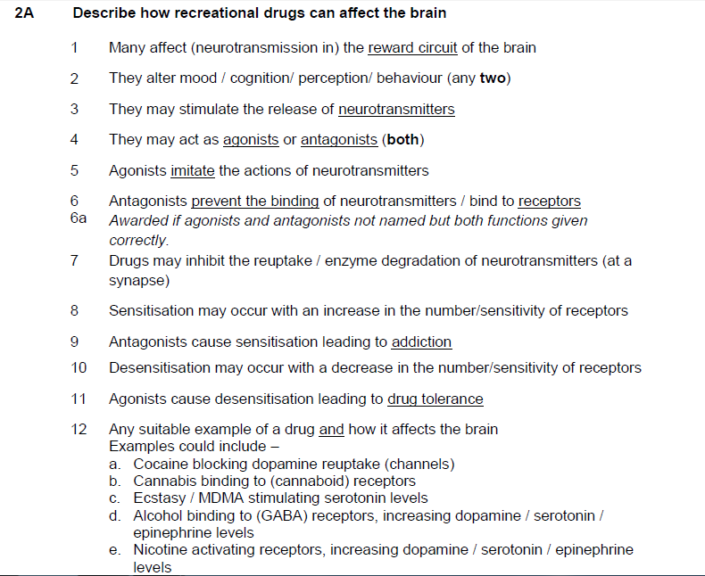

Slide 54
Testing your knowledge
Collect a white board.
Test yourself by trying the questions on page 279 of the textbook, without your notes!

