Slide 1
God Speaks to His People
Notes:
This short unit addresses the RERC 4-12a

Slide 2
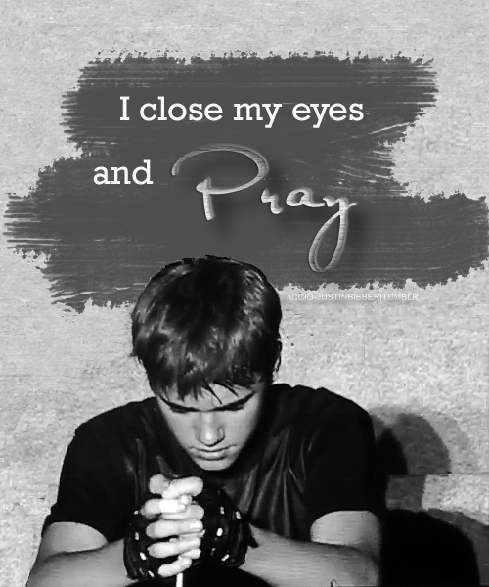
1. How God ‘spoke’ to people in the past

Slide 3
Quick quiz – identify these Old Testament characters

Slide 4
Quick quiz – identify these Old Testament characters

Slide 5
Quick quiz – identify these Old Testament characters

Slide 6
Quick quiz – identify these Old Testament characters

Slide 7
Quick quiz – identify these Old Testament characters

Slide 8
Quick quiz – identify these Old Testament characters

Slide 9
Each of these individuals ‘heard’ God calling them to do something special
They listened
They heard
They acted
They made a difference

Slide 10
Time for choice – choose one of these Old Testament Prophets to investigate
Moses
Abraham
Notes:
At this point the class is given the opportunity to select one of these Prophets to briefly study. The following slides will be selected according to the class choice i.e. if they pick Moses use the Moses slide, if Abraham then move onto the appropriate slides.

Slide 11
Moses
Knowing the story of Moses is crucial to understanding how the Bible describes God communicating with human beings
He lived in a time of great difficulty for the People of Israel, held captive in Egypt
Pharaoh, the Egyptian leader, in fear and hatred of these people, wanted to kill all male Israelite children
Moses mother, in fear of his life, hid him in a basket among the reeds by the River Nile
By chance, Pharaoh’s daughter found him, and brought him up as her own
Moses was therefore spared the brutal life of the Israelites and enjoyed the upbringing of Pharaoh’s family and royalty

Slide 12
From comfort to exile the happiness
http://biblelessonsite.org/slideshow14.html
Notes:
Use the link to connect to a short internet description of Moses’ life from being saved in the basket as a baby to settling down far from Egypt in the land of Midian. He was in exile and knew he could never return to Egypt where he had been brought up for fear of his life. Yet despite this he lived a peaceful life in the idyllic land he now found himself in until that fateful day when he came across the burning bush.

Slide 13
God speaks to Moses
http://www.youtube.com/watch?v=LZpYMr-Ed0Q
Notes:
After showing the 4 minute animation explain that Moses then went back to Egypt and confronted Pharaoh. With the help of God he brought 10 plagues on the Egyptian people before he was finally allowed to set the Israelite free from their captivity. They would spend 40 years in the wilderness before coming to the Promised Land.

Slide 14
Task: You are a journalist working for an online newspaper. You have to write an account of what has happened to Moses.
Explain the story in as much detail as possible
Be clear about what Moses heard God say
Describe the impact
Give your personal response to the story
Notes:
Pupils should be asked to write as detailed an account as possible of the events, trying to make clear: 1) that they understand how God spoke to Moses; 2) what God said to Moses; and 3) the impact this had on Moses from that moment onwards.

Slide 15
Abraham
Abraham was born in Ur, a city in Babylonia, although he moved to Haran with his family.
God called Abraham to leave his homeland even though he was 75 years old.
God called Abraham to trust him and go on the long journey to Canaan. When he arrived God promised Abraham that he would have many descendants – ‘as many descendants as there are stars in the sky or grains of sand along the seashore’ (Gen. 22:17) – and that He would give them this land.
Thinking it was impossible to have children with Sarah, Abraham had a son with the slave girl Hagar whom he called Ishmael. Sarah’s age, however, was not a barrier to God’s plan and she and Abraham had a son called Isaac.
Notes:
The emphasis here is that Abraham was a man of great Faith. Living some 3500 years ago in a world very different from our own, where the common religion was pantheistic, worshipping many gods, Abraham was unique to believe that God was One, and could speak to him personally. At an elderly age he was asked to leave all he knew behind and travel with his entire family to a far away land he knew nothing about. He was told he would father a great nation – but old himself and married to an elderly woman it is little wonder he doubted this part of the promise. But he did indeed have a son with his wife Sarah, starting a family which would become the people of Israel.

Slide 16
God asks Abraham to sacrifice his son Isaac
http://www.youtube.com/watch?v=s8koGvJnIXc&feature=related
Notes:
Use the link to connect to a short internet description of Moses’ life from being saved in the basket as a baby to settling down far from Egypt in the land of Midian. He was in exile and knew he could never return to Egypt where he had been brought up for fear of his life. Yet despite this he lived a peaceful life in the idyllic land he now found himself in until that fateful day when he came across the burning bush.

Slide 17
Making sense of the Abraham-Isaac story
http://www.bbc.co.uk/learningzone/clips/abraham-and-isaac/3662.html
Notes:
After showing the 4 minute animation explain that Moses then went back to Egypt and confronted Pharaoh. With the help of God he brought 10 plagues on the Egyptian people before he was finally allowed to set the Israelite free from their captivity. They would spend 40 years in the wilderness before coming to the Promised Land.

Slide 18
Task: You are a journalist working for an online newspaper. You have to write an account of what has happened to Abraham.
Explain the story in as much detail as possible
Be clear about what Abraham heard God say
Describe the impact
Give your personal response to the story
Notes:
Pupils should be asked to write as detailed an account as possible of the events, trying to make clear: 1) that they understand how God spoke to Moses; 2) what God said to Moses; and 3) the impact this had on Moses from that moment onwards.

Slide 19
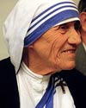
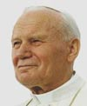
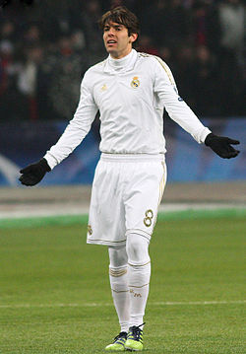
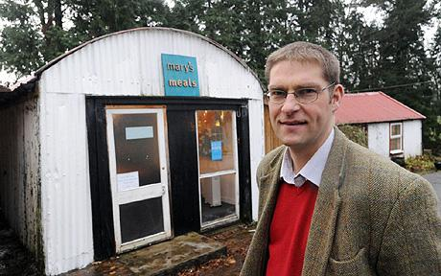
Modern stories of people who have ‘heard’ God speak to them
Notes:
This is the beginning of the second lesson in this short unit. We will be looking at the some examples of people who have ‘heard’ God’s call and acted upon it in some way to make the world a better place. You might like to begin by asking if the pupils can name the individuals on this slide, all people who have publically acknowledged their faith in God. They are: Kaká (Brazilian footballer), Dietrich Boenhoffer, Mother Theresa, Pope John Paul II and Magnus MacFarlane-Barrow (founder of Mary’s Meals).

Slide 20
What happened next?
Notes:
As a starter pupils are asked simply: what do they think happened next with each of these 6 photographs.

Slide 21
What happened next?

Slide 22
What happened next?

Slide 23
What happened next?

Slide 24
What happened next?

Slide 25
What happened next?

Slide 26
Throughout the world and human history, people claim to have heard God speaking to them. They believe this brings a challenge for them to change and make a difference to their world. They are called Christian witnesses.
Notes:
At this point in the lesson it is important to open discussion up to consider the issue of ‘hearing’ God. What does it mean? What is it like to ‘hear’ God speak? Has anyone in this group heard God, or listened to God or know anyone who has? What happened? There should be an emphasis on the term ‘Christian witness’ to make clear to pupils that these are individuals who seek to live their Christian faith in the real world.

Slide 27
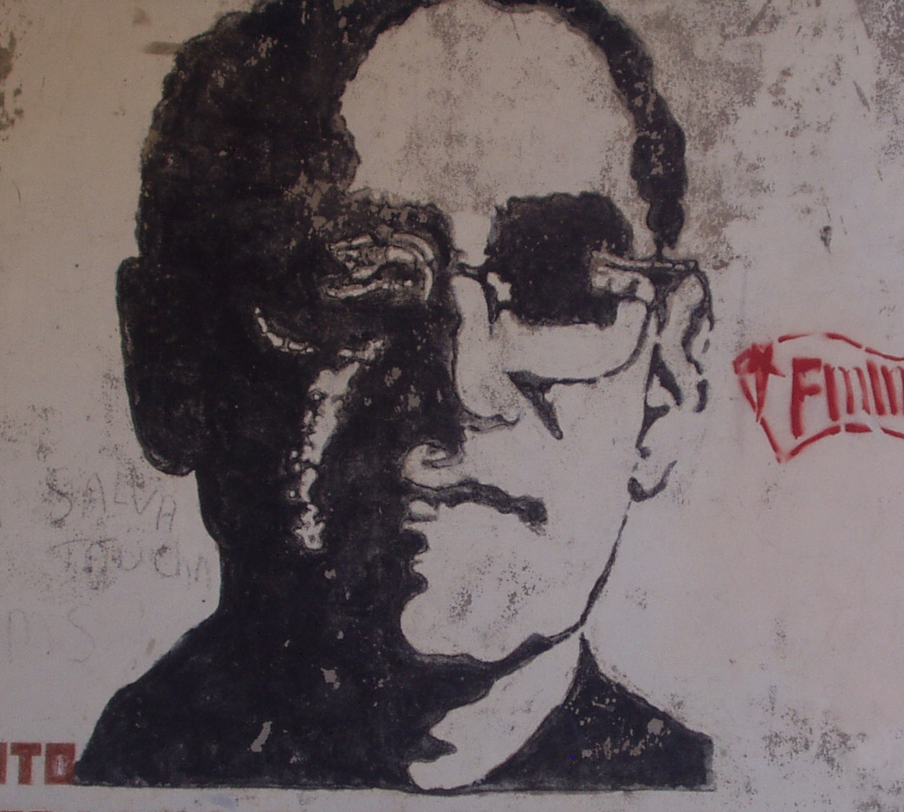
Oscar Romero 1917-1980
Notes:
Archbishop Oscar Romero is one such individual and we shall be investigating his life during this lesson.

Slide 28
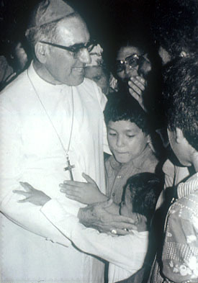
A Special Person
Oscar Romero was born on 15 August 1917 in El Salvador, Central America. When he left school he became a carpenter, but soon decided he wanted to become a priest.

Slide 29
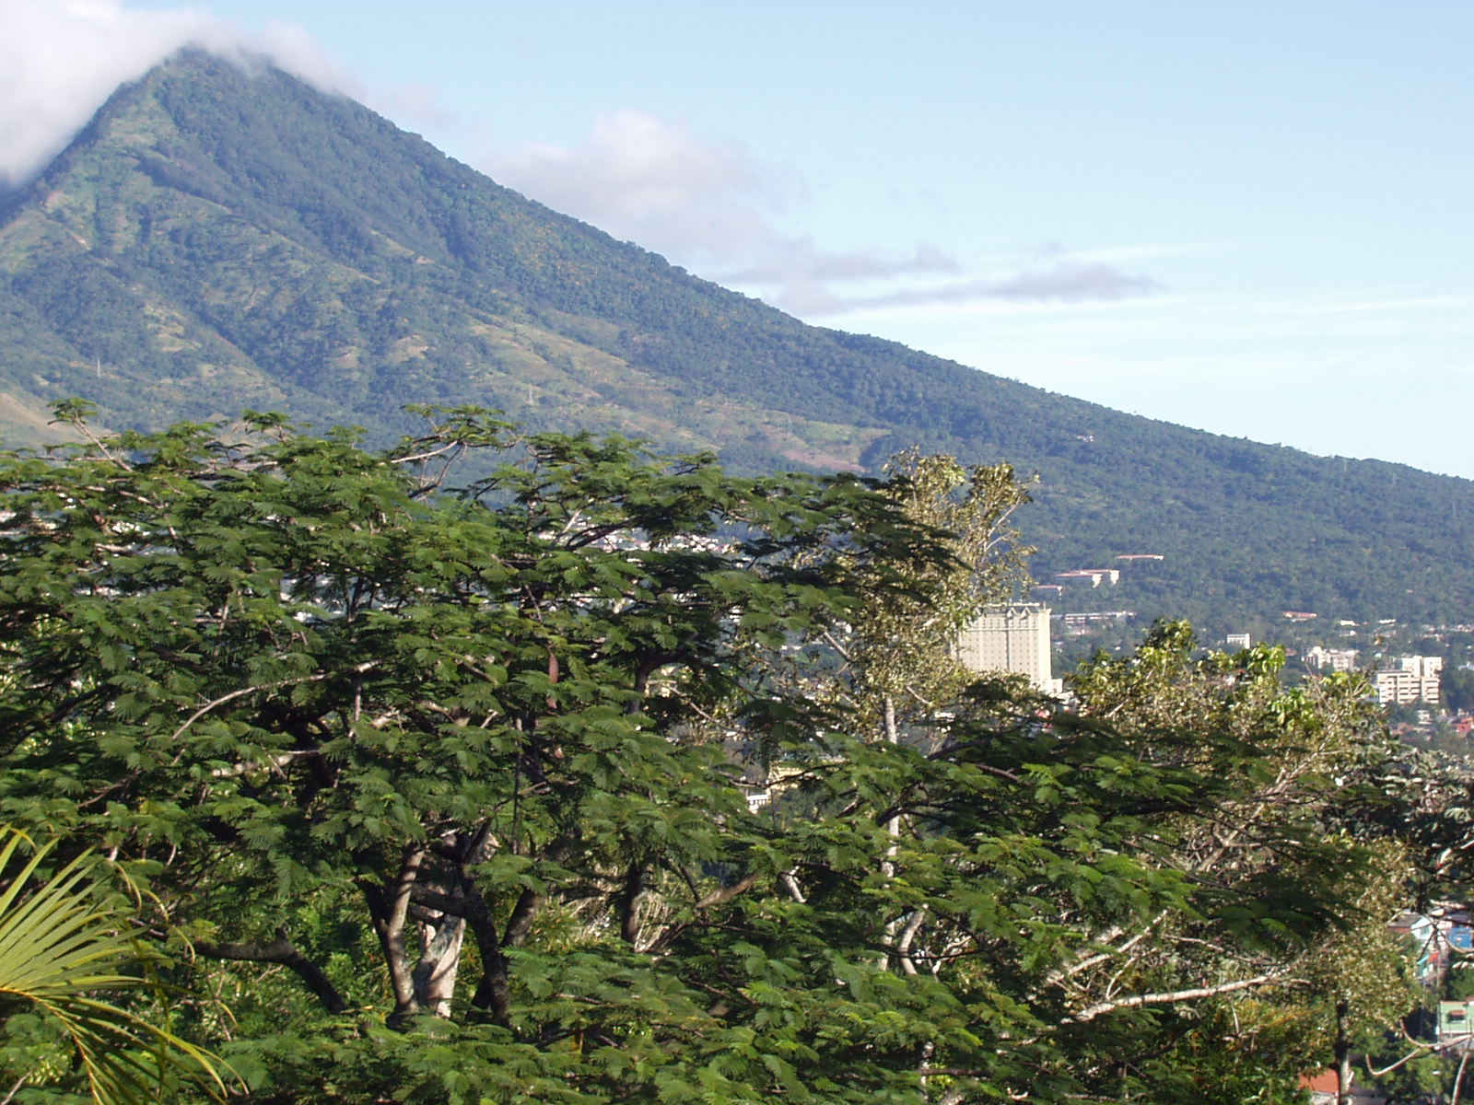
El Salvador at the time
A few families were very rich and owned lots of land. Most people were poor and earned very little.
People became very angry at this unfairness.
But the rich were very powerful. If anybody complained they were put in prison or even killed.

Slide 30
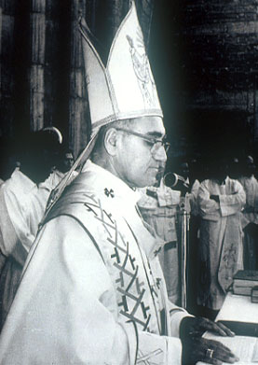
A Quiet Man
In 1977 Oscar Romero became the Archbishop of San Salvador, the capital.
He was a quiet, shy man and nobody thought he would speak out about how poor people were being treated.
They thought he would be too afraid.

Slide 31
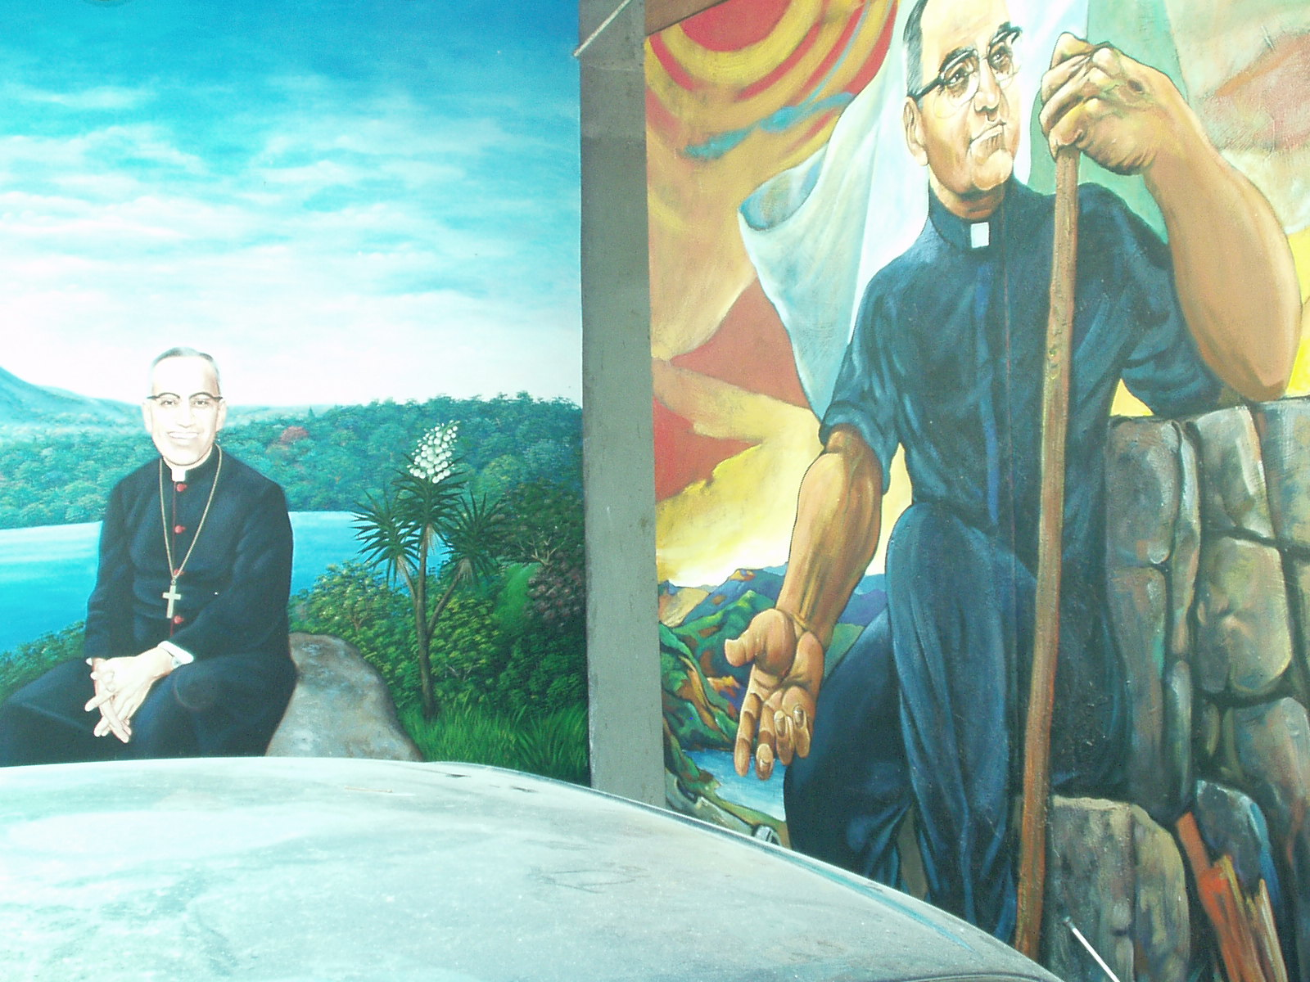
A friend’s influence
Romero’s friend Fr. Rutilio Grande worked with poor communities. He spoke out about how unfair things were and demanded better living conditions for poor people.
For this he was shot dead.
His death upset and angered Romero, who insisted his death be investigated. This never happened.

Slide 32
A voice for the voiceless
From that point Oscar Romero stopped being a quiet man and spoke out. He told the truth about what was happening to poor people in his country.
Every week in his sermons on the radio, he spoke out against the violence.
“Many would like the poor to keep on saying it is God’s will for them to live that way. But it is not God’s will for some to have everything and others to have nothing. That cannot be of God.”

Slide 33
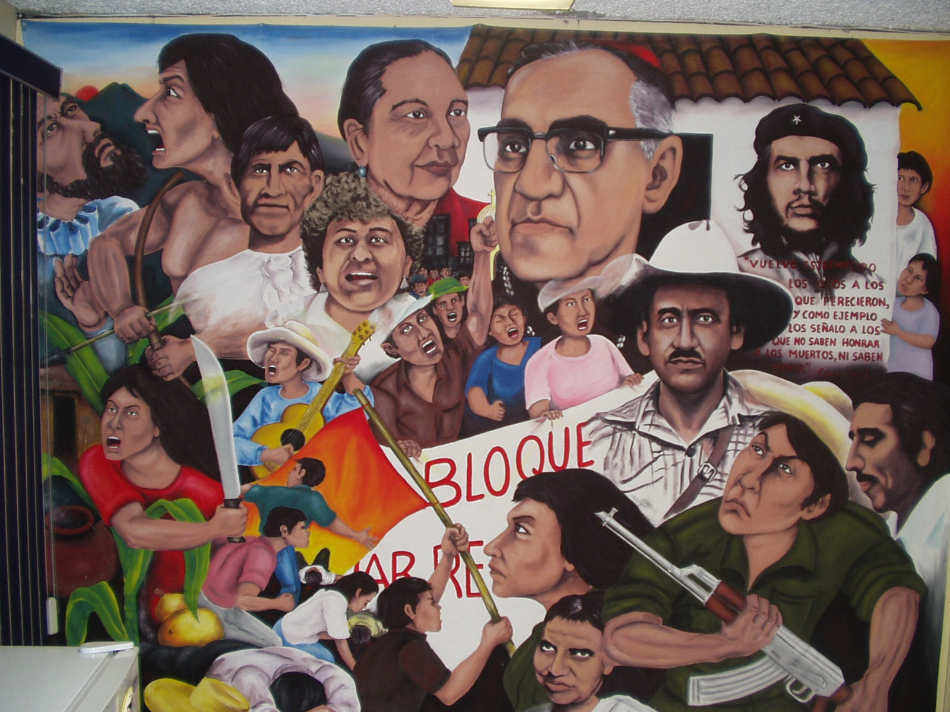
A brave man
Even though he was afraid that he would be killed, his strong faith in God helped him carry on.
“ if they kill me I will rise again in the Salvadorian people”

Slide 34
On 24 March 1980, Oscar Romero was celebrating mass. A car drew up and a shot was fired through the open church door.
Oscar Romero was killed.
http://www.bbc.co.uk/learningzone/clips/oscar-romero-a-modern-martyr/2870.html
Notes:
The SCIAF video clip is a useful explanation of the life of Romero and his ultimate sacrifice. It should help pupils to understand what happened in his life, how he responded to the call of God, the challenges it brought and its effects on how he is remembered today by the Salvadoran people.

Slide 35
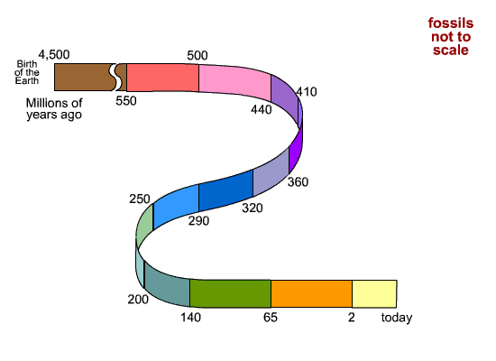
Create a timeline of Oscar Romero’s life
Notes:
Using the slide which follows, the main task for pupils to engage in is the creation of a timeline of the major events of Romero’s life.

Slide 36
The life of Oscar Romero
1917 - Oscar Arnulfo Romero is born into a family of ten on 15 August 1917 in Ciudad Barrios, El Salvador.
1937 - Oscar goes to Rome to study theology and stays there during World War II.
1942 - He is ordained a priest on 4 April 1942. He returns to El Salvador in 1944.
1944 - For 20 years he is Director of the Diocese of San Miguel.
1967 - He is made a Monsignor and moves to San Salvador, where he meets Fr. Rutilio Grande who becomes a good friend.
1970 - He is made a Bishop on 21 June and invites El Salvador’s president to the ceremony. People are angry that he seems to be supporting a government that is oppressing the people.
1974 - A month after he becomes Bishop of Santiago de Maria, the army kills three people in the village of Tres Calles.
1975 - In 1975 he writes a memo criticising some priests for being too political.
1977 - In February 1977 he becomes Archbishop of San Salvador. Some rich people are happy because they think he will stop the priests from helping the poor. On 12 March 1977 Fr. Rutilio Grande and two people he is travelling with are shot and killed.
1979 - Romero receives death threats.
1980 - Romero denounces the government and the army for their repressive policies: “In the name of God, and in the name of this suffering people whose cries rise to heaven more loudly each day, I beg you, I implore you, I order you, in the name of God, stop the repression!” (23.03.80)
On 24March 1980 a shot kills Romero as he says Mass. Thousands of people come to his funeral. The army fires into the crowd. Thirty people die and hundreds are injured.

Slide 37
1 thing I have learned 1 thing I’d like to know more about
Notes:
Before leaving pupils are asked to complete a post-it. They should write something they have learned about Romero’s life and something they would like to know more about.

Slide 38
Assembly Presentation
Working in groups
Using PowerPoint or posters
Produce a clear, informative and visually attractive creation
Notes:
Working in groups the class is asked to produce 10 minute presentation on the life of Archbishop Romero. If there is access to computers this might take the form of PowerPoint presentation, if not then large, colourful posters might be as effective. It might even be possible to arrange an S3 assembly on the theme of Romero’s life which one or two groups could actually present to their peers. If using computers limit pupils to the following websites: http://www.uscatholic.org/oscar_romero & http://www.romerotrust.org.uk/

Slide 39
Assembly Presentation
Success Criteria:
Summarise the story
Identify the calling from God
What challenge did it bring?
Describe the impact of his message

Slide 40
Conclusion
What did you contribute to your group’s work?
What is your personal response to the events of Oscar Romero’s life?
Notes:
It is important to complete this unit of work by giving pupil’s the opportunity to be clear about their contribution to the work of their group as well as identify their personal response to the events of Romero’s life. We are looking for their reaction to what they have learned about those events and what they think about his life.

