Slide 1
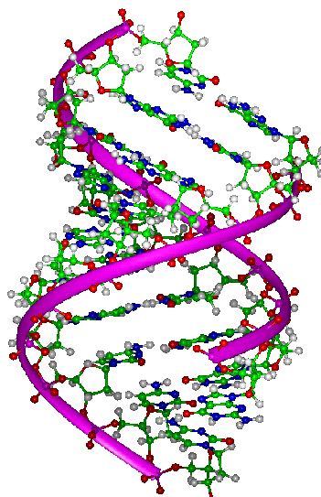
Structure & Replication of DNA
Unit 1 - Key Area 2
Part 1: Structure of DNA
Notes:
2 periods without doing research task

Slide 2
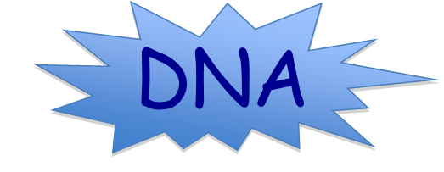
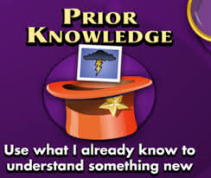
Produce a spider diagram on the back of your hand out to summarise everything you already know about…..
Once you have finished share with others in your group and add to your diagram.

Slide 3
Learning Intentions
Explain how DNA determines the genotype of an organism.
Describe the structure of a DNA molecule and how it is bonded.
Explain how DNA is packaged into chromosomes.
Notes:
3 periods

Slide 4
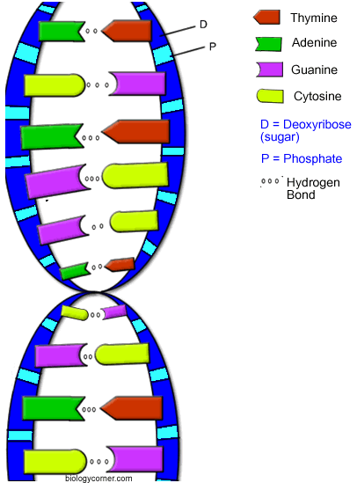
Genotype & DNA
DNA is a complex molecule present in all living cells which can direct its own replication.
DNA is the molecule of inheritance and it stores genetic information in its sequence of bases.
It contains the code to make tens of thousands of proteins in an organism!
This sequence of bases determines the organisms genotype (genetic makeup of an organism) and the structure of its proteins.
Notes:
Pupils copy onto handout

Slide 5
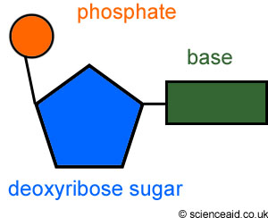
DNA Structure
Each molecule of DNA consists of 2 strands,
where each strand is made up of repeating units
called NUCLEOTIDES.
The nucleotide is made of :
Deoxyribose sugar
Phosphate
(Organic) Base
(of which there are 4 types)
What is the only difference between two nucleotides?
Notes:
Pupils make notes on handout

Slide 6
DNA Nucleotide
Easy way to remember the structure of a DNA nucleotide :0)
Phosphate
Group
My house (sugar), a garage (base) and a satellite dish (phosphate group)
O
O=P-O
O
5
CH2
O
N
Nitrogenous base
(A, G, C, or T)
C⁴
C¹
Sugar
(deoxyribose)
Pentose
C³
C²

Slide 7
1. Adenine (A)
A
The four different bases give rise to 4 different nucleotides
2. Thymine (T)
T
3. Guanine (G)
G
4. Cytosine (C)
C

Slide 8
Nucleotides: Going further
5’ end
Phosphate
Base
Sugar
3’ end
5’ pronounced “5 prime”
The 5' and 3' mean "five prime" and "three prime", which indicate the carbon number in the DNA's sugar backbone.
Notes:
Deoxyribose is a pentose sugar, a pentose sugar has five carbon atoms.
Deoxyribose is a modified sugar, lacking one oxygen atom (hence the name "deoxy"). This difference of one oxygen atom is important for the enzymes that recognise DNA and RNA, because it allows these two molecules to be easily distinguished inside organisms.

Slide 9
Why 5’ and 3’?
This is what a nucleotide looks like at the molecular level…
…lets zoom in to look at the sugar in more detail…

Slide 10
Deoxyribose is a 5 carbon sugar
Its 5 carbon atoms are numbered 1 to 5
Carbon 5
Carbon 4
Carbon 1
Carbon 2
Carbon 3

Slide 11
Lets simplify it a little…
Phosphate
Group
O
O=P-O
O
Nitrogenous
base
(A, G, C, or T)
5
CH2
O
N
C⁴
C¹
Sugar
(deoxyribose)
C³
C²

Slide 12
A deoxyribose sugar
Lets simplify it a little more…
Phosphate
See also diagram p16 of textbook
5C
1C
Base
4C
3C
2C
Notice that the deoxyribose sugar molecule has a base attached to its carbon 1 and a phosphate attached to its carbon 5.
https://www.youtube.com/watch?v=p835L4HWH68 (4:18)
Notes:
The 5' carbon has a phosphate group attached to it and the 3' carbon a hydroxyl group. This asymmetry gives a DNA strand a "direction". For example, DNA polymerase works in a 5' -> 3' direction, that is, it adds nucleotides to the 3' end of the molecule (the -OH group), thus advancing to that direction.
Brilliant video clip (can also be found in the folder)

Slide 13
Complementary base pairing
Each base can only join with one other base.
4 bases:
Thymine
Adenine
Cytosine
Guanine
This is always the case in DNA…
A pairs with T G pairs with C
And Teacher
Goes Crazy

Slide 14
Sugar-phosphate backbone
p
STRONG CHEMICAL BOND links the nucleotides between the phosphate and the carbon 3 of the sugar on another nucleotide.
These bonds are not easily broken and join nucleotides together into a long permanent strand - forming the DNA molecule’s sugar-phosphate backbone.
p

Slide 15
5’ end
Weaker hydrogen bonds form between complementary bases joining the two strands of nucleotides together.
3’ end
ADENINE
THYMINE
This complementary base pairing results in the formation of a double-stranded DNA molecule.
GUANINE
CYTOSINE
This means that the two strands are side by side but run in opposite directions (more about this later).
Notice how the two strands run anti-parallel to each other
3’ end
5’ end

Slide 16
Antiparallel strands
5’ end
(at phosphate group)
3’ end
(on deoxyribose)
A
T
One nucleotide
G
C
T
A
C
G
G
C
3’ end
(on deoxyribose)
5’ end
(at phosphate group)

Slide 17
Antiparallel strands
Each strand of DNA has a 3’ end and a 5’ end determined by whether the 3rd or 5th carbon on the sugar molecule is closest to the end.
The nucleotide chain is only able to grow by adding nucleotides to its 3’ end.
On your diagram the DNA strand on the left has its 3’ at the bottom and its 5’ end at the top.
The reverse is true of its complementary strand on the right.
This arrangement with the backbones side by side but running in opposite directions is described as antiparallel.
DNA strands for a 3’ end and a 5’ end, in a DNA molecule each strand runs side by side but in opposite directions.

Slide 18
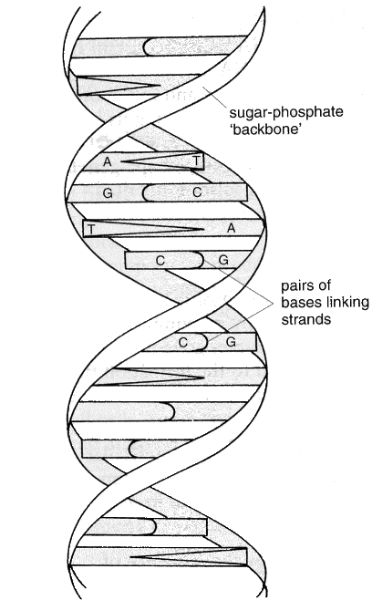
Double helix
The two DNA strands twist and coil into a ‘double helix’. This looks like a twisted ladder; the ‘uprights’ being made of the sugar phosphate backbones, and the ‘rungs’ being the base pairs.
5’
3’
A
T
G
C
2 strands twist into a
coil (double helix)
T
A
C
G
G
C
3’
5’
Weak hydrogen bonds - can be easily broken when required
Notes:
Good note page 18 of textbook which pupils could copy.

Slide 19
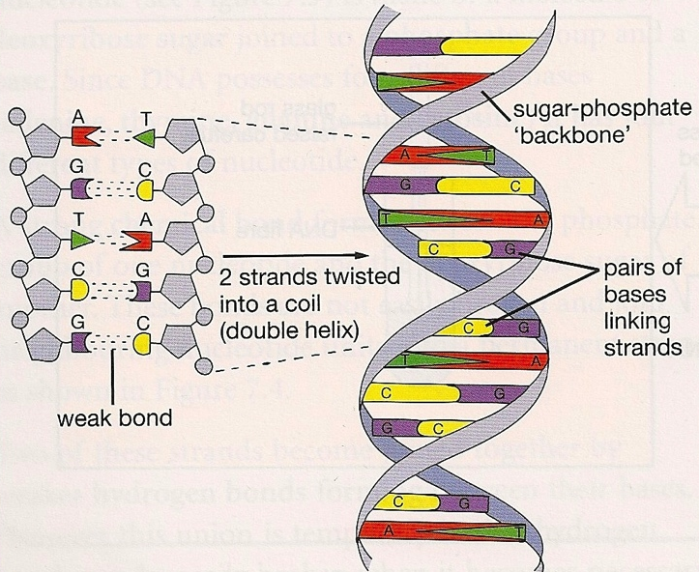
Weak hydrogen bonds - can be easily broken when required

Slide 20
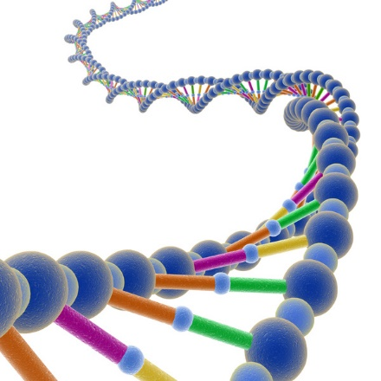
DNA Backbone: Key Points
Nucleotides bond to form a sugar–phosphate backbone.
Complimentary base pairs (adenine, thymine and guanine, cytosine,) held by weak hydrogen bonds which coil forming a double helix.
Double stranded antiparallel structure with deoxyribose and phosphate at 3' and 5' ends of each strand.

Slide 21
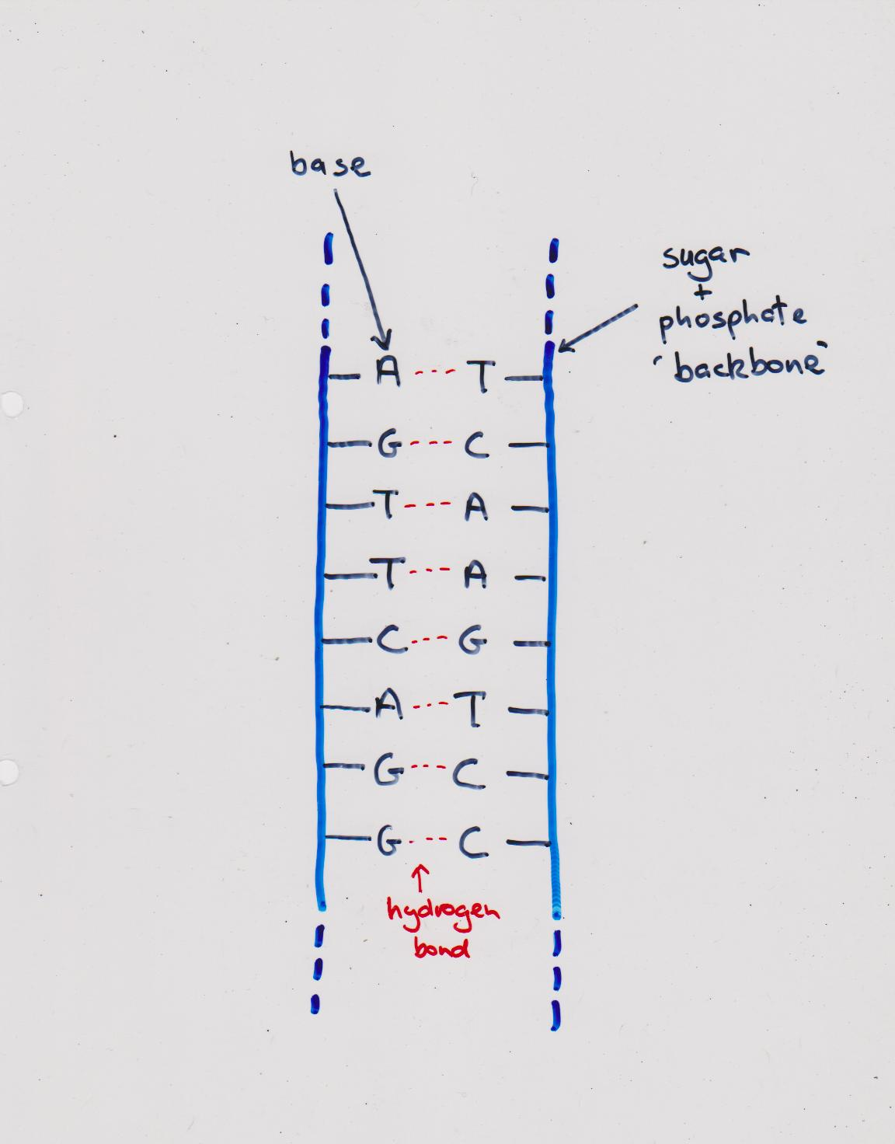
DNA shorthand representation

Slide 22
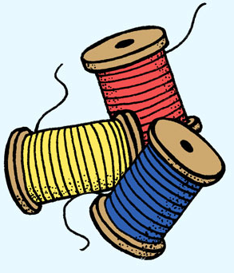
Arrangement of DNA in chromosomes
We know that the DNA is located in the membrane bound nucleus and takes the form of linear chromosomes.
A strand of DNA is several 1000 times longer than the length of the cell to which it belongs.
Around 2 metres of DNA has to be packed into the microscopic nucleus of every cell in the human body in a way that a chaotic tangle of strands is prevented!
The DNA is therefore organised
into tidy ‘spools’.
Each spool is made of protein with the DNA tightly coiled around them.
Notes:
5 copies printed

Slide 23
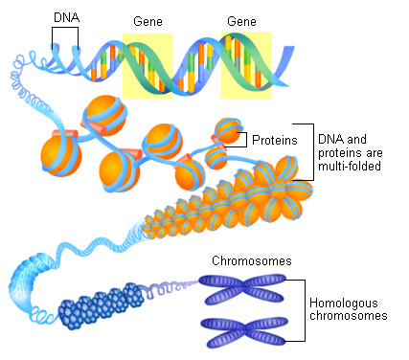
Arrangement of DNA in chromosomes
Key point: chromosomes consist of tightly coiled strands of DNA which are packaged with associated proteins
Notes:
Diagram is included in pupil handout

Slide 24
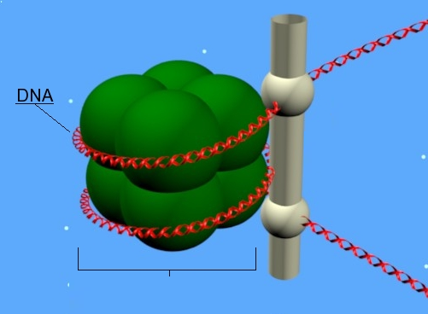
How DNA is packaged into chromosomes using proteins
Once both DNA strands are assembled and the double helix formed, the DNA molecule is tightly wound around associated proteins and packaged into chromosomes.
DNA
DNA wrapped around 8 special proteins
(called histones)
Notes:
5 copies are printed
Nucleosome diagram.
Proteins are called histones.
histones are highly alkaline proteins found in eukaryotic cell nuclei that package and order the DNA into structural units called nucleosomes. They are the chief protein components of chromatin, acting as spools around which DNA winds, and playing a role in gene regulation. Without histones, the unwound DNA in chromosomes would be very long. For example, each human cell has about 1.8 meters of DNA, but wound on the histones it has about 90 micrometres of chromatin, which, when duplicated and condensed during mitosis, result in about 120 micrometres of chromosomes.

Slide 25
Circular Chromosomes in Eukaryotic Cells
DNA is also found in the mitochondria present in
most plant and animals cells, as well as in the
chloroplasts of plant cells.
The DNA molecules found in mitochondria and
chloroplasts are small and circular, much like the DNA
of a typical bacterium. There are usually many copies
of DNA in a single mitochondrion or chloroplasts.

Slide 26
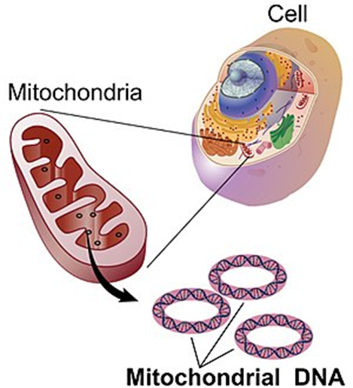
Circular Chromosomes in Mitochondria
DNA was discovered in the mitochondria in the 1960s. This DNA is different in structure to the linear DNA found in the nucleus of eukaryotic cells.
The DNA found in mitochondria forms circular chromosomes.
Mitochondrial DNA contains 37 genes, all of which are essential for normal mitochondrial function. Thirteen of these genes provide instructions for making enzymes involved in respiration. The remaining genes provide instructions for making molecules called transfer RNAs (tRNAs) and ribosomal RNAs (rRNAs),

Slide 27
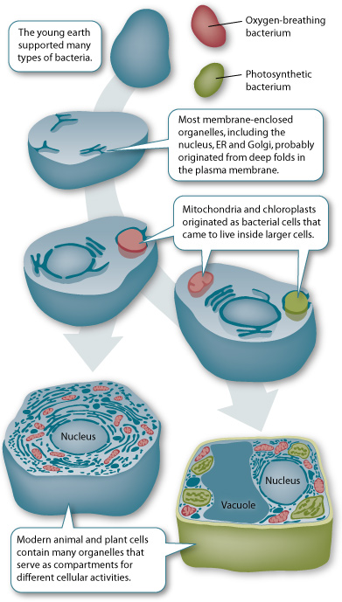
Circular Chromosomes in Chloroplasts
Small circular DNA molecules are also found in chloroplasts. Again each chloroplast will contain many
copies of the circular chromosome.
Similarities between the DNA of mitochondria and chloroplasts and the DNA of bacteria are an important line of evidence supporting the endosymbiont theory, which suggests that mitochondria and chloroplasts originated as free-living prokaryotic cells.

Slide 28
Cell type | Linear Chromosomes | Circular Chromosomes | Plasmids
Eukaryotes – animal
Eukaryotes - plant
Yeast cells
Prokaryotes
In mitochondria
In Nucleus
In mitochondria
In chloroplast
In Nucleus
In Nucleus
In mitochondria
In Cytoplasm
In Cytoplasm
In Cytoplasm

Slide 29
Test yourself… Show-me-boards :0)
Name the repeating units which make up a molecule of DNA.
2) Draw one of these units and label the component parts.
3) Indicate the position of the carbons 1 to 5.
4) Draw a second unit and show how these two units are joined to form part of the DNA backbone and give a characteristic of the bond.
5) Explain the base pair rule.

Slide 30
6) What type of bond holds the bases between opposite strands together?
7) What name is given to the final shape of DNA?
8) Explain why a molecule of DNA is described as anti-parallel.
9) Name the nucleotide component found at the
3’ and
5’ end of each strand.
10) Explain how DNA is packaged into chromosomes.

Slide 31
Practice question
In your groups discuss the following question:
How many guanine bases are on a DNA molecule that codes for a poly peptide chain 300 amino acids long, if 20% of the DNA strand is adenine?
Note - 3 bases code for each amino acid. (1 mark)
300 amino acids are coded for by 900 bases.
If 20% of the strand is adenine, then 20% must be thymine since they form complementary base pairs.
The remaining 60% are cytosine-guanine pairs.
Therefore, 30% of the 900 bases are guanine
= 270 bases.

Slide 32
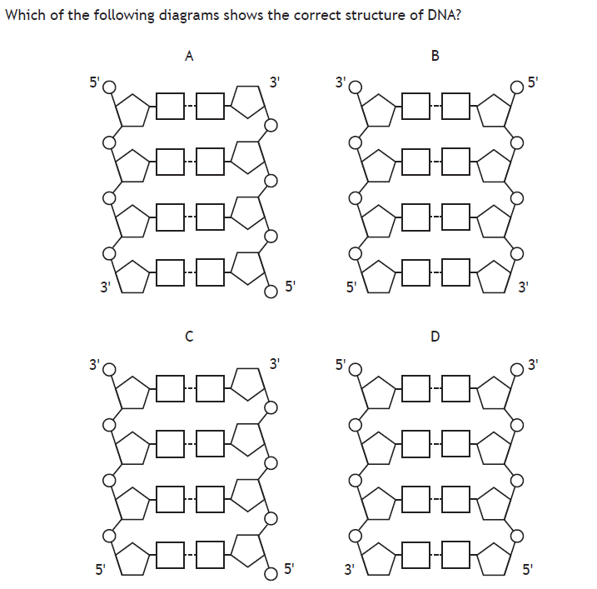

Slide 34
