Slide 1
Supporting your child with Reading, Writing and Maths
Parent Workshop March 2019
This Photo by Unknown author is licensed under CC BY-ND.
This Photo by Unknown author is licensed under CC BY-SA-NC.
This Photo by Unknown author is licensed under CC BY-SA-NC.

Slide 2
Helping develop good reading habits.

Slide 3
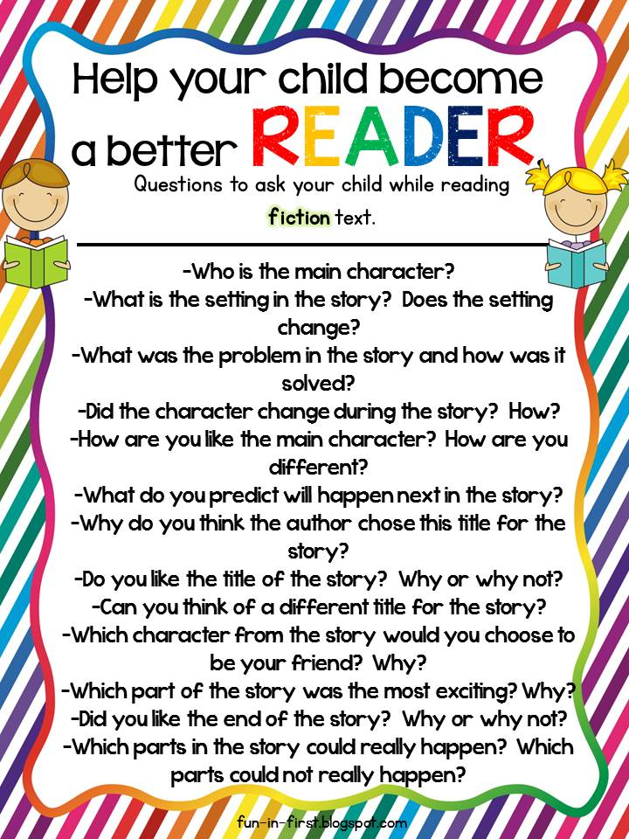

Slide 5
