Slide 1


Tannochside Primary School
Induction Day 1
P.1
2026/2027
Miss Grenfell

Slide 2


Our School
At Tannochside Primary School we aim to:
Thrive Together
Promote Positivity
Strive for Success
In Tannochside Primary we aim to create a stimulating and educationally sound environment where children are encouraged to feel confident in developing a healthy approach to learning. They are encouraged to work co-operatively with others to develop a caring, responsible attitude within their community.

Slide 3
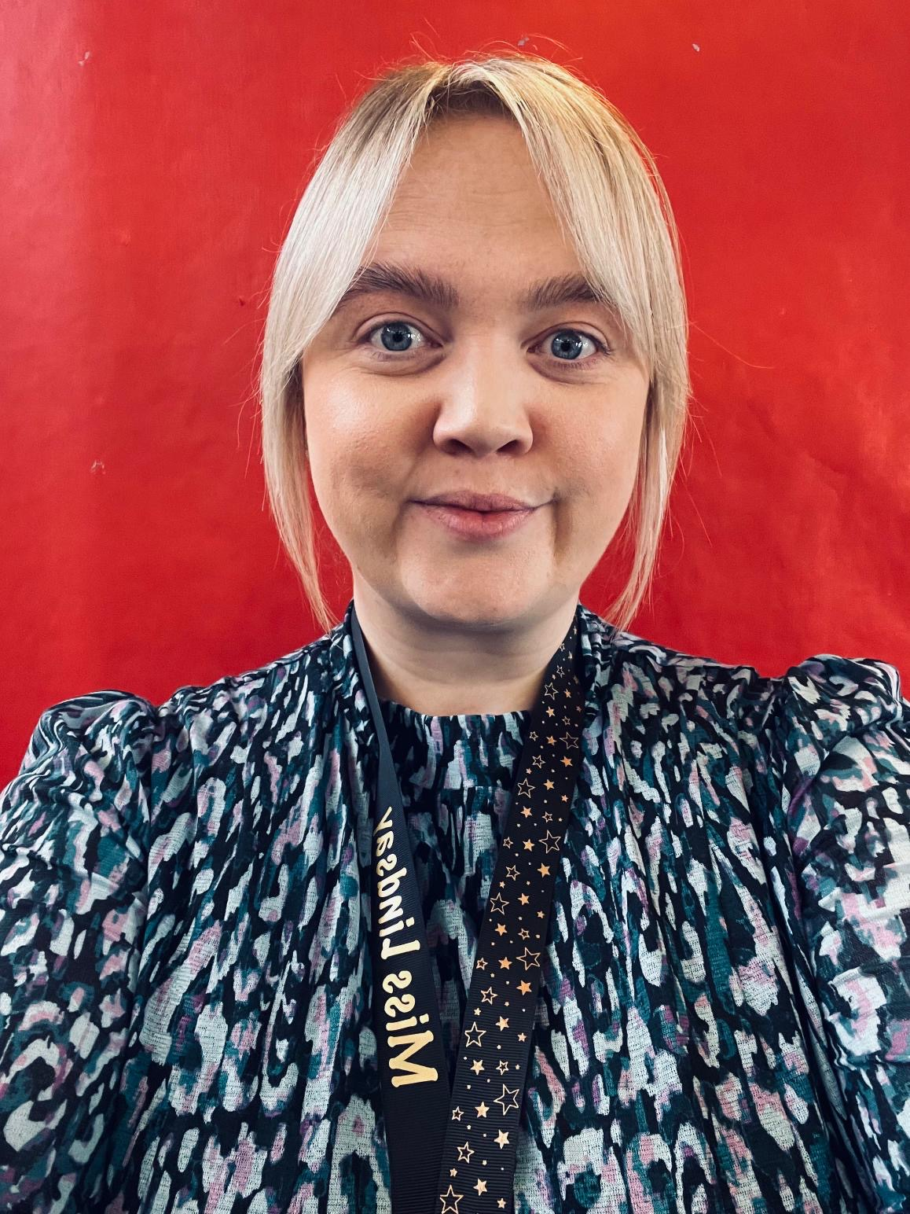
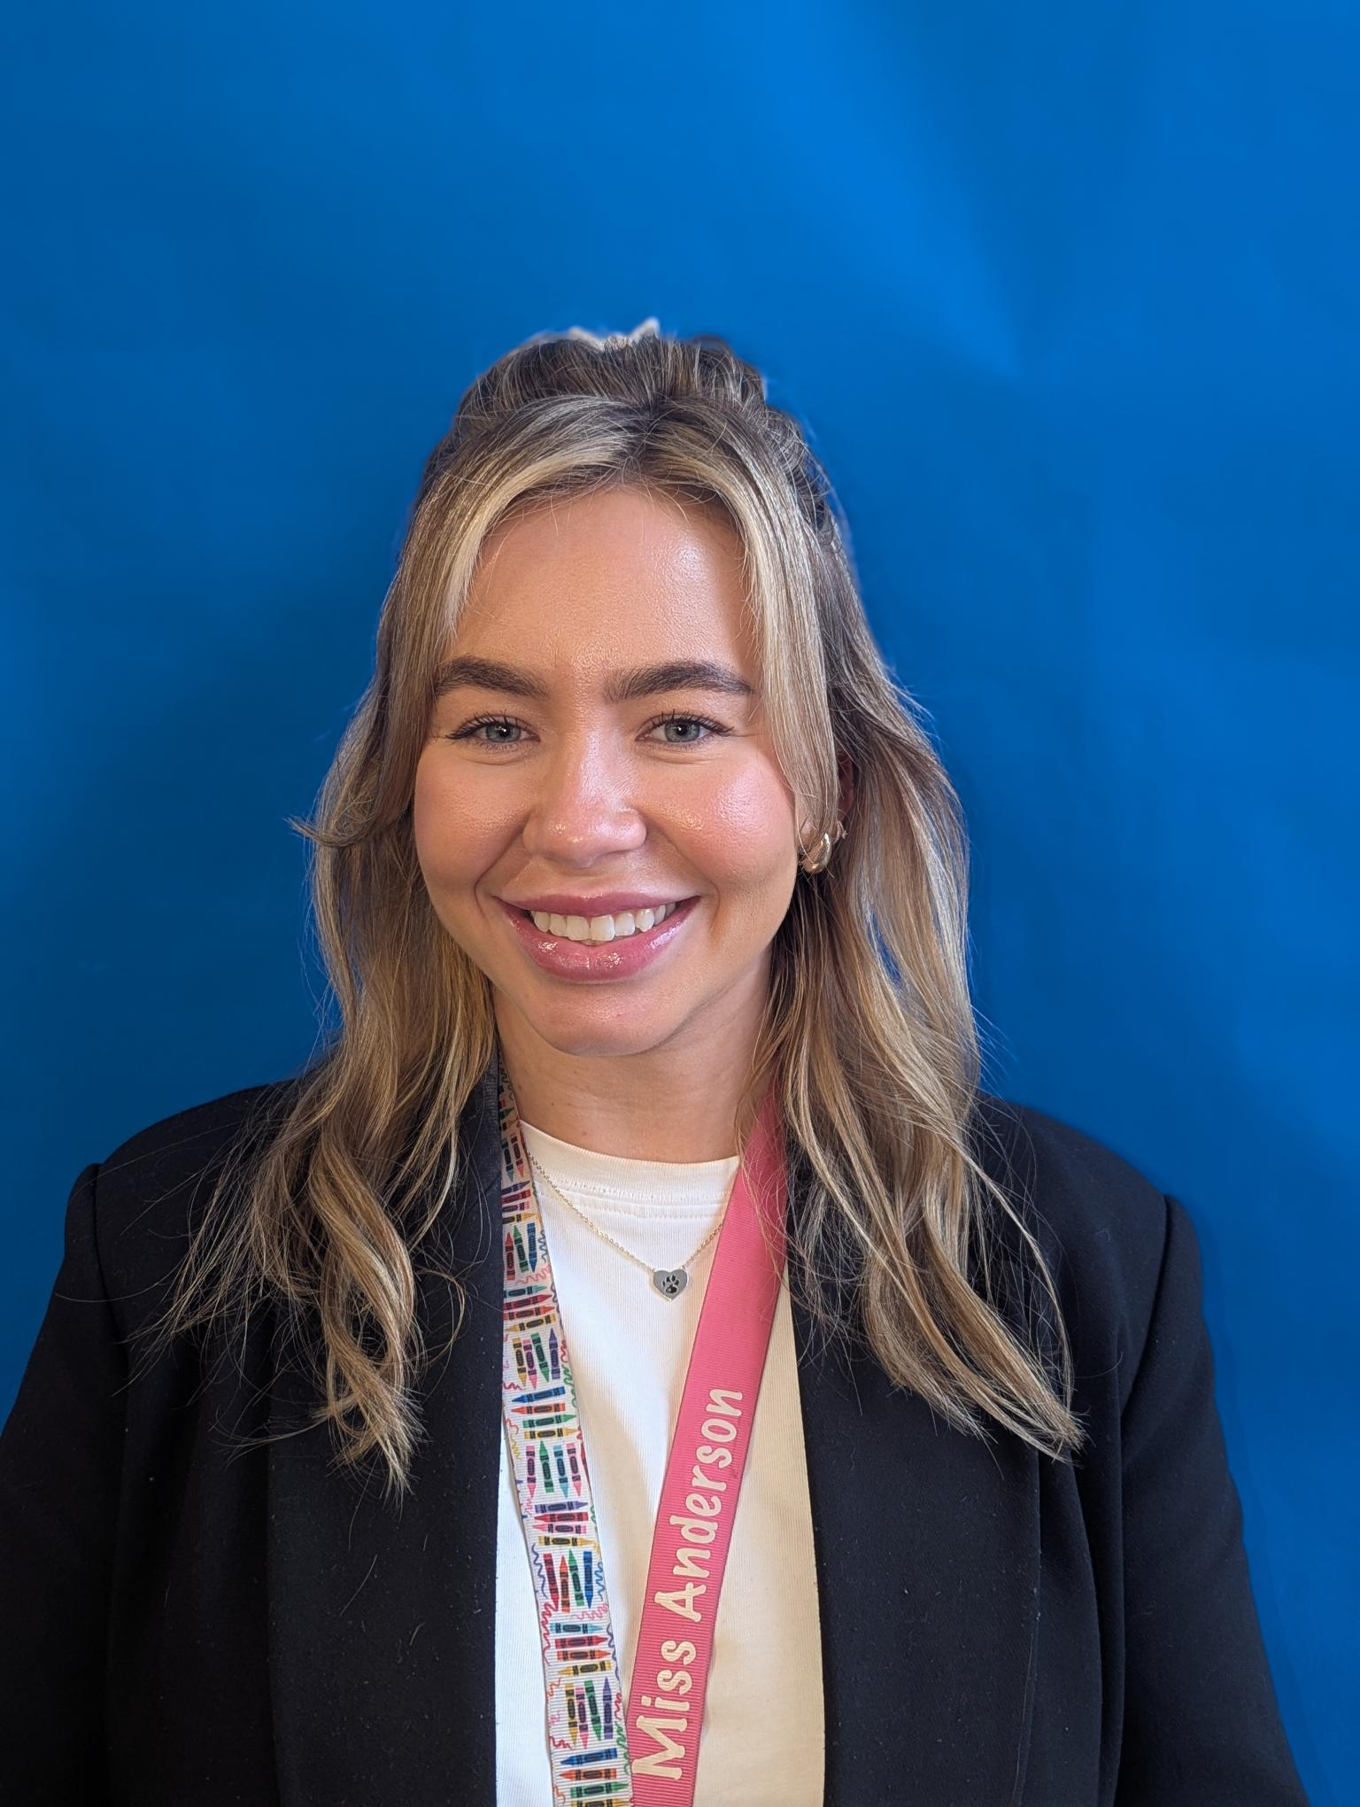
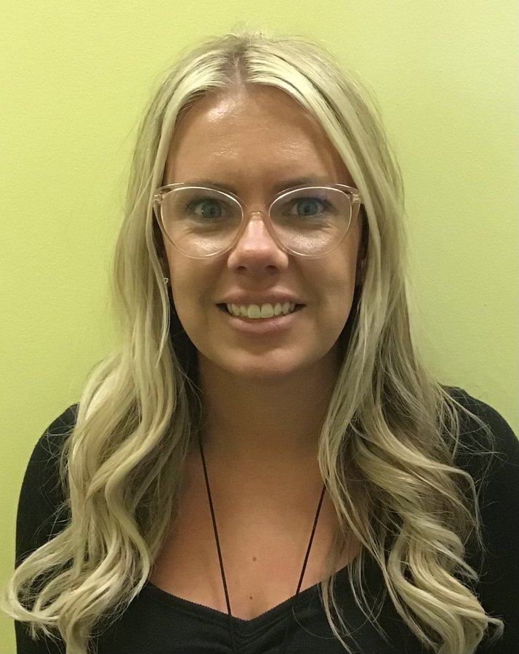
Welcome
Our P1 Teachers
Miss Lindsay
Miss Anderson
Miss Gillen

Slide 4
Classes
54 pupils enrolled so far.
3 classes. 2 x P1 classes and 1 x P1/2 class at present.
Pupils assigned an ‘adult’ for first few weeks, spend lots of time together settling into school.
Class Teachers will be formally assigned in September.
“Meet the Teacher” – parents will meet new teacher in September.

Slide 5
Uniform
Navy/tartan skirt/trousers, white shirt, navy jumper/cardigan, school tie.
Gym Day: white polo shirt (does not have to have school logo), navy jumper, navy tracksuit bottoms/leggings, trainers. Please send your child dressed for PE (shorts can be under trousers).
Please ensure you label all clothing, shoes, belongings.
Provide your child with a change of easy to change shoes for indoors. (Black/Navy Velcro)
All weather outdoors – OPAL activities – change of clothes in bag. Can bring wellies to be kept in cloakroom.

Slide 6
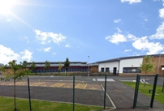
The School Building & Playground
Entry
P1 children will enter via the main school gate and enter the school from the glass doors on the right- hand side with their teachers.
Exit
P1 children will exit via the “Creche Garden” gate at 2:55pm.
See Transition Sway for any other updates.
OPAL – Play Activities and zones throughout school playground.

Slide 7
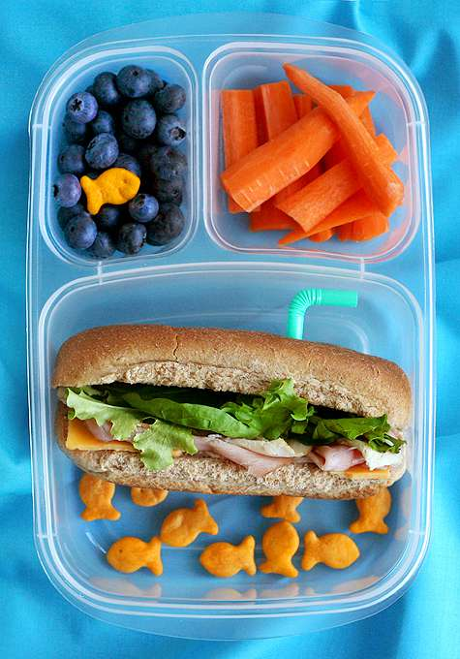
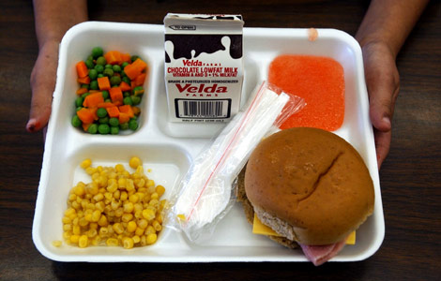
Lunchtime
All children P1-P5 are entitled to a free school meal.
Children will choose from: 1 Hot Meal, 1 Hot Vegetarian, Baked Potato (choice of 2 fillings) or a Sandwich (choice of 2 fillings)
Children can bring a packed lunch from home. Please make sure lunch bags/boxes are clearly labelled with your child’s name.
Encourage your child to be independent when eating their lunch. Using a knife/fork/spoon. Opening packaging, yoghurts etc. where possible.

Slide 8


Typical School Day
9:00-9:15am Registration, Lunches, Soft Start
9:15-10:40am Literacy - Teaching input, pencil task, ICT, practical play activities linked to new learning.
10:40-10:55am Interval (Main Playground/Creche)
11:00-11:15am Story Time
11:15-12:25pm Numeracy - Range of mental, active, ICT, practical and written tasks to participate in.
12:30-1:20pm Lunch (Menu posted on @TPSP1 Transition)
1:20-1:40pm Peer Massage and/or mindfulness
1:40-3:00pm IDL/Topic/PE/Science/Health SHINARRI Indicators, Circle Time, Story Time, Outdoor Activities.

Slide 9

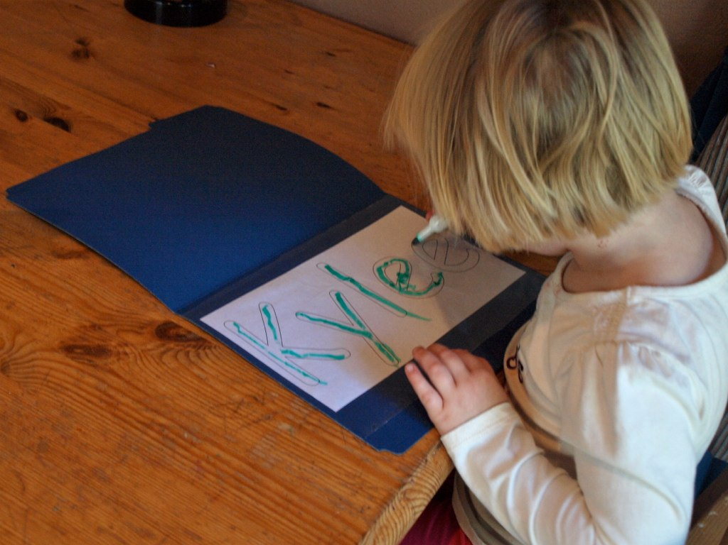
Activities/Tips for Starting School
Encourage children to develop their self care skills. Jacket zips, putting on and taking off jumpers, changing shoes and opening snacks.
Recognising/writing their name.
Tidy away their belongings independently.
Take turns and share with other children.
Follow simple instructions.
See ‘Starting School Booklet’ for further activities.

Slide 10

Useful Apps/Websites
Teach Your Monster to Read
Reading Eggs
Alphablocks/Numberblocks
Topmarks
https://www.scottishbooktrust.com/reading-and-stories/read-write-count
Froggy Match It
Read with Phonics
Doorway Online

Slide 11


Keeping in Touch
If you have any questions at all, please get in contact via email or phone-call:
Email:
Mrs Ferrie – Head Teacher
nlferriec@northlan.org.uk
Miss Grenfell – Depute Head Teacher
nlgrenfelll@northlan.org.uk
Miss Lindsay – P1 Teacher and Acting PT
nllindsayg1@northlan.org.uk

Slide 12
?Questions for next session?
Next session will take place Wednesday 20th May at 3:15pm. Two parts: active session with Sports Coach & library time with teachers.
Lunch order for final transition session on Wednesday 3rd of June at 11:00am – please complete and return to a member of staff.
If you feel your child would benefit from some extra support and/or enhanced transition, please make this known.
Please write any questions you have on a post it note before leaving and we will address these next session.

