Slide 1


Tannochside Primary School
Induction Day 1
P.1
2025/2026
Miss Grenfell

Slide 2


Our School
At Tannochside Primary School we aim to:
Thrive Together
Promote Positivity
Strive for Success
In Tannochside Primary we aim to create a stimulating and educationally sound environment where children are encouraged to feel confident in developing a healthy approach to learning. They are encouraged to work co-operatively with others to develop a caring, responsible attitude within their community.

Slide 3
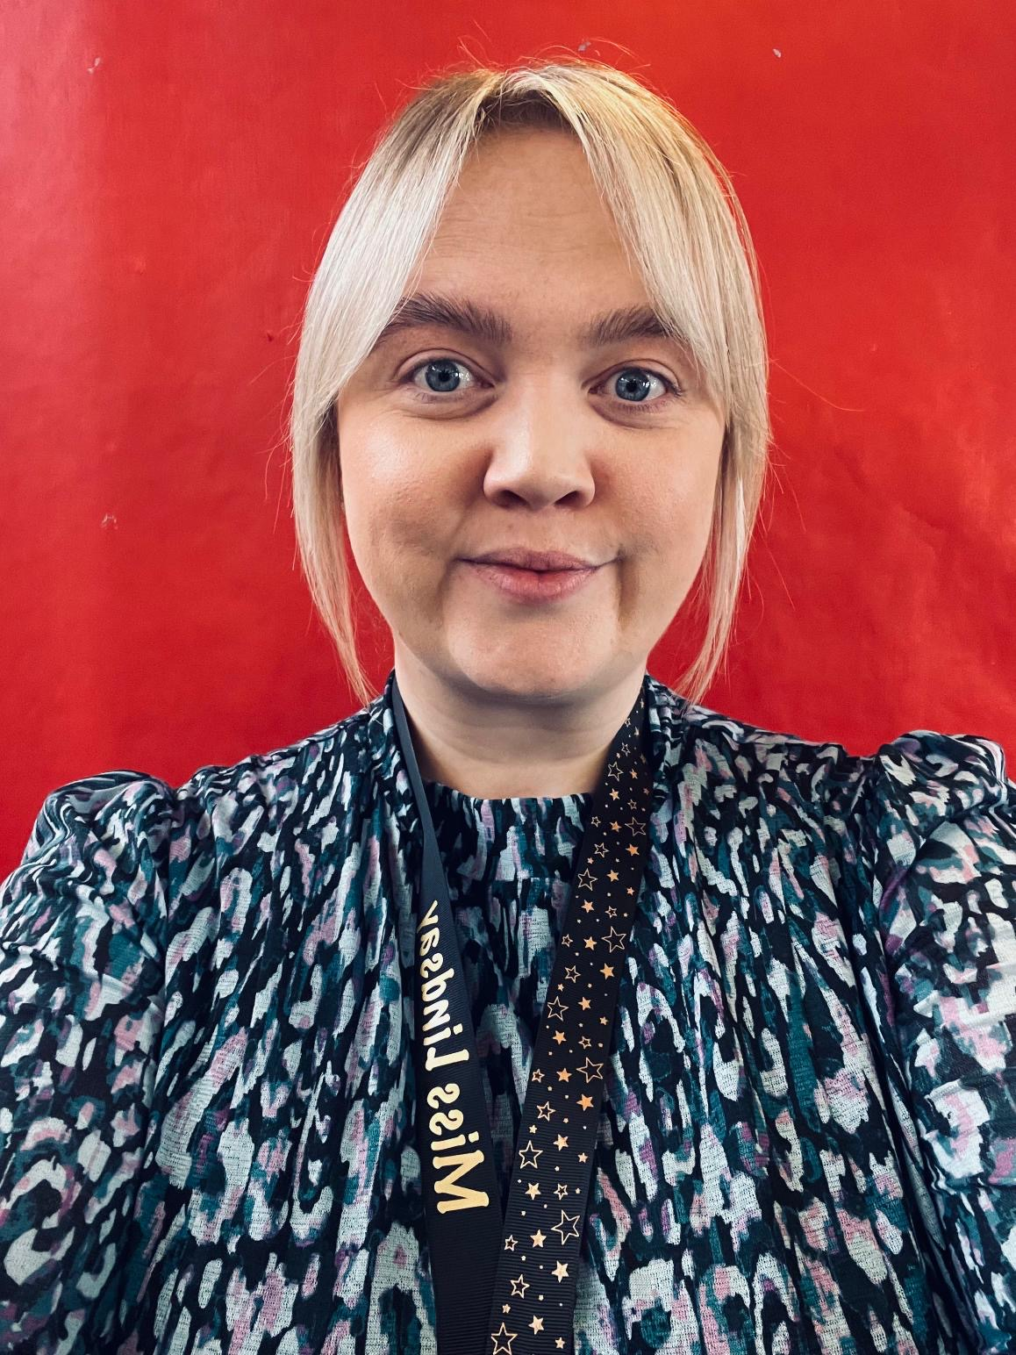
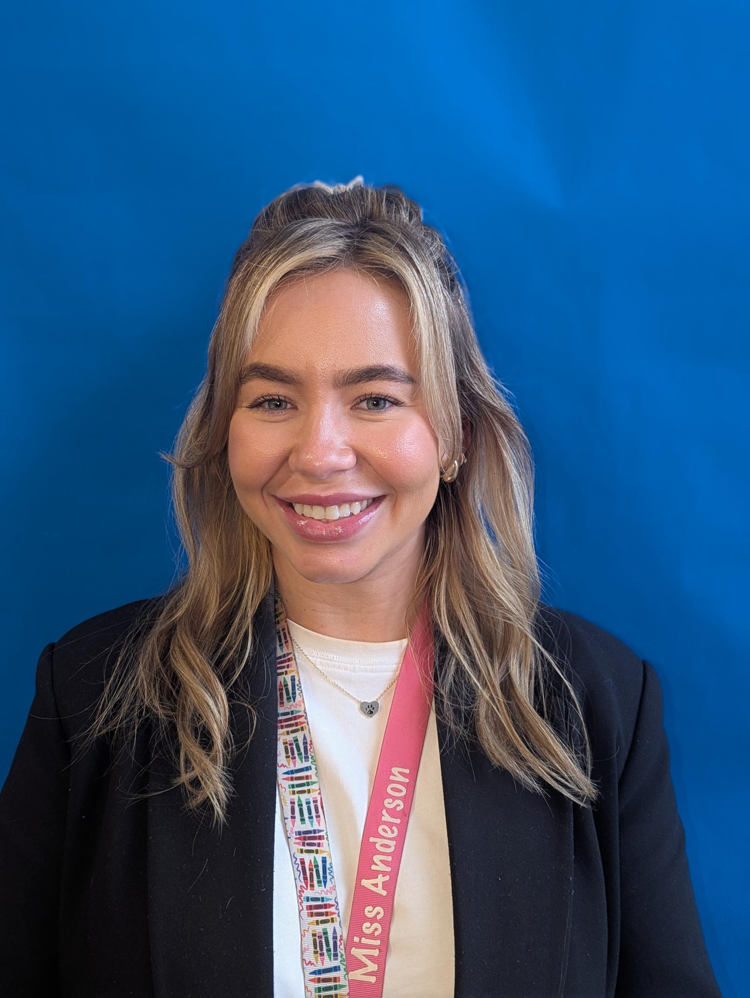
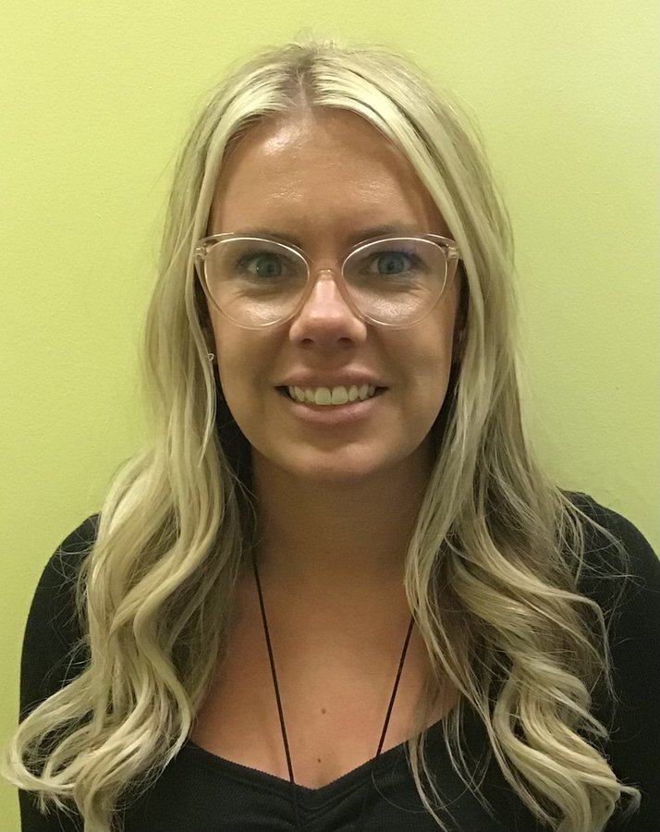
Welcome
Our P1 Teachers
Miss Lindsay
Miss Anderson
Miss Gillen

Slide 4
Classes
52/53 pupils enrolled so far.
3 classes, P1a, P1b and P1/2. Maximum 25 children each class.
Classes are not set at the moment. Currently split into 2 groups. Staff are working with nurseries, visiting and observing children, gathering information from staff to consider all factors before assigning classes.
Staff work and plan together to ensure consistency across all classes.
Meet the Teacher – parents will meet new teacher early September.

Slide 5
Play
Children will participate in a range of play activities in P1. Mix of adult led, responsive and free play activities.
Play zones within classroom.
Following NLC P1 Active Literacy and Numeracy Pathways. Teaching input and pencil tasks each day.
Interdisciplinary topics based are responsive based on children’s interests and through staff observations.
Outdoor Play – OPAL playground access.

Slide 6
Uniform
Navy/tartan skirt/trousers, white shirt, navy jumper/cardigan, school tie
Gym Day: white polo shirt (does not have to have school logo), navy jumper, navy tracksuit bottoms/leggings, trainers
Please ensure you label all clothing, shoes, belongings.
Provide your child with a change of shoes, preferably trainers, for indoors. (Black/Navy Velcro)
All weather outdoors – OPAL activities – change of clothes in bag.
LogoXpress will be attending next Transition event – 22nd May.

Slide 7
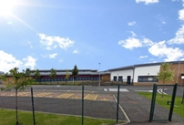
The School Building/Playground
Entry: P1 children will enter via the main school gate and enter the school from the glass doors on the right hand side.
Exit: P1 children will exit via the creche garden gate at 2:55pm.
See SWAY Transition Page for more details.
OPAL – Play Activities and zones throughout school playground.

Slide 8
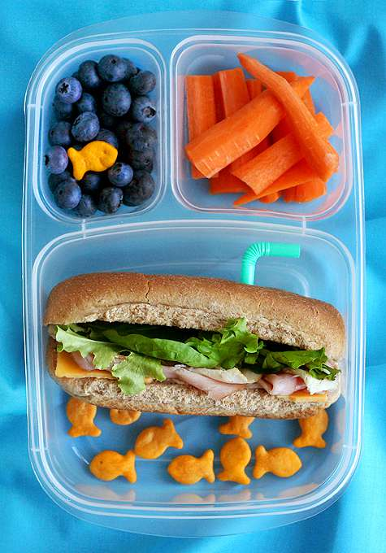
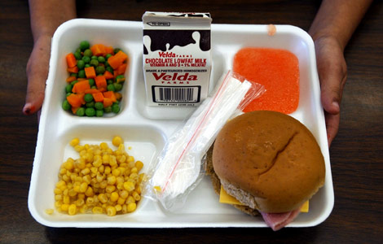
Lunchtime
All children P1-P5 are entitled to a free school meal.
Children will choose between: 1 Hot Meal, Vegetarian, baked potato (choice of 2 fillings) or a sandwich (choice of 2 fillings)
Children can bring a packed lunch from home. Please make sure lunch bags/boxes are clearly labelled.
Encourage your child to be independent when eating their lunch. Using a knife/fork/spoon. Opening packaging, yoghurts etc. where possible.

Slide 9


Typical School Day
9:00-9:15am – Registration, Lunches, Soft Start Play
9:15-10:40am Literacy - Teaching input, pencil task, ICT, practical play activities linked to new learning.
10:40-10:55am Interval (Main Playground/Creche)
11:00-11:15am Story time/ Go Noodle/ Play doh Party
11:15-12:25pm Numeracy - Range of mental, active, ICT, practical and written tasks to participate in.
12:30-1:20pm Lunch (Menu posted on Class SWAY page)
1:20-1:30pm Mindfulness (Peer Massage/Meditation)
1:30pm – 3pm IDL/Topic/PE/Science/Health SHANARRI Indicators, Circle Time, Story Time, Outdoor Activities.

Slide 10

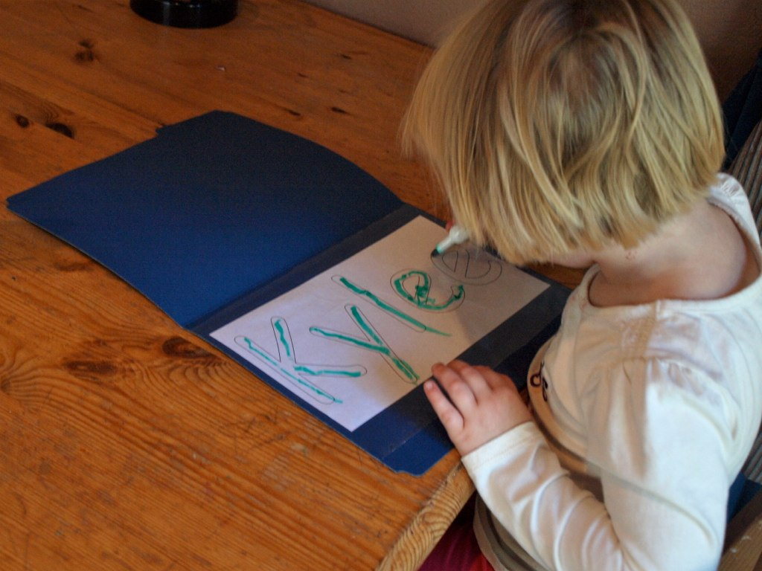
Activities/Tips for Starting School
Encourage children to develop their self care skills. Jacket zips, buttons, shoe laces (only if they can be done independently).
Recognising/writing their name.
Tidy away their belongings independently.
Take turns and share with other children.
Follow simple instructions.
See ‘Starting School Booklet’ for further activities.

Slide 11
First Day at School
P1 children start on Thursday 14th August 2025 at 10am.
Enter via the main school gate.
Parents and carers are welcome to bring their child into class and take some photos. 2 adults per child max in class.
Class teacher will take register and order each child’s lunch – school dinner or packed lunch.
Exit via the creche garden gate at 2:30pm.

Slide 12

Useful Apps/Websites
Teach Your Monster to Read
Reading Eggs
Alphablocks/Numberblocks
Topmarks
https://www.scottishbooktrust.com/reading-and-stories/read-write-count
Froggy Match It
Read with Phonics
Doorway Online

Slide 13

Keeping in Touch
If you have any questions at all, please get in contact via phone or email:
Email:
nlgallagherl1@northlan.org.uk - Lisa Grenfell DHT
nlferriec@northlan.org.uk – Clare Ferrie HT
Primary 1 will have their own class Sway from August.

Slide 14
?Questions for next session?
Next session will take place Thursday 22nd May – Nurture and OPAL information session with Logoxpress uniform attending.
Please write any questions you have on a post it note before leaving and we will address these on our SWAY account.
Lunch order for 3rd session – please complete at next session and return to a member of staff.

