Slide 1
Tannochside Primary School
Health and Wellbeing
P.1
2022/2023
Mrs Lisa Gallagher
DHT (Acting)

Slide 2
Physical Education
Pupils take part in 2 one hour sessions of PE every week. One session is indoors and one session is outdoors on our pitch.
Indoor kit – shorts, polo shirt/white t-shirt and trainers.
Outdoor kit – jogging bottoms or leggings, t-shirt, jumper and trainers. Please be mindful that pupils are out in all weathers.
Jewellery – please try to remove earring and jewellery at home before PE days. This is for the children‘s health and safety.
Pupils will develop their movement skills through practice and energetic play focusing on different sports. Gymnastics, ball sports, racquet sports, hockey, playground games and physical fitness.

Slide 3
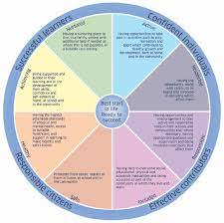
Healthy Schools:
Pupils follow the Healthy Schools Planner throughout P1-7. Pupils participate in Health lessons every week with a clear focus incorporated within each learning block.
Safe
Healthy
Achieving
Nurturing
Active
Respected
Responsible
Included

Slide 4
GIRFEC: (Getting it Right For Every Child)
Within North Lanarkshire, every child has an identified Named Person who will help ensure that a child or young person’s needs are fully supported.
In Primary Schools, the Named Person is the Head Teacher. The Named Person has a responsibility to help promote, safeguard and support a child or young person’s wellbeing.
Sometimes in order to meet a child’s needs, the class teacher will work with the parent/carer to create a GIRFME plan which contains SMART targets and areas of development to help a child develop and progress. This plan is shared with children and parents and is reviewed and updated termly.

Slide 5
Solihull Approach:
The Solihull Approach supports mental health and wellbeing in parents, children, schools, older adults and high stress workplaces through an evidence based model in trainings, online courses and resources.
The Solihull approach enhances emotional wellbeing, children and young people’s mental health, parental engagement, home-school relationships, attachment and trauma awareness, school readiness, attendance, behaviour, and post-pandemic recovery.
All staff within Tannochside have completed Solihull training and use the Solihull approach within their day to day teaching.
Parent courses are available online free of charge and feedback from parents is very positive.

Slide 6
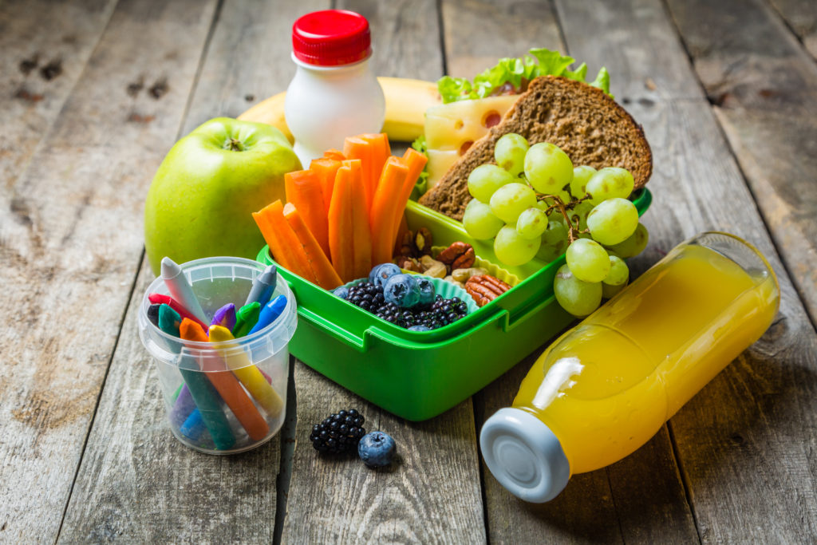
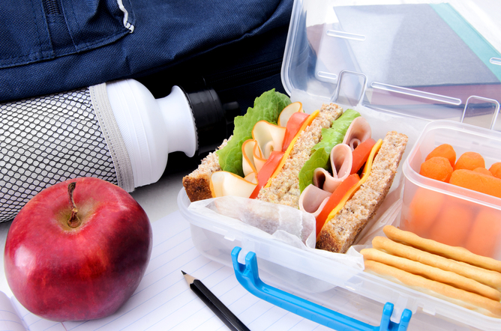
The Dinner Hall:
Lunch for P1-5 is free of charge. The menu for each week is shared on a Sunday via our school Twitter page.
Breakfast Club is also free for children in P1-5. This runs Monday to Friday from 8:15am until 8:45am. Children can choose from cereal, toast, milk/water.
Within the dining hall, children are encouraged to eat and tidy away after themselves as independently as possible. Our dining room supervisor will assist children who require some help.
Healthy tuck shop is available during break times. This is charged via cashless online system. Usernames and passwords provided to each child to allow parents to top this up if required.

Slide 7
The Hub
Nurture in Tannochside
Mrs McGregor

Slide 9
Boxall Profile Assessment Tool
Assessment of children's social, emotional and behavioural development.
Identifies the gaps in their development, allowing us to create specific individual targets.

Slide 10
How it works…
Children attend the Hub in small groups.
Daily routine.
Huge focus on play based learning.
Individual targets which they are aware of and work towards.
Targets shared with parents/guardians.
Enjoy social snack time together.
A consistent, positive approach awaits daily.
Safe, quieter space to allow for regular emotion check ins and time to talk to teacher.
Quiet, calm spaces to sit in if required.
Achievements celebrated together.

Slide 11
Seasons for Growth is a successful, well researched, peer support education programme that gives young people and adults the opportunity to learn that change, loss and grief are normal and valuable parts of life.
If your child has experiences loss, change of grief then this program may benefit them. In the new term a letter will be issued to all pupils. Please return the letter if you think this is something that would benefit your child.

