Slide 1
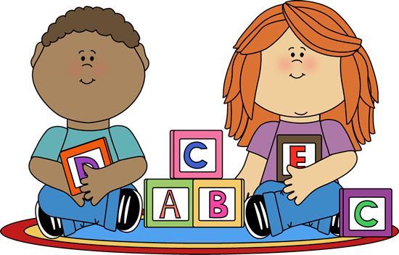
Tannochside Primary School
Induction Day 1 Primary 1 Literacy
2022-2023
Mrs. Gallagher

Slide 2
NLC Active Literacy
Introduction to P1 & Literacy Programme
Phonics/Magnetic boards
Common words/Spelling
Written work
Reading
Literacy games / activities
Home Learning
Websites and Apps
Notes:
As part of the literacy programme in Tannochside Primary School, we follow North Lanarkshire’s Active Literacy Programme. Today I will explain how we deliver the 3 main aspects of this programme, phonics, spelling and reading and how you can best support your child at home to help reinforce their learning, We will look at how we first introduce the children to the programme and what we cover in the first 4 weeks, then how we deliver aspects such as phonics, common words, written work and reading. I’ll cover some top tips for supporting your child’s reading at home, some of the home learning activities we tend to use as well as useful websites and apps you can use to support your child’s learning. There will be an opportunity at the end to ask any questions and have a look at some of the literacy resources used within the school.

Slide 3
Weeks 1-4
Settling in
Percy the Park Keeper
Key language skills: - listening and attention - auditory and visual memory - rhyme - concepts of print
Notes:
At the very beginning of Primary 1 we feel it is important to get to know the routines of school life before jumping straight into the nitty gritty of literacy learning, so we tend to start off with a 4 week “settling in” period where most of the work is teacher led. This time is important for building relationships with your little ones as well as laying the groundwork for when the independent work begins. The main way we teach or assess key skills is through exploring the stories of Percy the Park Keeper (behaviours of a good listener), Auditory and Visual memory (can they keep things they hear and see in their m. We love Percy in Primary 1 and you will probably end up hearing all about his antics come August time! Using a stimulus like Percy allows us to work on key aspects of language learning such as listening and attention ( FEATURES OF GOOD LISTENING), Rhyme (can they hear rhymes?) and concepts of print (to prepare them for independent reading).

Slide 4
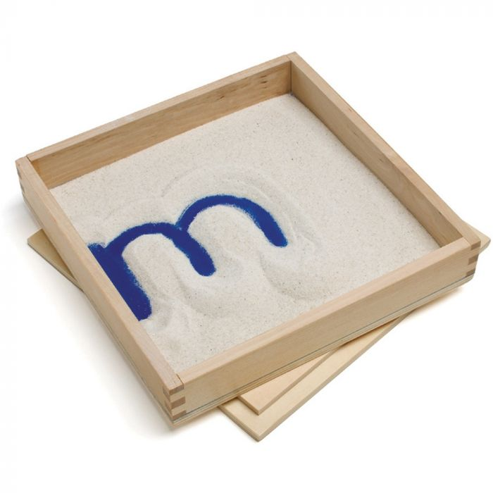
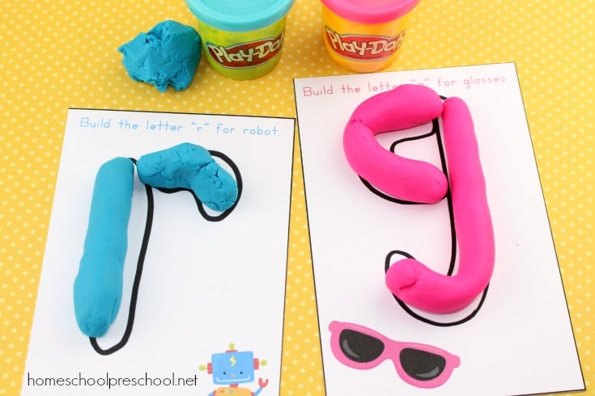
Weeks 1-4
Nursery Rhymes
Fine Motor Skills
Play opportunities
Notes:
One of the new additions to our programme in recent years is that we explore classic nursery rhymes as part of our literacy programme, again to help prepare the children for what is to come when we begin word building and identifying sounds in words. These tend to link directly with Percy the Park Keeper in the first few weeks, for example, Old McDonald had a Farm and you might hear your child talking about their “Rhyme of the Week” when they come home. We also put a lot of emphasis on Fine Motor Skills in those initial weeks, and throughout Primary 1, to ensure we are giving the children the best start for writing and developing pencil control. Typical resources we tend to use are sand trays, playdough, cutting jobs, anything involving small objects like lego building or pin boards… and they are always linked to the learning they have been doing in class or in that particular lesson. So if they have been reading about Percy’s fence blowing down, they might be asked to build a stronger one using lego, or if they have been practising their name or certain letters, they might write them into sand or form them with playdough. They all serve a great purpose but are fun at the same time! We also try to incorporate as many play opportunities as we can throughout the school day, again to allow for that element of fun but also to allow children to transfer their skills into a variety of different contexts. We try to extend our learning to the outdoors as much as we can too and this year our P1s have loved developing “Percy’s Garden” in our school’s crèche garden at the main entrance, so your little ones will be able to take full advantage from the get go this year!

Slide 5
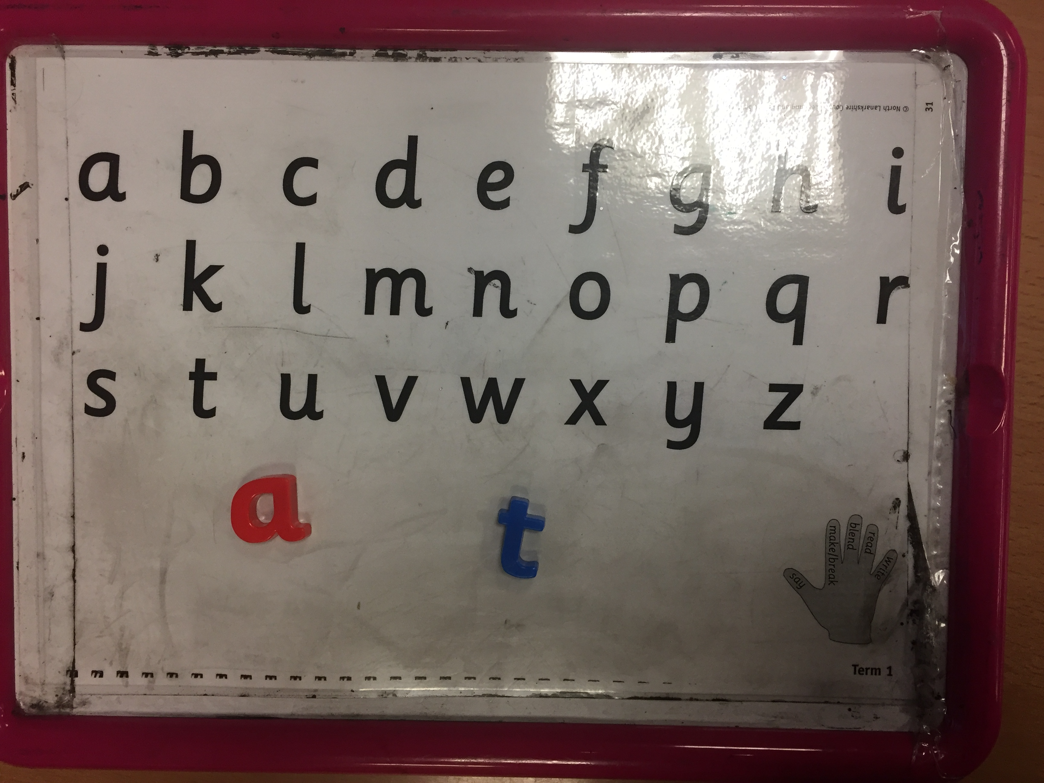
Phonics
August to December - 2 sounds per week
Consolidation weeks
Each child has a magnetic board
Used to identify, read and write sounds/words
Say, make/break, blend, read, write
Forming letters
Play games at home with your child. E.g I spy, Alphabet Bingo.
Notes:
After that initial settling in period, we then move on to the slightly more formal phonics and spelling programme. In P1 we begin by teaching the initial sounds, introducing 2 new sounds per week. Every child is given a magnetic board in class with vowels in red and all other letters in blue. These are used to introduce sounds, blending sounds to make words. Children are encouraged to ‘Say, make/break, blend, read and write’ simple words using their magnetic boards. Show example. I will explain further about how to form and write the letters correctly later in the presentation. Every 4-6 weeks, children consolidate their learning and revise all sounds covered, allowing them to then form simple words. Such as at, sat, sit, tip, tap. At home, encourage your child to identify words with their new sound, find objects around the house beginning with that sound, play games such as ‘I SPY’, alphabet bingo etc. Try to make the learning active and fun.

Slide 6
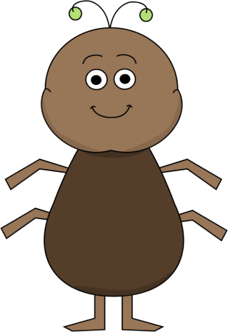
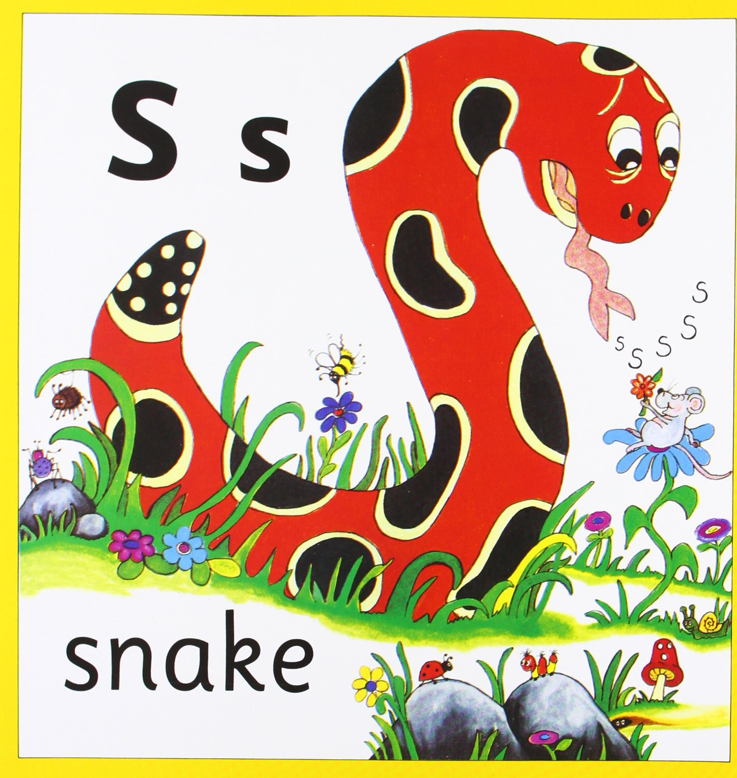
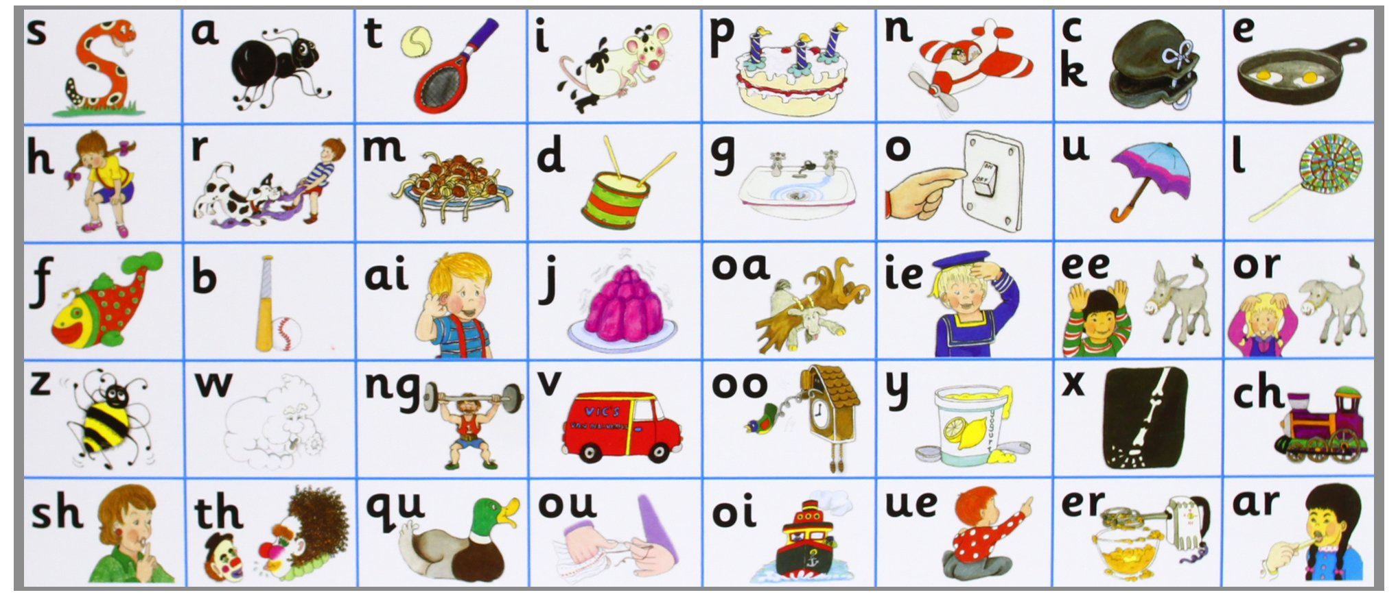
Jolly Phonics
a a ants on my arm
a a ants on my arm
a a ants on my arm
They’re causing me alarm
a
The snake is in the grass
The snake is in the grass
S s s s
The snake is in the grass
Notes:
In Tannochside we use the Jolly Phonics resource to help support literacy. This programme uses a multi-sensory, synthetic approach to teaching phonics, using songs and actions to help children learn their sounds. These books help to introduce the sounds with their appropriate action. I will now let you hear an example of the songs the children learn when covering the sounds ‘-a’ and ‘-s’. You can download the Jolly Phonics app for your child’s tablet at home and all the songs are easily found on YouTube with a simple search “Jollyphonics a” e.g.

Slide 7
Sunnybank Colour Coding
Notes:
We also use Sunnybank colour coding as standard when teaching new sounds. It is a speech and language intervention to support children in the accurate pronunciation of sounds. Using the colour coded mouth seen here, we refer to which part of the mouth each letter is formed in. So letters like m or b would be red as you use your lips to make them, t would be blue as you need to move your tongue to the top of your mouth and something like a would be yellow, using the back of the mouth to produce that sound. By exposing the children to this methodology from P1 we hope that it encourages them to really think about how they say each sound which will help them when building and decoding words further into the programme.

Slide 8
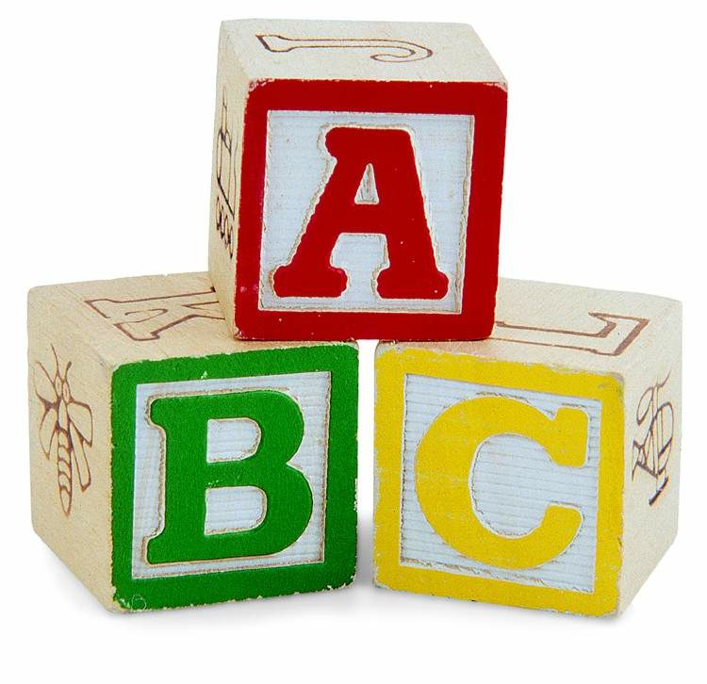
Phonemes
From around January/February – phonemes
A phoneme is 1 unit of sound given by 2 or more letters. Eg sh, ch, th
Building on activities from term 1
Continue to reinforce and consolidate individual sounds.
Notes:
When children are secure and confident in using and identifying all initial sounds, we then begin to introduce phonemes in P1. Phonemes are 1 unit of sound given by 2 or more letters sh ch th etc. You can support your child at home in the same way as before, building on the activities already covered in term 1. Throughout this time, we also continue to reinforce and consolidate individual sounds.

Slide 9
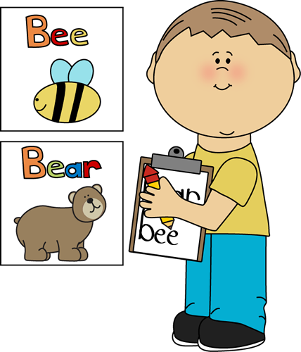
Common Words
Three/four words per week
Most commonly used words
Look, say, cover, write, check
Reading and writing spelling words
Some words that can’t be sounded out
out my the
Notes:
Common words are high frequency sight words that are often tricky to sound out. These are introduced in sets of 2, 3 or 4 every week. Pupils are encouraged to practise reading and writing these words daily to help improve their sight vocabulary when reading. Common word flashcards are sent home weekly and it is important that children work hard to revise previous weeks as well as the new words. Encourage your child to look for their common words within their reading book or in other text around the house. Fun spelling strategies can be used such as newspaper spelling, rainbow spelling, fast spelling etc. Near the beginning of the year, we always issue an activity grid with lots of ideas of different tasks you can do to help your child at home so you can look forward to that. We encourage pupils to Look, Say, Cover, Write and Check their words. I will now show you an example of this.

Slide 10
Written Work
Pencil control
Overwriting – underwriting - independent
Daily writing linked to phonics, reading and spelling.
Weekly taught writing lesson focusing on particular teaching points
Cross curricular writing
Punctuation and handwriting
Notes:
To prepare for P1, you can encourage your child to hold a pencil correctly and work on their fine motor skills like I mentioned before, cutting, writing, building with small objects, colouring etc. It is very important that pupils learn the correct way to form each letter, using a dot to begin and following the dots to make the letter. Practise activities are sent home as part of the home learning activities. Children begin by overwriting which then develops into underwriting before writing independently. Beginning with writing letters, then combining letters to make simple words before progressing onto sentences. Pupils will complete daily written activities related to phonics, common words and their reading book. Teachers deliver 1 taught writing lesson per week which focuses on formation initially and builds to writing independent sentences and stories, encouraging the children to be imaginative. In the first few weeks these are usually based around the adventures of Percy the Park Keeper and typically link to the class topic thereafter. Punctuation and handwriting are focused on throughout each written activity too. Encourage and remind your child when to use capital letters and full stops at home.

Slide 11
Reading
Front cover / title
Picture clues
Pointing out tricky words
Identifying known words
Predictions
Prior knowledge
Answering open and closed questions
Creating questions
Summarising
Notes:
You child will receive 2 reading books per week. It is very important that you read with your child every night, modelling how to read with expression. A few points to consider are: read and explain powerpoint.

Slide 12
Tips for Reading with your child
Find a quiet time.
Read together
Give praise and encouragement
Talk about the book
Use your finger, left to right
Don’t cover the pictures!
Ask questions
Have fun
Encourage reading/Environmental Print
Notes:
When planning time for reading with your child, here a few tips you may want to consider: Read and explain powerpoint.
*In the beginning most of their learning is done through modelling and mimicking so don’t be alarmed if it seems like they are memorising stories… that is part of the learning process!

Slide 13
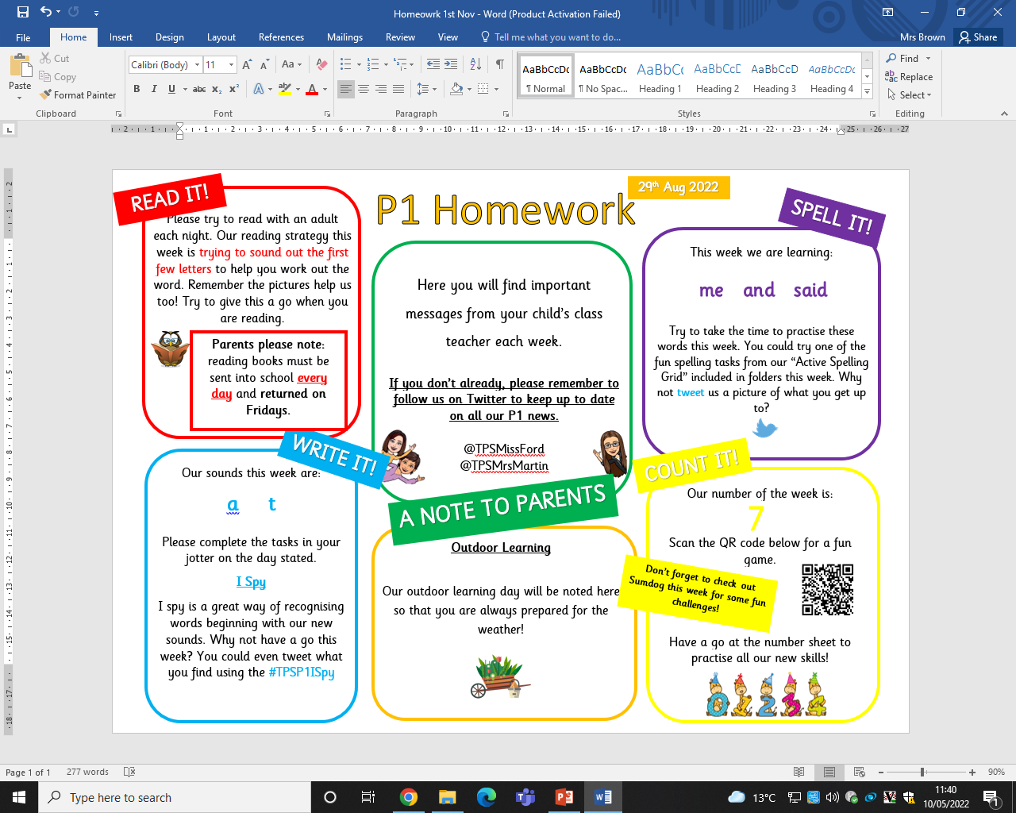
Home Learning
Notes:
Each week, you child will be given a range of home learning tasks to complete including literacy and numeracy activities. It is important that you work closely with your child to complete all tasks to help reinforce as much learning as possible. The activities are broken down into small parts to complete every night. The class teacher will keep you updated of any upcoming events and reminders. You can liaise with the class teacher and ask any questions using this sheet.

Slide 14
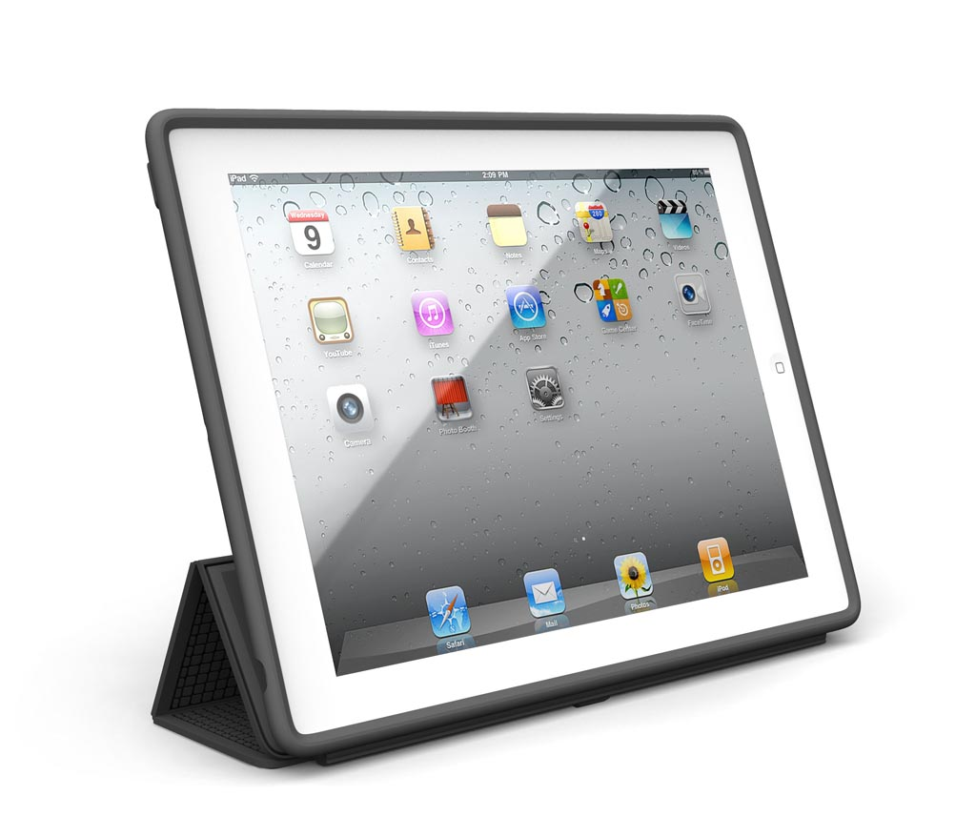
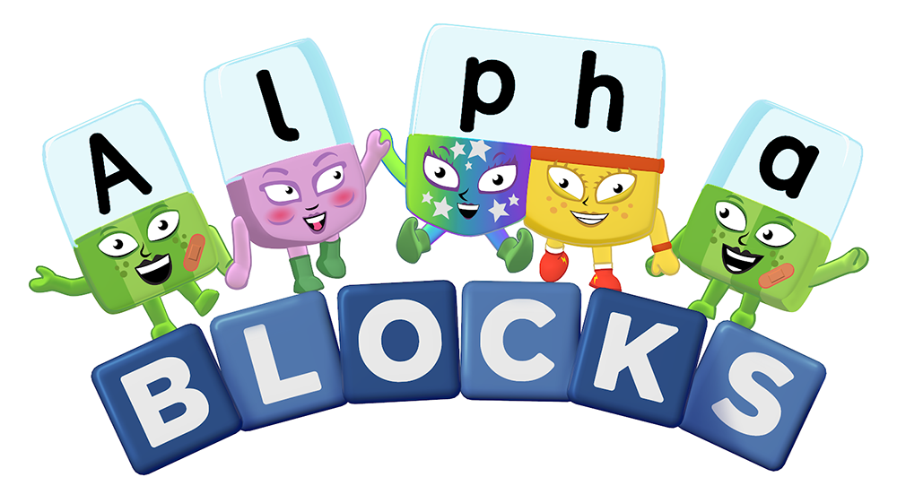
Tips for learning at home:
Jollyphonics Phone/tablet app or on YouTube
Jack Hartmann We love to sing and dance along to his videos on YouTube too – good morning, count to 20 etc.
Alphablocks & Numberblocks
Geraldine the Giraffe Excellent for reinforcing sounds and phonemes. Again, accessed through YouTube.
Doorway Online Wonderful website for practising number and letter formation.
Topmarks website Lots of great maths games!
Notes:
Lastly, I have included some apps or websites you can use at home to reinforce spelling, phonics and reading allowing the children to access a wide range of text and play a range of fun games.

Slide 15
Next Induction Dates:
Numeracy Monday 23rd May 3:15pm-4pm
Nurture/Lunch Thursday 9th June 11:00am-12:15pm
Notes:
A quick note to remind you of the next 2 induction dates. The next focus will be on Numeracy.
If you would like to take some time looking at the resources on display and if you have any questions please write them down on the post it notes and we can answer them at the end.
Thank you.

Slide 16
nlferriec@northlan.org.uk nlgallagherl1@northlan.gov.uk
@TPSMrsMartin
@TPSMissFord
@TPSP1Transition

