Slide 1
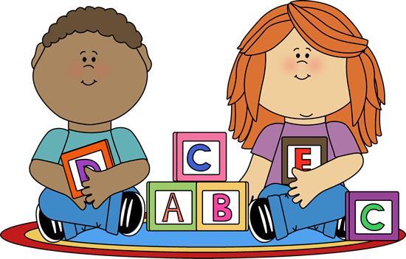
Tannochside Primary School
Induction Day 1 - Literacy
P.1
2020-2021
Mrs. Gallagher

Slide 2
NLC Active Literacy
Phonics/Magnetic boards
Common words/Spelling
Written work
Reading
Literacy games / activities
Home Learning
Websites and Apps
Notes:
As part of the literacy programme in Tannochside Primary School, we follow North Lanarkshire’s Active Literacy Programme. Today I will explain how we deliver the 3 main aspects of this programme, phonics, spelling and reading and how you can best support your child at home to help reinforce their learning, We will look at phonics, common words, written work, reading and top tips for supporting your child’s reading at home, home learning activities as well as useful websites and apps you can use to support your child’s learning. There will be an opportunity at the end to ask any questions and have a look at some of the literacy resources used within the school.

Slide 3
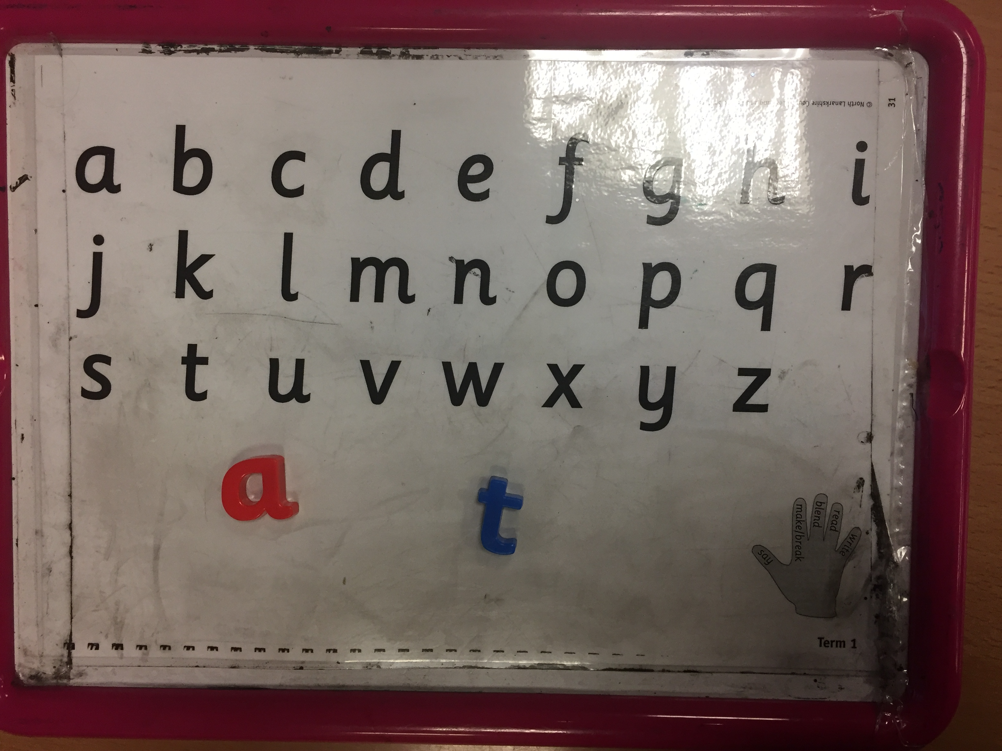
Phonics
August to December - 2 sounds per week
Consolidation weeks
Each child has a magnetic board
Used to identify, read and write sounds/words
Say, make/break, blend, read, write
Forming letters
Play games at home with your child. E.g I spy, Alphabet Bingo.
Notes:
Firstly. I will begin with phonics. In P1 we begin by teaching the initial sounds, introducing 2 new sounds per week. Every child is given a magnetic board in class with vowels in red and all other letters in blue. These are used to introduce sounds, blending sounds to make words. Children are encouraged to ‘Say, make/break, blend, read and write’ simple words using their magnetic boards. Show example. I will explain further about how to form and write the letters correctly later in the presentation. Every 4-6 weeks, children consolidate their learning and revise all sounds covered, allowing them to then form simple words. Such as at, sat, sit, tip, tap. At home, encourage your child to identify words with their new sound, find objects around the house beginning with that sound, play games such as ‘I SPY’, alphabet bingo etc. Try to make the learning active and fun.

Slide 4
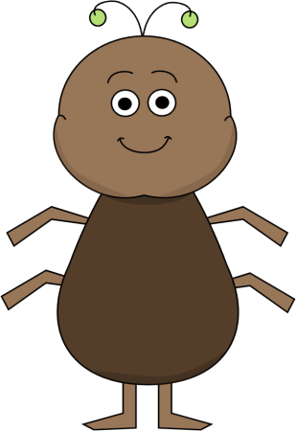
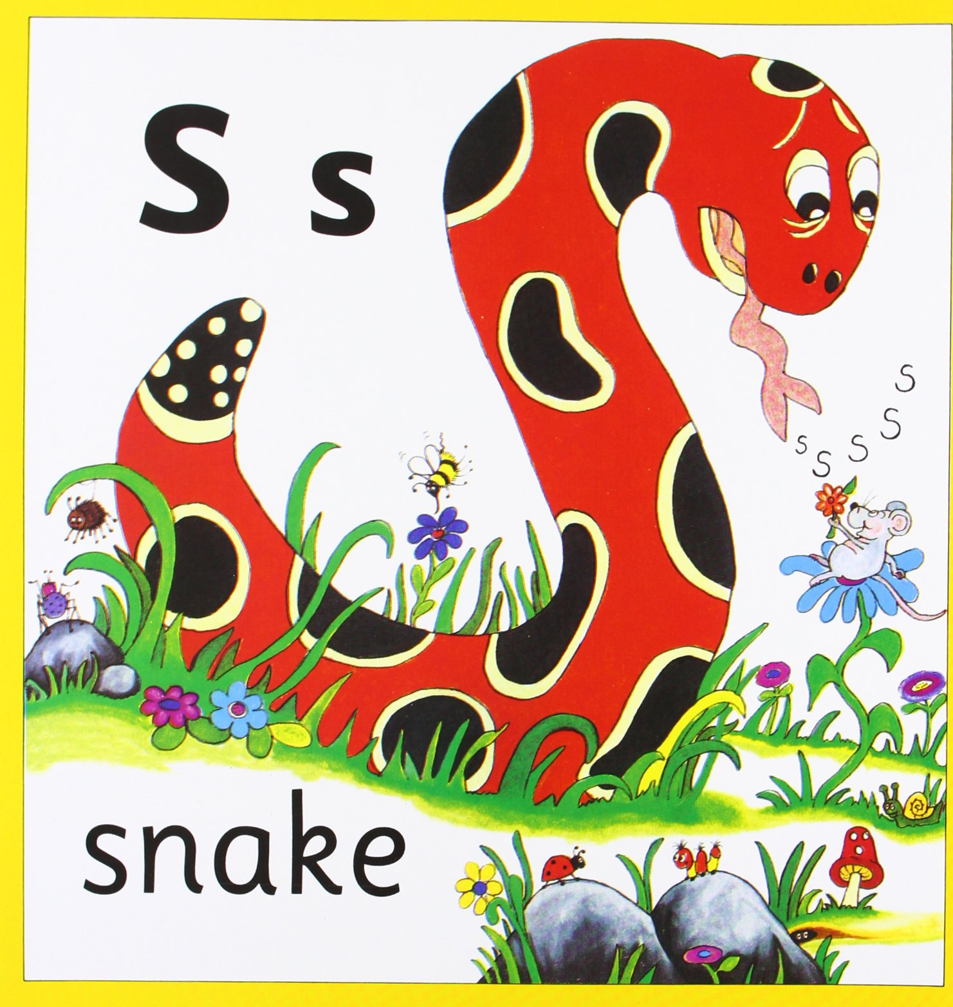
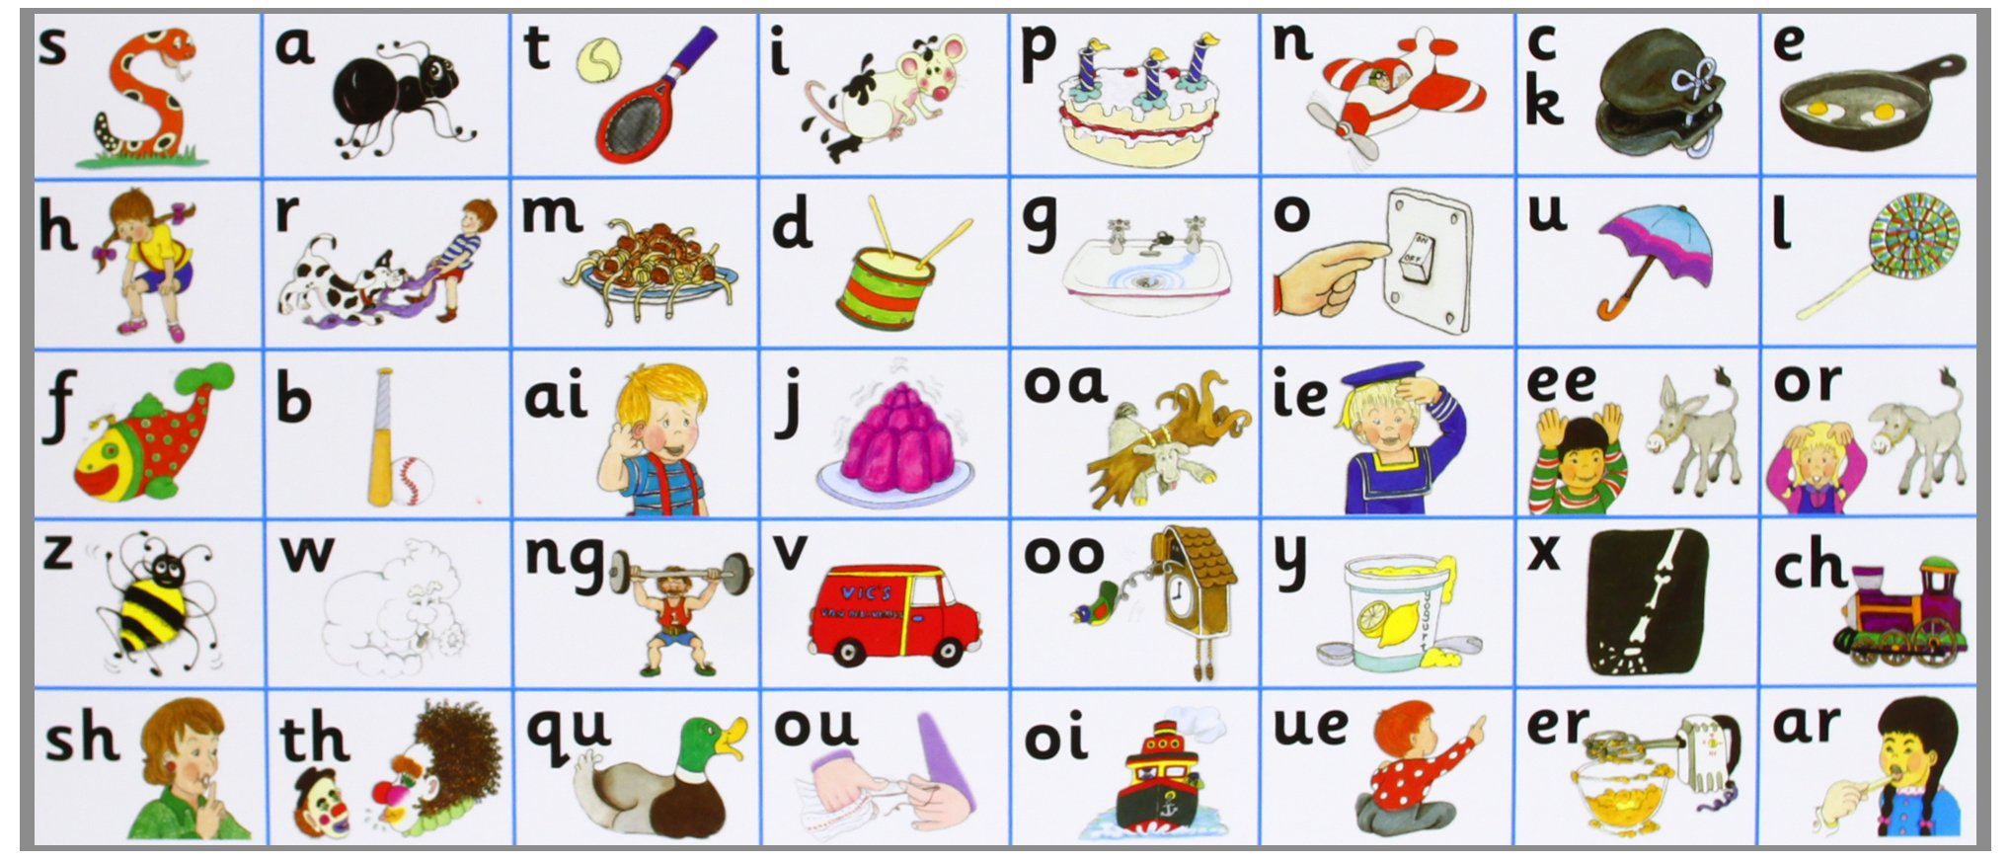
Jolly Phonics
a a ants on my arm
a a ants on my arm
a a ants on my arm
They’re causing me alarm
a
The snake is in the grass
The snake is in the grass
S s s s
The snake is in the grass
Notes:
In Tannochside we use the Jolly Phonics resource to help support literacy. This programme uses a multi-sensory, synthetic approach to teaching phonics, using songs and actions to help children learn their sounds. These books help to introduce the sounds with their appropriate action. I will now let you hear an example of the songs the children learn when covering the sounds ‘-a’ and ‘-s’. You can download the Jolly Phonics app for your child’s tablet at home.

Slide 5
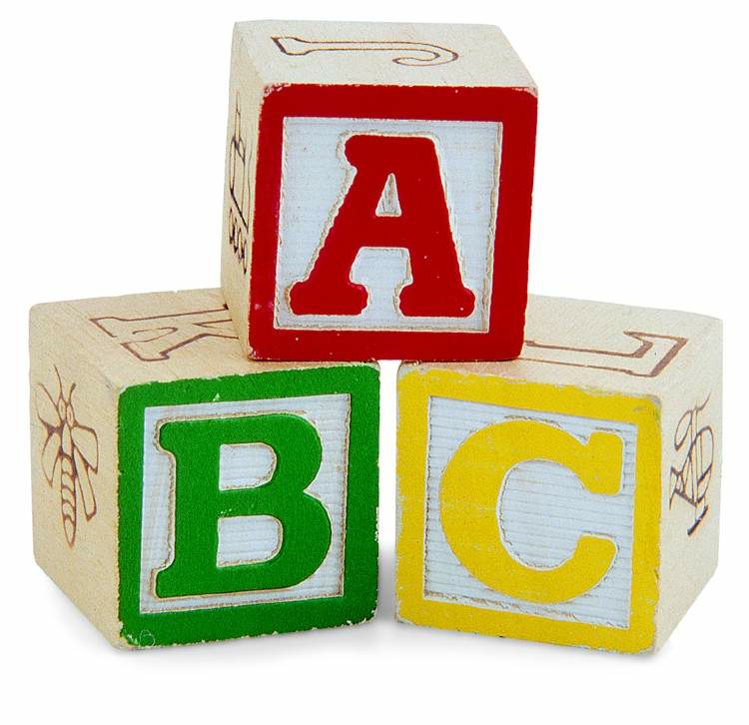
Phonemes
From January – phonemes
A phoneme is 1 unit of sound given by 2 or more letters. Eg sh, ch, th
Building on activities from term 1
Continue to reinforce and consolidate individual sounds.
Notes:
When children are secure and confident in using and identifying all initial sounds, we then begin to introduce phonemes in P1. Phonemes are 1 unit of sound given by 2 or more letters sh ch th etc. You can support your child at home in the same way as before, building on the activities already covered in term 1. Throughout this time, we also continue to reinforce and consolidate individual sounds.

Slide 6
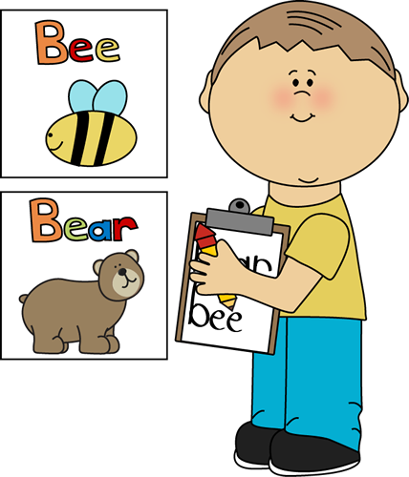
Common Words
Three words per week
Most commonly used words
Look, say, cover, write, check
Reading and writing spelling words
Some words that can’t be sounded out
out my the
Notes:
Common words are high frequency sight words that are often tricky to sound out. These are introduced in sets of 3 every week. Pupils are encouraged to practise reading and writing these words daily to help improve their sight vocabulary when reading. Common word flashcards are sent home weekly and it is important that children work hard to revise previous weeks as well as the new words. Encourage your child to look for their common words within their reading book or in other text around the house. Fun spelling strategies can be used such as newspaper spelling, rainbow spelling, fast spelling etc. We encourage pupils to Look, Say, Cover, Write and Check their words. I will now show you an examply of this.

Slide 7
Written Work
Pencil control
Sound booklets
Overwriting – underwriting - independent
Daily writing linked to phonics, reading and spelling.
Weekly taught writing lesson focusing on particular teaching points
Cross curricular writing
Punctuation and handwriting
Notes:
To prepare for P1, you can encourage your child to hold a pencil correctly and work on their fine motor skills, cutting, writing, building with small objects, colouring etc. It is very important that pupils learn the correct way to form each letter, using a dot to begin and following the dots to make the letter. Practise booklets are sent home as part of the home learning activities. Children begin by overwriting which then develops into underwriting before writing independently. Beginning with writing letters, then combining letters to make simple words before progressing onto sentences. Pupils will complete daily written activities related to phonics, common words and their reading book. Teachers deliver 1 taught writing lesson per week which focuses on different genres and teaching points, encouraging the children to be imaginative. Punctuation and handwriting are focused on throughout each written activity. Encourage and remind your child when to use capital letters and full stops at home.

Slide 8
Reading
Front cover / title
Picture clues
Pointing out tricky words
Identifying known words
Predictions
Prior knowledge
Answering open and closed questions
Creating questions
Summarising
Notes:
You child will receive 2 reading books per week. It is very important that you read with your child every night, modelling how to read with expression. A few points to consider are: read and explain powerpoint.

Slide 9
Tips for Reading with your child
Find a quiet time.
Read together
Give praise and encouragement
Talk about the book
Use your finger, left to right
Ask questions
Have fun
Encourage reading/Environmental Print
Notes:
When planning time for reading with your child, here a few tips you may want to consider: Read and explain powerpoint.

Slide 10
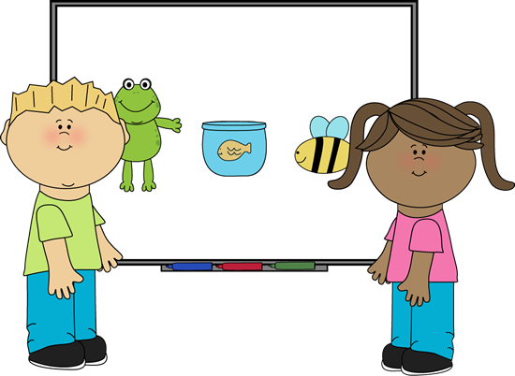
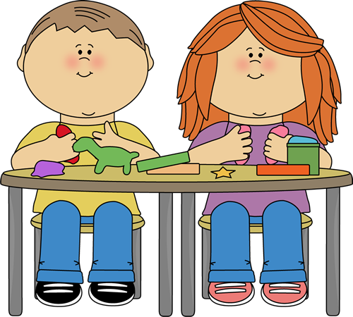
Literacy Games / Activities
Word/alphabet jigsaws
Playdoh formation mats
Chalk writing
Interactive smartboard activities
Picture cards – tell a story
Notes:
We use a number of resources to support pupil learning in class such as: read powerpoint. At the end of this presentation, you will have a chance to look at some of the resources used within the class to support literacy.

Slide 11
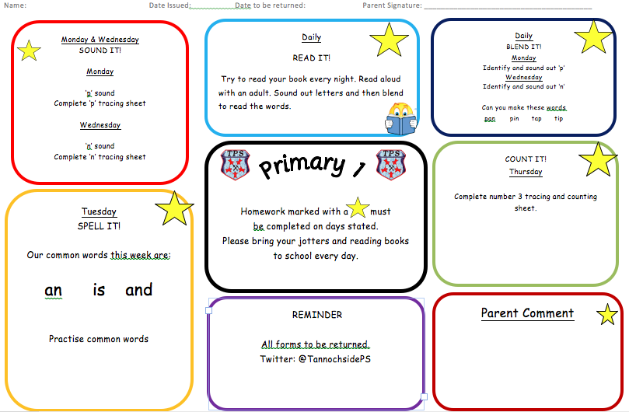
Home Learning
Notes:
Each week, you child will be given a range of home learning tasks to complete including literacy and numeracy activities. It is important that you work closely with your child to complete all tasks to help reinforce as much learning as possible. The activities are broken down into small parts to complete every night. The class teacher will keep you updated of any upcoming events and reminders. You can liaise with the class teacher and ask any questions using this sheet.

Slide 12
Useful Websites:
http://scottishbooktrust.com/learning/read-write-count/
https://www.jollylearning.co.uk/jolly-phonics/
Apps: Jolly Phonics, Teach Your Monster to Read, Froggy Match It, Read with Phonics, Doorway Online, Alphablocks.
Notes:
Lastly, I have included 2 websites which you may find useful with ideas on how best to support your child in Primary 1. Also, the apps listed are recommended by the NLC literacy base and can help support your child’s learning. Some are free, however, some incur a small charge. The apps reinforce spelling, phonics and reading allowing the children to access a wide range of text and play a range of fun games.

