Slide 1
N5 Chemistry Revision Mind Map
Unit 2

Slide 2
Chemistry Revision Mind Map Unit 2– Homologous series 1
What is a homologous series?
What are the prefixes for carbon compounds?
1 Carbon- 2 Carbons-
3 Carbons- 4 Carbons-
5 Carbons- 6 Carbons-
7 Carbons- 8 Carbons-
Describe the steps required to name a carbon compound.
What is the trend in boiling and melting points within a homologous series as molecular size increases?
Describe how to identify an alkane from
their structure
their name
What is the general formula of:
1. alkanes
2. alkenes
3. cycloalkanes
Explain the above trend.
What are hydrocarbons?
Describe how to identify an alkene from
their structure
their name
Draw 2-methylpentane
Draw 2-methylbut-2-ene
What are saturated hydrocarbons?
What are unsaturated hydrocarbons?
Describe the test to distinguish between unsaturated and saturated compounds.
Describe how to identify an cycloalkane from
their structure
their name

Slide 3
Chemistry Revision Mind Map Unit 2–Homologous series 2
What are isomers?
Draw hex-1-ene and one of its isomers
What is meant by hydration?
Draw butane and one of its isomers
Draw the product made when water reacts with propene
What is an addition reaction?
What is meant by halogenation?
Draw propene and one of its isomers
What is meant by hydrogenation?
Draw the product made when bromine reacts with but-1-ene.
Draw the product made when hydrogen reacts with ethene

Slide 4
Chemistry Revision Mind Map Unit 2– Everyday consumer products 3
Describe how to identify an alcohol (alkanol) from
their structure
their name
Describe how to identify an carboxylic acid (alkanoic acid) from
their structure
their name
Draw the full structural formula of butan-2-ol
Draw the shortened structural formula of hexan-3-ol
What is name is given to the functional group of alcohols (alkanols)?
What is name is given to the functional group of carboxylic acids (alkanoic acids) ?
Draw the molecular formula of propan-1-ol
What is the general formula of alcohols(alkanols)?
Which carboxylic acids (alkanoic acids) is the main component of vinegar?
Draw the full structural formula of heptanoic acid.
What happens to the solubility of (alkanols) as their size increases?
What happens to the solubility of carboxylic acid (alkanoic acid) as their size increases?
Draw the shortened structural formula of pentanoic acid.
Explain why as alcohols (alkanols) increase in size their melting and boiling points increase
Explain why as carboxylic acid (alkanoic acid) increase in size their melting and boiling points increase
Draw the molecular formula of methanoic acid.

Slide 5
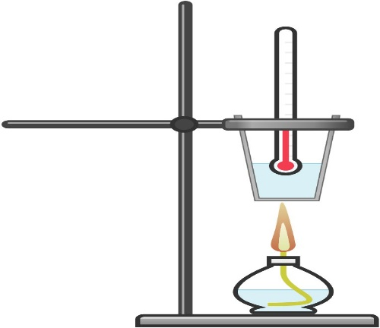
Chemistry Revision Mind Map Unit 2– Energy from fuels 4
What word is used to describe a reaction or process that releases heat energy?
Write a word equation, chemical equation and balanced chemical equation for when propane reacts completely oxygen.
Which formula allows the energy released when a fuel burns to be calculated?
What word is used to describe a reaction or process that takes in heat energy?
What are the units for each term in the above equation?
What is a fuel?
Calculate the energy released when 50cm³ of water is heated from 10.3ºC to 28.4ºC. Include the correct units for your answer.
Using this apparatus which measurements would need to be taken to allow the energy released to be calculated?
What happens during a combustion reaction?
Calculate the temperature rise when 100g of water absorbs 26.7 kJ of energy. Include the correct units for your answer.
What is produced when a hydrocarbon or alcohol burns in a plentiful supply of oxygen (complete combustion)?
Give examples of possible sources of error within this experiment. Include a way of preventing the error.
What is produced when a hydrocarbon or alcohol burns in a limited supply of oxygen (incomplete combustion)?
Calculate the specific heat capacity of the sodium chloride solution which requires 15.6kJ of energy to heat 100g of solution by 24ºC. Include the correct units for your answer

