Slide 1
N5 Chemistry
Revision Mind Map
Unit 1

Slide 2
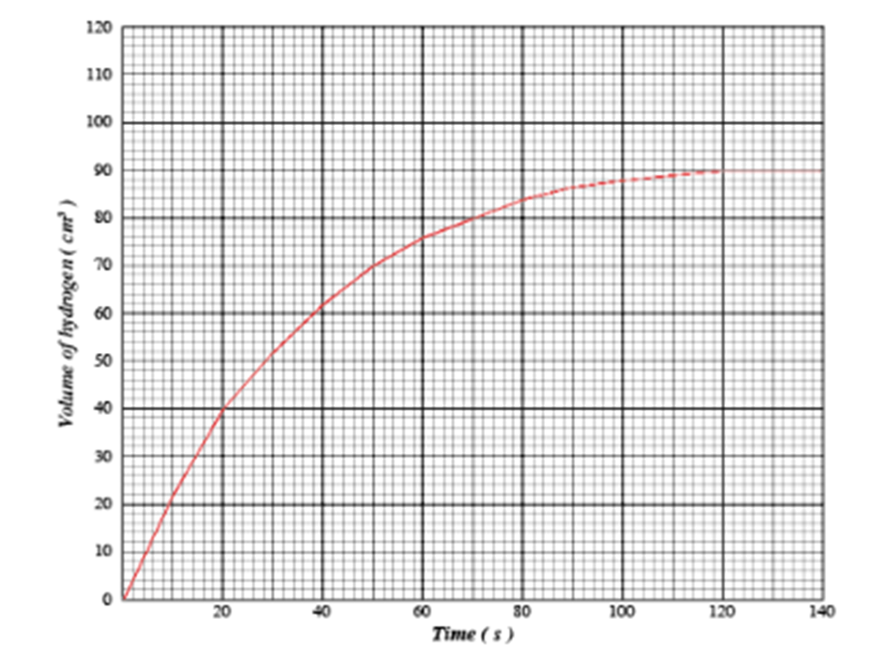
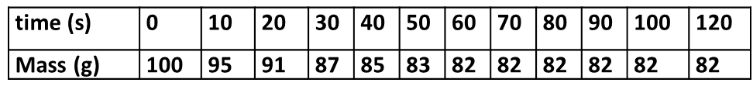
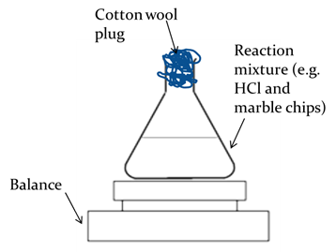
Chemistry Revision Mind Map Unit 1– Reaction Rate 1
List 4 factors which will increase the rate of a chemical reaction.
Draw an label 2 pieces of apparatus which could be used to collect a gas in this reaction:
1.
2.
The graph below shows the volume of hydrogen produced in the reaction of 1g of magnesium ribbon and 1 mol/l hydrochloric acid.
Draw a green line on the graph to show using 1g of magnesium powder and 1 mol/l hydrochloric acid.
Draw a blue line on the graph to show using 1g magnesium ribbon and 0.5mol/l hydrochloric acid.
Draw a line to show when the reaction finished and state the time.
Reaction stopped:
The average rate of reaction in the first 40 seconds is:
How do you calculate average rate of reaction?
Calculate the average rate of reaction between 10 and 40 seconds, using the appropriate units.
What will happen to the mass of this apparatus over time? Explain why?
In a reaction the volume increased from 20cm³ to 80cm³ in 200 seconds. What was the average rate of reaction in cm³s⁻¹?

Slide 3
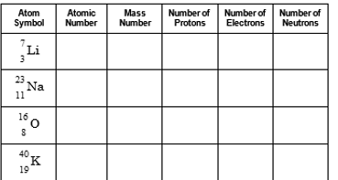
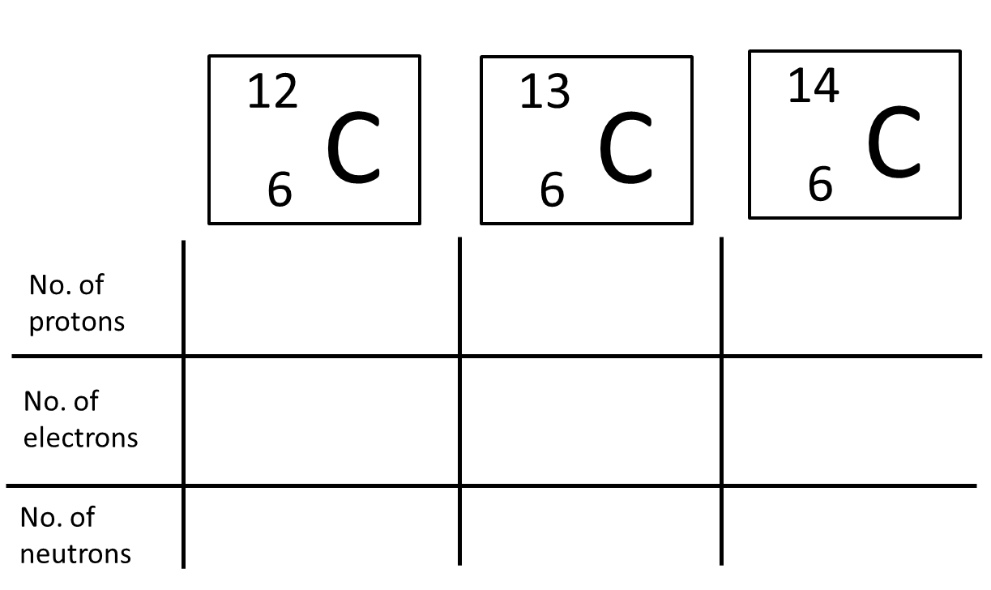
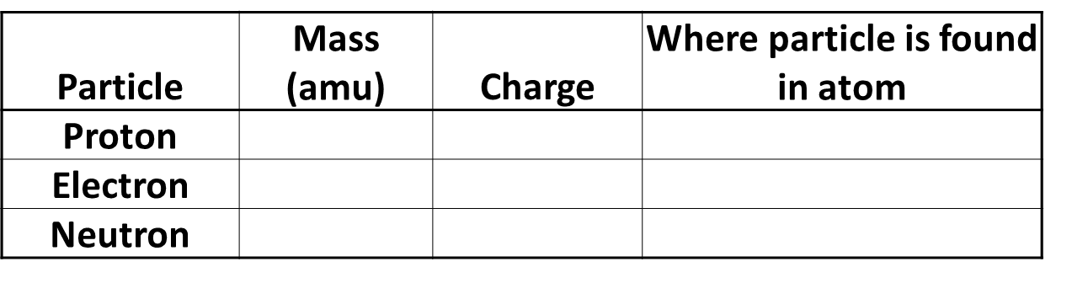
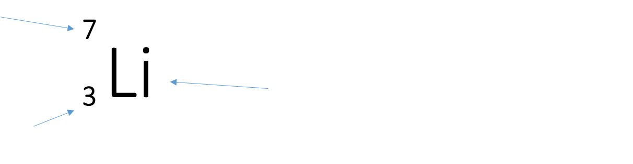
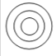
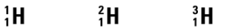
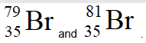
Chemistry Revision Mind Map Unit 1– Atomic structure 2
Draw and label the structure of the atom.
State how you could calculate the mass number of an element.
Complete the following:
What is an isotope:
Complete the following:
State how you could calculate the number of neutrons in an element.
How many electrons are able to go in the 1st, 2nd, 3rd shell.
1st:
2nd:
3rd:
Complete the table:
Below shows you nucleotide notation of an element. Label what each arrow is showing
Draw an electron shell diagram for sodium and for oxygen add write the electron arrangement:
Sodium:
Oxygen:
Hydrogen has 3 isotopes, it has a relative atomic mass of 1.0, which isotope do you think is most abundant ?
State why an atom is neutral.
What does the atomic number tell us
Write the nucleotide notation for Sodium which has a mass number of 23.
Bromine has two isotopes, shown. The relative atomic mass of bromine is 80. What does this suggest about the percentage of each isotope?
What charge is the nucleus of an atom.

Slide 4
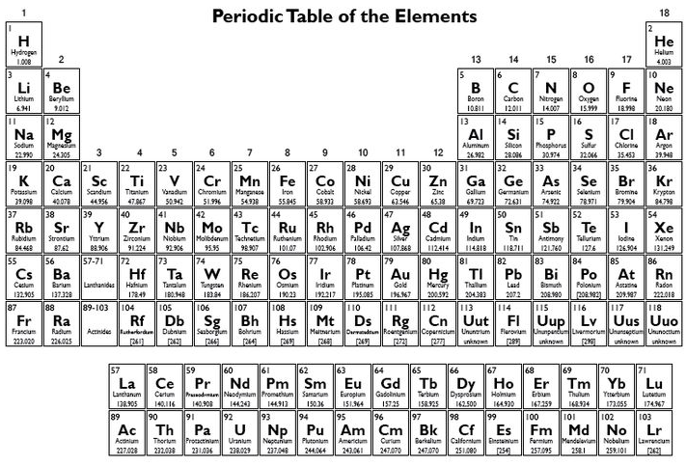
Chemistry Revision Mind Map Unit 1– Periodic Table 3
State the name of group 1 elements.
State the name of Group 7 elements.
Explain why the group 0/8 elements have similar chemical properties?
Labels the groups, high-light the metals and non-metals.
Are group 1 elements reactive or unreactive? Why?
Explain why group 7 elements have similar chemical properties?
Describe how the reactivity changes as you go down group 1.
Are group 8 elements reactive or unreactive? Why?
Explain why group 1 elements have similar chemical properties?
State the name of group 8/0 elements.
Define the following:
Element:
Atom:
Compound

Slide 5
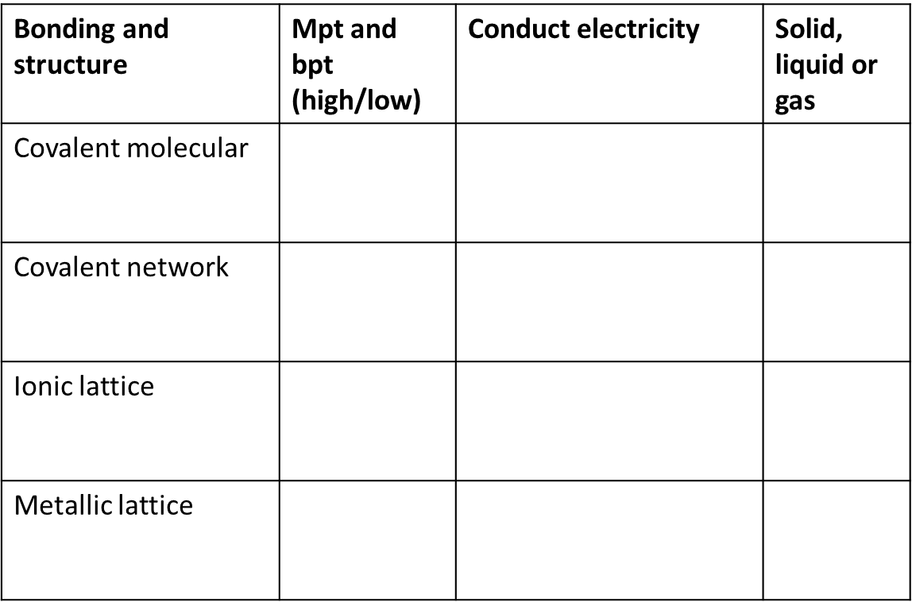
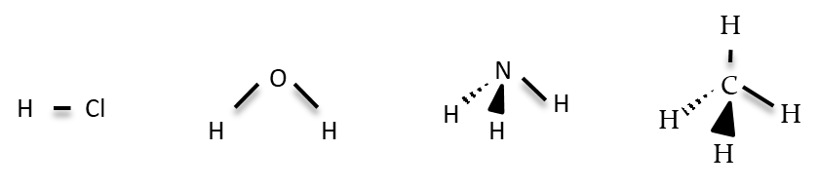
Chemistry Revision Mind Map Unit 1– Bonding 4
What is a covalent bond
What holds the electrons together in a covalent bond
Draw a diagram showing outer electrons to show NH₃
Complete the table below:
Draw a diagram showing outer electrons to show the bonding in HCl
What group in the periodic table are monatomic? What does this mean.
What is an ionic bond
What elements are diatomic? What does this mean.
What is a compound
What name is given to describe the shapes of the following molecules.
Why can ionic solutions conduct electricity when in solution but not when solid?:
What is a metallic bond
Draw a diagram showing outer electrons to show N₂
Why do elements in an ionic bond transfer electrons?
Why can metallic substances conduct electricity.
What is a molecule
.

Slide 6
Chemistry Revision Mind Map Unit 1– Writing formula 5
Write the chemical formula for the following: (SVSDF method)
Magnesium hydride
2) Carbon iodide
3) Silicon oxide
4) Beryllium sulphide
Write the chemical formula for the following:
(prefix method)
Carbon dioxide
2) Dinitrogen tetraoxide
3) Nitrogen trihydride
4) Dihydrogen dioxide
Write the chemical formula for the following:
(SVSDF using roman numerals method)
Copper(II) oxide
Nickel(II) chloride
Vanadium(V) oxide
Write the chemical formula for the following:
(SVSDF using GROUP ions, p8 of data book)
Magnesium phosphate
2) Copper(II) nitrate
3) Ammonium carbonate
Write the ionic formula for the following: (remember metals have a positive charge, non-metals have a negative charge)
1) Aluminium Sulfide 2) Copper (II) Nitrate 3) Aluminium hydroxide

Slide 7
Chemistry Revision Mind Map Unit 1– Calculations 6
Draw the calculations triangle you use in chemistry with the appropriate units
Calculate the mass of:
3 moles of K₂S0₄
0.025 moles of Mg(NO₃)₂
Calculate the % calcium in calcium chloride, CaCl₂
Calculate the % potassium in potassium sulfate, K₂SO₄
Calculate the gram formula mass for the following:
1) CO₂
2) K₂SO₄
3) Mg(NO₃)₂
Calculate the number of moles of:
15g of K₂S0₄
2) 0.04g of Mg(NO₃)₂
Calculate the mass of CO₂ produced from 5g of ethene (C₂H₄)
C₂H₄ + 3O₂ → 2CO₂ + 2H₂O

Slide 8
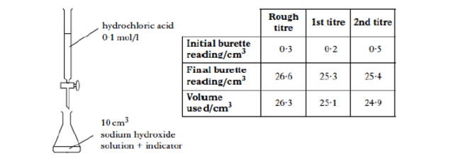
Chemistry Revision Mind Map Unit 1– Acids and Bases 7
Describe the concentration of H⁺ and OH⁻ ions in a neutral solution.
Complete the word equation for the following:
Metal oxide + acid →
Metal hydroxide + acid →
Metal carbonate + acid →
Sodium oxide + hydrochloric acid →
Potassium hydroxide + sulphuric acid →
Calcium carbonate + nitric acid →
The following titration was carried out:
Why is an indicator used?
Calculate the average volume of hydrochloric acid used in the titration.
Why is the rough titre not used?
What does concordant results mean?
What two pieces of equipment are used in titrations to measure accurate volumes?
Describe the concentration of H⁺ and OH⁻ ions in an acidic solution.
What are spectator ions?
Describe the concentration of H⁺ and OH⁻ ions in an alkali solution.
30 cm³ of 1 mol l⁻¹ potassium hydroxide solution was neutralised by 50 cm³ of sulphuric acid. Calculate the concentration of the sulphuric acid.
H₂SO₄ + 2KOH → K₂SO₄ + 2H₂O
Which type of oxides dissolve in water to form an acidic solution?
Which type of oxides dissolve in water to form an alkali solution?
Which type of oxides dissolve in water to form a neutral solution?
Name three metal bases:

