Slide 1
Chemistry Revision Mind Map Unit 3 – Collision Theory 1
What is a negative impact to industry if reaction rate is too slow? |  | List five factors which effect reaction rate:
What is a negative impact to industry if reaction rate is too fast?
For a chemical reaction to occur, which two requirements are necessary. You may wish to use diagrams to help with your explanation.
 | How do you calculate relative rate of reaction? What are the units? When would you use a relative rate of reaction calculation?
Define the term activation energy mean?
Define an activated complex?
Why does increasing pressure increase reaction rate? You may wish to use a diagram.

Slide 2
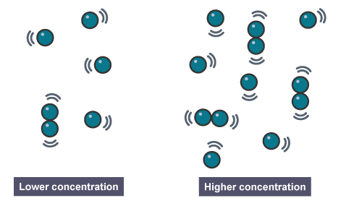
Chemistry Revision Mind Map Unit 3 – Collision Theory 2
State two conditions necessary for collisions to result in the formation of products | Use collision theory to explain why decreasing particle size increases reaction rate. Use may wish to use a diagram. | Use collision theory to explain why increasing concentration increases reaction rate. You may wish to use a diagram.
How does a catalyst increase the rate of a reaction?
Is a catalyst used up during a chemical reaction? Does the catalyst provide energy to the reaction?

Slide 3
Chemistry Revision Mind Map Unit 3 – Collision Theory and Kinetic energy 3
Use collision theory to explain why increasing temperature increases reaction rate. Use ay wish to use a diagram. | Draw an energy distribution diagram and draw a line to show activation energy. On the diagram draw a second curve to show an increase in temperature. Explain why a small increase in temperature results in a large increase in reaction rate. | Draw an energy distribution diagram and draw a line to show activation energy. On the diagram draw a line to show the effect of adding a catalyst. Explain why adding a catalyst results in an increase in reaction rate.
What is temperature a measure of?

Slide 4
Chemistry Revision Mind Map Unit 3 – Collision Theory and Kinetic energy 4
Sketch a graph to show the effect of increasing concentration on relative rate of reaction. Sketch a graph to show the effect of increasing temperature on relative rate of reaction.
The straight line shows that rate is directly proportional to concentration.
The curved line shows that a small increase in temperature results in a
If you double the concentration, you the rate of reaction.
increase in rate if reaction.

Slide 5
Chemistry Revision Mind Map Unit 3 – Reaction pathways 5
Draw a potential energy diagram to show the energy pathways for an exothermic reaction. | How do you calculate enthalpy change (ΔH) |  | Define an endothermic reaction
 | Is enthalpy change positive or negative for exothermic reactions?
 |  |  | Draw a potential energy diagram to show the energy pathways for an exothermic reaction and draw a line to show the addition of a catalyst. Explain why the addition of a catalyst increases reaction rate. What happens to Ea when a catalyst is added? What happens to ΔH when a catalyst is added?
 | Is enthalpy change positive or negative for endothermic reactions?
 | How do you calculate activation energy (Ea)?
Draw a potential energy diagram to show the energy pathways for an endothermic reaction.
 | On both potential energy diagrams drawn, annotate the following: Activated complex Activation energy (Ea) Enthalpy change (ΔH)
 | Define an exothermic reaction

Slide 6
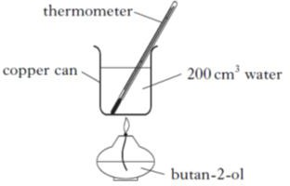
Chemistry Revision Mind Map Unit 3 – Chemical Energy 6
In industry exothermic reactions may require heat to be removed, why? | Which two products are formed when a hydrocarbon is burned in oxygen. |  | 1g of butan-2-ol was burned and the temperature rose from 12°C to 44 °C. Use these results to calculate the enthalpy of combustion of butan-2-ol. State two improvements to the experiment above and an explanation of the improvement.
In industry endothermic reactions may cost more, why? What is the definition of enthalpy of combustion?
 | One mole of substance is the same as the what of the substance?
 | The enthalpy of combustion of methanol (CH₃OH) is -727 kJ mol^{-1.}. What mass of methanol has to be burned to produce 72.7 kJ of energy?
Why is the below equation not an enthalpy of combustion equation? 2CO + O₂ → 2CO₂
 | Write the equation used to calculate heat energy and specify what each part of the equation is.

Slide 7
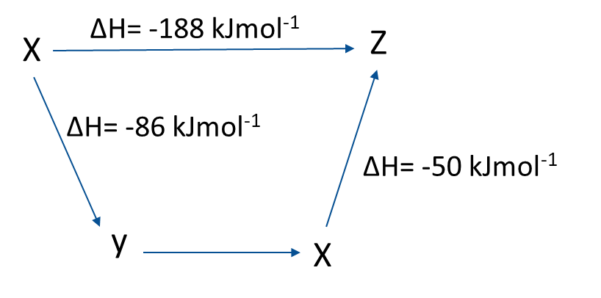
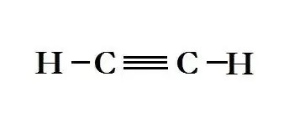
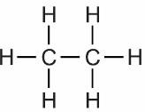
Chemistry Revision Mind Map Unit 3 – Hess’s Law and Bond Enthalpy 7
Hess’s Law states:
CS₂ (l) + 3O₂ (g) → CO₂ (g) + 2SO₂ (g) | Which phase must the reactants be in when calculating bond enthalpy?
Calculate the enthalpy change, for this reaction using the
following information
 |  | What is the equation to calculate bond enthalpy?
C (s) + O₂ (g) → CO₂ (g) ΔH= -400.4 kJ mol ⁻¹
S (s) + O₂ (g) → SO₂ (g) ΔH= -299.6 kJ mol ⁻¹
C (s) + 2S (s) → CS₂ (l) ΔH= 77.8 kJ mol ⁻¹
 |  | Using bond enthalpies, calculate the enthalpy change for the following reaction + 2H₂ (g) →
Define the molar bond enthalpy
Define the mean molar bond enthalpy
According to Hess’s Law, calculate the ΔH
value from Y to X.

Slide 8
Chemistry Revision Mind Map Unit 3 – Equilibrium 8
At equilibrium, the rates of the forward and reverse reaction are ______. At equilibrium, the concentration of reactants and products are _____________________ . | Enthalpy change for an exothermic reaction is: | In the following equation: 2CO (g) + O₂ (g) ⇌ 2CO₂ (g) What effect will the following have on the equilibrium: Increasing pressure? Why? Decreasing pressure? Why?
 | Enthalpy change for an endothermic reaction is:
What is Le Chatelier’s Principle? | In the following equation: 2SO₂ (g) + O₂ (g) ⇌ 2SO₃ (g) ΔH = -197kJ What effect will the following have on the equilibrium: Increasing the temperature? Why? Decreasing the temperature? Why? What would you need to do to the temperature to increase the yield of products?
In the following equation Br₂(l) + H₂O(l) ⇌ Br –(aq) + BrO – (aq) + 2H⁺ (aq) What effect will the following have on equilibrium: Sulfuric acid was added? Why? Sodium hydroxide was added? Why? Silver nitrate was added? Why?
 |  | In the following equation: H₂ (g) + I₂ (g) ⇌ 2HI (g) What effect will the following have on the equilibrium: 1. Increasing pressure? Why?
 | What state does a change in pressure effect?

Slide 9
Chemistry Revision Mind Map Unit 3 – Calculations 9
2.45g of magnesium is added to 100 cm³ of dilute hydrochloric acid, concentration 1mol l⁻¹ Identify the limiting reagent. Mg + 2HCl → MgCl₂ + H₂ | Excess ethyne was reacted with 3.7g of hydrogen chloride and 4.1 g of the product, 1,1-dichloroethane was obtained. Calculate the % yield using the equation: C₂H₂ + 2HCl →C₂H₄Cl₂ |  | What is molar volume? @ STP
 |  |  | What volume of hydrogen would be produced if 10g of H₂SO₄, reacts completely with excess zinc? (molar gas volume is 22.4 litres mol ⁻¹) Zn(s) + H₂SO₄ (aq) → ZnSO₄ (aq) + H₂ (g)
 | What does 100% atom economy mean?
What is percentage yield? |  |  | What mass of oxygen has been used when burning propane, if 3.6 litres of carbon dioxide is produced? (all gases being at the same temperature and pressure, take the molar volume of carbon dioxide to be 22.4l/mol) C₃H₈ (g) + 5O₂ (g) → 3CO₂ (g) + 4H₂O (l)
 | Calculate the atom economy for this reaction where hydrogen is the desired product. CH₄ + H₂O → CO + 3H₂

Slide 10
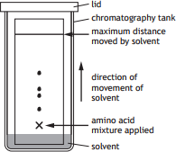
Chemistry Revision Mind Map Unit 3 – Chemical Analysis 10
In paper chromatography what is the: Mobile phase: Stationary phase: |  | In gas chromatography why is a gas such as helium used as the mobile phase? | How do you make up a standard solution? (3 marks)
What two factors influence separation by chromatography:
 |  | The peak in a chromatogram indicates what? If the peak is off the scale what does this indicate? How could you make the peak in scale?
 |  |  | Why is an indicator used? Why is a white tile used? In a redox titration using acidified permanganate, why is an indicator not required? Why is an acid added?
Larger molecules move ________________ in chromatography. Rf value = distance of substance/distance travelled by solvent Calculate the Rf Value of spot 3 in the chromatogram below.
 |  | Which pieces of equipment are used for accurate measurements in chemistry
 |  |  | Calculate the concentration of Iron (II) sulfate solution given that 20cm³ of it reacted with 0.02mol l⁻¹ potassium permanganate solution. The average volume of potassium permanganate solution used was 10cm³ The redox equation is: MnO₄ ⁻ + 8H⁺ + 5Fe²⁺ → 5Fe³⁺ + Mn²⁺ + 4H₂O
 |  | What name is given to titres between 0.2cm³?
 |  | Why is the first titre never used when calculating the average titre?
 |  | What is a standard solution?

